Slide 1

Theme of the week: Remembrance
Thoughts and Prayers 6th October – 10th November

Slide 2

Friday Mass
Who?
Mass this week will be led by 11N & 11T
When?
Friday Morning at 8.20am
Where?
In the School Chapel. See you there!
ALL ARE MOST WELCOME.
ALL WORDS ARE DISPLAYED ON THE SCREEN.

Slide 3


MORNING PRAYER IN THE CHAPEL THIS WEEK
Monday 6th November - 7S
Tuesday 7th November - 7T
Wednesday 8th November – 7M
Thursday 9th November - 7R
Friday 10th November - 12T

Slide 4
Lunchtime events: All are welcome..
Crafts and Mindfulness
(Mondays in the chapel)
Islamic Union
(Tuesday G15)
Christmas club
(Fridays G13)
Christian Union
(Tuesdays in G16)

Slide 5
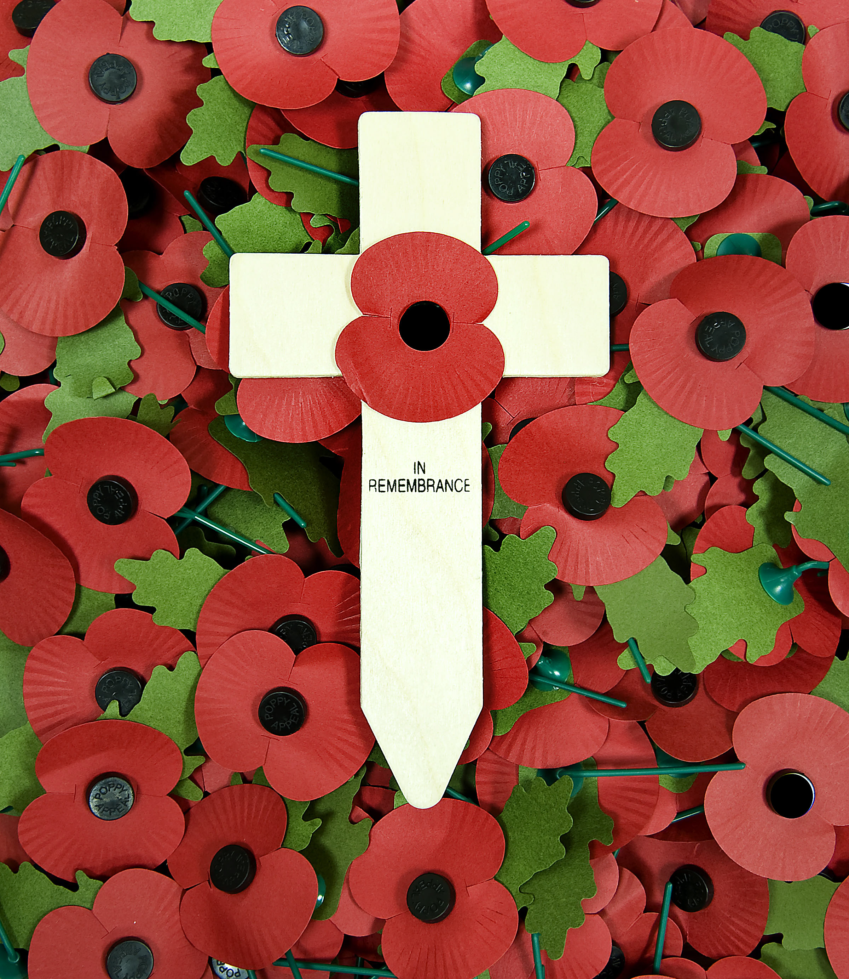
Remembrance
Remembrance is the act of recalling, commemorating, and honoring the memory of people, events, or experiences from the past, typically those associated with significant historical, cultural, or personal significance.
It involves reflecting on the past and preserving the memory of individuals who have passed away, the sacrifices made by those in times of conflict, and important historical milestones.
Remembrance can take many forms, such as memorial services, monuments, ceremonies, holidays, museums, and educational programs.
Discussion: Why do you think it is important that we mark remembrance?

Slide 6
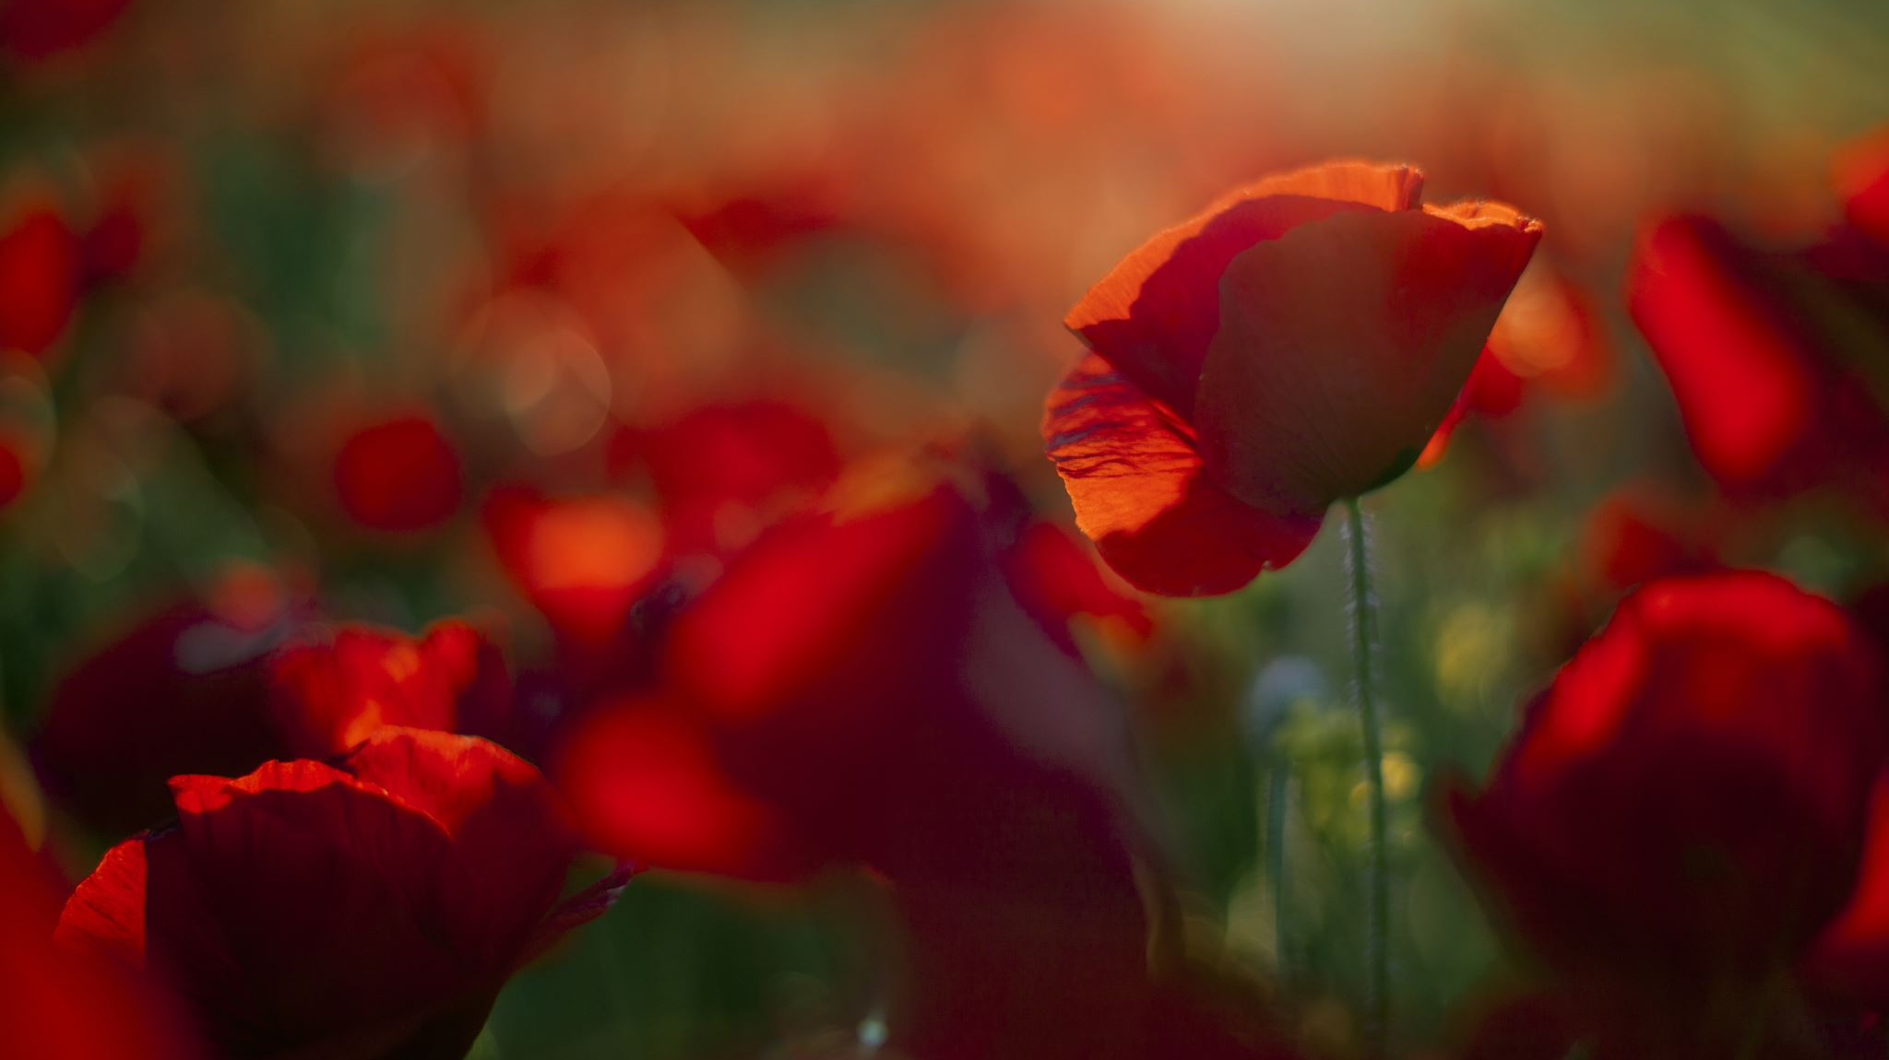
Remembrance is important for several reasons:
Preserving history: Remembrance helps us to preserve and pass on the lessons of history. It ensures that the knowledge and experiences of previous generations are not forgotten and provides a sense of continuity and connection to the past.
Honoring sacrifices: Many remembrance events and activities are dedicated to honoring the sacrifices of individuals who have given their lives or made significant contributions for the betterment of society, such as soldiers, activists, and leaders. It's a way to express gratitude and pay tribute to their efforts.
Fostering empathy and understanding: Remembrance can help build empathy and understanding by allowing people to connect with the experiences and suffering of others. It encourages people to learn from the mistakes of the past and work towards a more peaceful and just future.
Promoting unity and solidarity: Remembrance can bring communities and nations together in a shared experience of reflection and commemoration. It helps reinforce a sense of unity and solidarity among people who have a common history or shared values.
Healing and closure: For individuals who have experienced loss or trauma, remembrance can be a therapeutic process. It provides an opportunity to remember and honour loved ones and can aid in the healing and closure process.
Education and awareness: Remembrance activities often involve educational elements, such as exhibitions and documentation, which help inform the public about historical events and their impact. This knowledge can lead to a better understanding of the world and its complexities.
Cultural and national identity: Remembrance is an essential aspect of cultural and national identity. It helps define a community's values, shared history, and collective memory.
Preventing the repetition of mistakes: By remembering past conflicts, atrocities, and injustices, society can strive to avoid making the same mistakes in the future. Remembrance encourages critical thinking about the consequences of certain actions.

Slide 7

Lord,
We give thanks for the courage and dedication of our veterans, both living and departed. We remember their sacrifices, the hardships they endured, and the wounds, visible and invisible.
Bless them with your healing and comfort, and may we never forget the debt of gratitude we owe them.
Amen

Slide 8
Theme of the week: Remembrance
Thoughts and Prayers 6th October – 10th November

Slide 9
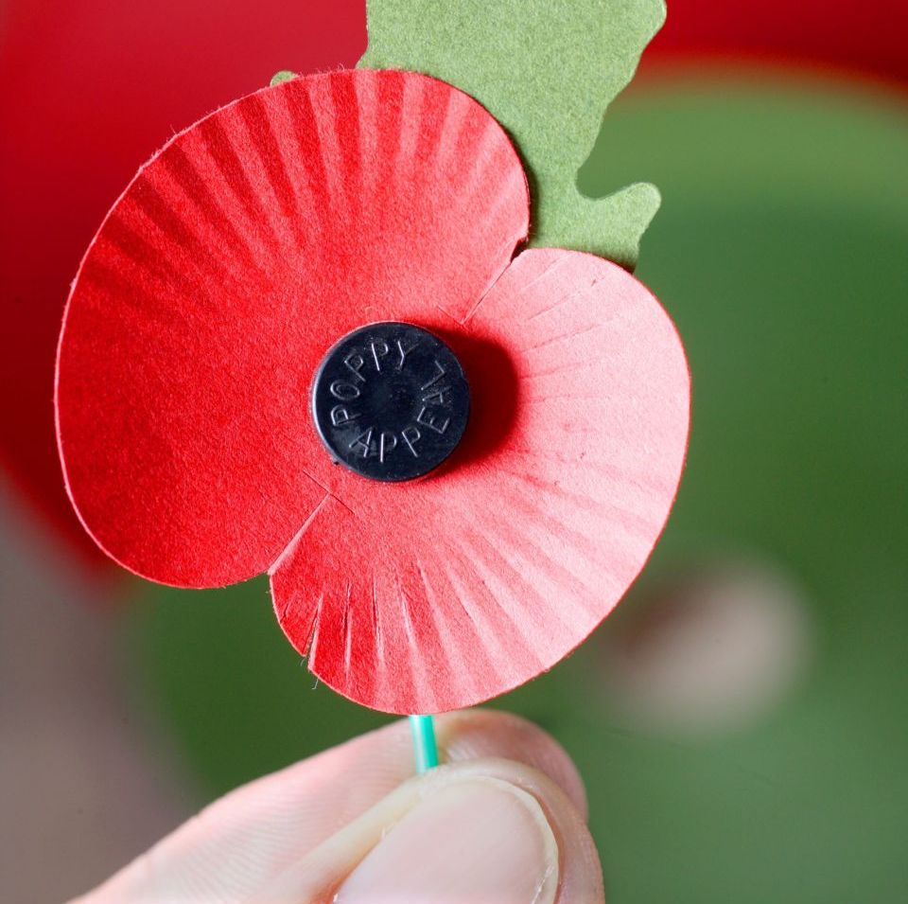
Poppy Appeal
The Poppy Appeal is a fundraising campaign and symbol associated with the Royal British Legion, a British charity that provides support to members and veterans of the British Armed Forces and their families. The campaign is primarily focused on the period leading up to Remembrance Day, which is observed on November 11th each year in the United Kingdom and other Commonwealth nations.
The Royal British Legion uses the sale of red poppies and related merchandise to raise funds to support veterans and their families. The funds collected through the Poppy Appeal go towards various programs and services, including welfare support, rehabilitation, and financial assistance for veterans and their families. These services are essential in helping those who have served in the military and have been affected by conflict.
The Poppy Appeal is a significant part of the annual Remembrance commemorations and plays a role in ensuring that the sacrifices made by those in the armed forces are remembered and that support is provided to those who need it. Poppy wreaths are also commonly laid at war memorials and cenotaphs on Remembrance Day, and people observe a two-minute silence at 11 a.m. to pay their respects to the fallen.

Slide 10

How does the RBL support veterans?
The Royal British Legion (RBL) provides various forms of support for soldiers and veterans suffering from mental health issues as part of its broader mission to assist members of the British Armed Forces community. Here are some of the ways in which the RBL supports individuals dealing with mental health challenges:
Mental Health Services: The RBL offers a range of mental health services, including counseling and therapy, to help individuals who are struggling with conditions such as post-traumatic stress disorder (PTSD), depression, anxiety, and other mental health issues. These services may be provided directly by the RBL or in partnership with other organizations and mental health professionals.
Funding and Grants: The RBL can provide grants and financial support to veterans and their families to access mental health treatment, support, and services that may not be readily available through other means. This financial assistance can help individuals cover the costs of therapy, counseling, or other mental health interventions.
Transition Support: The RBL assists individuals transitioning from the military to civilian life, which can be a challenging period that may contribute to mental health issues. They offer guidance and support to help veterans adjust to civilian life, find employment, and access mental health resources.
Peer Support and Companionship: The RBL recognizes the importance of peer support and offers opportunities for veterans to connect with others who have had similar experiences. This can provide emotional support and a sense of camaraderie that can be beneficial for mental health.
Raising Awareness: The RBL works to raise awareness of mental health issues affecting veterans and service members, reducing the stigma associated with seeking help for mental health concerns. By doing so, they encourage individuals to reach out and access the support they need.
Research and Advocacy: The RBL may also support research into military-related mental health issues and advocate for improved mental health services and policies for veterans and service personnel.

Slide 11
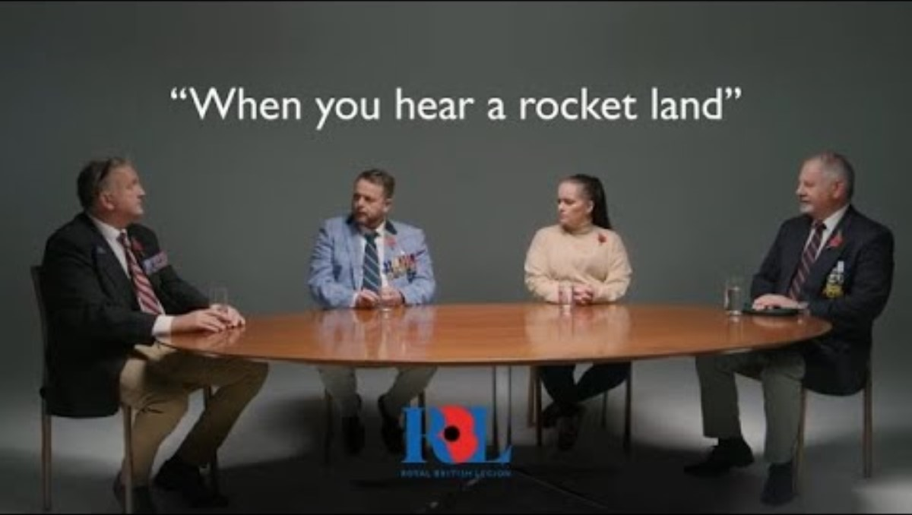

Slide 12
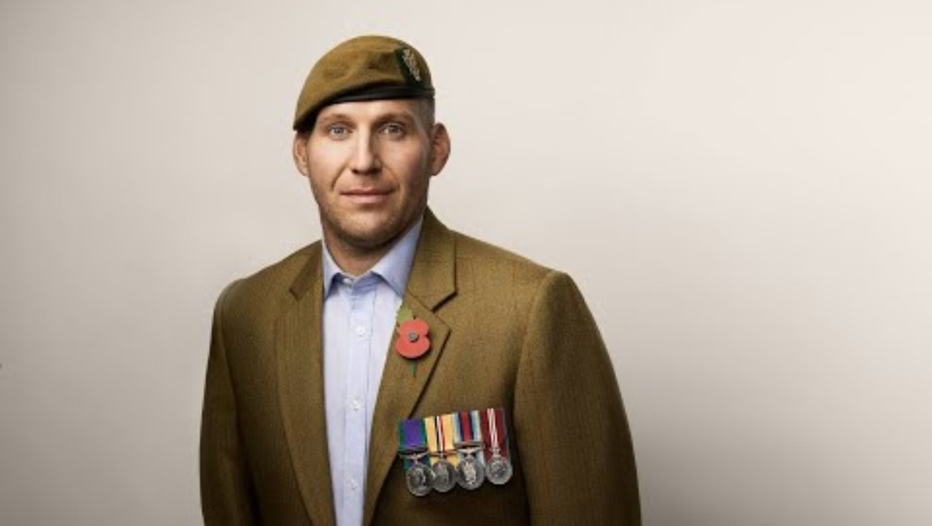

Slide 13
Almighty Father,
On this Remembrance Day, we gather to remember those who gave their lives in the pursuit of peace. We pray for an end to the conflicts and wars that continue to plague our world. Grant us the wisdom and strength to work tirelessly for peace and understanding, that their sacrifice may not have been in vain.
Amen

Slide 14
Theme of the week: Remembrance
Thoughts and Prayers 6th October – 10th November

Slide 15
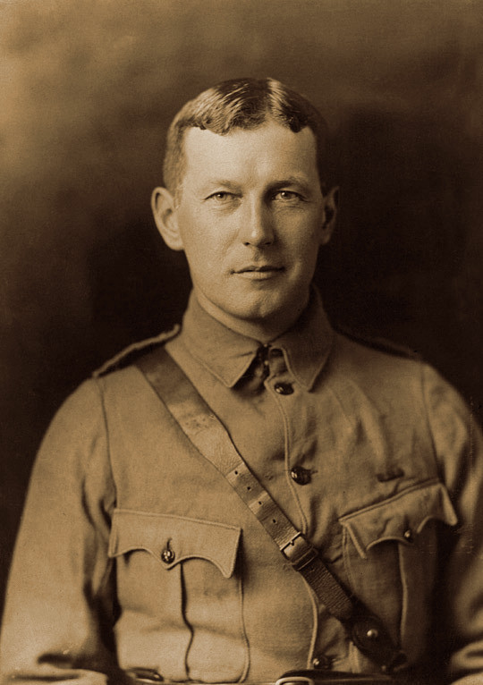
The Origin of the Poppy
The symbol of the Poppy Appeal is the red poppy flower, which has been associated with remembrance and honoring those who have died in conflict since the end of World War I. The red poppy became a symbol of remembrance after the famous war poem "In Flanders Fields" by Lieutenant Colonel John McCrae described how poppies continued to grow amid the graves of soldiers in the Flanders region of Belgium, which was a major battlefield during World War I.
Why do you think this symbol holds meaning?

Slide 16
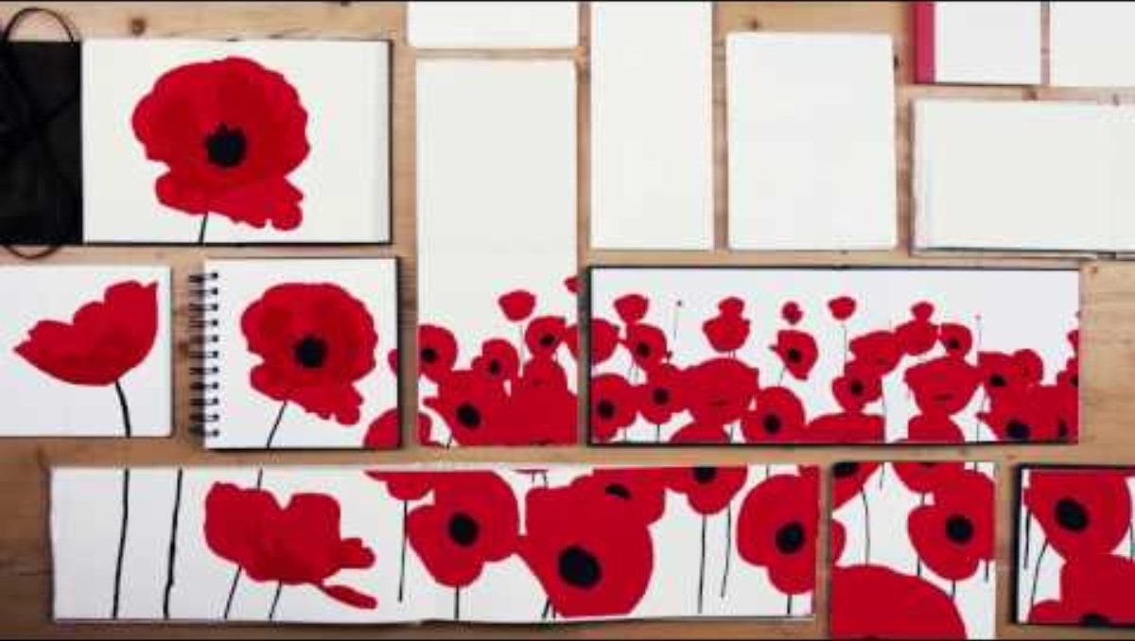

Slide 17
In Flanders Fields
Lieutenant Colonel John McCrae
In Flanders fields the poppies blow
Between the crosses, row on row,
That mark our place; and in the sky
The larks, still bravely singing, fly
Scarce heard amid the guns below.
We are the Dead. Short days ago
We lived, felt dawn, saw sunset glow,
Loved and were loved, and now we lie,
In Flanders fields.
Take up our quarrel with the foe:
To you from failing hands we throw
The torch; be yours to hold it high.
If ye break faith with us who die
We shall not sleep, though poppies grow
In Flanders fields.
Choose your favourite line of the poem and get ready to share your ideas with the class.
What do you think McCrae's message is?

Slide 18

Lord,
We pray for the unity of the human family. Help us to learn from the past, so we may strive for a future where the lessons of history guide us towards greater understanding, tolerance, and compassion. Grant us the strength to overcome divisions and work together for a more peaceful world.
Amen

Slide 19
Theme of the week: Remembrance
Thoughts and Prayers 6th October – 10th November

Slide 20
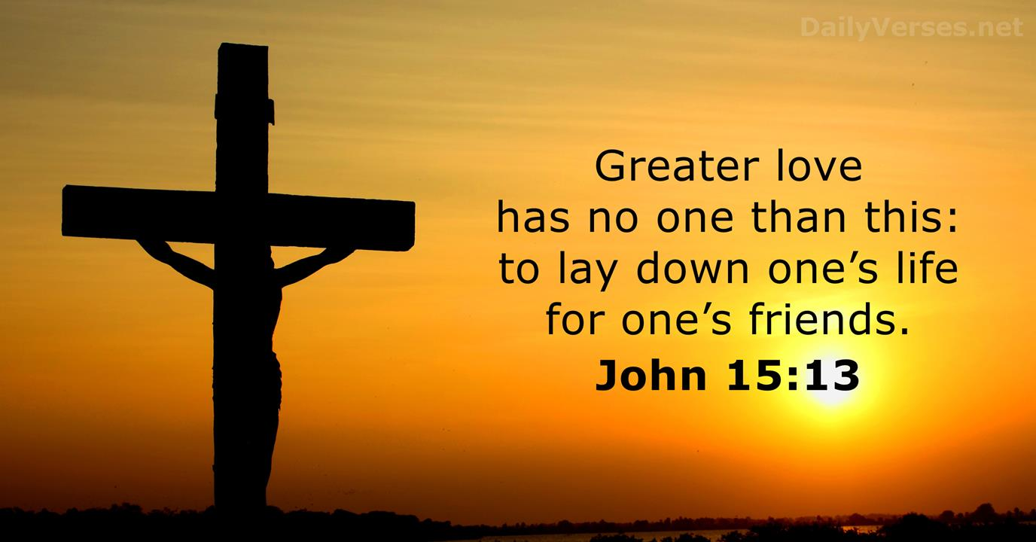
How does this verse reflect the theme of remembrance?

Slide 21
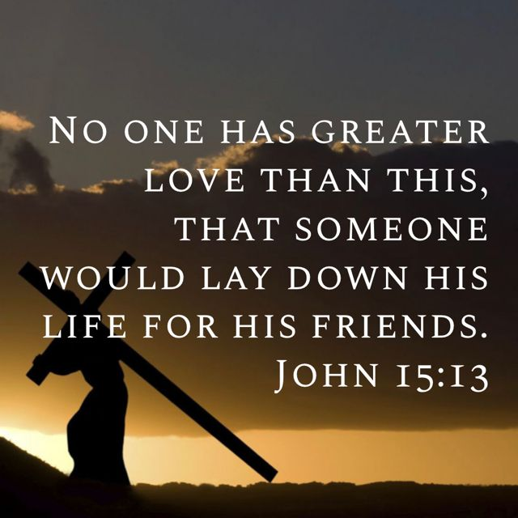
Profound Sacrifice:
Following in the footsteps of Christ
When we remember those who have sacrificed their lives, whether in the context of military service, humanitarian efforts, or other courageous acts, this verse can serve as a reminder of the ultimate form of love and devotion.
It highlights the idea that there is no greater expression of love than being willing to give up one's own life to protect or save those they care about.
This reminds us of the significance of a soldier's actions and their enduring legacy. It encourages us to reflect on the depth of love and selflessness that can exist in humanity and to remember and honor those who exemplify these qualities through their sacrifices.

Slide 22
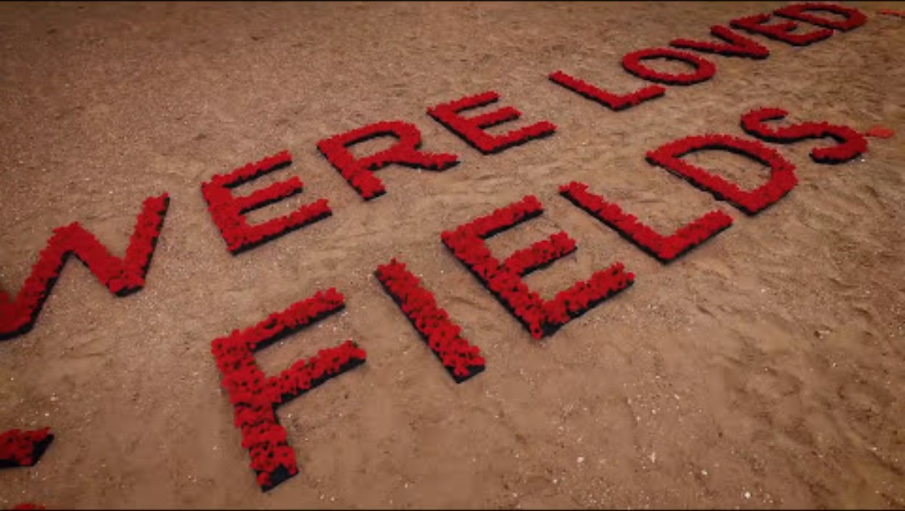

Slide 23
Almighty Father,
We bow our heads in solemn remembrance of those who laid down their lives for the cause of freedom. We remember their valor and selflessness. May their souls rest in eternal peace, and may we honor their memory by working to build a world where conflict and suffering are no more.
Amen

