Slide 1
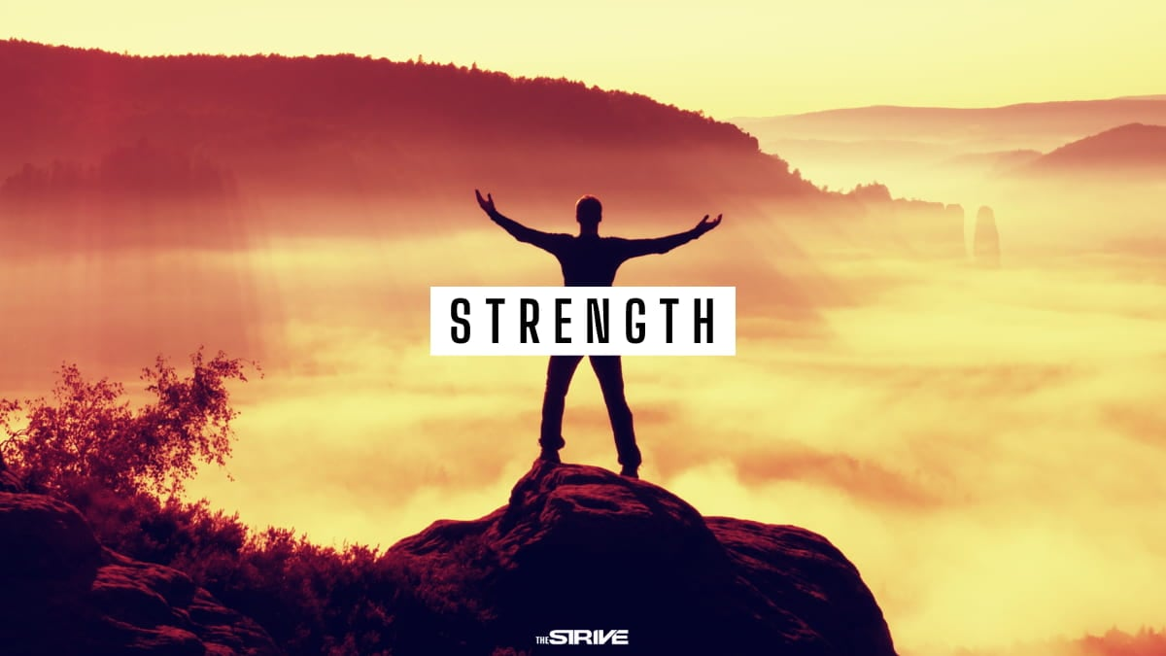
Theme of the week: Strength
Thoughts and Prayers 16th October – 20th October

Slide 2


MORNING PRAYER IN THE CHAPEL THIS WEEK
Monday 16th October - 8I
Tuesday 17th October- 8N
Wednesday 18th October – 8T
Thursday 19th October - 7A
Friday 20th October - 8M

Slide 3

Friday Mass
Who?
Mass this week will be led by 8T
When?
Friday Morning at 8.20am
Where?
In the School Chapel. See you there!
ALL ARE MOST WELCOME.
ALL WORDS ARE DISPLAYED ON THE SCREEN.

Slide 4
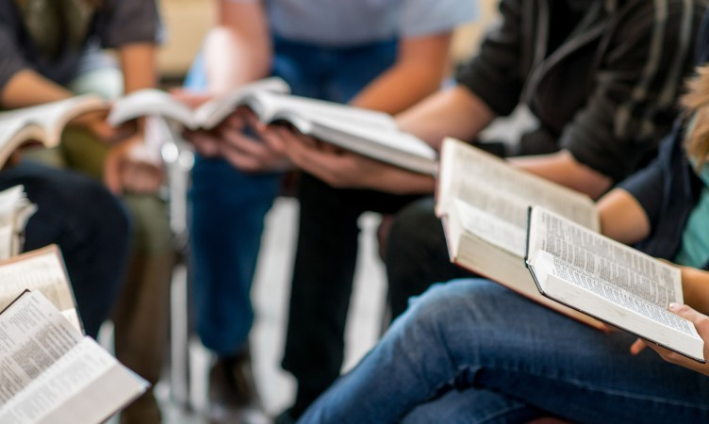
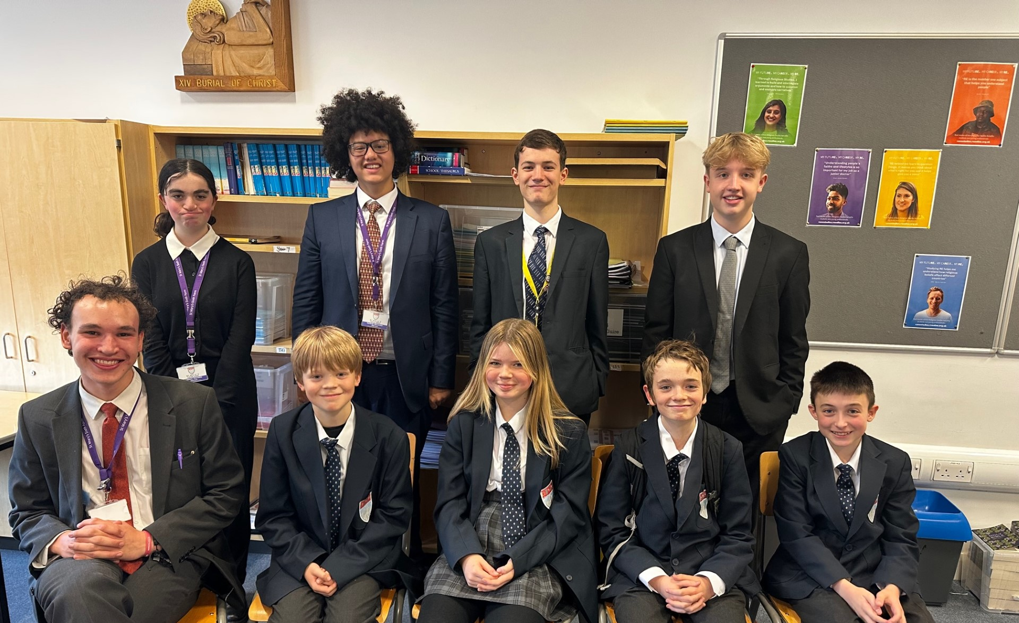
Join us at Christian Union
"CU is a place for anyone of any faith, year group or background to come into a safe environment, play games, have fun, share ideas and learn a little about the real-world significance of Jesus and faith (not to mention sharing biscuits). It exists to help students in their school and wider lives to find unconditional security, significance and acceptance from both the great people and activities, but most of all from God, who knows and loves each of us, and knows and wants what is best for our lives. We aim to do this in a fun relevant and engaging way. We love to welcome new faces."
Josh Sorensen (Year 12)
Leader of Christian Union
CU meets every Tuesday lunch time in G16. Feel free to bring lunch with you or see Mrs Blackburn for an early lunch pass.

Slide 5
Lunchtime events: All are welcome..
Crafts and Mindfulness
(Mondays in the chapel)
Islamic Union
(Tuesday G15)
Christmas club
(Fridays G13)
Christian Union
(Tuesdays in G16)

Slide 6

Personal Strength
Strength comes in various forms, not just physical strength. It can also be emotional, mental, or even moral strength.
Take a moment to think about a time when you felt strong or confident. It could be an achievement, a challenge you have overcome, or a moment when you have displayed resilience.
Self-awareness is an excellent skill to practice. It is important that you are able to identify your own personal strengths.
What is it that makes YOU strong?

Slide 7

Take pride in your strengths
It can sometimes feel uncomfortable to talk highly of ourselves. We sometimes fail to see our own strengths because we are too busy being self-critical, and when we do acknowledge them, we feel scared to share them incase people think we are being arrogant.
CHALLENGE yourself today to share one of your STRENGTHS with your partner.
​"I'm a really strong listener. I'm proud that I'm good at listening because it means that my friends always feel like they can talk to me, and I am able to give them good advice. My strength is that I am a good friend."

Slide 8

Lord,
We gather in gratitude for the strength within us. Help us to recognise the moments when we've felt strong and confident, even when life's challenges seem daunting. Give us the wisdom to understand that our inner strength is a gift from You. Guide us to use our strengths to make a positive impact on the world.
Amen

Slide 9
Theme of the week: Strength
Thoughts and Prayers 16th October – 20th October

Slide 10
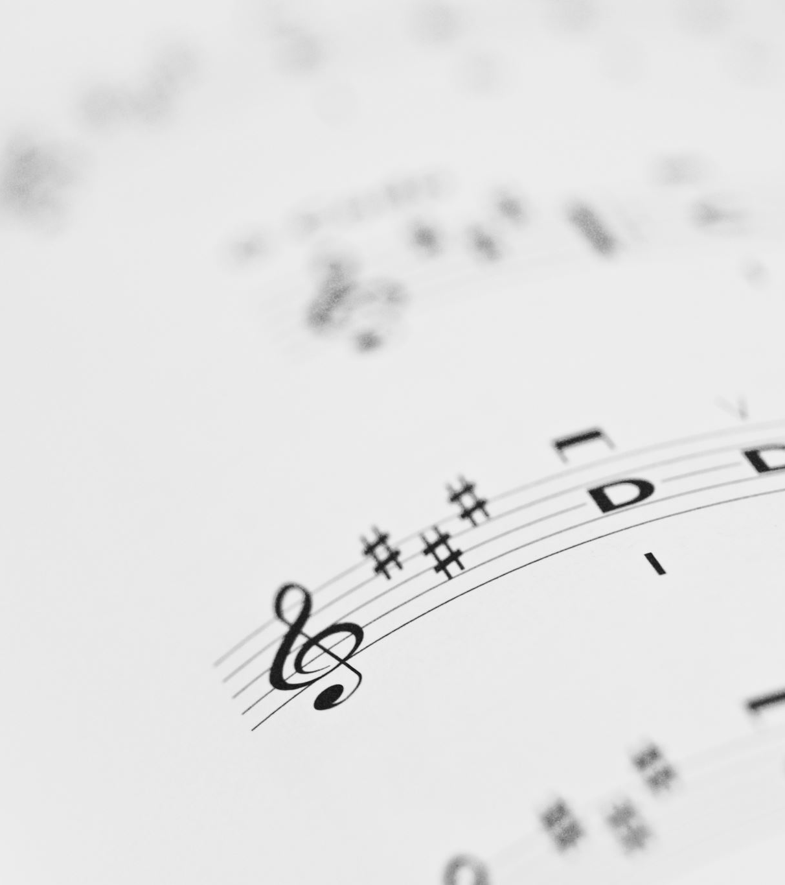
Strength in Music
The next four slides each contains a piece of music based on the theme of 'strength'.
Vote as a class and choose the one you want to listen to in full.
Once you have listened to the full piece, you will explore how the lyrics or melody make you feel. How do you think they present the idea of strength and what message do you take away from the music?

Slide 11
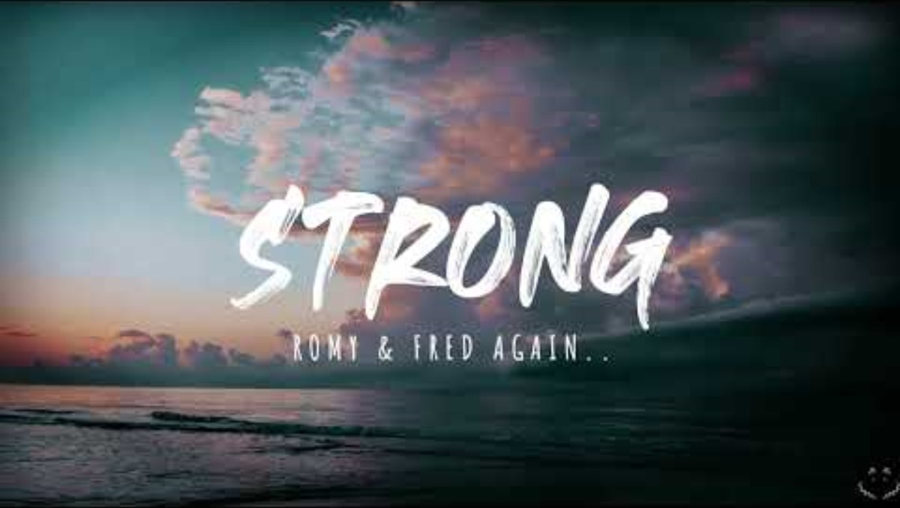
1

Slide 12

2

Slide 13
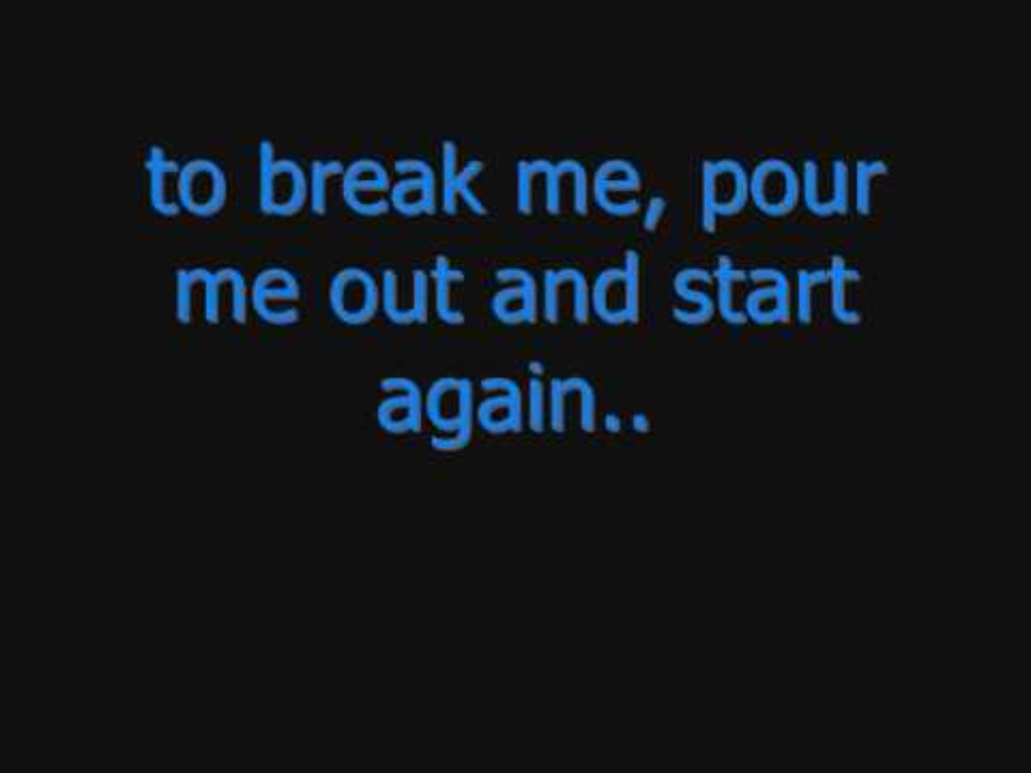
3

Slide 14
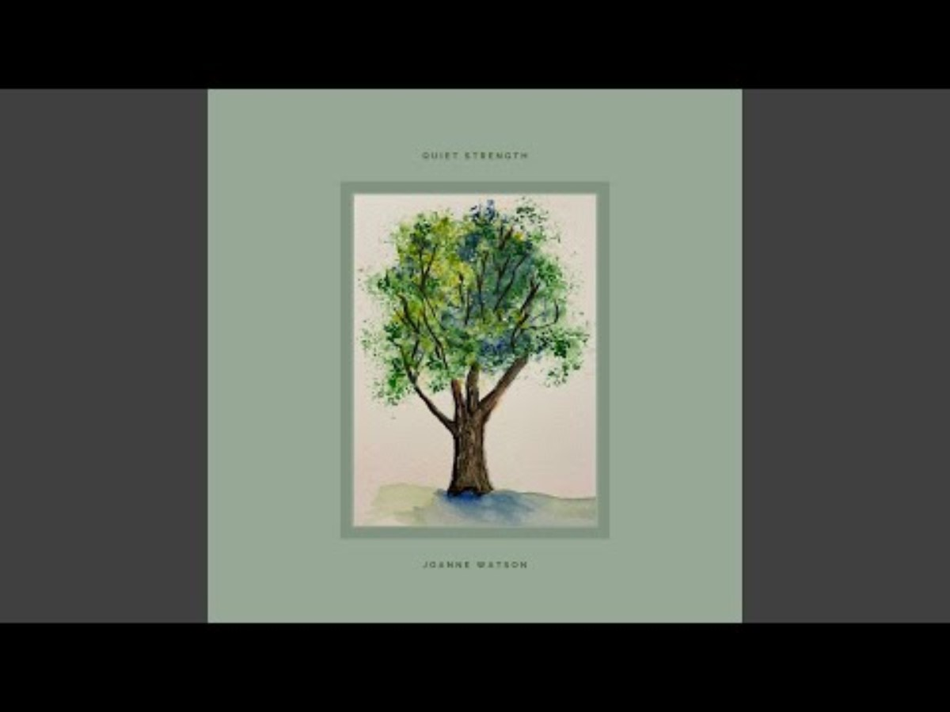
4

Slide 15

Spirituality in Melody and Lyrics
Music has a wonderful way of allowing us to be spiritual and mindful. It has the ability to heal and strengthen us.
Discuss your ideas with a partner and get ready to share with the class.
Did you like the music? Why?
How do you think they present the idea of strength and what message do you take away from the music?

Slide 16
Almighty Father,
We acknowledge the various forms of strength that you've bestowed upon us - physical, emotional, mental, and moral. Teach us to harness these gifts for good and inspire us to seek strength in our unique abilities. May we use our strengths to serve others and bring light to the world.
Amen

Slide 17
Theme of the week: Strength
Thoughts and Prayers 16th October – 20th October

Slide 18
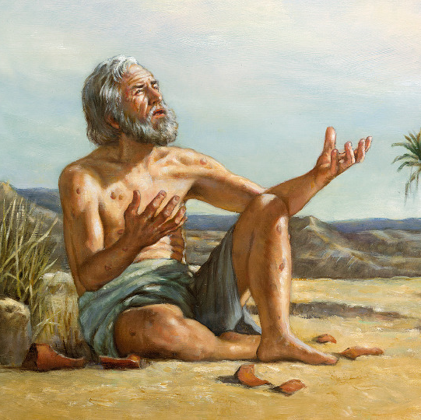
What questions do you have about this picture?
What is happening?
Who do you think he is?
What would you ask him if he could reply?

Slide 19

One Bible story that exemplifies strength in hard times is the story of Job. The Book of Job is found in the Old Testament and tells the tale of a man named Job who faced immense suffering and hardship but remained steadfast in his faith.
Job was a righteous and wealthy man who experienced a series of calamities. He lost his livestock, his servants, and even his children. In addition, he was afflicted with painful sores all over his body. Despite these extreme trials, Job did not curse God or lose his faith. He maintained his trust in God's wisdom and providence.
Job's story demonstrates the strength of character, patience, and faith in the face of unimaginable adversity. It also serves as a testament to the idea that even in the most challenging times, one can find the strength to persevere by holding on to their faith and trusting in the ultimate wisdom and plan of God. In the end, God restored Job's fortunes and blessed him with even greater prosperity, reaffirming the idea that faith and strength in hard times can lead to eventual restoration and blessings.

Slide 20
Now that you know Job's story, what do you think is happening here?
What would you say to him?
How does his facial expression tell you about the way he is feeling?

Slide 21
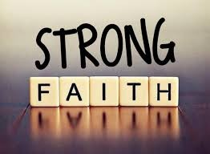
To apply the message from the story of Job in our own lives during difficult times, we should:
Cultivate Contentment: Learn to be content in all circumstances, finding peace and gratitude even in adversity.
Rely on Faith: Turn to your faith, prayer, and spiritual practices for strength, trusting in a larger purpose.
Be Resilient and Patient: Endure challenges with patience, knowing they are temporary, and grow stronger.
Seek Community Support: Lean on friends and family for help and emotional support.
Hold onto Hope: Believe in eventual restoration and blessings, even after suffering.
These principles can help you navigate hard times with grace and determination, just as Job did in his story.
‘There is nothing I cannot master with the help of the One who gives me strength.’
(Philippians 4:12-14, 19-20)

Slide 22

Lord,
In moments of adversity, grant us the resilience to rise and the strength to move forward. May we always remember that challenges, though difficult, provide an opportunity for growth. We thank you for the strength that arises from our struggles and ask for the courage to face any obstacle that comes our way.
Amen

Slide 23
Theme of the week: Strength
Thoughts and Prayers 16th October – 20th October

Slide 24
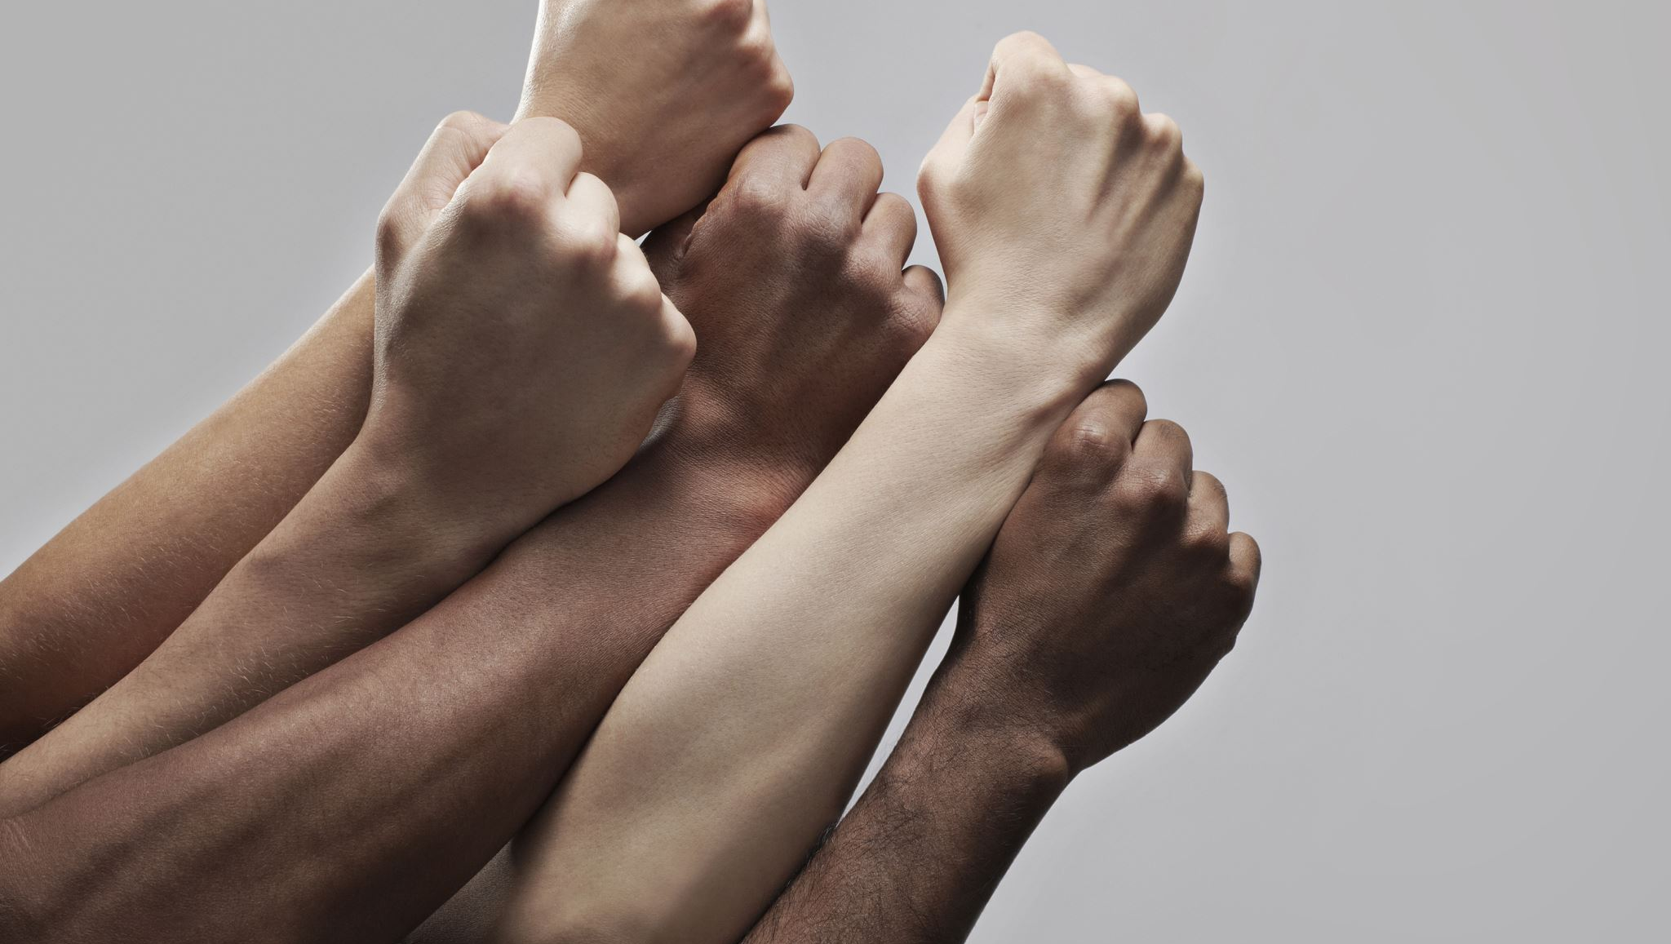
Strength in Unity
What does this phrase mean to you?

Slide 25
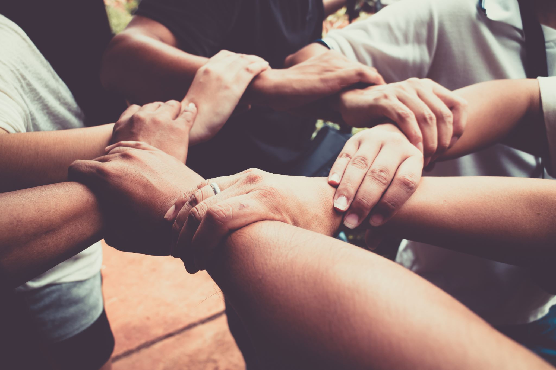
Think about a time when you have felt a part of a strong and supportive community, whether it's a sports team, a club, or a group of friends.
Reflect on the impact of unity and cooperation in achieving common goals.

Slide 26
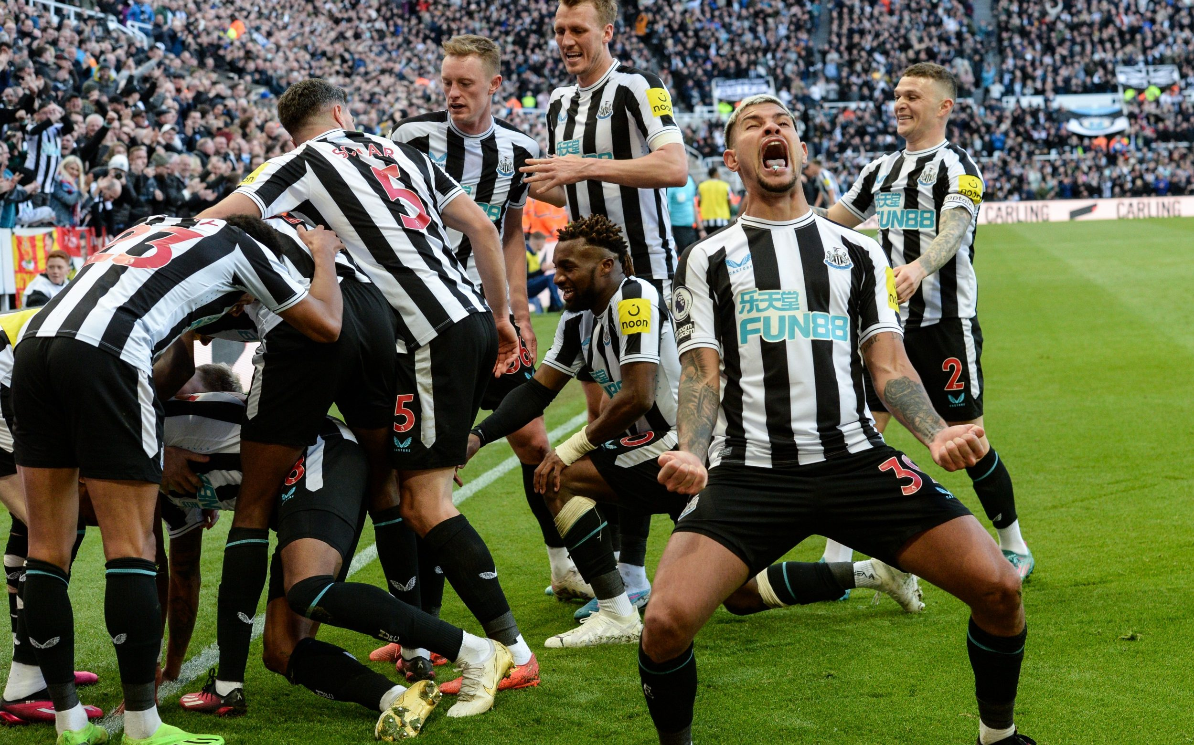
How does this image show strength in numbers?
Why might this team be a good example of group strength?
Each of the people in this image have their own individual strengths – how can this help them to be stronger together?

Slide 27
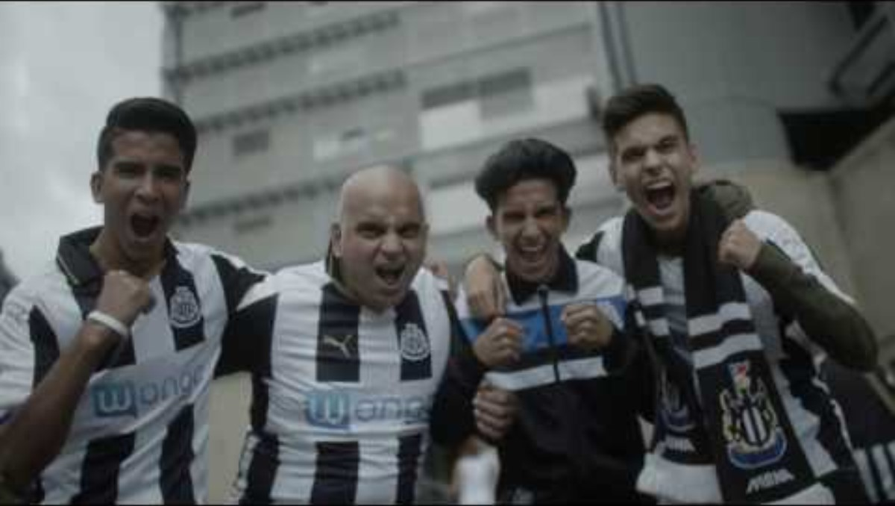

Slide 28
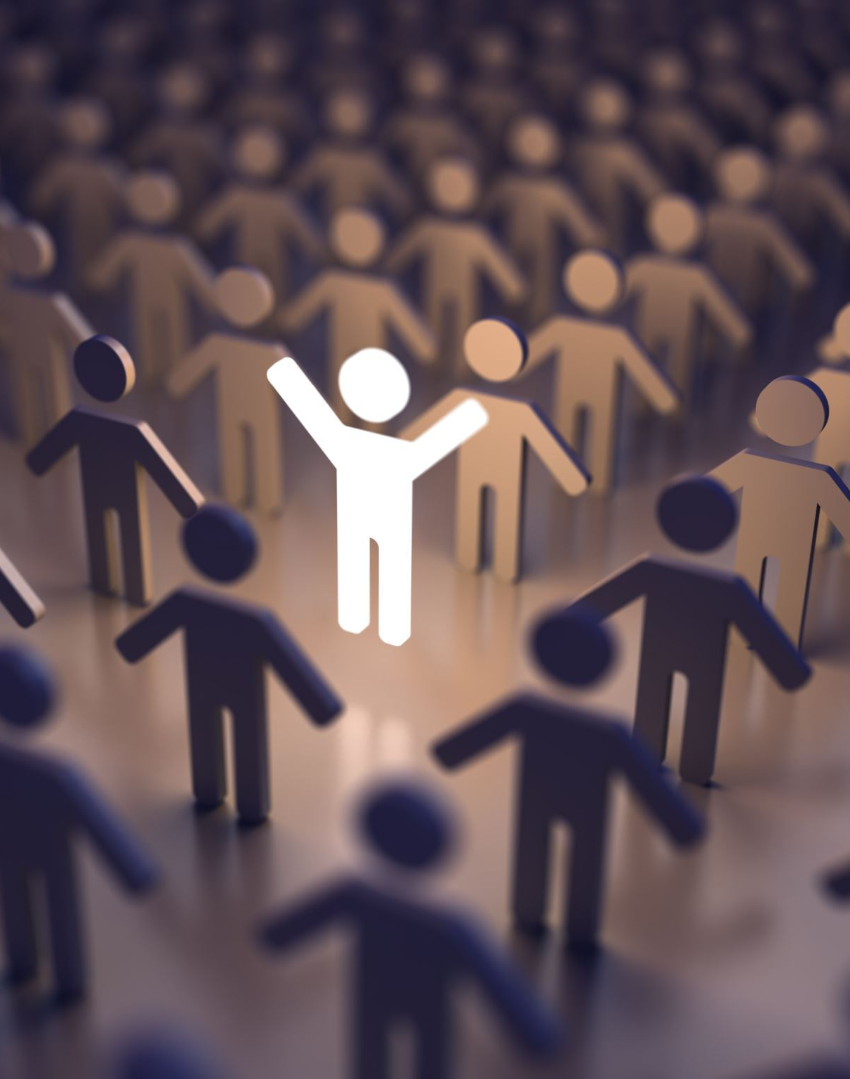
We Are United
Being part of a group or community provides a strong support system. When individuals come together, they can share their experiences, empathise with one another, and provide emotional support during challenging times. This sense of belonging and the knowledge that others are there to help can make individuals feel emotionally stronger.
Remember that you are never alone in your moments of need. You can rely on the support of those in your team and you can rely on God to lift you up in your moments of weakness.
The fans of Newcastle United have never lost faith, even throughout the darkest of times for their club. They kept the hope alive and now they are celebrating together.

Slide 29
Almighty Father,
We pray for the power of unity. As we come together as one, may our collective strength be a force for good in the world. Help us to support and lift each other, knowing that together we can achieve great things. Bless us with the strength to be bridges, connecting people in love, compassion, and understanding.
Amen

