Slide 1

Theme of the week: Harvest
Thoughts and Prayers 2nd – 6th October

Slide 2
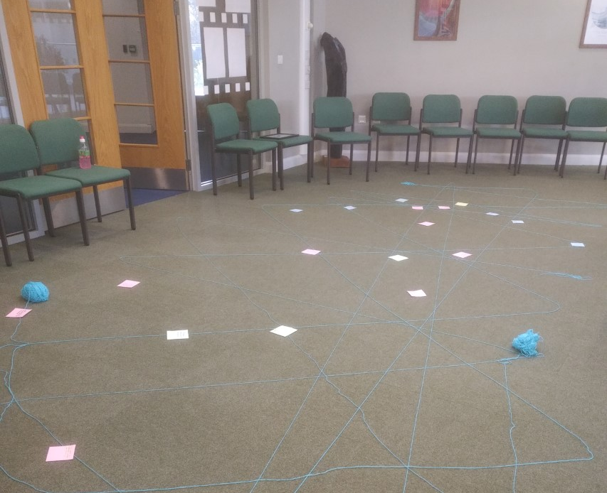

MORNING PRAYER IN THE CHAPEL THIS WEEK
Monday 18th September - 12M
Tuesday 19th September- 11A
Wednesday 20th September – 11I
Thursday 21st September - 11N
Friday 22nd September - 11M

Slide 3
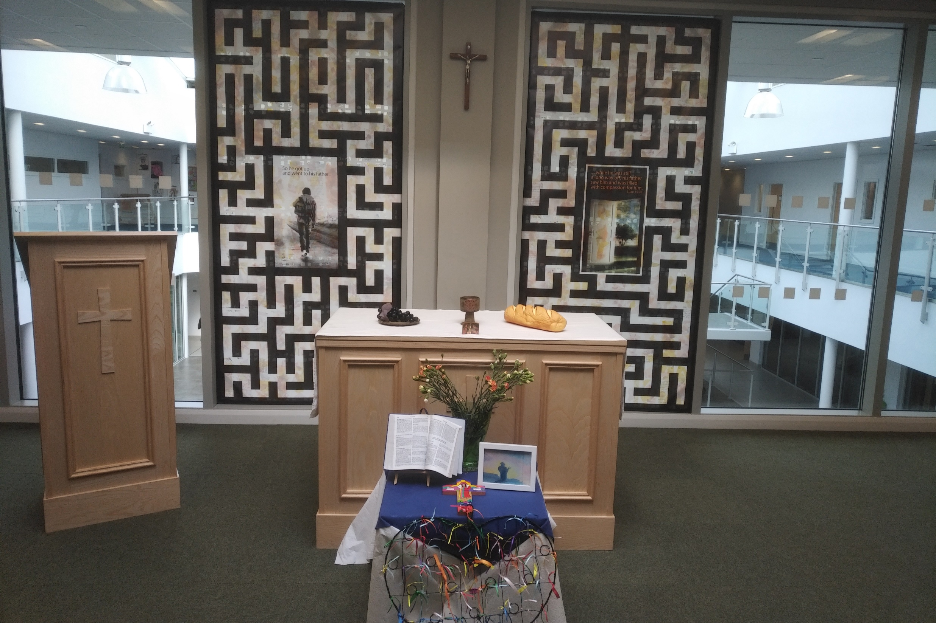
Friday Mass
Who?
Mass this week will be led by 9Y & 9M
When?
Friday Morning at 8.20am
Where?
In the School Chapel. See you there!
ALL ARE MOST WELCOME.
ALL WORDS ARE DISPLAYED ON THE SCREEN.

Slide 4
Lunchtime events: All are welcome..
Crafts and Mindfulness
(Mondays in the chapel)
Islamic Union
(Tuesday G15)
Christmas club
(Fridays G13)
Christian Union
(Tuesdays in G16)

Slide 5

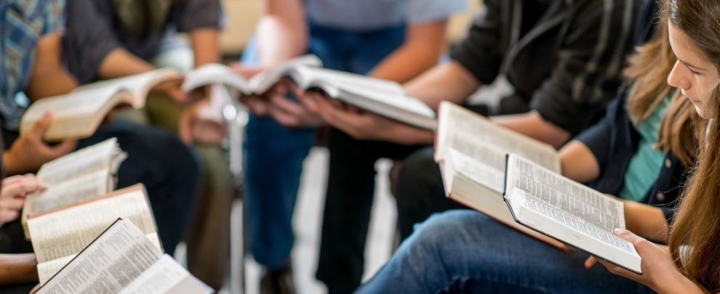
What is Christian Union?
"CU is a place for anyone of any faith, year group or background to come into a safe environment, play games, have fun, share ideas and learn a little about the real-world significance of Jesus and faith (not to mention sharing biscuits). It exists to help students in their school and wider lives to find unconditional security, significance and acceptance from both the great people and activities, but most of all from God, who knows and loves each of us, and knows and wants what is best for our lives. We aim to do this in a fun relevant and engaging way. We love to welcome new faces."
Josh Sorensen (Year 12)
Leader of Christian Union
CU meets every Tuesday lunch time in G16. Feel free to bring lunch with you.

Slide 6
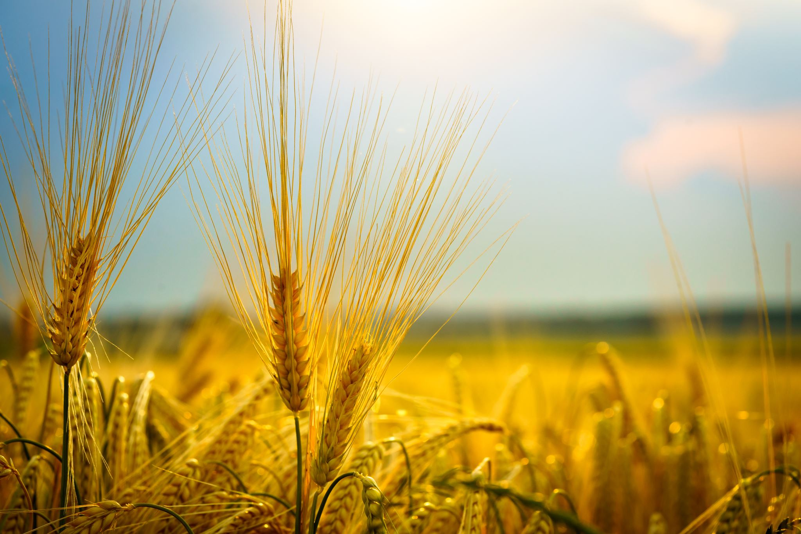
Why is Harvest important for Christians?
It is a time to give thanks to God for the food and good things that He provides.
It helps Christians to remember that not everyone has as much as they do and challenges them to be generous to others.
It also reminds Christians of God’s faithfulness in continuing to provide for humanity.

Slide 7

Lord,
As we begin our reflection on harvest, help us to see the abundance of your blessings in our lives. We thank you for the food on our tables, the shelter over our heads, and the love of our families and friends. May we never take these gifts for granted, and may our hearts be filled with gratitude for your endless grace.
Amen

Slide 8
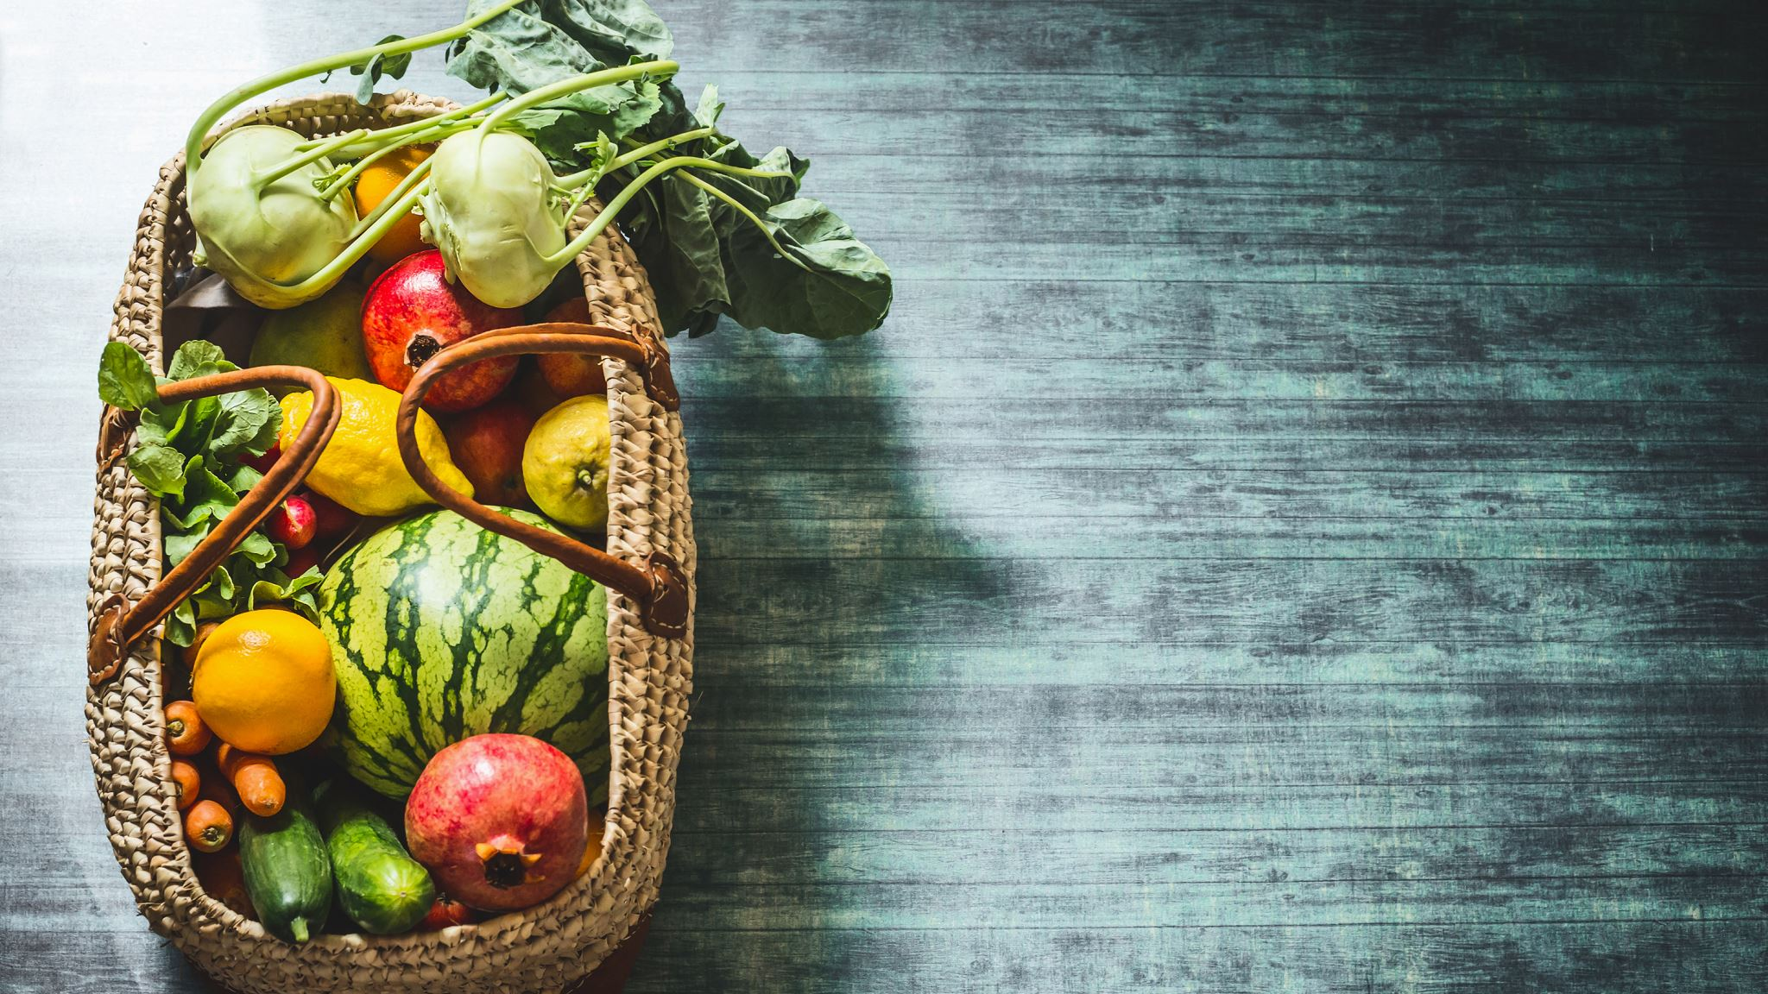
Gratitude
Today, we reflect on the theme of harvest, a time when the fruits of our labour are gathered. It is an opportunity to recognise the abundance of God's blessings in our lives and cultivate a sense of gratitude.
Take a few minutes to write down three things you are grateful for. Share your reflections with a partner, discussing the importance of recognising the blessings in our lives.

Slide 9
Theme of the week: Harvest
Thoughts and Prayers 2nd – 6th October

Slide 10
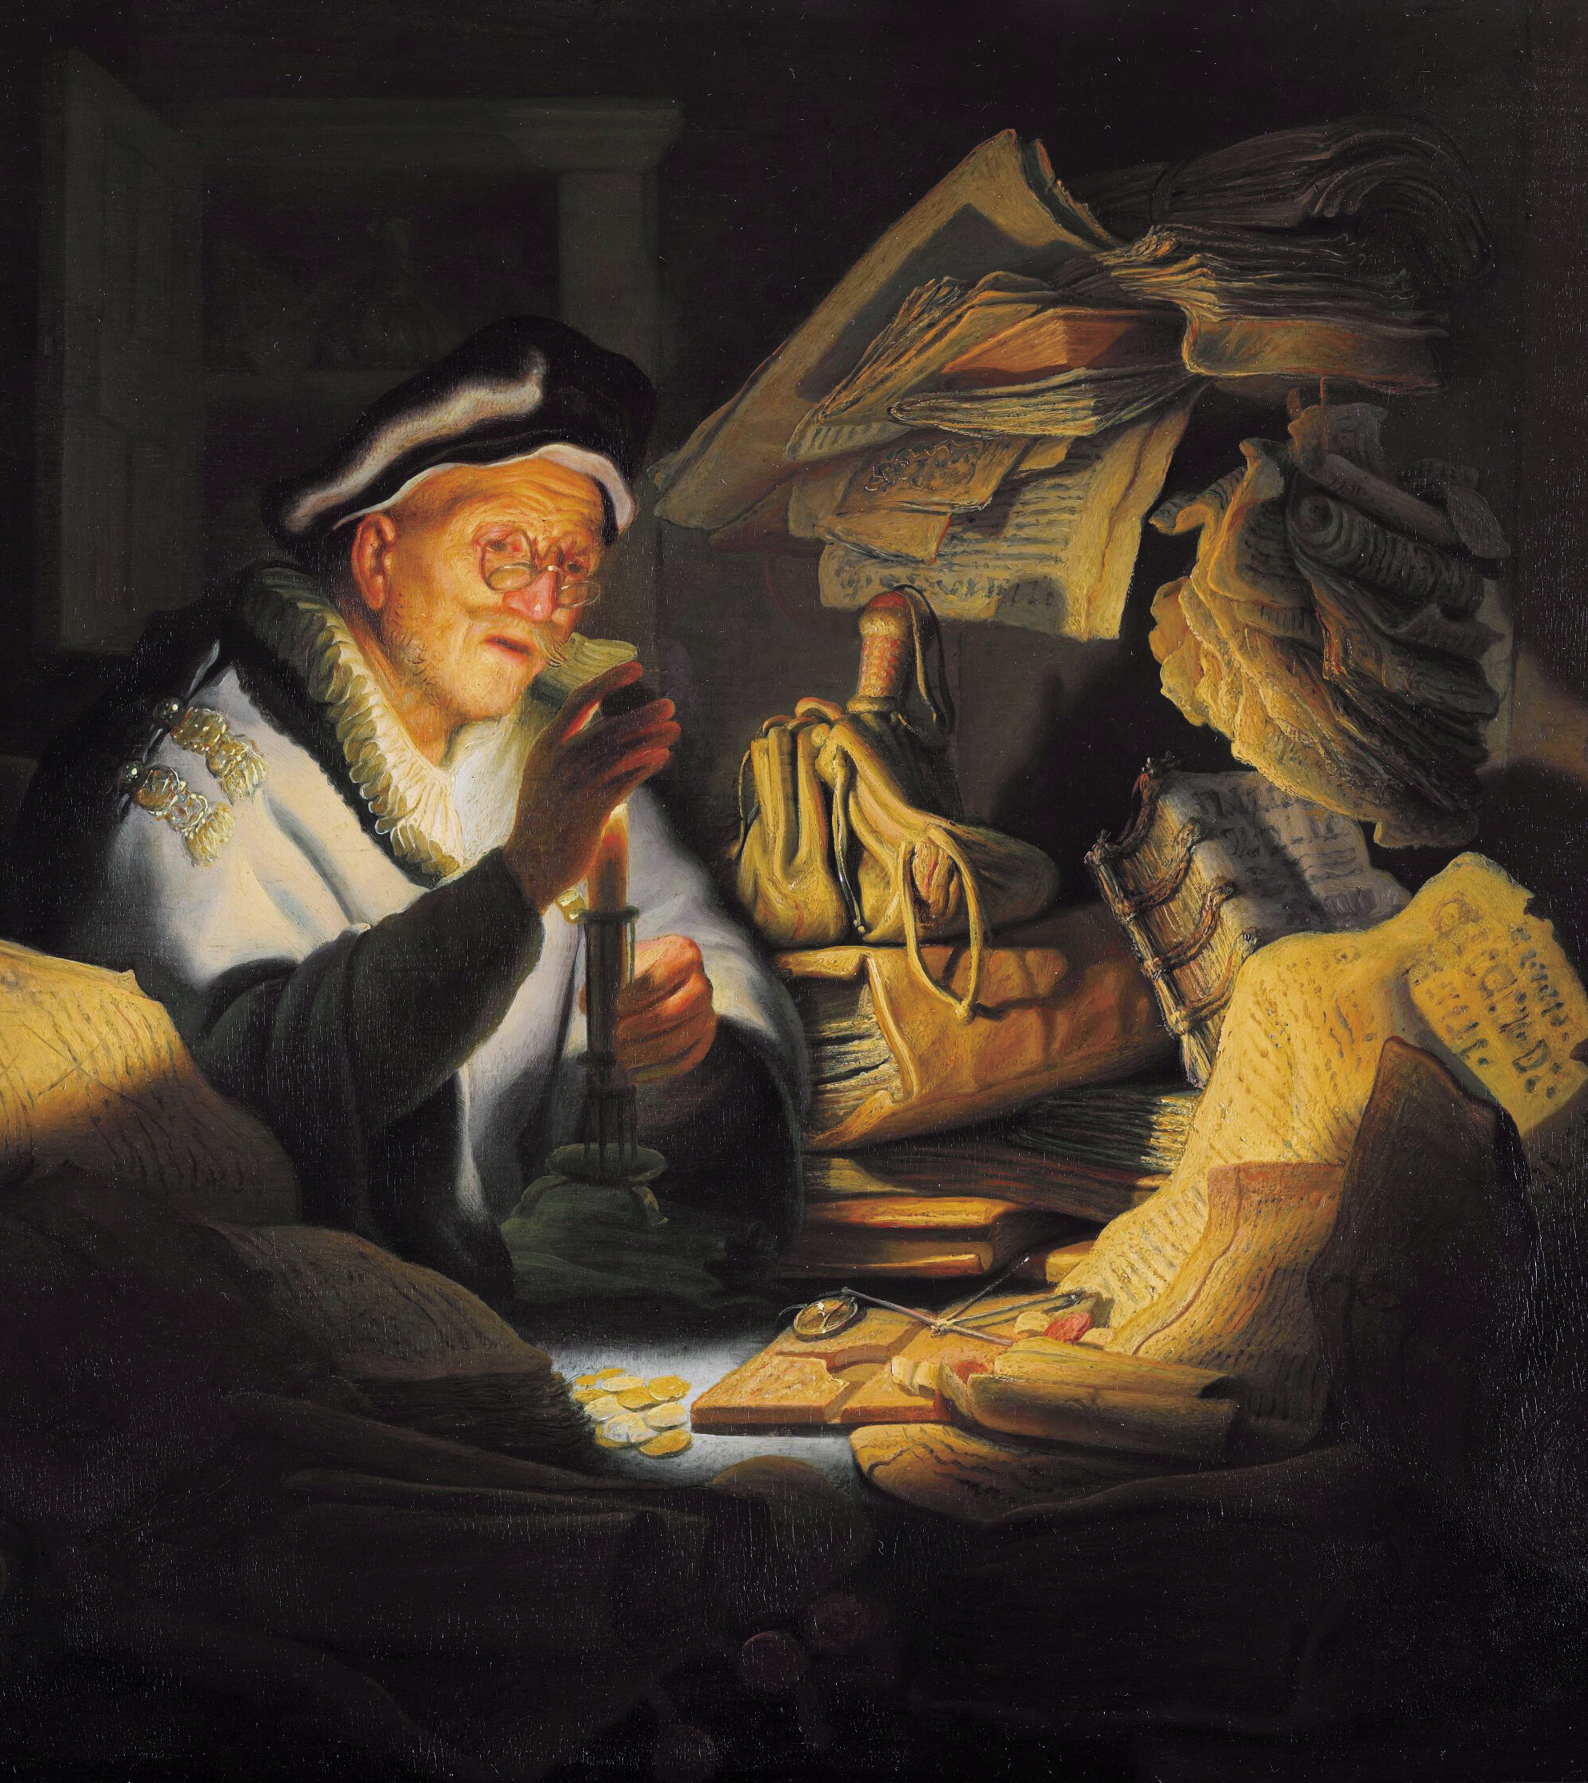
The theme this week is based on the Parable of the Rich Fool
Luke 12:15-21
"Then he said to them, 'Watch out! Be on your guard against all kinds of greed; life does not consist in an abundance of possessions.' And he told them this parable: 'The ground of a certain rich man yielded an abundant harvest. He thought to himself, "What shall I do? I have no place to store my crops." 'Then he said, "This is what I'll do. I will tear down my barns and build bigger ones, and there I will store my surplus grain. And I'll say to myself, "You have plenty of grain laid up for many years. Take life easy; eat, drink and be merry." 'But God said to him, "You fool! This very night your life will be demanded from you. Then who will get what you have prepared for yourself?" 'This is how it will be with whoever stores up things for themselves but is not rich toward God.'"

Slide 11
The theme this week is based on the Parable of the Rich Fool
Luke 12:15-21
"Then he said to them, 'Watch out! Be on your guard against all kinds of greed; life does not consist in an abundance of possessions.' And he told them this parable: 'The ground of a certain rich man yielded an abundant harvest. He thought to himself, "What shall I do? I have no place to store my crops." 'Then he said, "This is what I'll do. I will tear down my barns and build bigger ones, and there I will store my surplus grain. And I'll say to myself, "You have plenty of grain laid up for many years. Take life easy; eat, drink and be merry." 'But God said to him, "You fool! This very night your life will be demanded from you. Then who will get what you have prepared for yourself?" 'This is how it will be with whoever stores up things for themselves but is not rich toward God.'"
Discuss with your partner:
What do you think the message of this parable is?
What can we take from this and how can we implement the teaching in our own life?
What do you think is being warned against here?

Slide 12
The five key messages in this parable...
Warning Against Greed and Materialism: The rich man in the story is preoccupied with his wealth and possessions, to the point of hoarding even more than he needs. This reflects a mindset of greed and a fixation on earthly riches.
Temporal Nature of Life: The rich man assumes he has many years ahead to enjoy his wealth, but his life is unexpectedly cut short. This reminds us that we cannot control the length of our lives, and we should not put all our focus on accumulating material possessions for an uncertain future.
Misplaced Priorities: The rich man's focus on building bigger barns and storing his surplus grain illustrates a misplaced priority. Instead of using his wealth to help others or serve a greater purpose, he selfishly accumulates wealth for personal indulgence. This highlights the folly of pursuing wealth at the expense of spiritual and moral values.
Lack of Spiritual Richness: The rich man's ultimate spiritual poverty is evident when God calls him a "fool." He's rich in material possessions but spiritually impoverished. The parable underscores that true wealth, or being "rich toward God," comes from living a life of faith, generosity, compassion, and a commitment to spiritual values.
Stewardship and Accountability: The rich man is entrusted with resources, but he fails to use them wisely. It serves as a reminder that we are stewards of the resources and blessings we receive, and we will be held accountable for how we use them.

Slide 13
Almighty Father,
Guide us to be generous with the bounty you have given us. May we remember that our wealth is not measured by what we own but by what we share. We pray for the strength and compassion to extend a helping hand to those in need, just as you have blessed us.
Amen

Slide 14
Theme of the week: Harvest
Thoughts and Prayers 2nd – 6th October

Slide 15
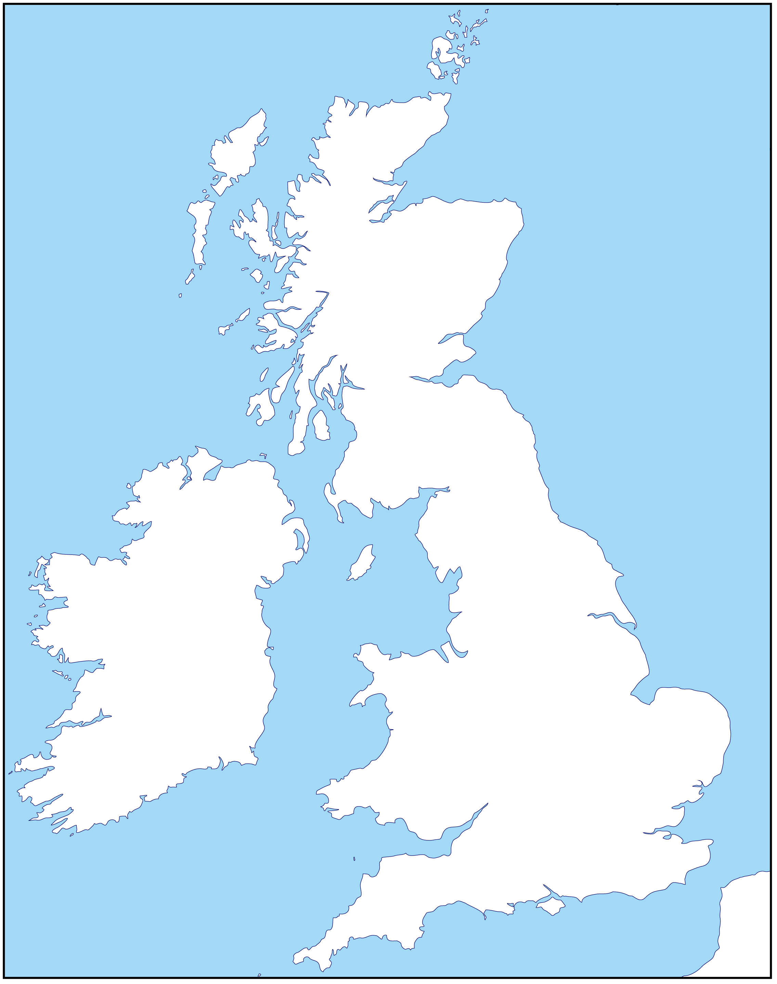
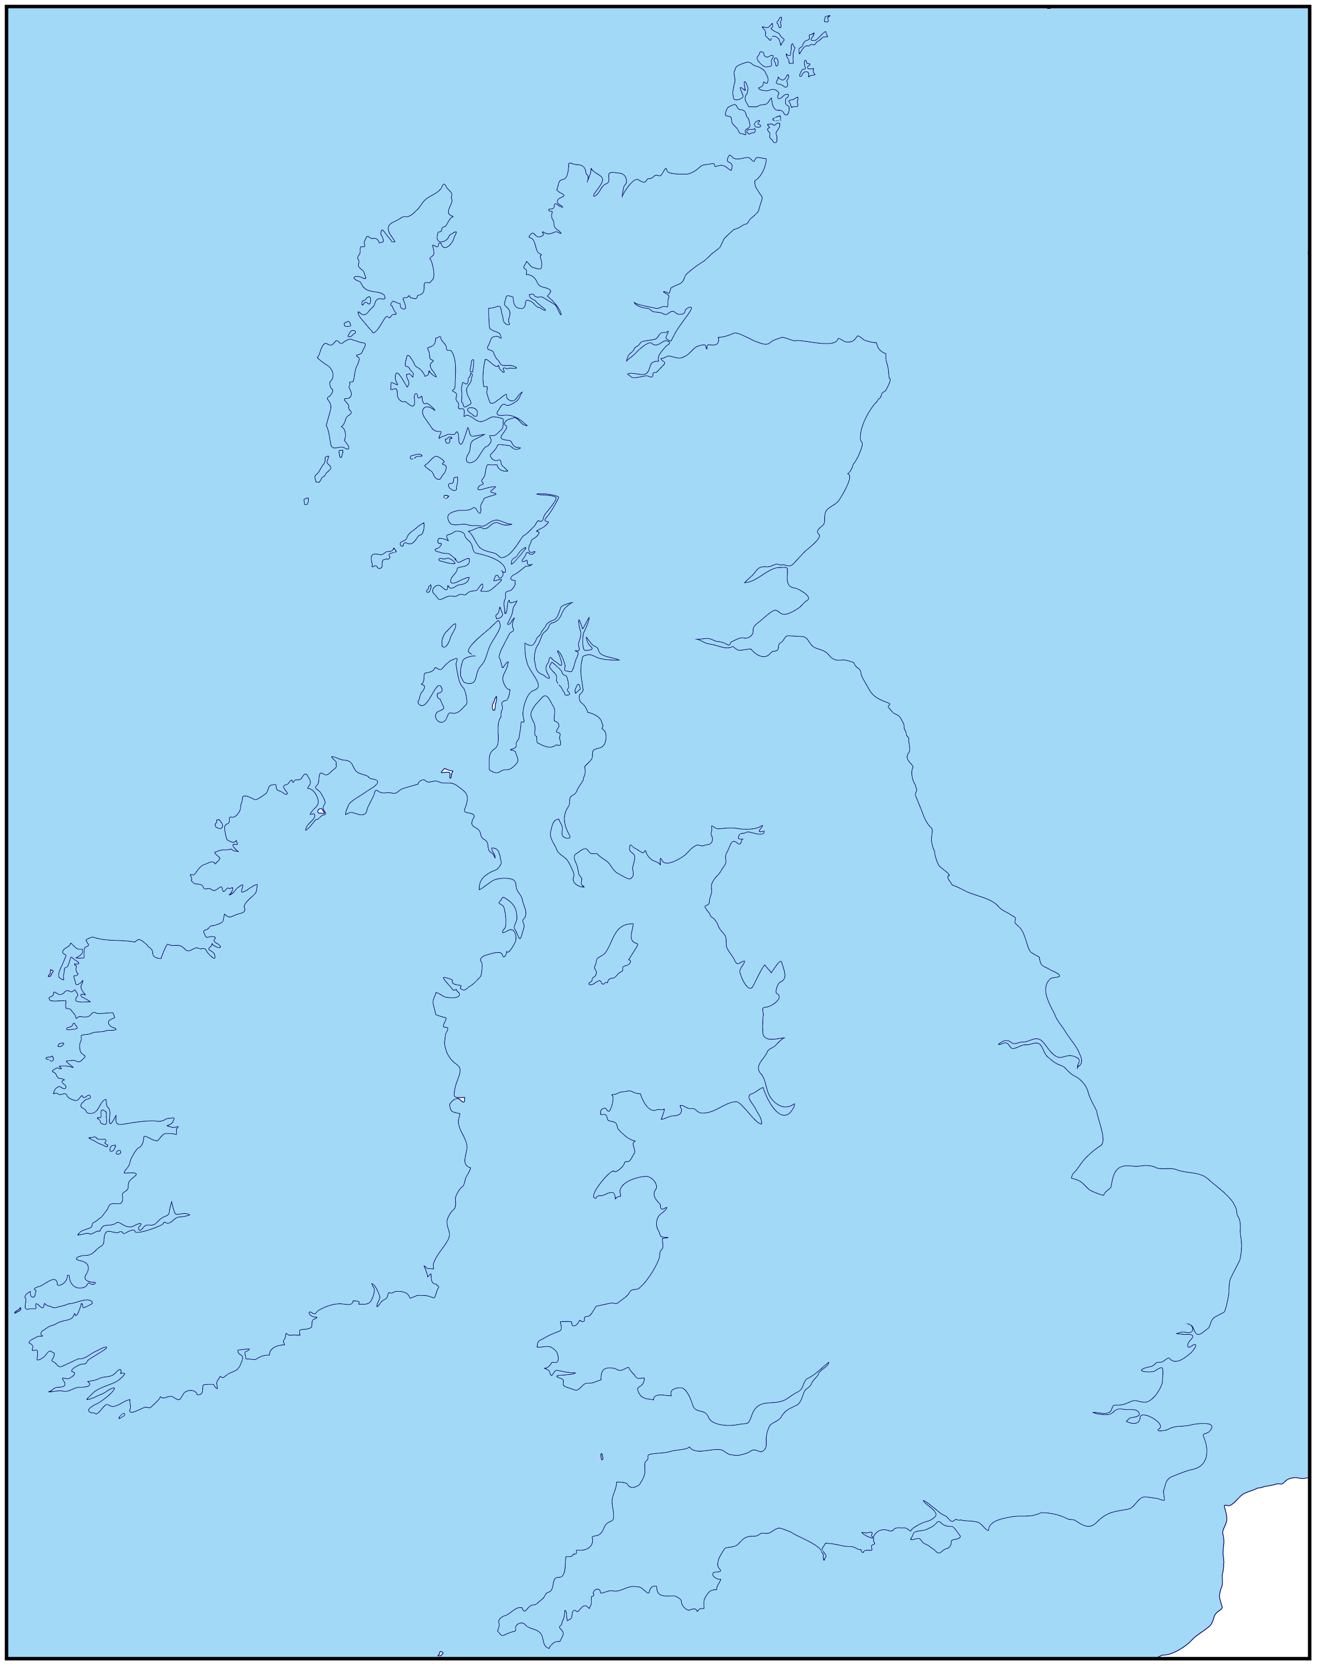
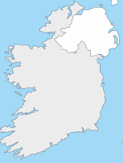
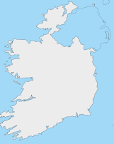
Harvest
Imagine the whole of the UK covered in floodwater...
…not just a few places, but everywhere.
Notes:
Picture credit: Community World Service Asia (CWSA)
Map: D-maps.com

Slide 16
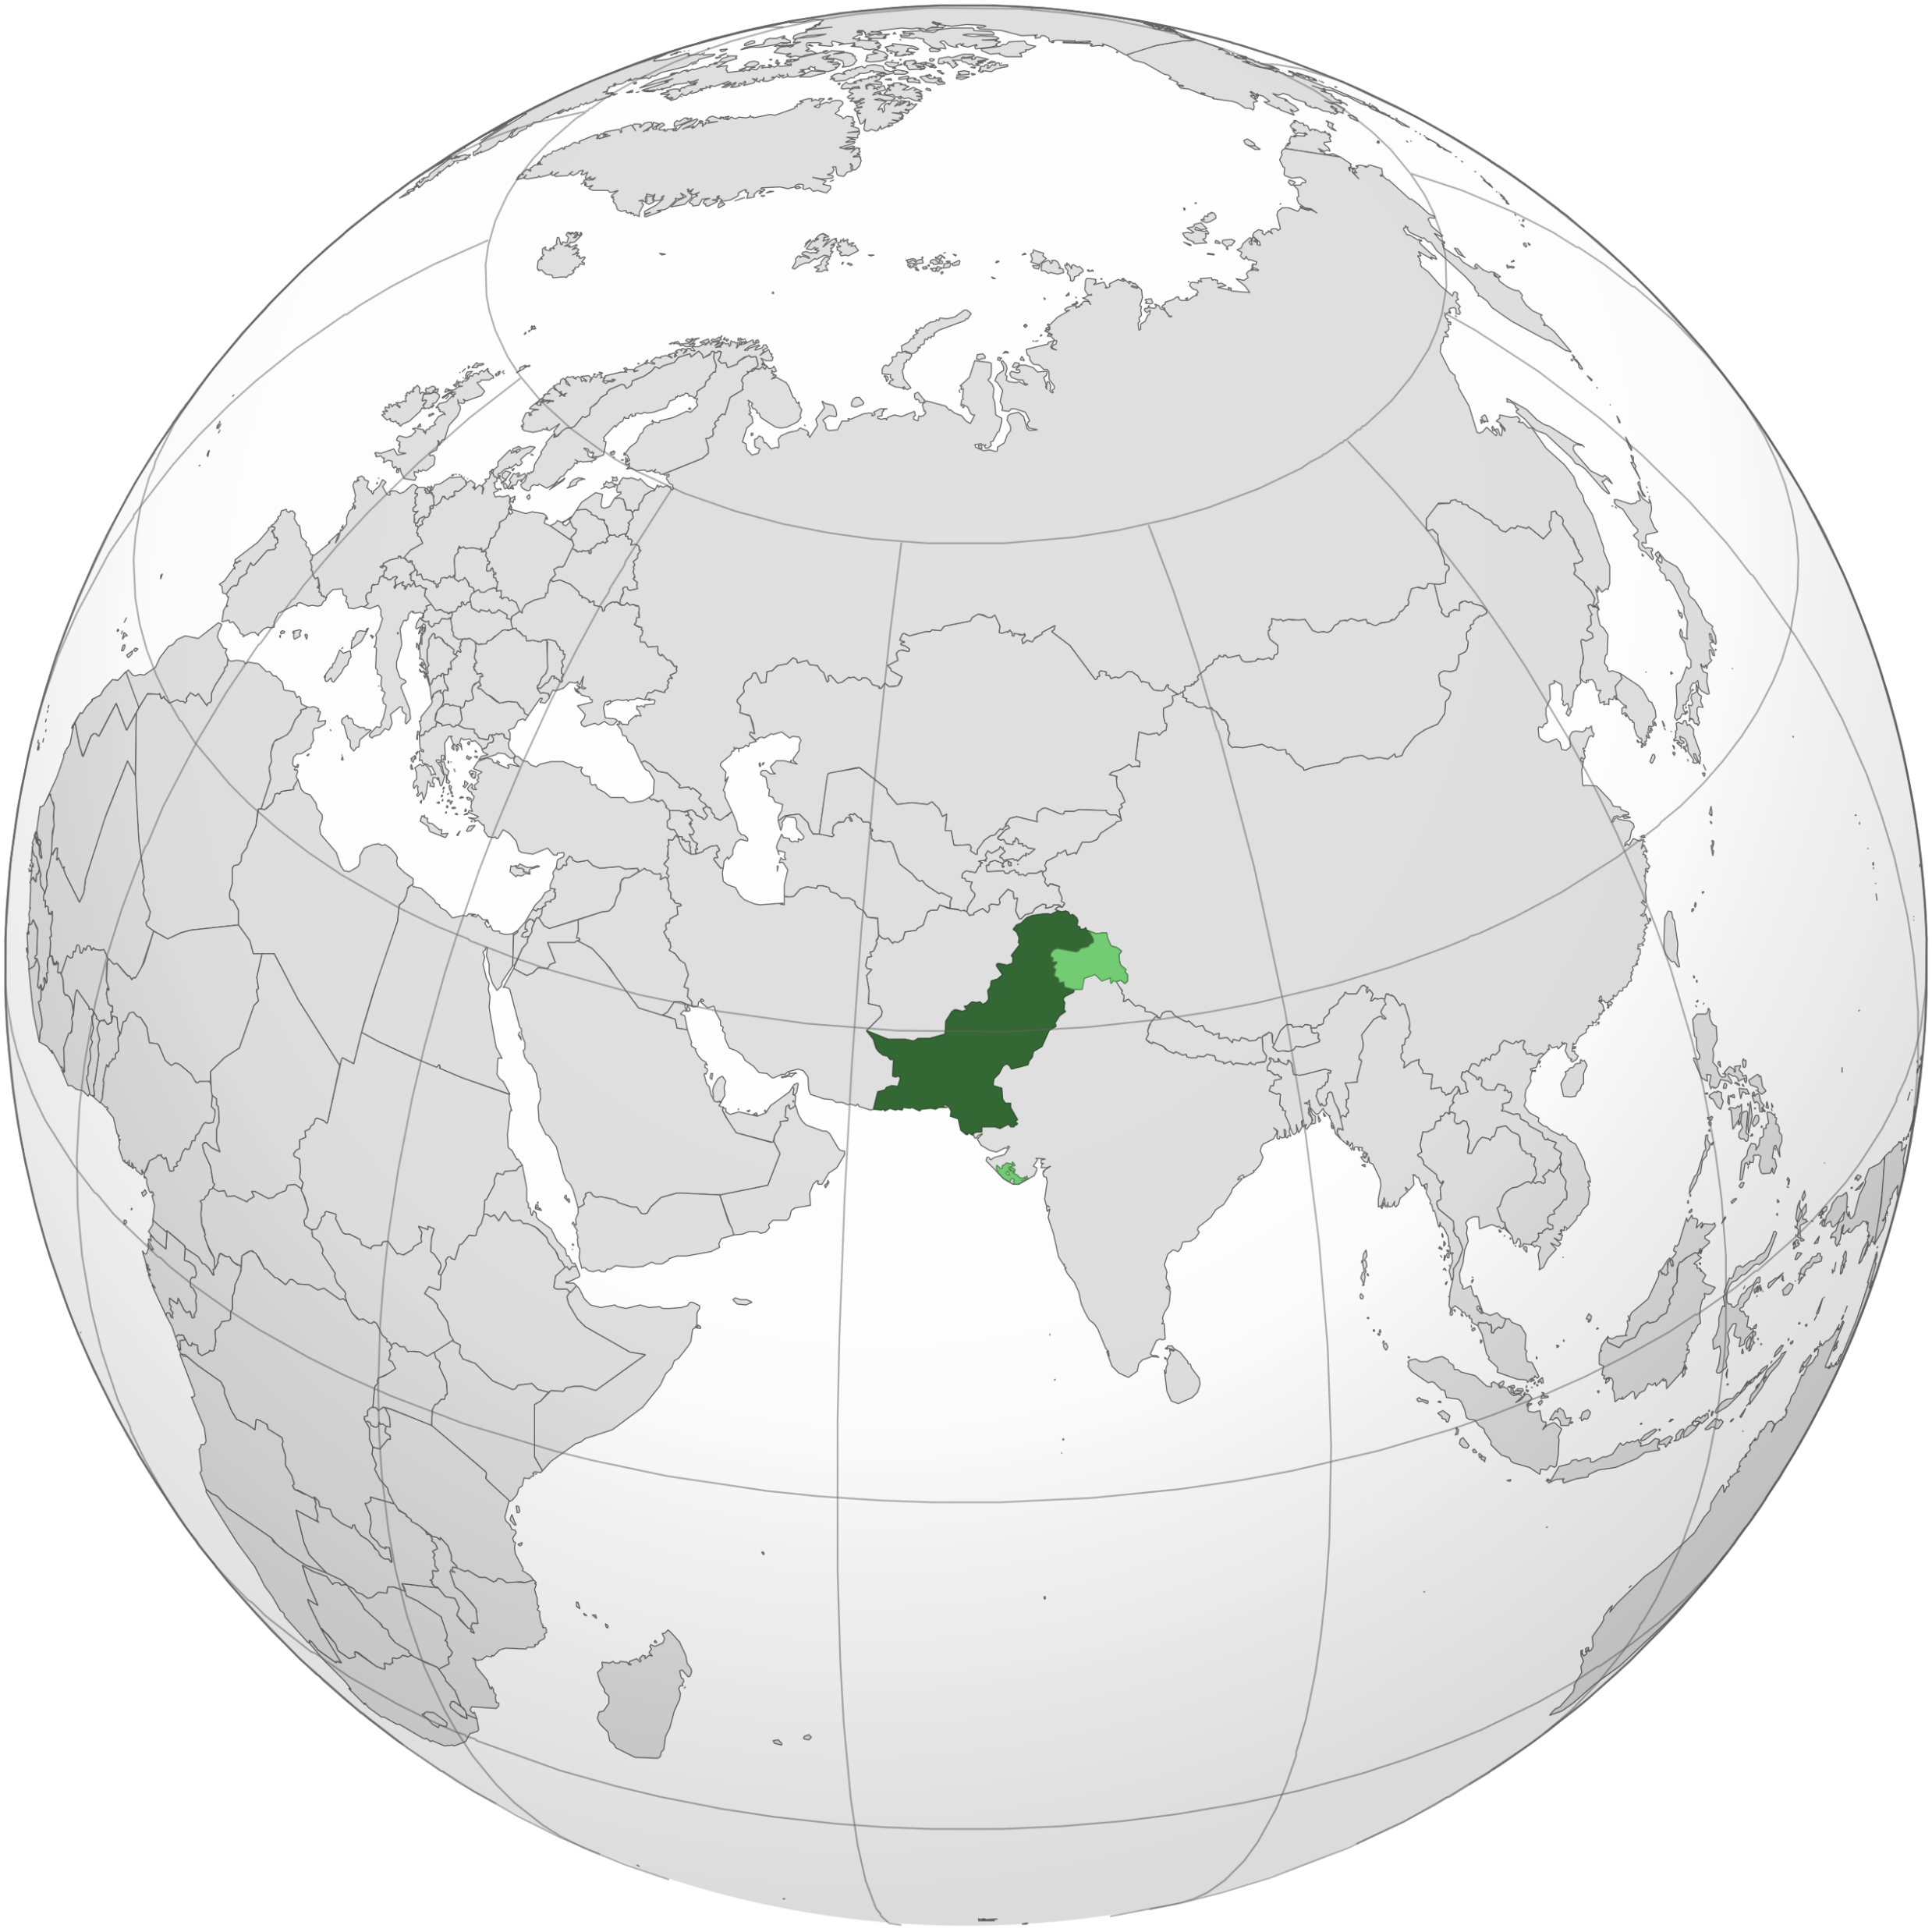
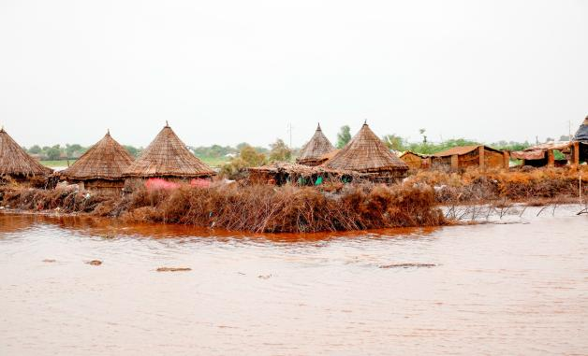
Harvest
Last summer, in Pakistan, an area the same size as the UK was under water as terrible floods swept away people, homes and animals.
By harvest time, when farmers usually gather in their crops, there was no harvest to gather.
Notes:
Picture credit: Community World Service Asia (CWSA)
Map: Wikipedia

Slide 17


‘Caritas’ means ‘love’
Many people died in the floods, and many others were injured.
As part of the global Caritas network, CAFOD was quickly able to help.
Caritas has experts all around the world - organisations like CWSA, Community World Service Asia.

Slide 18
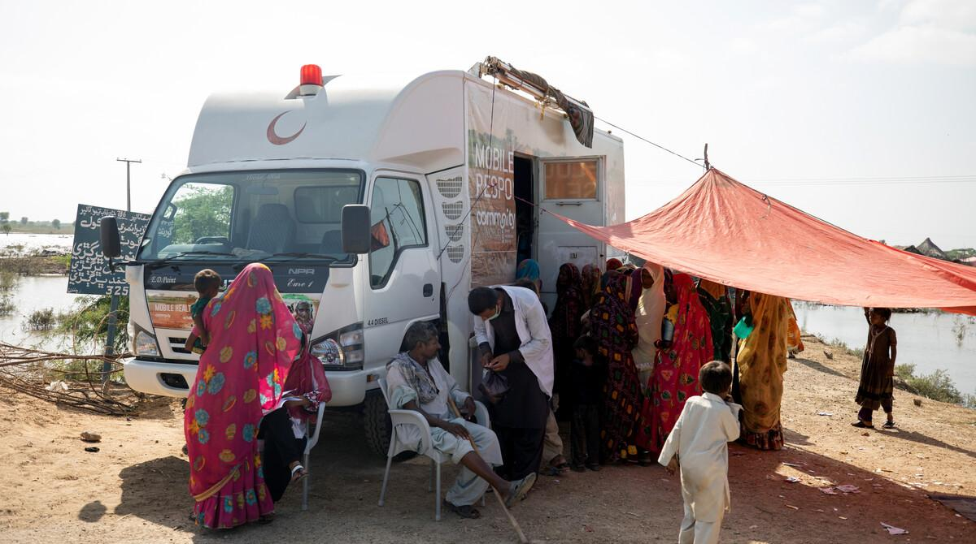

No-one beyond reach
CWSA sent mobile clinics to reach some of the people who most
needed medical help, funded
in part by fundraising
in schools like ours.
Notes:
[If you have time, at this point, click the arrow to show the 2-minute video about the mobile health clinic at cafod.org.uk/secondary]
Picture credit: Community World Service Asia (CWSA)

Slide 19
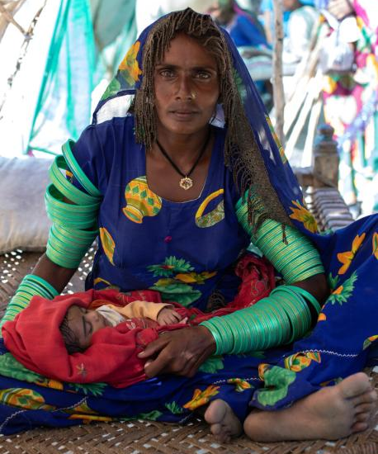
True stories
Meera gave birth to a daughter, Marwi, during the floods.
While at the hospital, the family’s home was swept away.
They moved into a temporary shelter on the roadside, with little food and only contaminated water to drink.
Diseases spread through the camp.
Notes:
[Meera and Marwi are pseudonyms]
Photo credit: Community World Service Asia (CWSA)

Slide 20
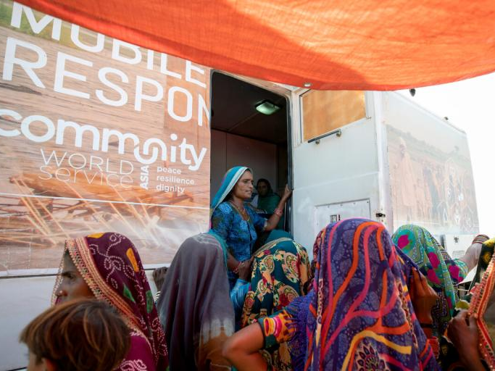
True stories
Meera recalls: “Our children got sick, and we had no medicines.”
Then a CWSA mobile clinic run by Doctor Nasha and her team arrived in Meera’s village.
Meera hurried to bring her children and got them the
life-saving medicines and treatment they needed.
Notes:
Photo credit: Community World Service Asia (CWSA)

Slide 21


Slide 22
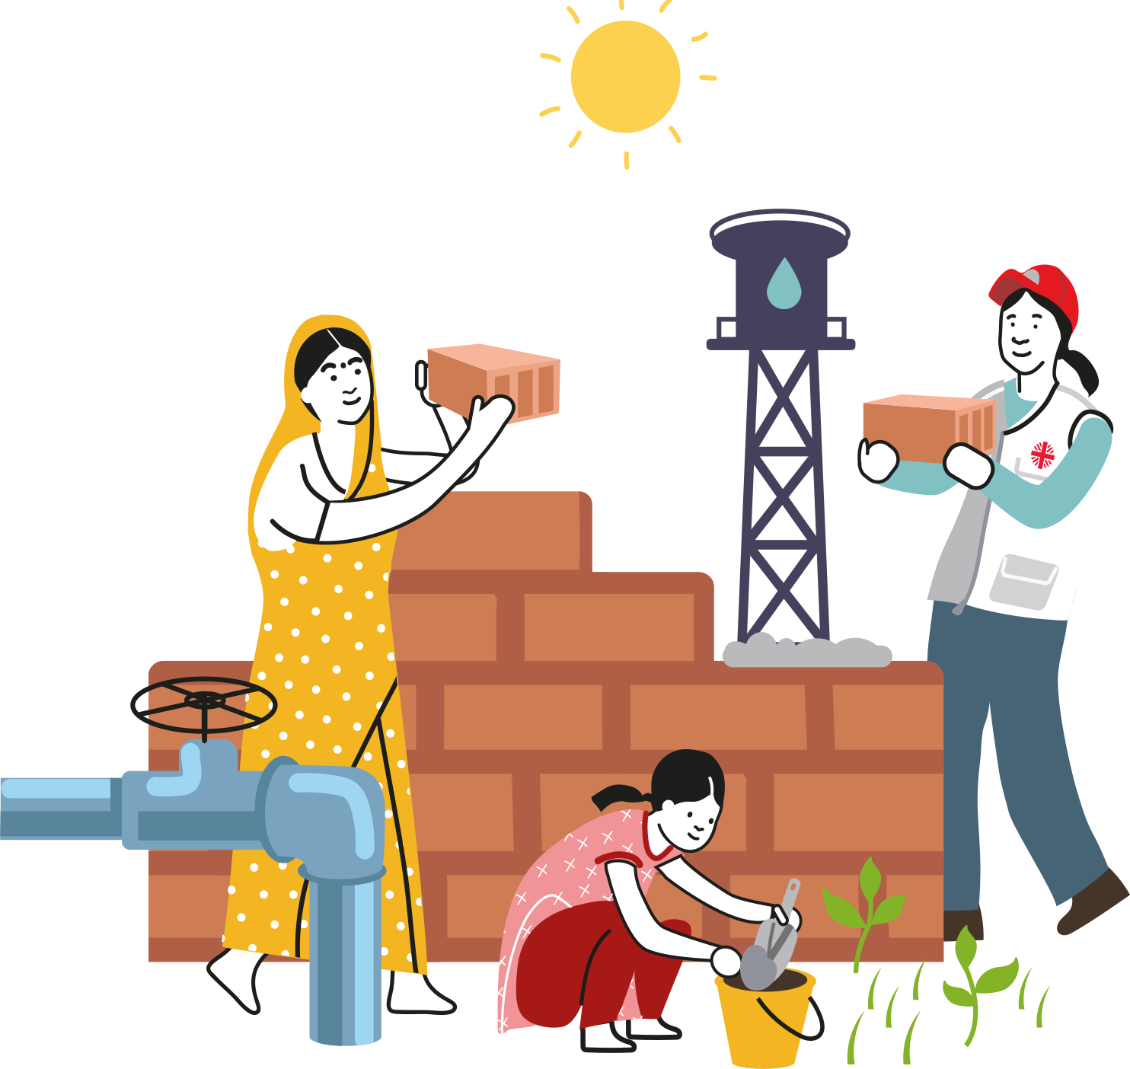
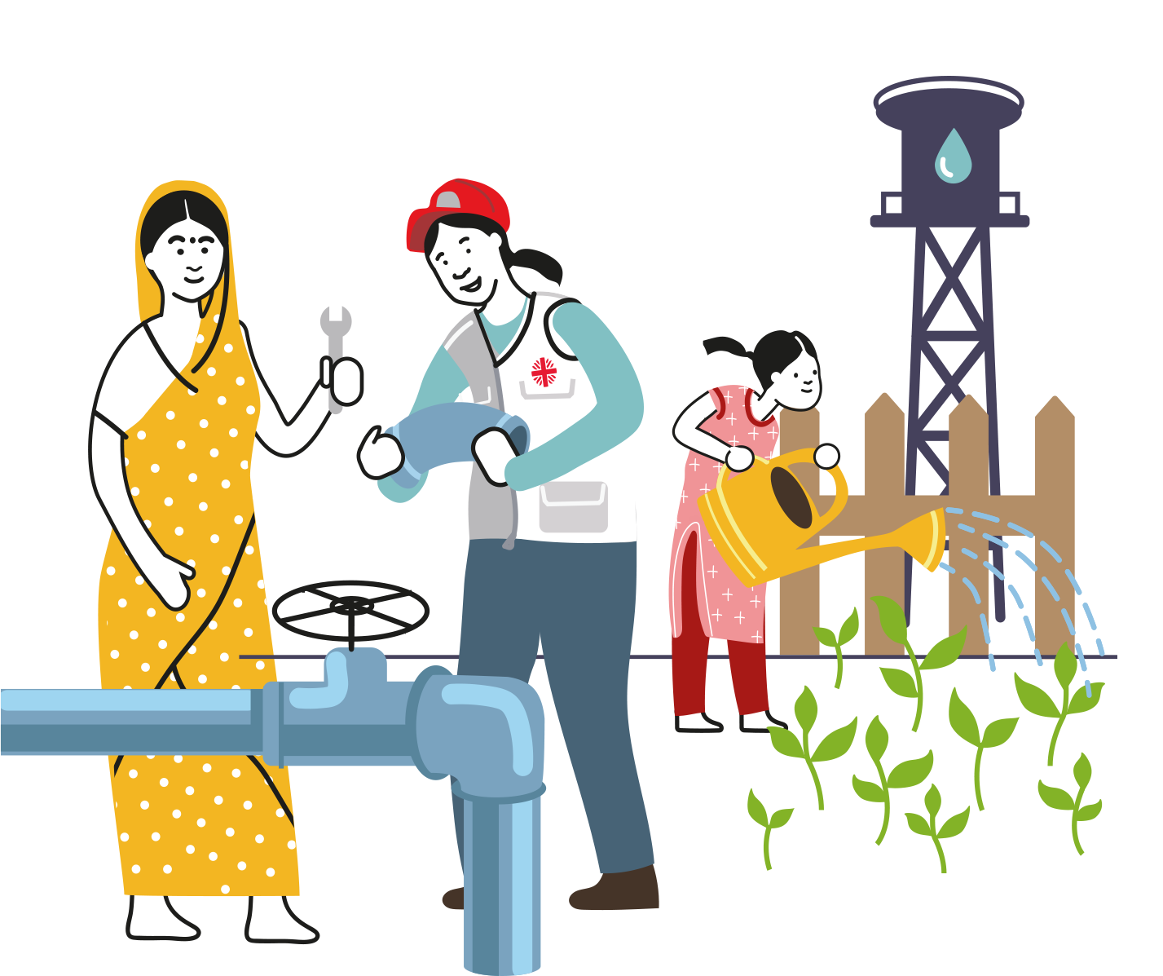
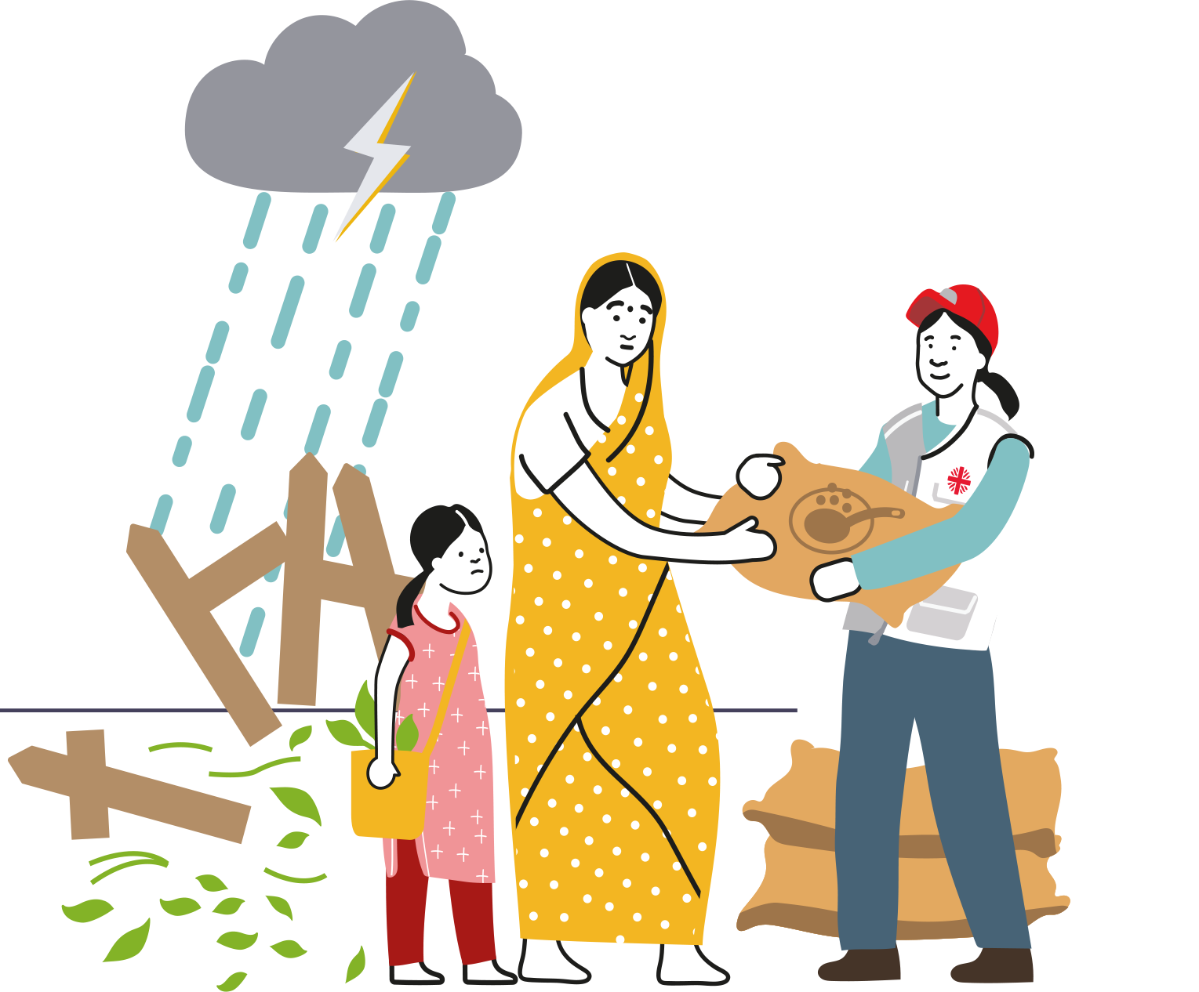
CAFOD does not leave after an emergency but continues to support communities as they rebuild so that they are better prepared for the next emergency.
BEFORE
>
>
DURING
AFTER
…any emergency
Notes:
Photo credit: Khaula Jamil/ CWSA

Slide 23

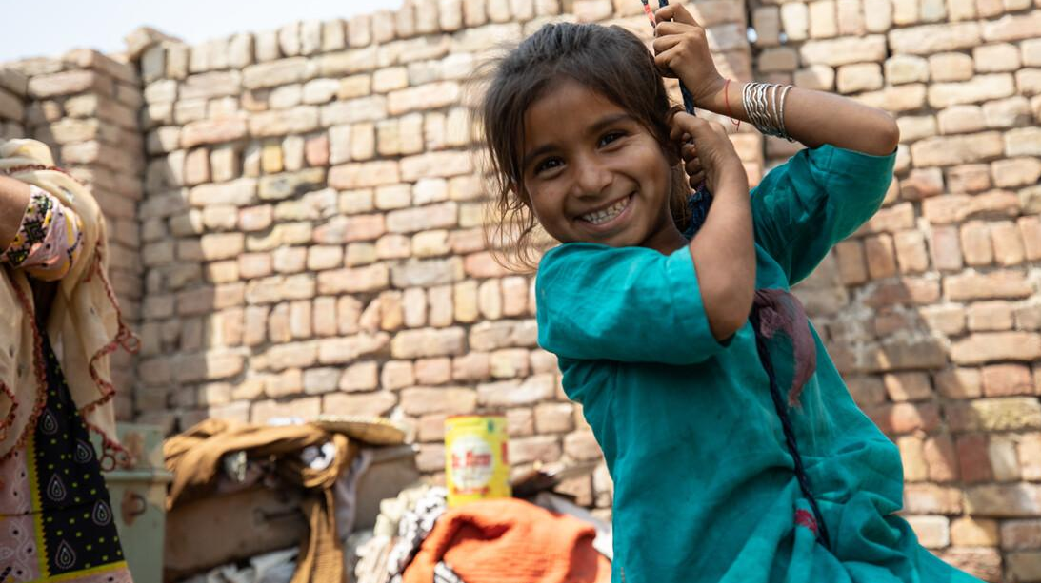
Let’s pray together:
Loving God, we stand
with our sisters and brothers,
who have done little to cause
the climate crisis,
yet are forced to endure its impacts.
Give us determination
to work with them for justice,
generosity
to share your gifts more fairly,
and inspiration
to care for creation together,
until everyone can live life to the full.
We ask this through Christ our Lord.
Amen.
Notes:
Photo credit: Khaula Jamil/ CWSA

Slide 24
Theme of the week: Harvest
Thoughts and Prayers 2nd – 6th October

Slide 25
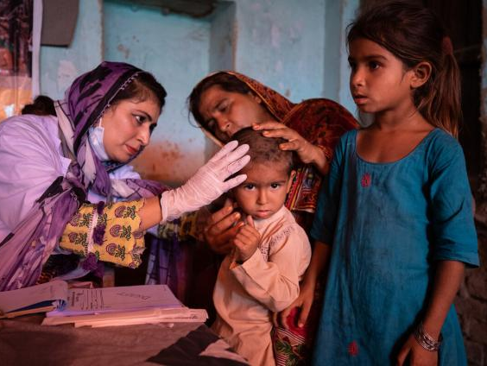
True stories
Another person who attended the clinic was ten-year-old Ayra, whose mother, Sultana, brought her to the clinic for help.
The family were forced to leave their home when it was damaged in the floods. Ayra and her siblings were suffering from malnutrition and skin infections.
The clinic provided medicine at no cost.
Notes:
Photo credit: Khaula Jamil/ CWSA

Slide 26
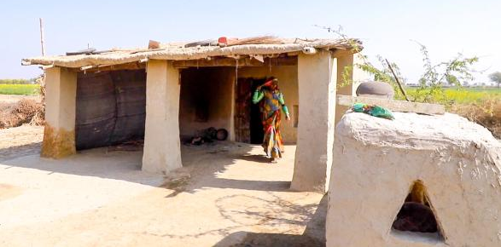
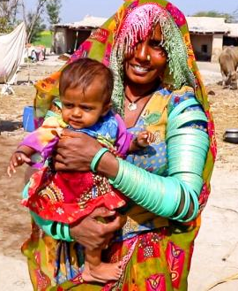
A year later
Meera’s baby, Marwi, is now a healthy one-year-old.
Together, Meera and her husband have rebuilt their home and are working hard to recover what they lost in the floods.
Notes:
Photo credits: Community World Service Asia (CWSA)

Slide 27
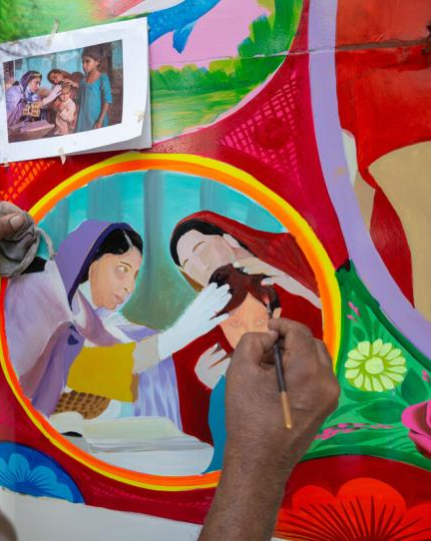
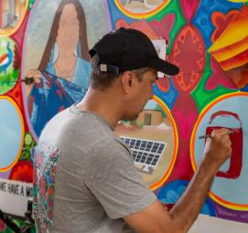
A year later
Ayra made a full recovery… and is now famous!
Her story has been painted on the mobile clinic that she attended.
Local artists, Ali Salman Anchan and his team, painted the van with bright colours to celebrate the flood survivors. Ali said: “I felt how brave they are during this national disaster.”
Notes:
Photo credits: Zoral Naik

Slide 28


Slide 29
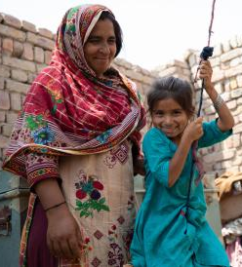
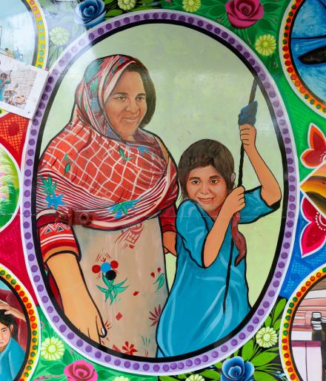
A year later
Ayra’s mother loved the paintings.
She said: “We are happy to see the painting on the truck!”
“I am filled with joy and so is my daughter.”
Notes:
Photo credits: Zoral Naik; Khaula Jamil/ CWSA

Slide 30
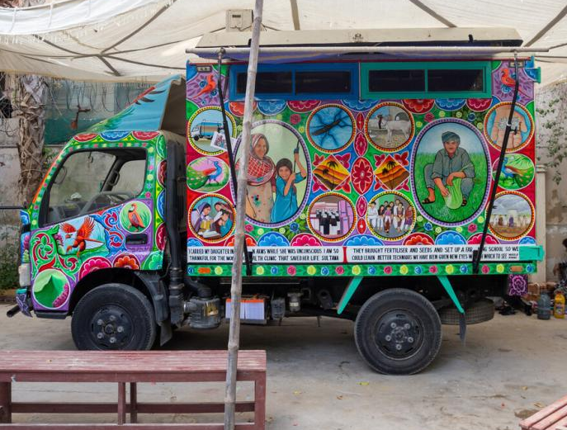
Brightening lives
This van is back on the road, bringing life-saving medical help to remote communities.
And brightening their lives too!
Ali said: “We put our identities, stories, faith and culture into this truck. Wherever it goes it brings joy to the people.”
Notes:
Photo credit: Zoral Naik

Slide 31


Brighten Up this harvest
You have the capacity to Brighten Up our world too…
and you don’t have to wait for the next emergency.
Why is fundraising so important?
Do you think we have a responsibility to help others?
How can you support through fundraising?
Remember, every little helps when it comes to charity! Here's how the funds raised can help CAFOD...
Notes:
[Add here the details of whatever Brighten Up fundraising you are doing in school.]

Slide 32





Find out more: cafod.org.uk/secondary

Slide 33
Lord,
We come before you with hearts filled with gratitude for the gift of charity. Teach us to be channels of your love and compassion, to see the needs of others, and to respond with open hearts.
Grant us the strength to give generously, not only of our resources but also of our time and kindness. Help us to remember that in giving, we receive the greatest blessings.
May your spirit of charity guide our actions, so that we may make a positive difference in the lives of those in need. In practicing charity, may we reflect your boundless love to the world.
Amen

