Slide 1

Theme of the week: Forgiveness
Thoughts and Prayers 18th – 22nd September

Slide 2
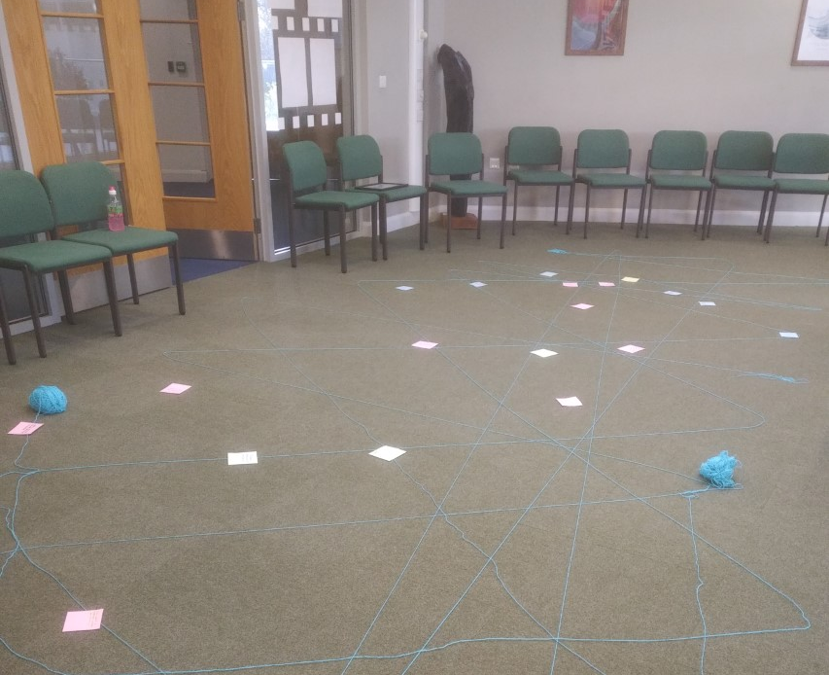

MORNING PRAYER IN THE CHAPEL THIS WEEK
Monday 18th September - 9T
Tuesday 19th September- 9M
Wednesday 20th September – 13T
Thursday 21st September - 9R
Friday 22nd September - 9Y

Slide 3
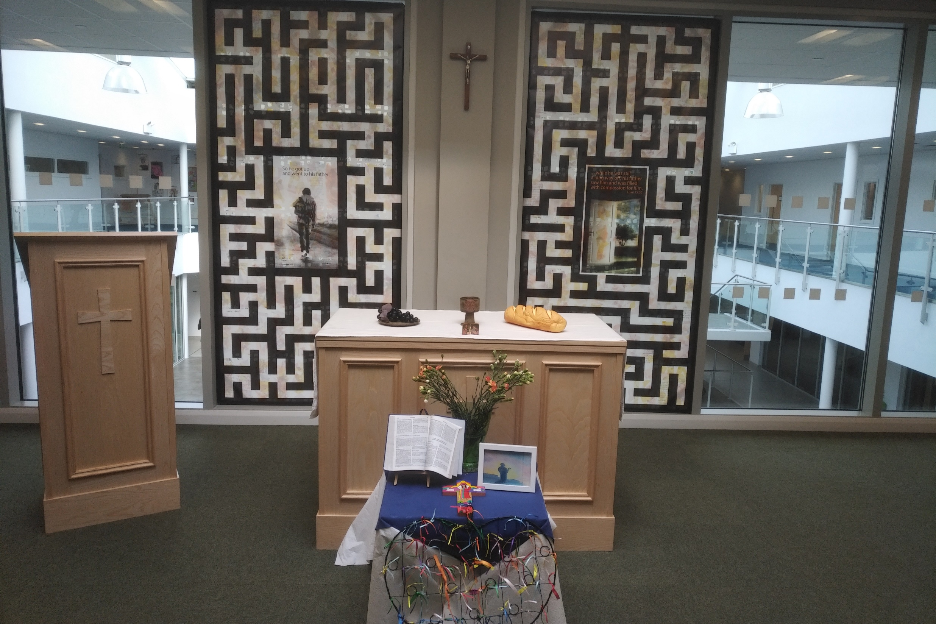
Friday Mass
Who?
Mass this week will be led by 10R
When?
Friday Morning at 8.20am
Where?
In the School Chapel. See you there!
ALL ARE MOST WELCOME.
ALL WORDS ARE DISPLAYED ON THE SCREEN.

Slide 4
Forgiveness is a powerful and often misunderstood concept. It can be challenging to grasp, but it holds the potential to bring profound healing and growth.
Q: How does this image link to the theme of forgiveness?
Forgiveness

Slide 5
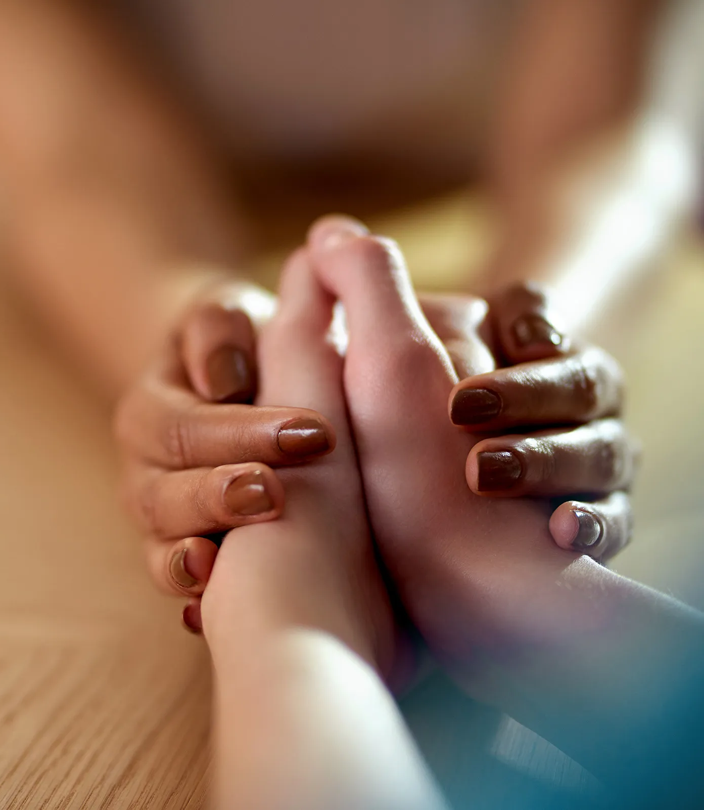
The process of forgiveness
Forgiveness is often a process rather than a one-time event. It requires time, reflection, and effort. Today, we will explore the stages of the forgiveness process.
Reflect on a past experience where you forgave someone or were forgiven. How did the process unfold?
How do you feel about the idea that forgiveness is a process rather than a one-time action?
What challenges might you encounter while going through the forgiveness process?
What are the potential benefits of forgiveness, both for yourself and the person who hurt you?

Slide 6
R
E
A
C
H
Recall the hurt.
To heal, you have to face the fact that you’ve been hurt. Make up your mind not to be nasty and hurtful, not to treat yourself like a victim, and not to treat the other person as a bad person. Make a decision to forgive. Decide that you are not going to pursue payback but you will treat the person as a valuable person.
Empathise.
Empathy is putting yourself in the other person’s chair. Try to understand their motivation or their perspective. This builds empathy, and even if you can’t empathise, you might feel more sympathy, compassion, or love, which helps you heal from hurt.
Altruistic gift.
Give forgiveness as an unselfish, altruistic gift. We all can remember when we wronged someone—maybe a parent, teacher, or friend—and the person forgave us. We felt light and free. And we didn’t want to disappoint that person by doing wrong again. By forgiving unselfishly, you can give that same gift to someone who hurt you.
Commit.
Once you’ve forgiven, write a note to yourself—something as simple as, “Today, I forgave [person’s name] for hurting me.” This helps your forgiveness last.
Hold onto forgiveness.
You might doubt that you actually forgave the person or find yourself becoming angry or resentful at some point so it is important to try to hold on to your forgiveness and remember why you have forgiven this person in the first place.

Slide 7

Lord,
We gather before you, seeking the grace to forgive others as you have forgiven us. Grant us the strength to let go of resentment and embrace the healing power of forgiveness. Help us see those who have wronged us with compassion and grant us the wisdom to know that forgiveness leads to peace and reconciliation.
Amen

Slide 8
Theme of the week: Forgiveness
Thoughts and Prayers 18th – 22nd September

Slide 9
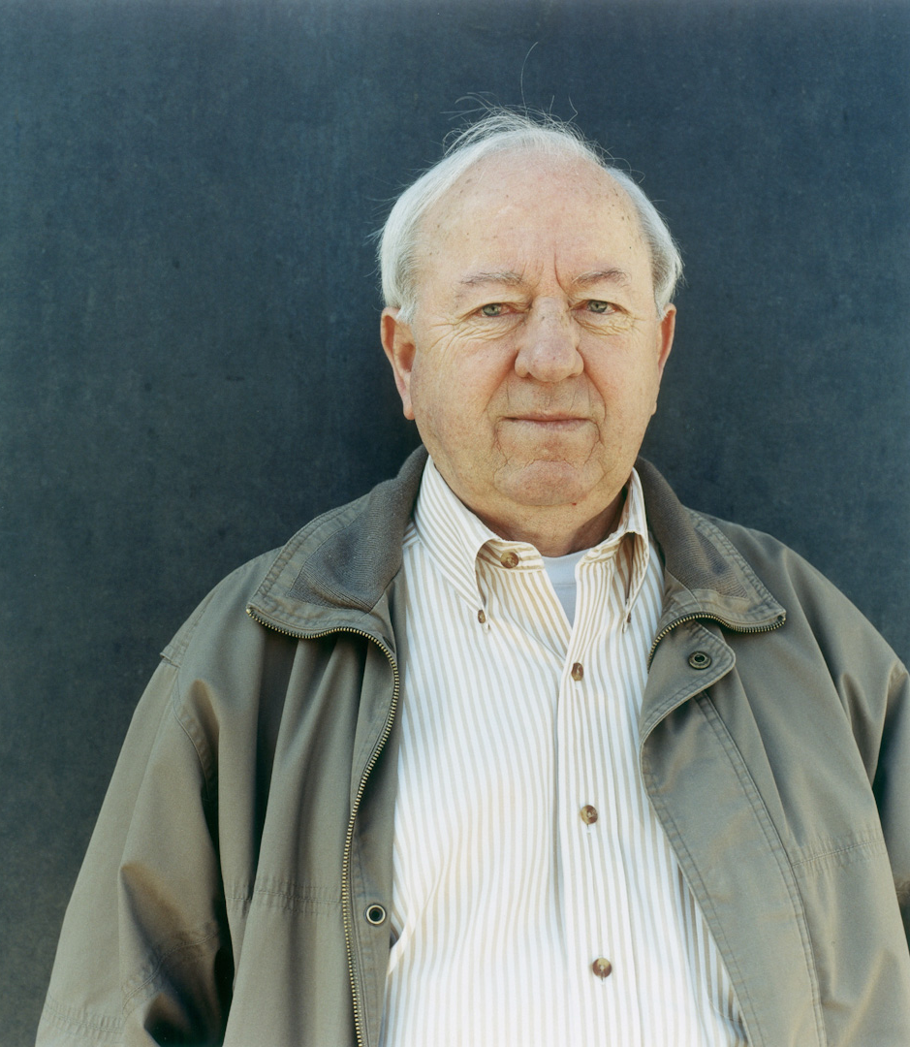
Forgiving others
In April 1995 Bud Welch’s 23-year-old daughter, Julie Marie, was killed in the bombing of the Murrah Federal Building in Oklahoma City along with 167 others. In the months after her death, Bud changed from supporting the death penalty for Timothy McVeigh and Terry Nichols to taking a public stand against it. In 2001 Timothy McVeigh was executed for his part in the bombing.

Slide 10
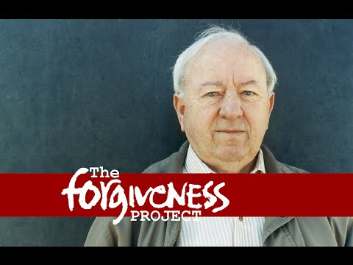

Slide 11

"I didn't release Tim McVeigh, I released myself"
How can forgiving others set us free?

Slide 12
Almighty Father,
We lift up to you those who have done wrong, seeking your forgiveness and grace for them. Help them find the path of repentance and grant them your mercy and love. May your transformative forgiveness bring healing and redemption to their lives.
Amen

Slide 13
Theme of the week: Forgiveness
Thoughts and Prayers 18th – 22nd September

Slide 14
Jesus' Forgiveness
The Bible story about forgiving "70 times 7" or "70 times 10" from Matthew 18:21-22 teaches the importance of unlimited forgiveness. When Peter asks Jesus how many times he should forgive someone, Jesus responds with "seventy-seven times," symbolizing boundless forgiveness. The overall message is that Christians should extend forgiveness generously and without keeping score, just as God forgives us limitlessly.
‘I do not tell you to forgive seven times, but seventy seven times.’ (Matthew 18:21-35)

Slide 15
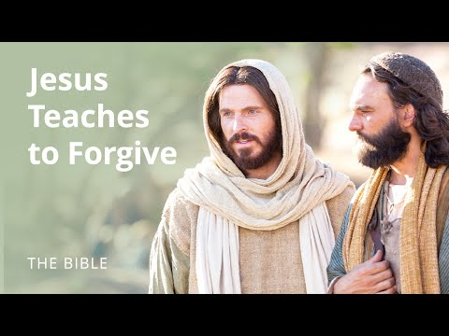

Slide 16
Lord,
We thank you for the boundless forgiveness demonstrated through your Son, Jesus Christ. His love and mercy inspire us to forgive others as He forgave. Grant us the grace to extend compassion and pardon to those who have wronged us, just as Jesus did. In His name, we pray.
Amen

Slide 17
Theme of the week: Forgiveness
Thoughts and Prayers 18th – 22nd September

Slide 18
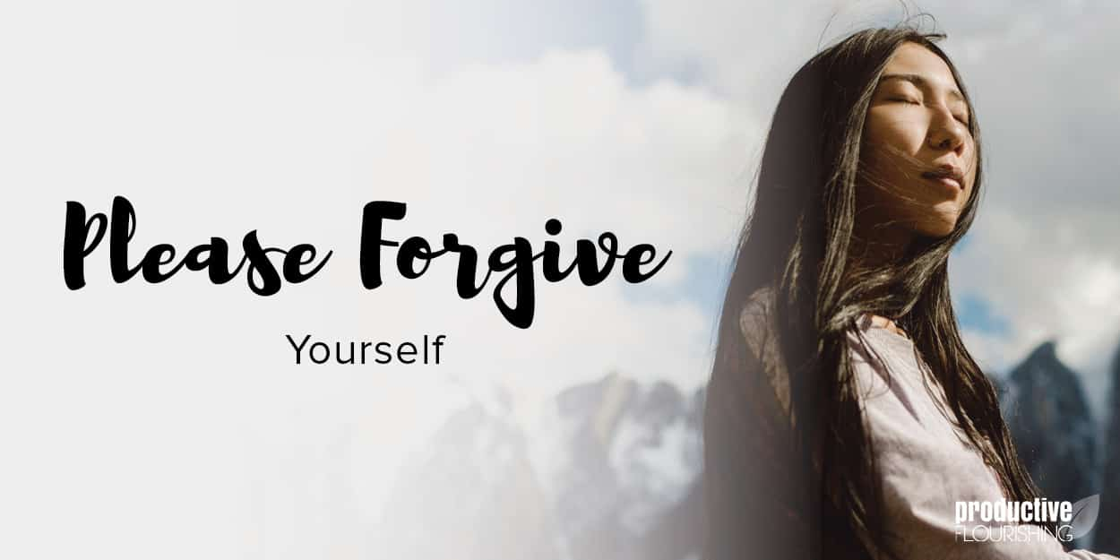
Forgiving ourselves can be just as important as forgiving others. It's a vital component of personal growth and emotional well-being. Today, we will explore the concept of self-compassion and its connection to forgiveness.

Slide 19

Reflection Questions:
How do you usually treat yourself when you make a mistake or have regrets?
What does self-compassion mean to you, and how might it relate to forgiveness?
Can you think of a time when practicing self-compassion helped you forgive yourself or someone else?
What steps can you take to cultivate self-compassion in your life?

Slide 20

I forgive myself
Take a moment to make a mental list of any mistakes or regrets you have in your life.
You are going to spend time meditating with a focus on self forgiveness.
You should feel a sense of 'letting go'.
If you sense your mind wandering, focus on the phrase 'I forgive myself'.

Slide 21


Slide 22
Lord,
I come before you with a humble heart, seeking forgiveness and grace. I acknowledge the mistakes I have made, the burdens I carry, and the need to forgive myself.
Help me, Lord, to release the weight of my own judgments and self-criticism. Grant me the strength to forgive myself as you forgive me, without reservation. Fill my heart with love and compassion for myself, just as you love and have compassion for me.
May I find the courage to let go of past errors and embrace the journey of self-improvement and self-love. Guide me towards self-acceptance, so I may reflect your boundless love and forgiveness in my own life.
Amen

