Slide 1
Task 1
Paper 2 : Design & Making Principles .
What to include:
Overall page design which reflects the design movement.
Explanation of the origins of the design movement e.g. what came before it, socio economic changes, technology changes.
Explanation of the key features seen in the design movement e.g. use of tubular steel, laminated plywood curves, modular units, biomimicry.
Key terms to describe the design movement.
Names of a variety of Product Designers who followed the principles of tis design movement.
Names and images of iconic products from this design movement
For each iconic product explain how its features, materials, manufacture etc reflect the qualities of the design movement.
Names and products designed by modern designers which have been inspired by the historic design movement.
On the next page you will see a grid with your design movement options and some basic information to help with the beginning of your research. There are 2 further slides which give examples of Bauhaus information pages which may inspire your layout.
As part of your paper 2 you will investigate the design movements which have influenced the last 120 years of product design and still have an influence on modern designers. Watch the video in the link to gain an overall understanding of the movements: Video
You will choose 2 design movements from the next slide and create a digital revision / learning resources to be used by all A Level Product Design students.
You should complete the task on PowerPoint so that it can be enlarged to an A3 size in printing. This means that your text can be as small as a size 5.

Slide 2
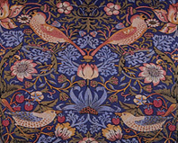
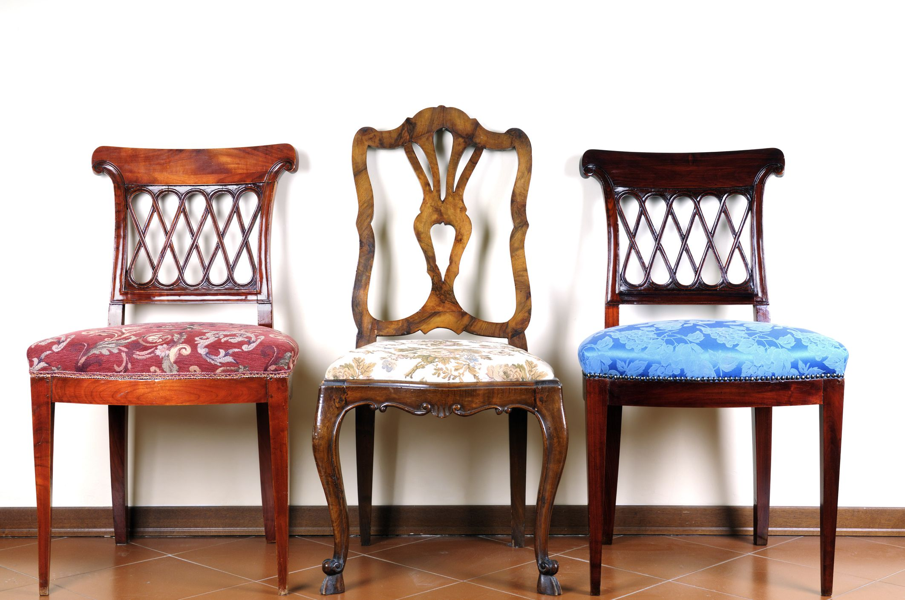
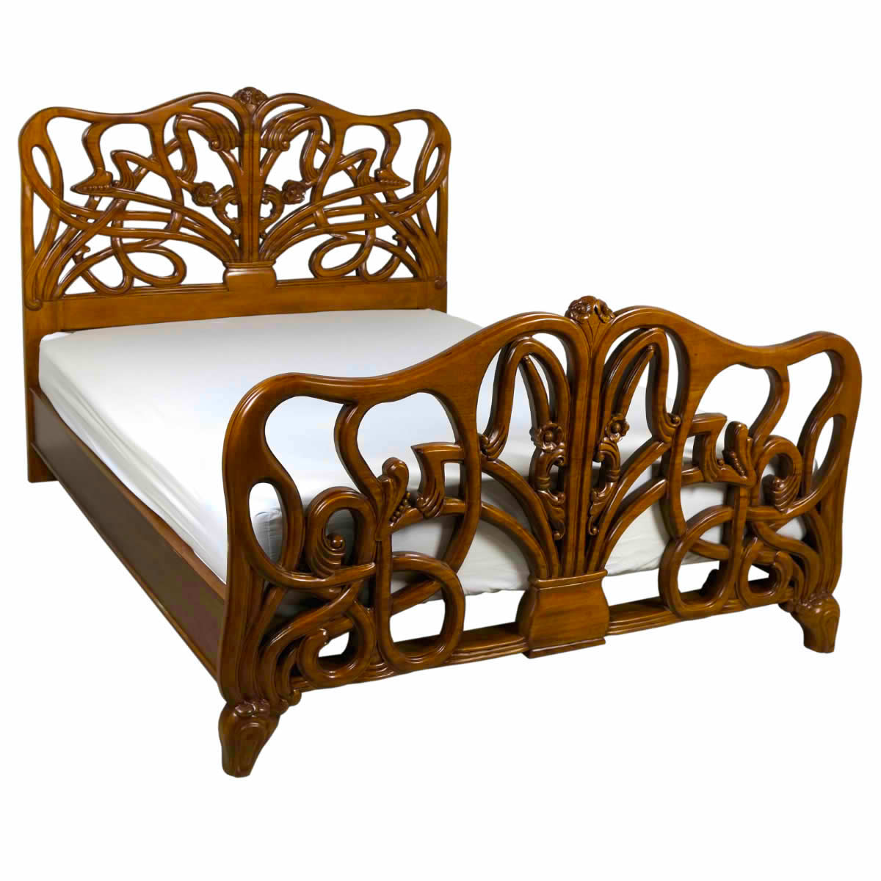
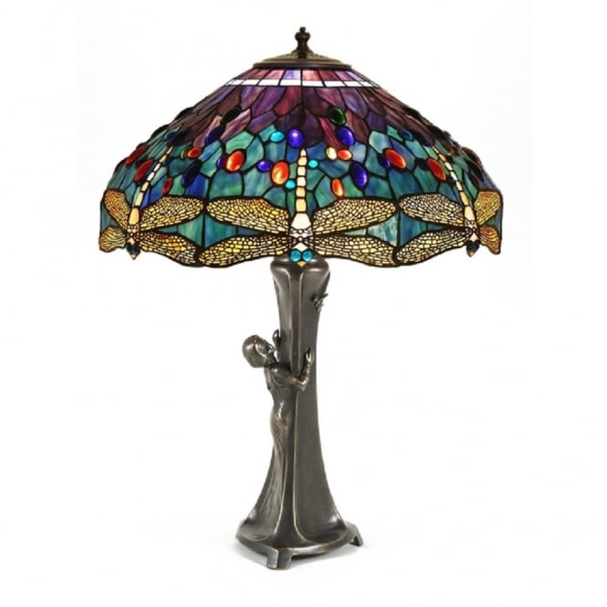
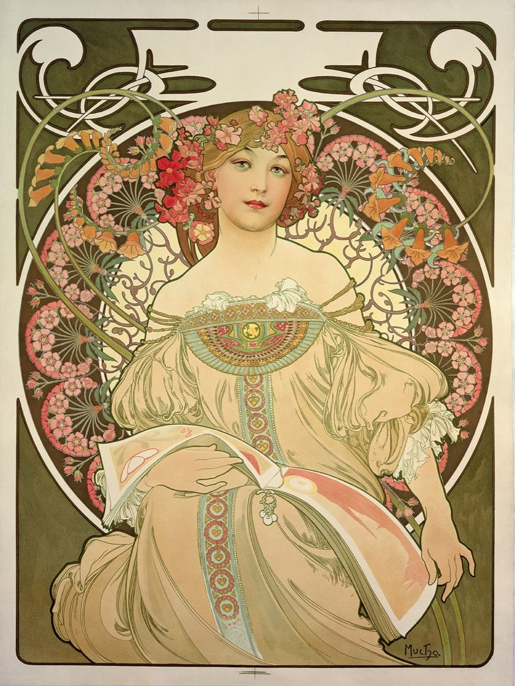
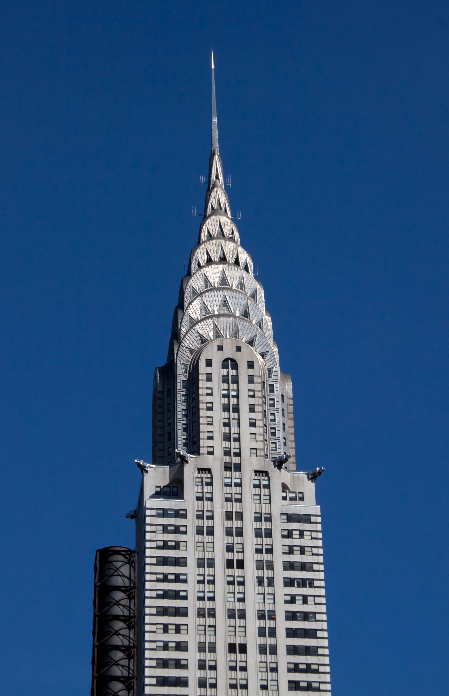
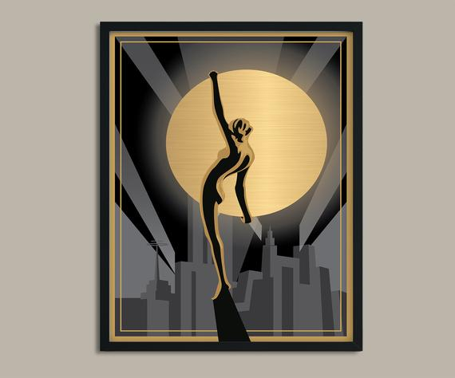
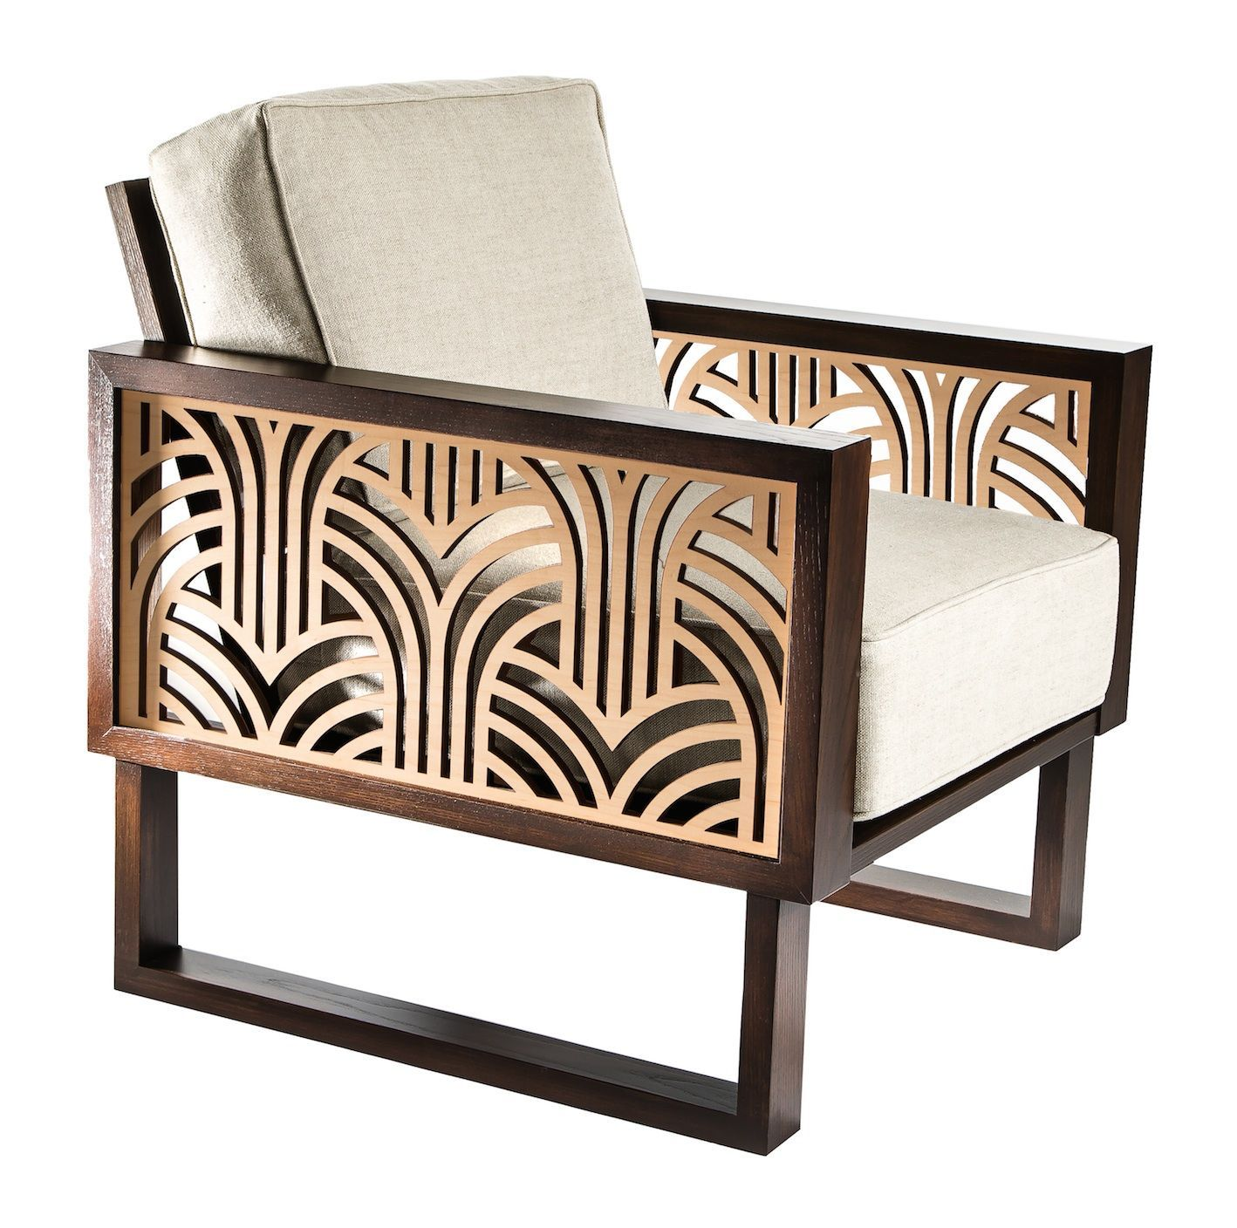
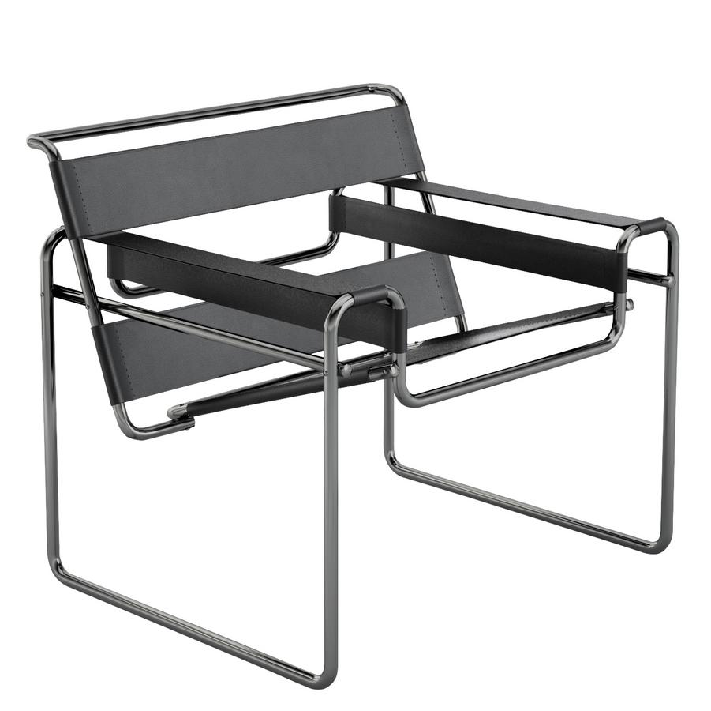
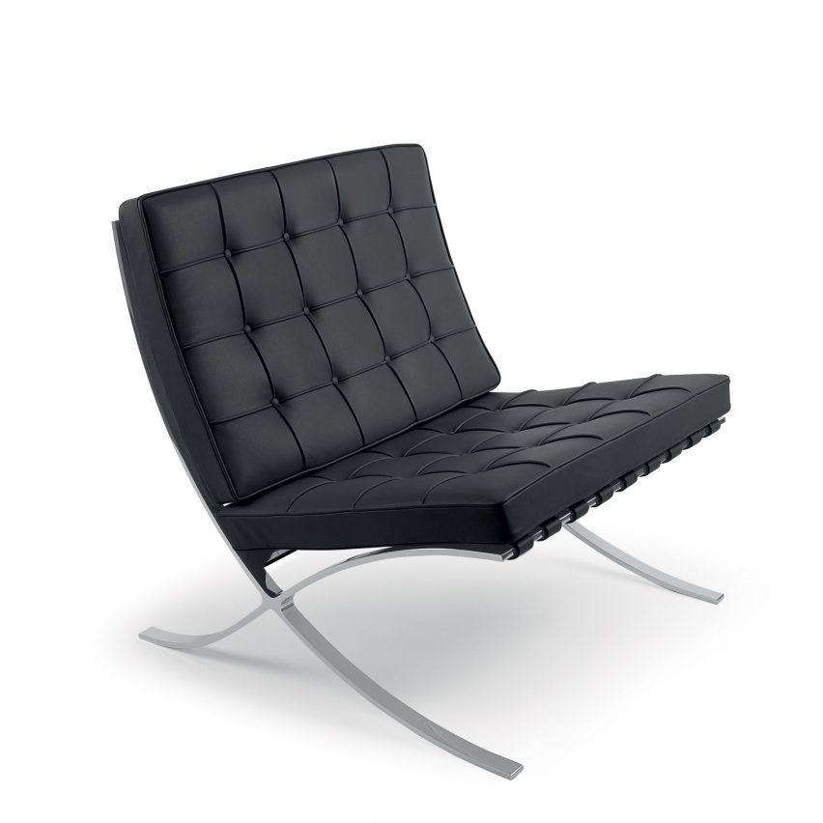
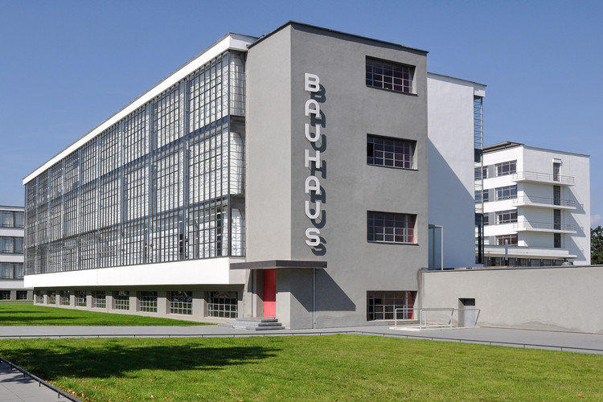
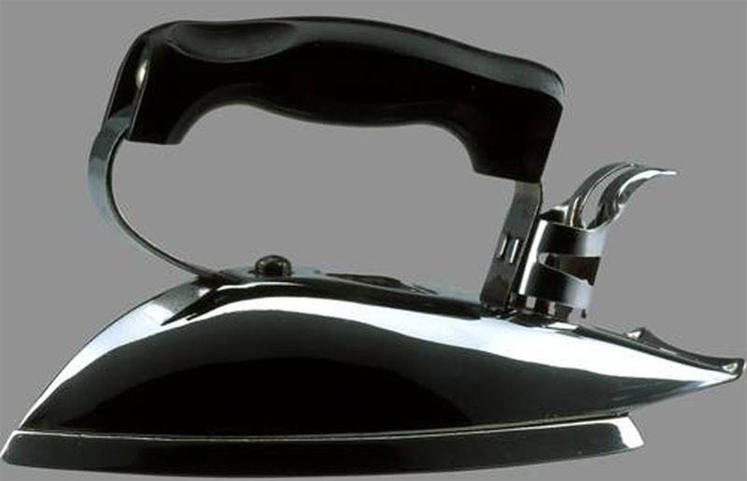
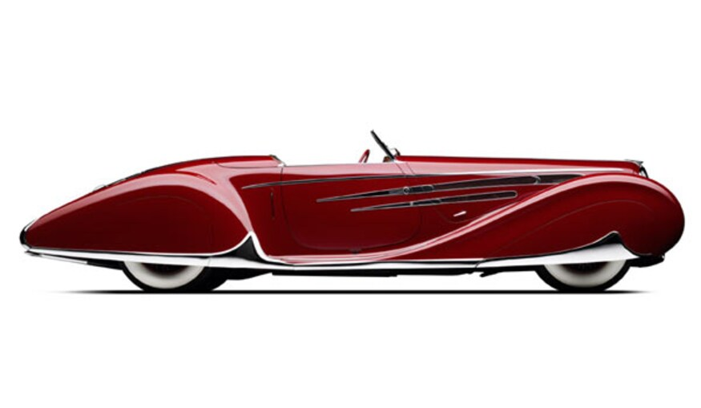
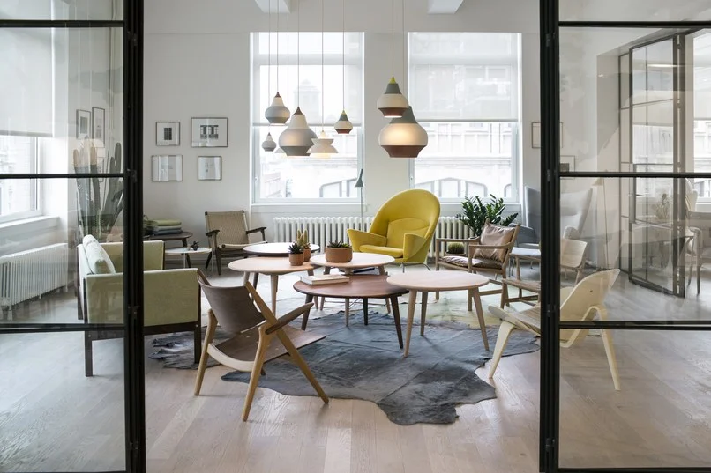
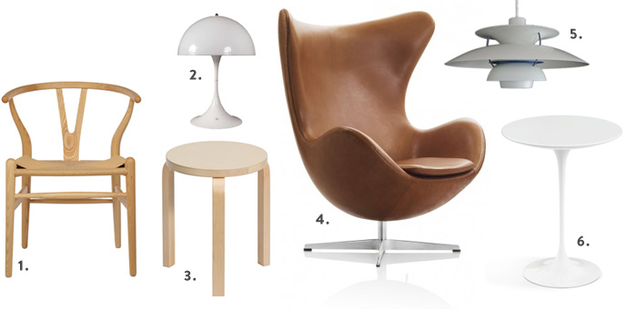
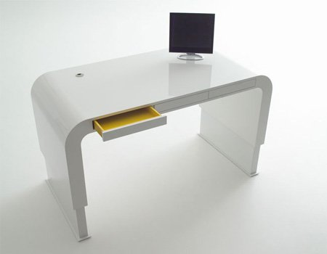
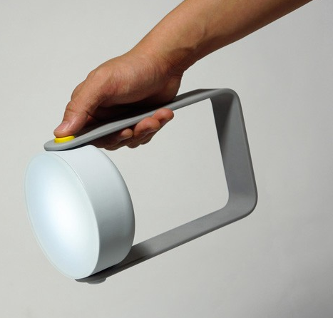
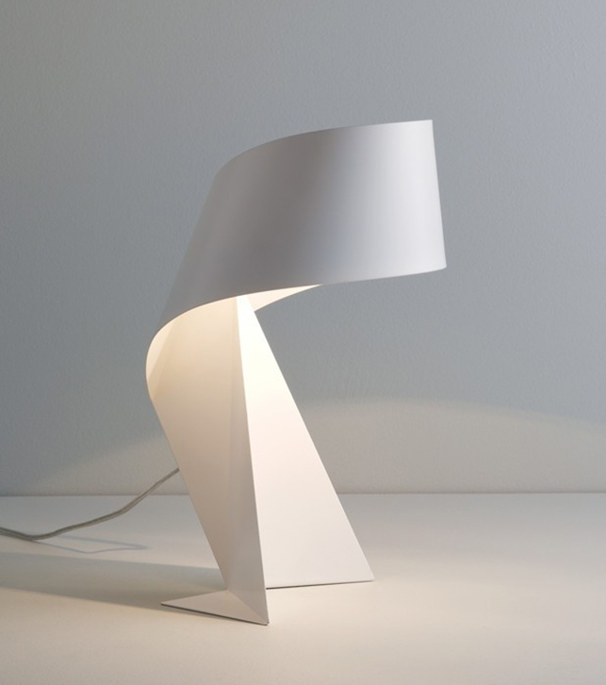
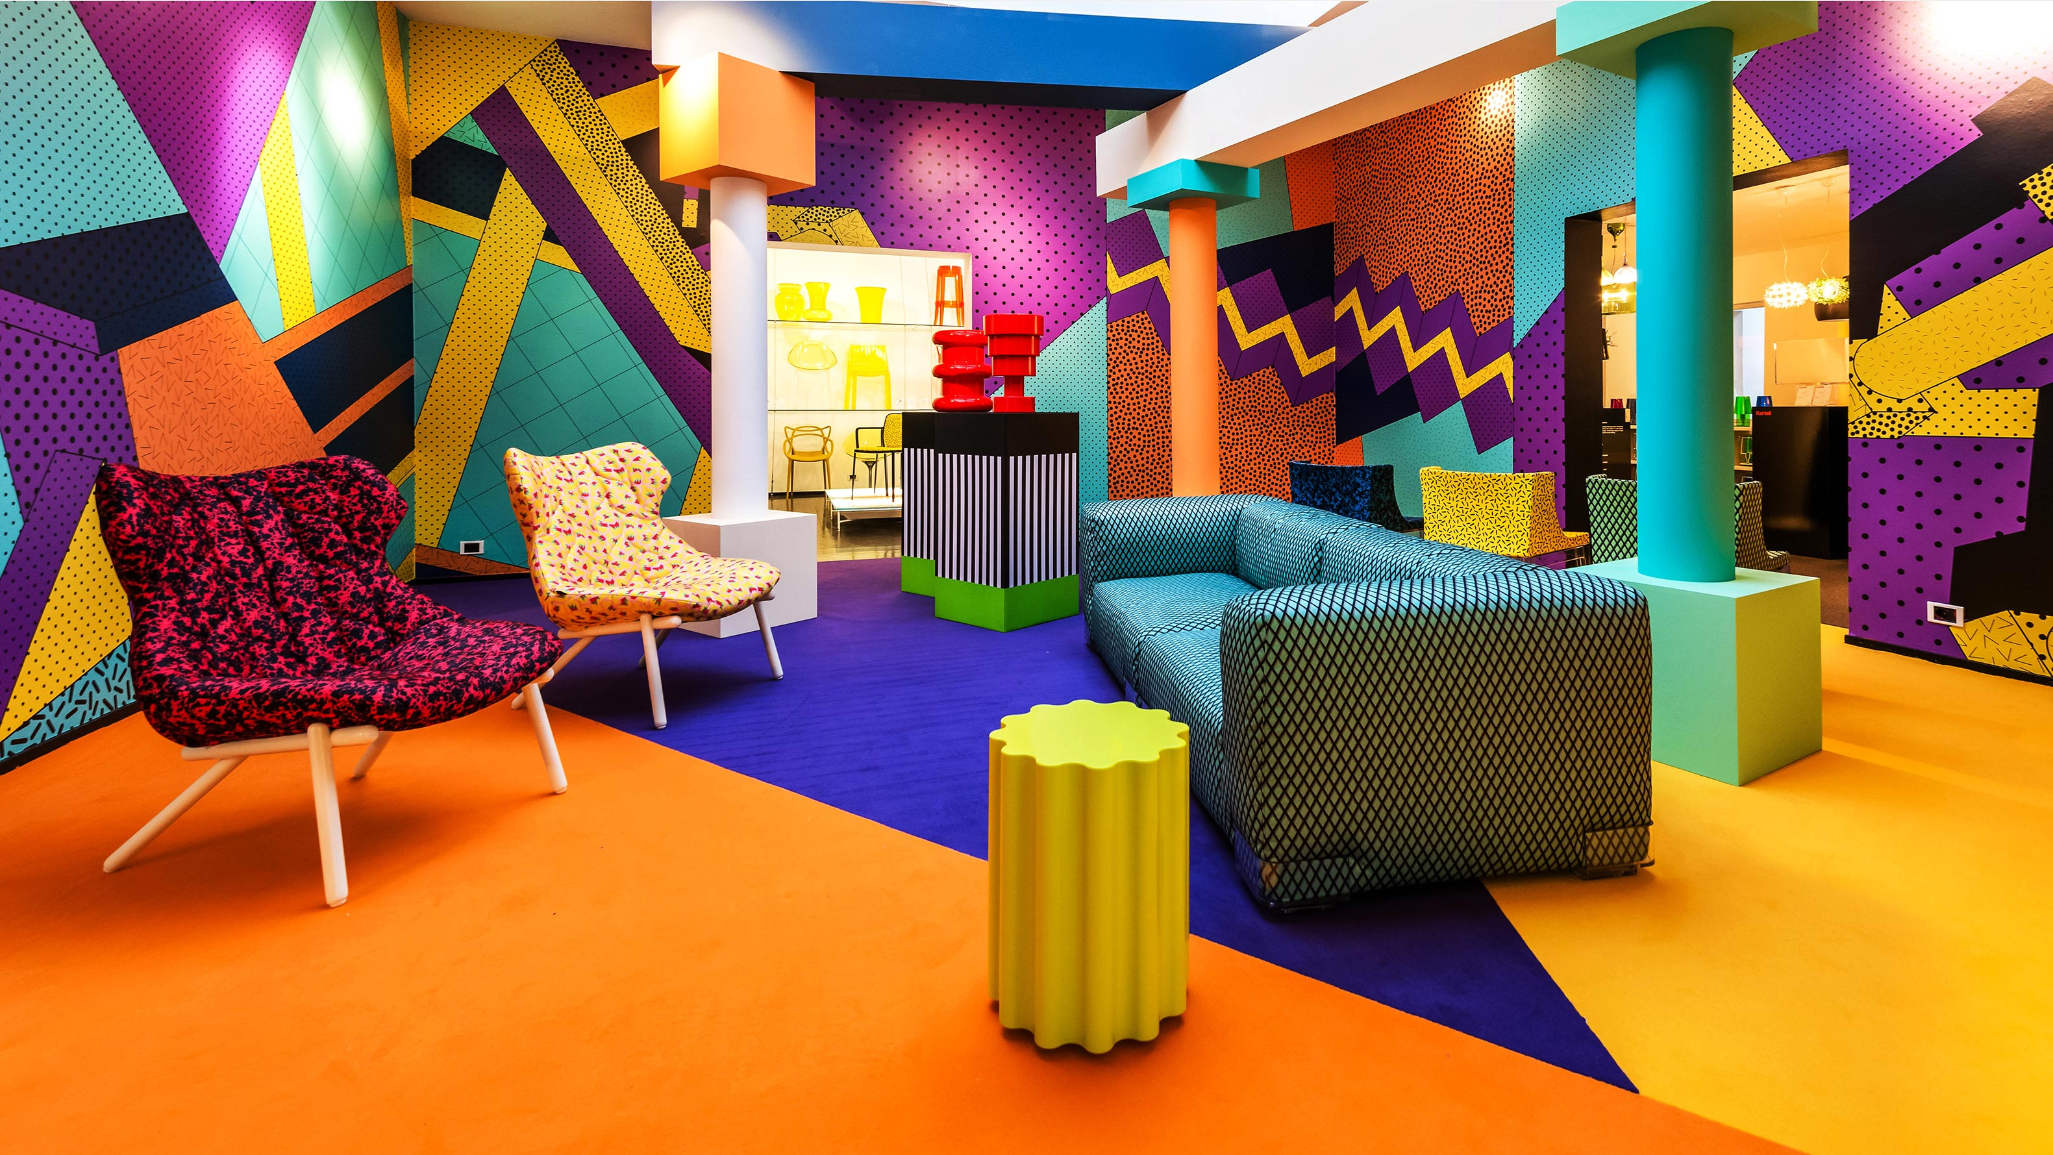
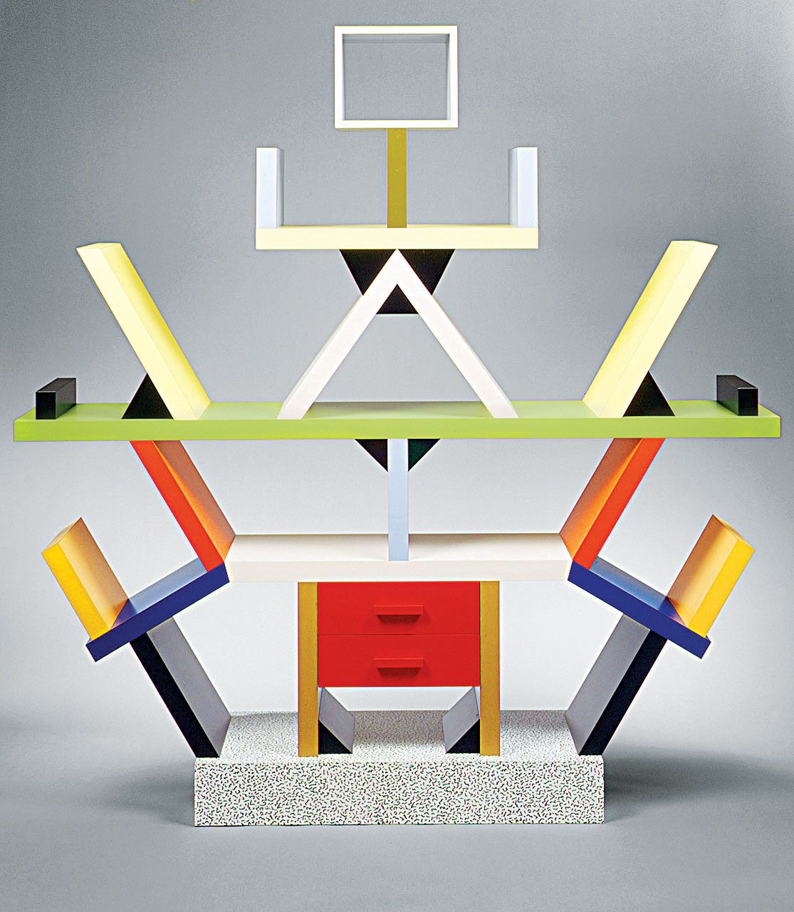
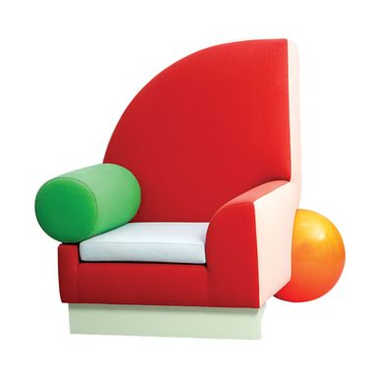
Design Movement | Images | Influences | Designers | Features
Arts and Crafts (1850-1900) |  | Traditional craft and hand skills rather than machinery | William Morris Charles Voysey Richard Norman Shaw | Traditional wood joints in furniture Use of natural forms Highly decorative – with birds and florals shown on textiles and wallpapers
Art Nouveau (1880-1910) |  | Linear patterns of Japanese prints French Post-impressionist art Arts and Crafts Movement | Alphonse Mucha Louis Comfort Tiffany Charles Rennie Macintosh | Floral and decorative patterns Elegant and graceful lines Use of traditional materials
Art Deco (1925-1939) |  | End of WW1, growth of mass production Range of international styles coming into the public eye | Claric Cliff Eileen Gray Rene Lalique Walkter Dorwin Teague | Stylised geometric shapes Bold colours often paired with black, chromes and metallic Sunburst motiffs
Bauhaus (1919-1933) |  | Post-WW1 idealism Arts and crafts movement WW1 industry methods and materials Art Deco’s geometric forms | Walter Gropius Marcel Breuer Marianne Brandt Mies Van Der Rohe | Form follows function principle Use of steels, chromes and leather Modernism style-design
Streamlining (1930-1950) |  | Post-WW2 lack of materials Vehicle innovations breaking speed records Rise of Bakelite | Raymond Loewy Norman Bel Geddes Henry Dreyfuss Walter Dorwin Teague | Long horizontal lines and curving forms Aesthetic influences from industrial and nautical design Sleek appearance Use of metals and plastics
Scandinavian Modern (1935-Present) |  | Dark Scandinavian winters leading to designers maximising light and cozy features Practical and functional designs | Finn Juhl Hans Wegner Arne Jacobsen | Clean lines Neutral colour palette Sleek and functional
Minimalism (1967-1978) |  | Japanese traditional design and architecture De Stijl art and design | Donald Judd Agnes Martin Dan Flavin Anne Truitt | Repetition of simple geometric forms Monochromatic/limited colour Hard-edged Little/minimal use of materials
Memphis (1981-1988) |  | Rebelling against functional modernism Art Deco Pop Art | Ettore Sottsass Michele De Lucchi Martine Bedine | Less is Bore principles Post-modernism design Bright, colourful and sculptural design Simple and Abstract forms Use of non-traditional materials

