Slide 1
Task 3
Paper 2 : Design & Making Principles .
What to include:
A timeline of the product or brand timeline
Images of product or brand developments
Explanations about what changes were made, why they were made and the sales of the brand or product.
On the next page you will see a slide which includes a diagram of a product life cycle and an explanation of how products are redeveloped. There is a further slide which gives an example of a product or brand life cycle diagrams which may inspire you.
As part of your paper 2 you will discuss how brands develop and market their products. As part of this, you will look at the Product Life Cycle, watch the following video to understand this concept: Video 3
Choose a brand or product which you have a personal interest in e.g. Under Armour, Pepsi, Air Jordans. You will research the product or brand life cycle for your choice.
You should complete the task on PowerPoint so that it can be enlarged to an A3 size in printing. This means that your text can be as small as a size 5.

Slide 2
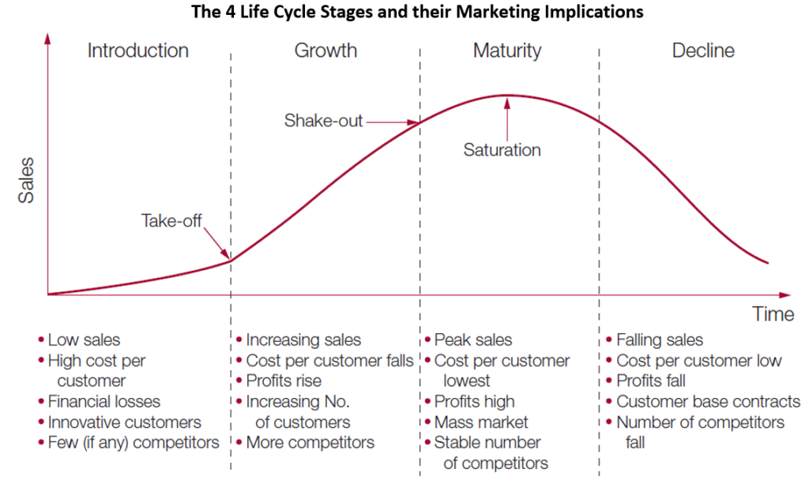
Redefining and Redeveloping Products
Companies will often employ extension strategies to maintain their sales. Examples include:
Demand/Customer Pull | This is where designers respond to demand from consumers for desirable product features. E.g. colour choice and battery life in smart phones
Technology Push | Research and development costs lead to the technology push if new ideas. However, these then need to be ‘sold’ to consumers. E.g. Google Glass failed to be sold to consumers due to cost and privacy concerns
Planned Obsolescence | This is where products are designed to fail and be replaced. This can be for company profit or lack of compatibility with software or lack of parts being manufactured.
Evolution of Products | This is generally caused by new technologies, manufacturing methods, materials, etc. Research and Development departments (R&D) explore and develop new ideas for companies.
Product Life Cycle (PLC) Chart
The Product Life Cycle Chart helps companies track and predict product sales. This is not to be confused with the life cycle assessment of products in regards to sustainability

Slide 3
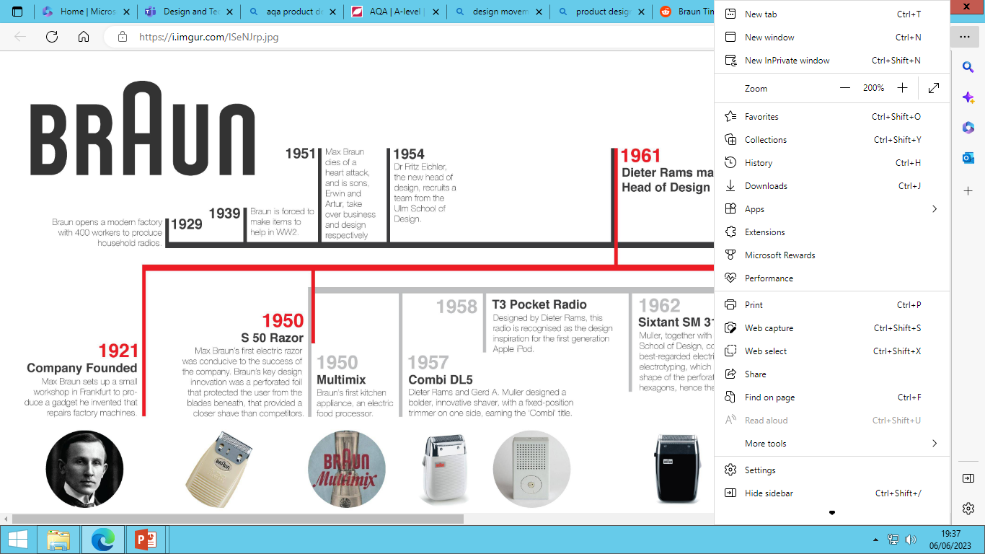
ISeNJrp.jpg (8192×2048) (imgur.com)

