Slide 1
Task 2
Paper 2 : Design & Making Principles .
What to include:
Overall page design which reflects the style of the designer.
Explanation of the design philosophy of the designer and the key features seen in the designers work e.g. Japanese travel inspired their work, use of simplified form and colour theory.
Key terms to describe the designers work.
Names and images of iconic products from this designer.
For each iconic product explain how its features, materials, manufacture etc reflect the style or design philosophy of the designer.
Names and product images of products designed by others designers which have been inspired by the iconic designer.
On the next page you will see a slide which includes the iconic designers you can choose from and some basic information about them to start your research. There is a further slide which gives an example of a designer page for Santiago Calatava which may inspire you.
As part of your paper 2 you need to be able to discuss the work of some iconic Product and Graphic Designers. Watch the video in the link to understand all the designers covered in the course: Video 2
You will choose 1 Designer from the next slide and create a digital revision / learning resources to be used by all A Level Product Design students.
You should complete the task on PowerPoint so that it can be enlarged to an A3 size in printing. This means that your text can be as small as a size 5.

Slide 2
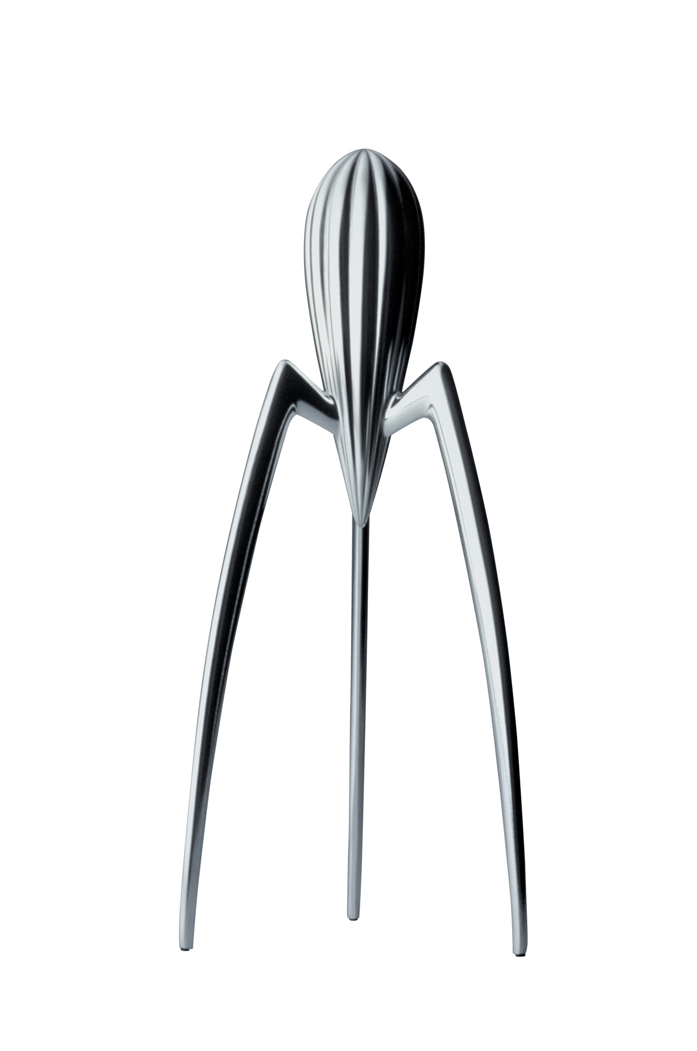
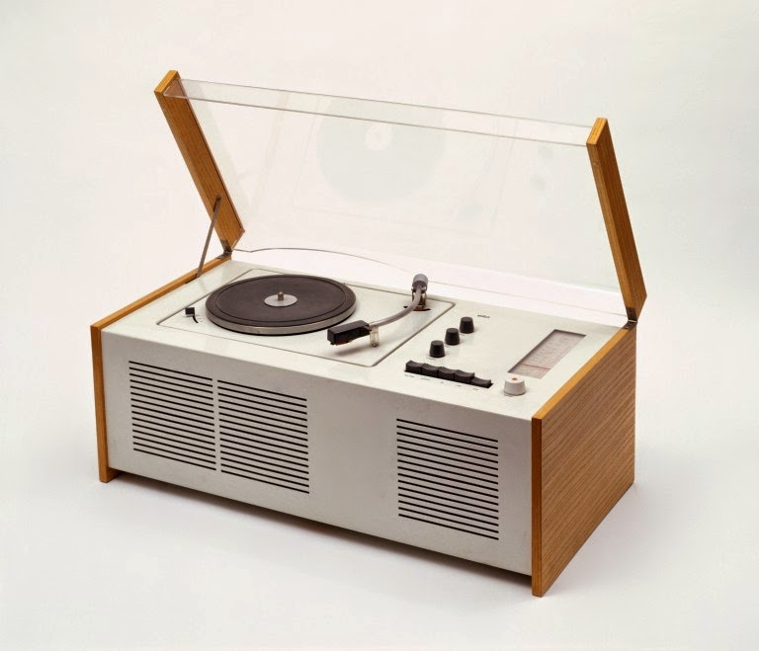
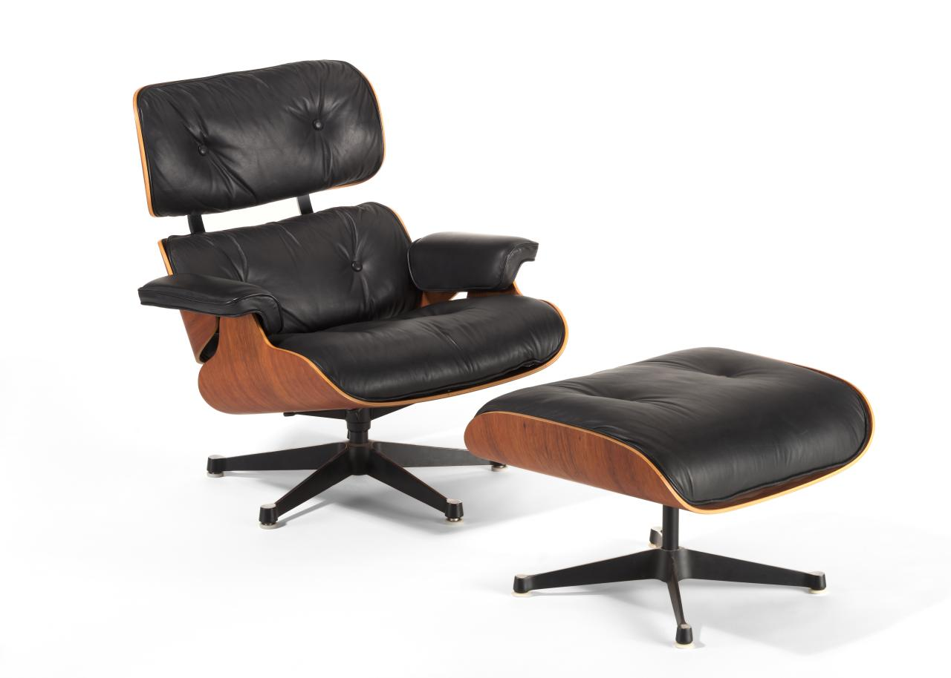
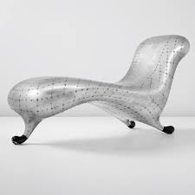
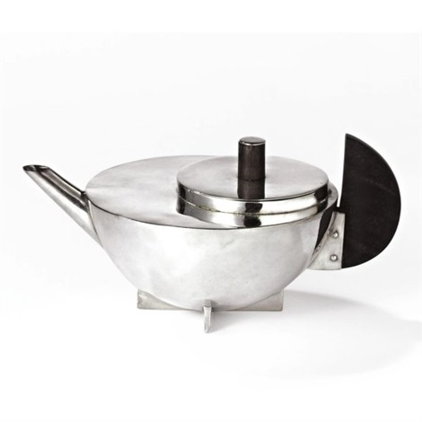
Phillipe Starck
Image | Juicy Salif Lemon Squeezer (1990)
 | Aluminium casting Inspired by Phillipe Starck eating squid Sculptural aesthetics Potentially unstable Pip collection isn’t perfect
James Dyson
Image | DC01 Vacuum Cleaner (1993)
 | Introduced “bag-less” dual-cyclone cleaning system Colour scheme aids use Injection moulded ABS Uses many integral fixings Clear bin shows dust
Margaret Calvert
Image | “Men at Work” Road Sign (1965)
 | Stylised pictogram Simple and clear communication Standardised sign systems Replaced old-fashioned signs that had ‘all caps’ text
Dieter Rams
Image | Braun SK4 Radio Record Player (1956)
 | Innovative incorporation of thermoplastics and electronics Highly functional No superfluous features
Charles and Ray Eames
Image | Lounge Chair 670 (1956)
 | Design aims for a “warm look” Combines industrial production with hand craftsmanship Moulded plywood shell with rosewood veneer Leather upholstery
Marc Newson
Image | Lockheed Lounge (1986)
 | Aircraft style rivet construction Styled on mercury “blob” Statement piece rather than functional Limited batch made Only needed to be “more comfortable than a bus stop”
Marianne Brandt
Image | Tea Infuser MT49 (1924)
 | Typical Bauhaus design Simple geometric form Offset lid is functional for preventing drips Ebony handle positioned for ease of pouring

Slide 3
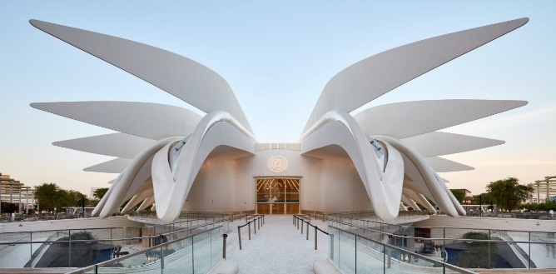
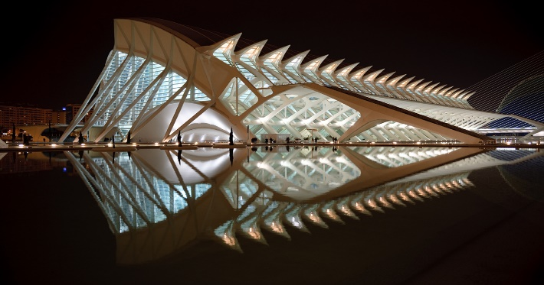
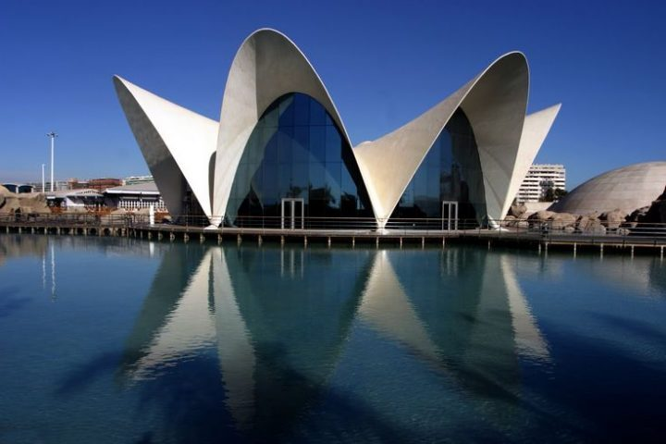
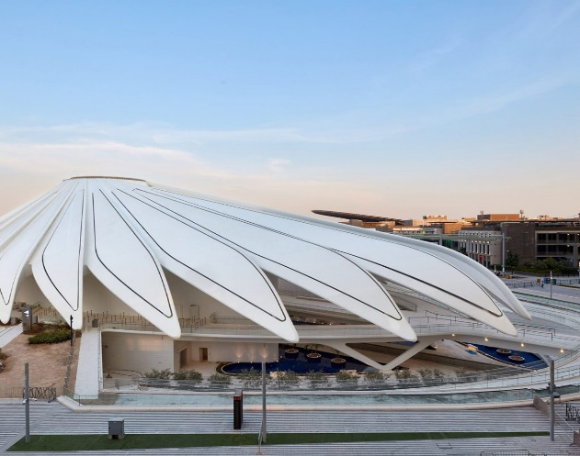
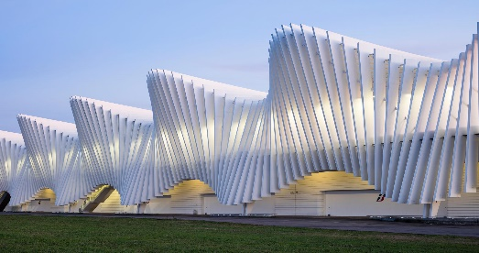
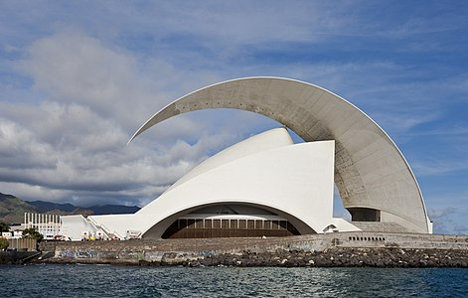
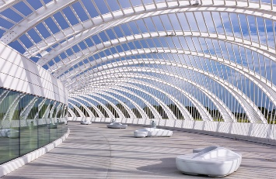
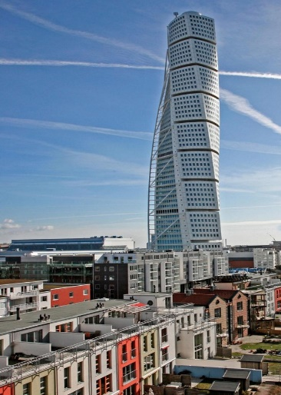
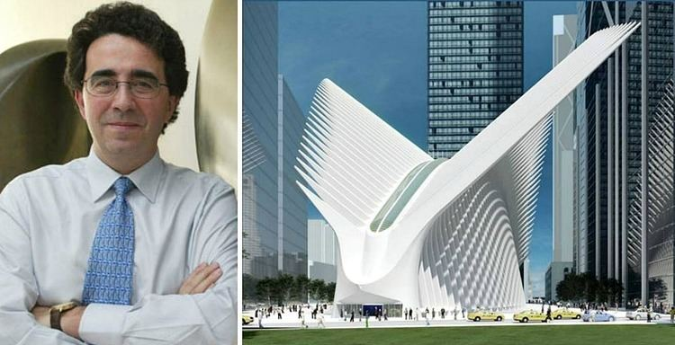
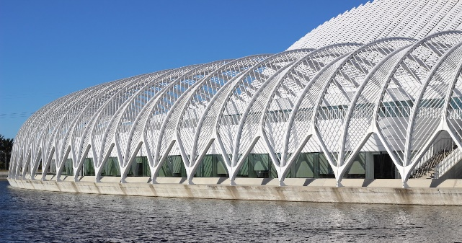
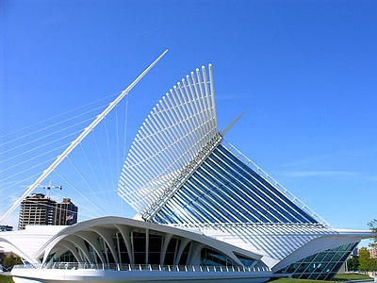
Santiago Calatrava
One of the most well-known and celebrated architects of our times is the Spanish architect Santiago Calatrava. Known for his innovative and dynamic architectural style, Calatrava has designed some of the most famous buildings in the world including the Olympic Sports Complex of Athens and the Turning Torso in Malmo, Sweden.
Calatrava started his career as a structural engineer, who gained fame for the unmistakable beauty of his designs. Even though he started practicing in 1981, he received international attention several years later in 1987 after he finished designing his first bridge in Barcelona. This was the beginning of a career filled with many spectacular bridges, amongst other structures. He has designed over 47 bridges so far, in cities all over the globe. These bridges, inspired by elements of nature, are a perfect blend of technological prowess and aesthetical beauty. This has been a recurring trend of Calatrava’s throughout his career. His refusal to compromise on his artistic vision ensures that he is increasingly bold and daring with how technology is incorporated in his designs.
Along with being a talented architect and structural engineer, Calatrava is also a sculptor and painter. While he has claimed to not follow any particular architectural style or movement, he has drawn inspiration from the works of engineers and sculptors. As an architect, Calatrava is fascinated by the concept of movement in buildings and sculptures. He has often tried to translate this idea of the flexibility of structures into many of his projects with varied success. The Turning Torso in Malmo is one of his most popular designs which originally started as a sculpture. His designs have proven that art in its many forms is an intrinsic component of architecture.
The human body has also been one of the major inspirations for Calatrava’s designs. From the Turning Torso to buildings like the L’Hemisferic and Museu de les Ciencies Principe Felipe in the City of Arts and Sciences in Valencia, Calatrava, like many artists and architects before him, Leonardo Da Vinci to name one, has been fascinated by the complexities of the human body. He is also inspired by numerous other natural elements like sea waves and bird wings. Several of his buildings and bridges open like a bird extending its wings, graceful and beautiful at the same Calatrava’s designs look towards the future, not just in terms of technology but also through the materials that the architect uses. Indeed, Santiago Calatrava has revolutionized the usage of concrete and steel in architecture. Calatrava also has a predilection of using the colour white. This stems from the fond memories of whitewashed Mediterranean buildings of his childhood. This usage of white colour lends a certain airiness and lightness to his structures, combined with his organic designs, the final buildings appear almost ethereal and other-worldly.

