Slide 1
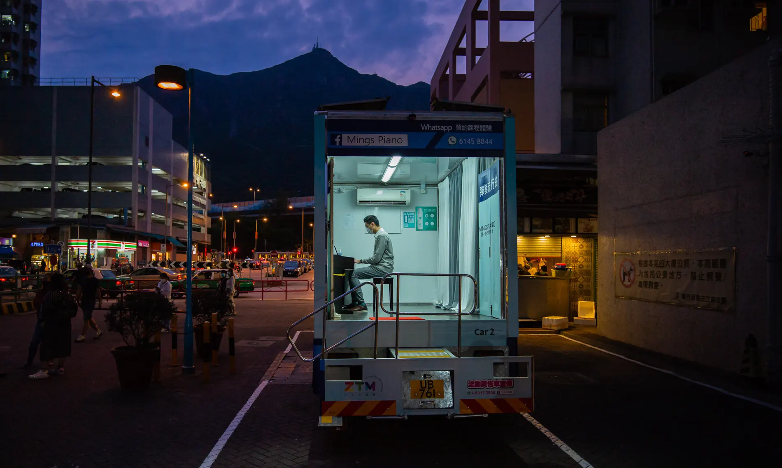
RECAP
Hong Kong, China
A man plays a piano inside a truck, hired by a music school. In attempt to keep their business running during the coronavirus pandemic, Ming’s Piano, a music school with 12 teachers and about 200 students, has hired three trucks to deliver lessons to students’ doorsteps
Photograph: Billy HC Kwok/Getty Images
What do you notice about the light in this composition?
What is the effect of this light on the subject?
What interest you the most in the frame?

Slide 2
RECAP
Hong Kong, China
A man plays a piano inside a truck, hired by a music school. In attempt to keep their business running during the coronavirus pandemic, Ming’s Piano, a music school with 12 teachers and about 200 students, has hired three trucks to deliver lessons to students’ doorsteps
Photograph: Billy HC Kwok/Getty Images
Artificial Light illuminates the main focus of the image i.e. the music teacher
The piano teacher looks isolated aware from the other life going on in the street.
The other artificial lights in the frame highlight other areas of the composition

Slide 3
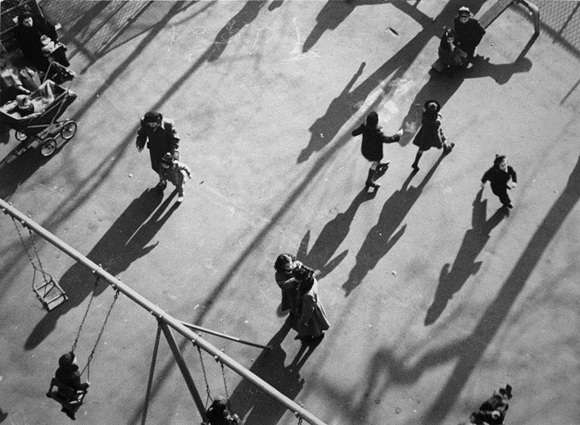
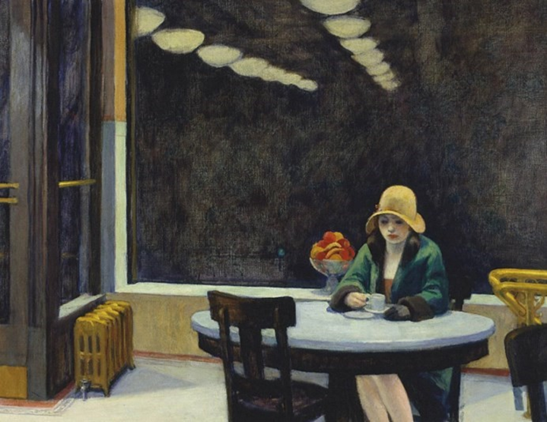
Week 3 PHOTOGRAPHY Outline
This week you will be collecting ideas for a FINAL SET OF PHOTOGRAPHS FOR Structures. This theme will continue when you return to school. You will consider alternative ideas for arranging your photographs. You will refer back to earlier experiments to plan your final images. You will visually analyse the work of photographers and use appropriate language to discuss their work. .

Slide 4
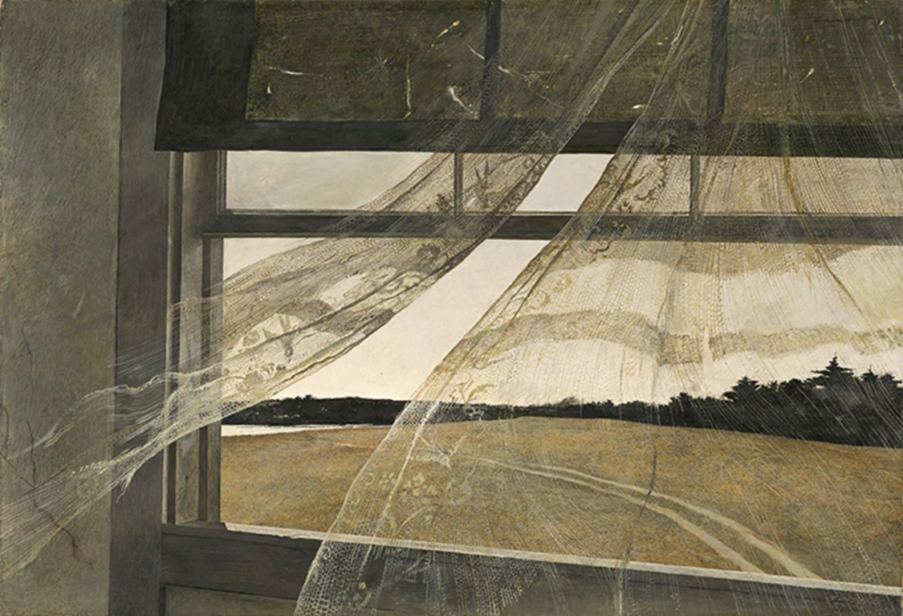

Task 1:
1/ Choose two of the photographers or fine artists from the following slides. You will be photographing using their style or technique.
2/ Using the Talking about Photographs slide and the keywords write about your chosen artists/photographers. This could be handwritten or typed up with images of their work.
You can use a photographer or artist for this! A Level Photographers are often taking inspiration from paintings and drawings for their photographs.

Slide 5
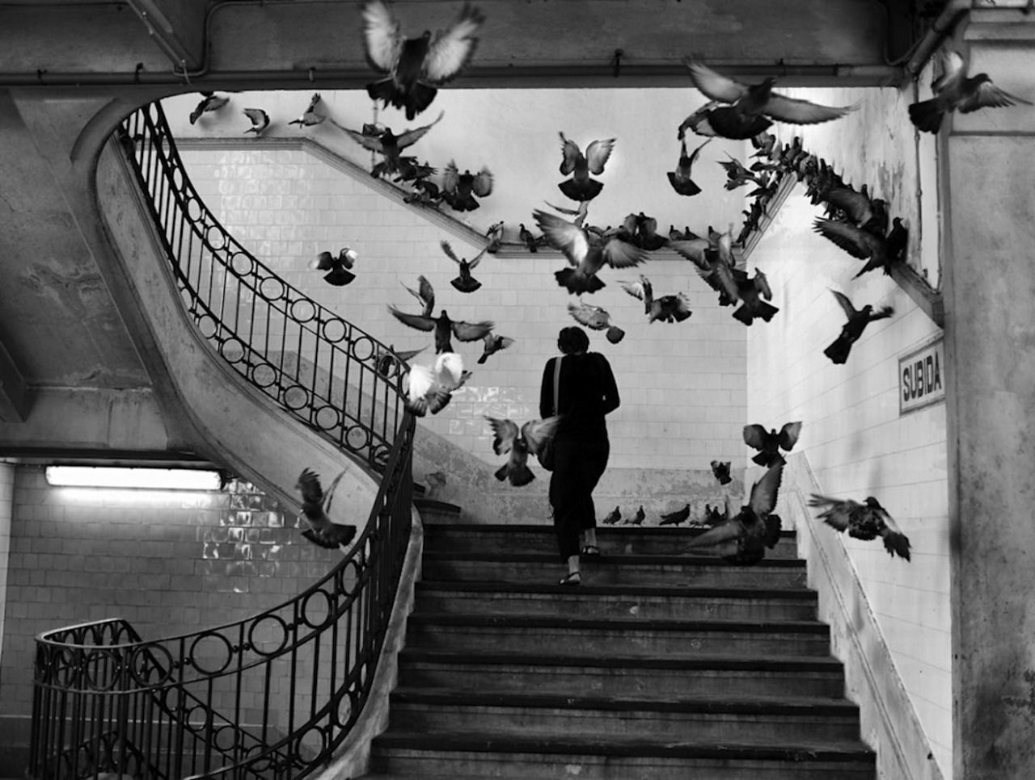
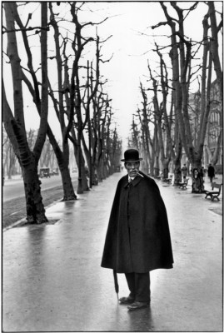
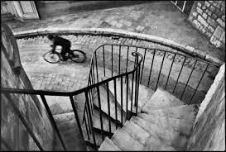
Henri Cartier-Bresson
"To take a photograph is to align the head, the eye and the heart. It's a way of life"
- Henri Cartier-Bresson

Slide 6
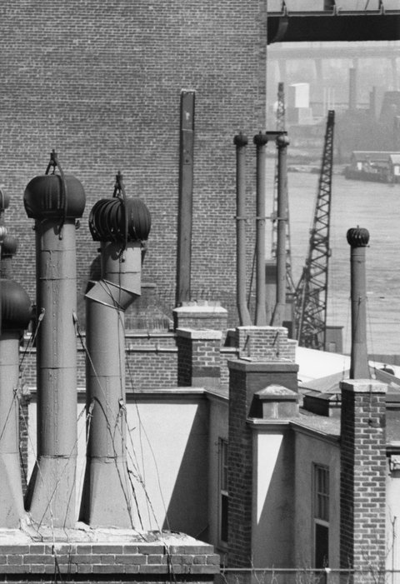

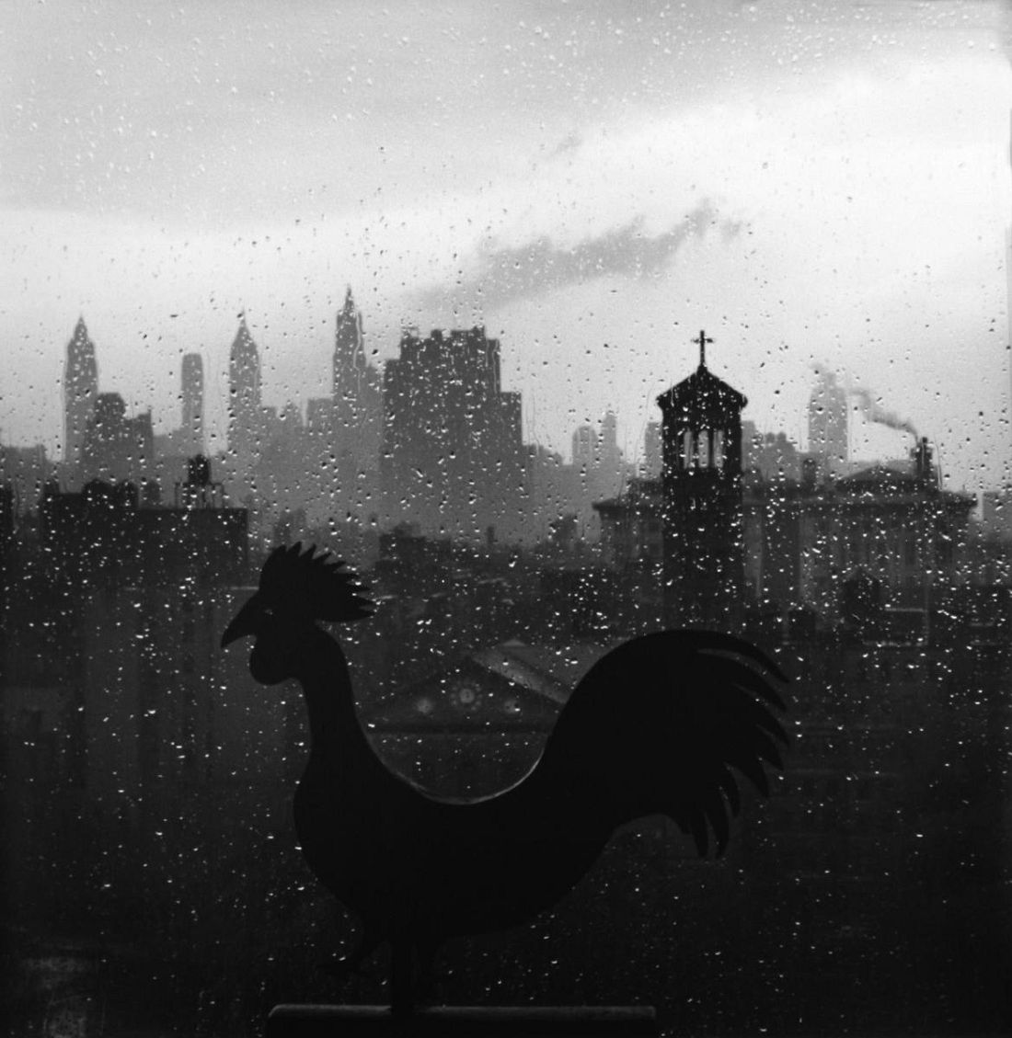
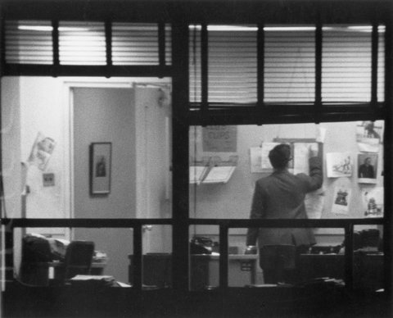
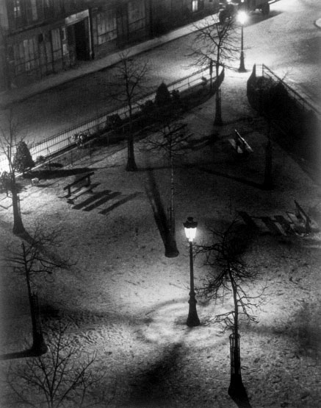
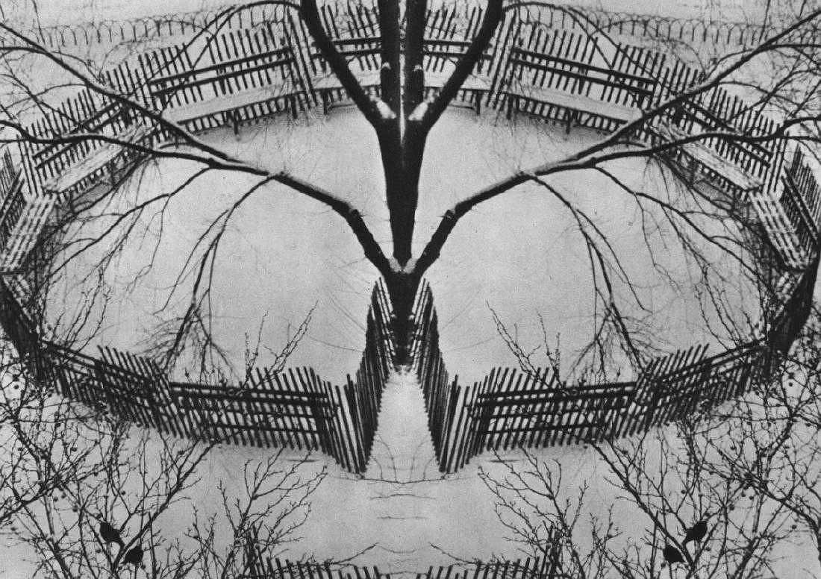
MASTERS OF PHOTOGRAPHY
Andre Kertesz BBC Master Photographers (1983)
Capturing the world around him, often photographing subjects from his window or front door.
The camera was a sketchbook to him. Shooting with the camera and making mistakes. Learning from each mistake.
André Kertész: Window Views

Slide 7
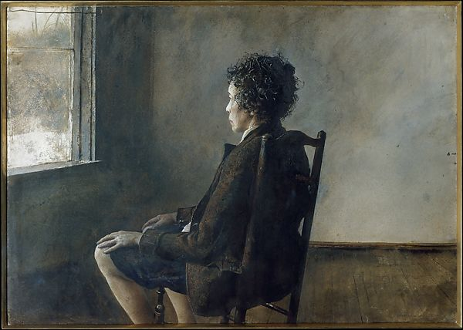
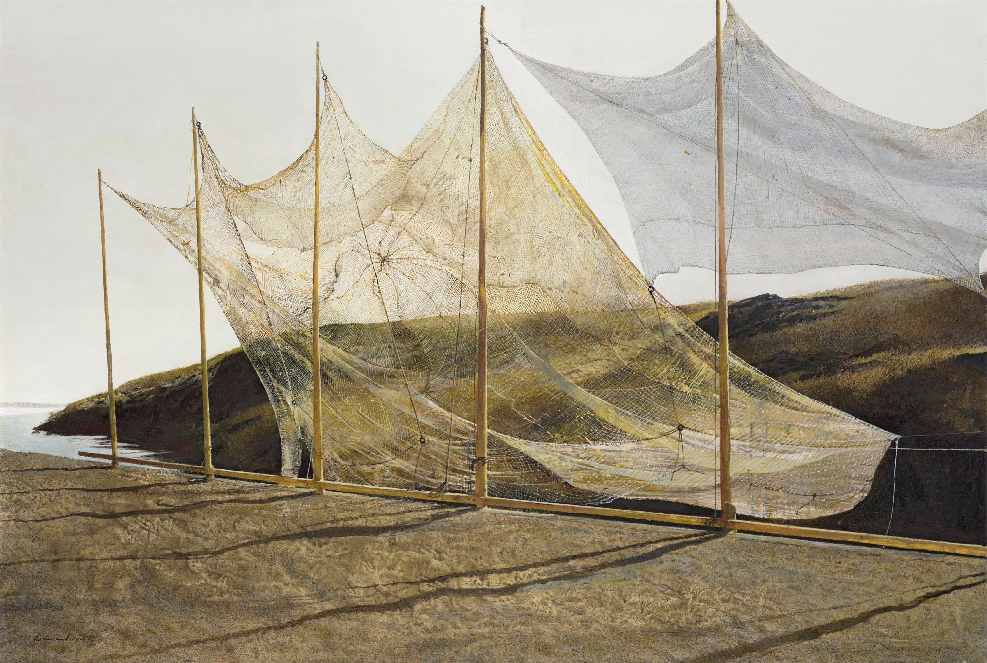
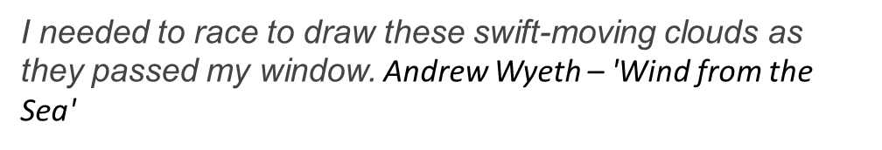
Andrew Wyeth

Slide 8

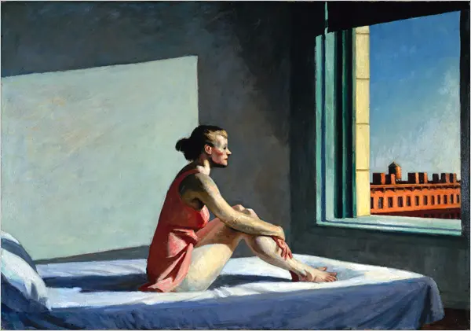
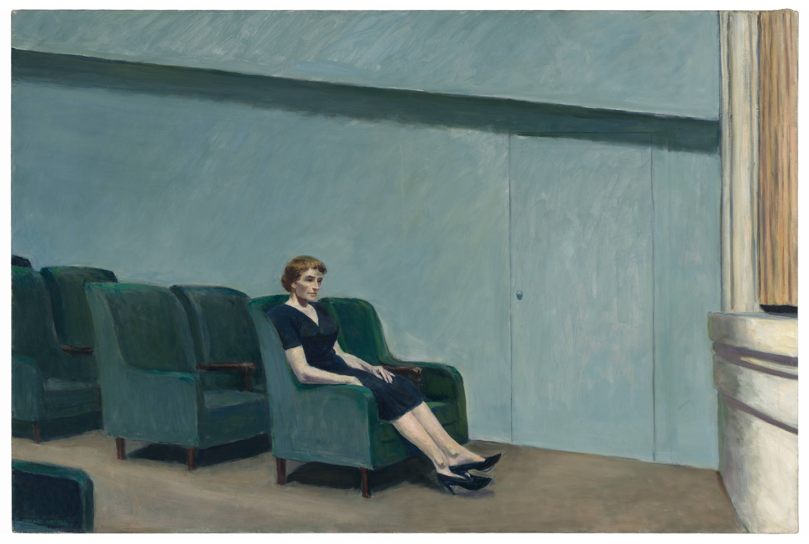
Edward Hopper
Notice the single figure
The use of light (natural & artificial light)
The window & glass

Slide 9
Talking about photography
Visual/Form Analysis
What grabs your attention first within the frame?
How is your eye led around the frame?
How is the image composed? (light source, backdrop; shape, perspective etc)
Is the photographer's position important? (above, below the subject?)
Content/Description of photograph
Does the photograph have a title? Does it affect the way you feel about the image?
What is the photograph? (portrait, landscape etc)
What is it about? What is happening in the frame? (Describe it)
Describe the techniques used in the photograph (lighting; contrast; colour; pose; depth; composition)
Is there a running theme within the work?
Personal Opinion
What was your first reaction?
What is the mood of the photograph?
Is there a message within the photograph or series of photographs?
What interests you about the photograph? (use key terms to help you explain your answer)
How does the image make you feel?
Why do you feel like this?
Does the colour; theme; texture; or technique affect the mood?
Process
How has the photographer set up the composition?
Has the image been enhanced/manipulated by editing or dark room work?
What techniques has the photographer explored? (depth of field; shutter speeds; exposure; lighting; filters etc)
Photographer's Name Add background information about the photographer.

Slide 10
Analysing my own photography
Content/Description of photograph
Does the photograph have a title?
What is the photograph? (portrait, landscape etc)
What is it about? What is happening in the frame? (Describe it)
Describe the techniques you have used. (lighting; contrast; colour; pose; depth; composition; speed; exposure)
Are you trying to create a theme within the work?
Are you trying to communicate a message or a feeling within your photos?
Visual/Form Analysis
What grabs your attention first within the frame?
How is do you want the view to be led around your image?
How is the image composed? (light source, backdrop; shape, prespective etc)
Where did you take the photograph from? (above, below the subject?)
Personal Opinion
What was your first reaction to your shoot?
What mood have you created and how have you done this?
Are you trying to make a statement /give a message through the photograoh?
What has been successful about the photograph?
Is there anything you would develop further or tweak in your next shoot?
Process
How did you prepare for the photoshoot? (set up of the shoot; costume; props; location; time; camera setting)
Has the image been enhanced/manipulated by editing or dark room work? (Show your edits)
What techniques have you explored? (depth of field; shutter speeds; exposure; lighting; filters etc)

Slide 11
KEYWORDS
Add your own keywords here:
Shape
Texture
Surface
Tone
Pattern
Repetition
Colour
Space
Focal point
Background
Composition
Setting/environment
Framing
Macro
Zoom
Editing
Tripod
Digital Negative
Photogram
Contour
Landscape
Portrait
Abstract
Expressive
Content (the subject)
Focus
Automatic
Manual
Shutter speed
Aperture (measured in f stops)
Depth of field (focus/focal point)
Artificial light (lamps)
Natural light
Highlights
Shadows
Contrast
Double Exposure
Angle
Viewpoint
Macro Photography ( extreme close up )

Slide 12
TASK 2
Consider:
Location: Where will you take your selection of image? Do you need a particular backdrop?
Lighting: What light source will you use and where will it be in relation to your subject t? e.g. natural, lamps, street light, phone light.
Composition: Where will you place your main subject? What do you want the viewer to notice first?
Viewpoint: Where will be when taking the photographs? Try taking the same view from different heights.
Task Take a set of photographs in the style of your chosen photographers/artists. You could combine ideas or have a separate shoot for each photographer.
Aim 10- 15 Photographs (This will include photographs of the same subject, but making changes to the angles, lighting, pose etc. )
REMEMBER!
YOU ARE NOT MAKING COPIES OF THEIR WORK YOU ARE USING THEM AS INSPIRATION.
TAKE YOUR TIME ☺

Slide 13

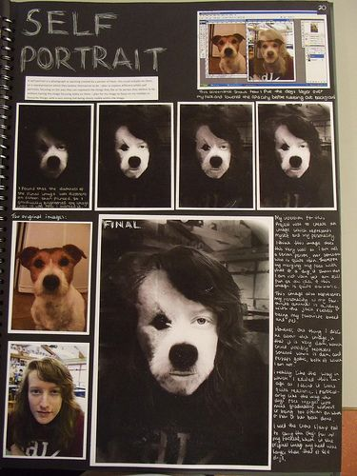
TASK 3 EDITING & PRESENTING YOUR PHOTOSHOOTS.
UPLOAD YOUR PHOTOGRAPHS TO THE COMPUTER.
b/ You can use free software PIXLR https://pixlr.com/e/ to edit your images. Some photographs don’t need to be edited And are better left alone. ONLY EDIT YOUR IMAGES IF YOU THINK THEY NEED IT. E.G Changing the contrast, cropping, colour saturation.
There are lots of help videos available on YOU TUBE.
https://www.youtube.com/watch?v=Gu5ly-pN034 (CHANGING YOUR COLOUR IMAGE TO BACK & WHITE)
Save images as JPEG file and then organise them into a photography folder.
C) You can then present your originals and edits on powerpoint slides or you can print them off at home and arrange them in a sketchbook.
THINK ABOUT THE LAYOUT & ADDING TITLES TO YOUR WORK.
EXPLAIN ANY EDITS YOU’VE MADE.

Slide 14
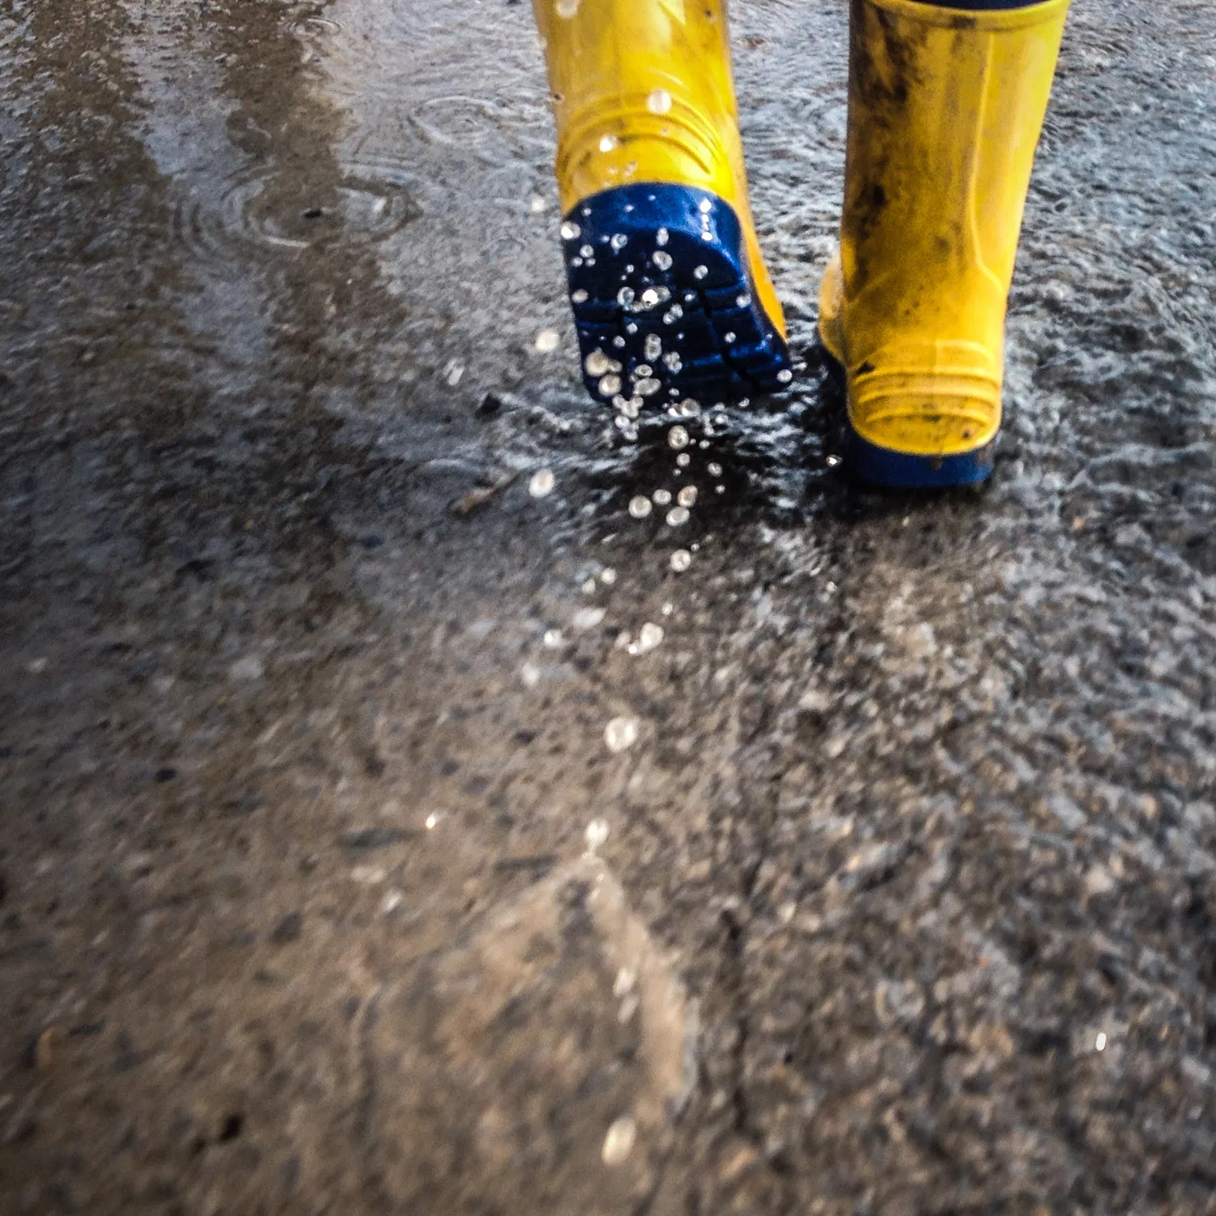
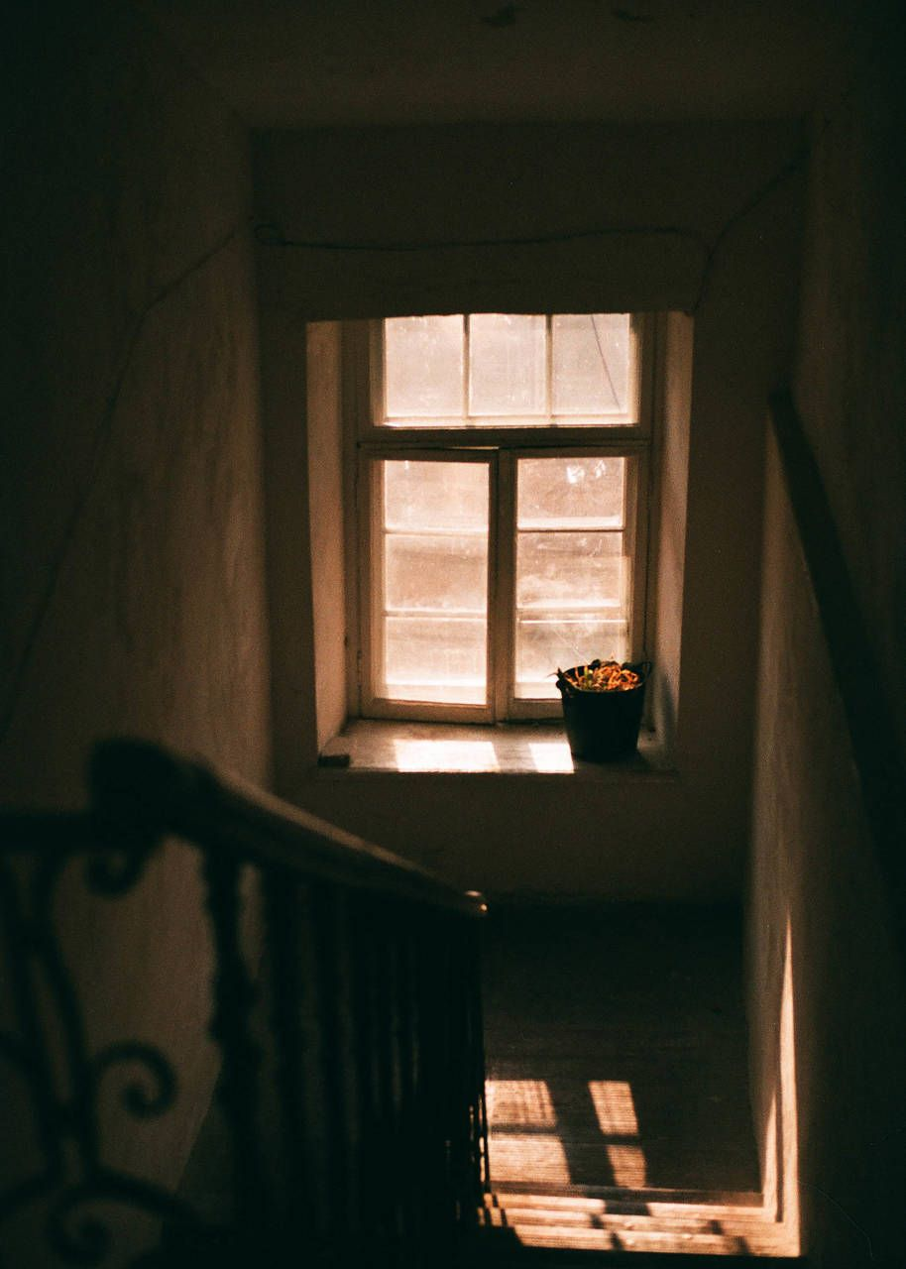
KEEP SNAPPING
Over the summer, get out with your camera/phone and take interesting photographs. This will really help you build up your skills and develop your eye for a great composition! ☺ Enjoy.
IDEAS OF THINGS TO PHOTOGRAPH:
PORTRAITS
PEOPLE
OBJECTS
MOVEMENT
LANDSCAPES
ANIMALS
HAVE FUN WITH WEIRD ANGLES AND USUSUAL LIGHTING.

Slide 15
EXTRA ARTICLES
https://mymodernmet.com/all-about-photo-awards-2020/?fbclid=IwAR3Eyck25SD2IQRHassg2PK8s1jW76KaANq19P6GRvjDM-La25PfxMvpTjw PHOTOGRAPH AWARDS

