Slide 1

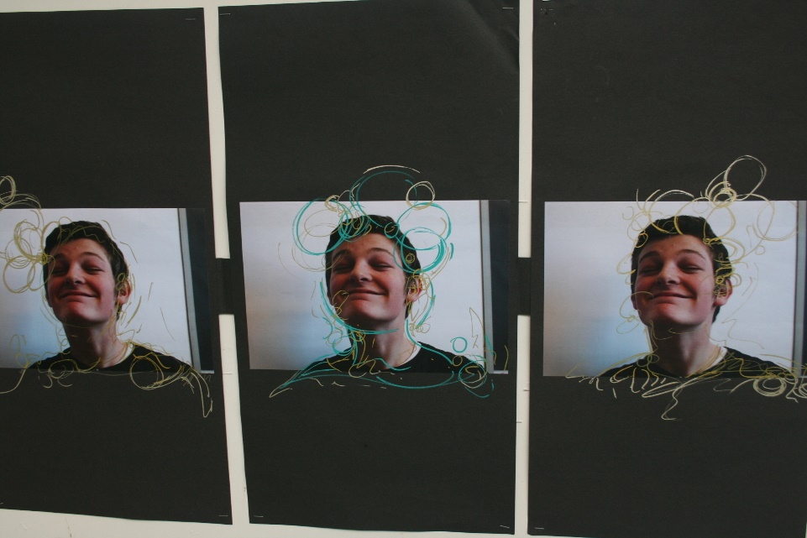
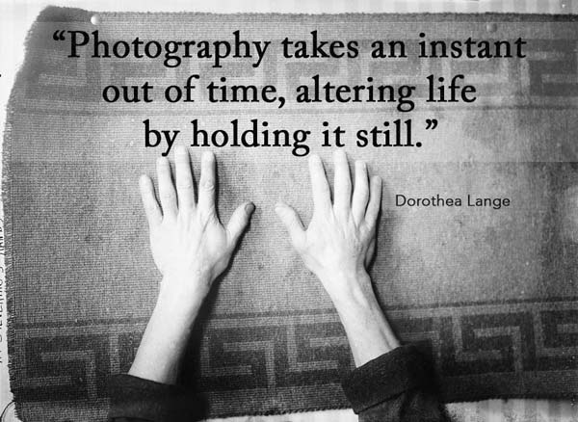
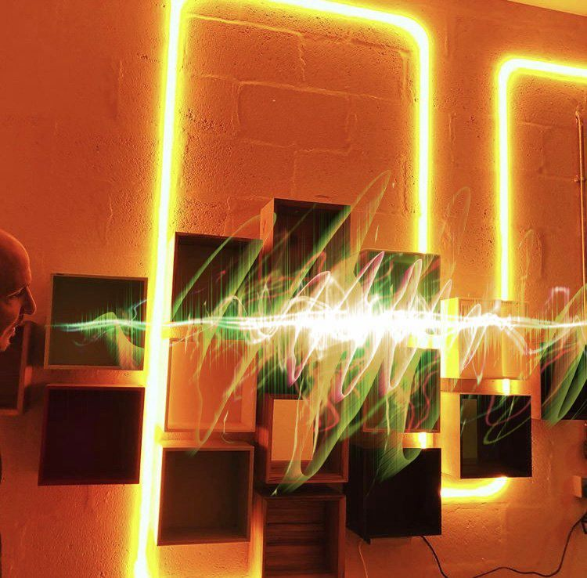
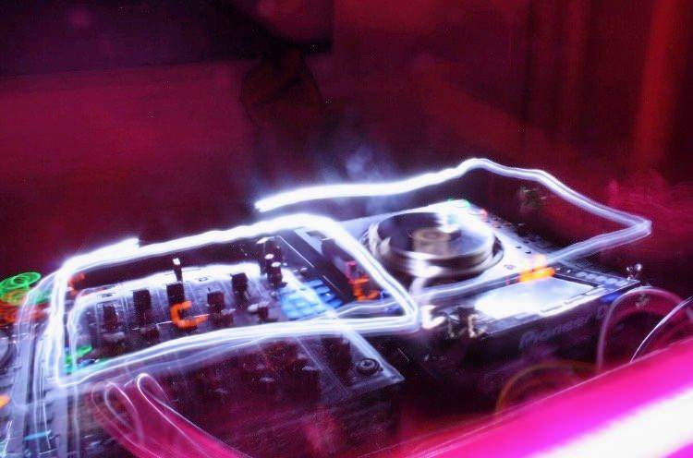
A Level Photography Bridging Project Week 1

Slide 2
Entry Requirements for Studying A-level Photography
Students who are keen to study photography and enjoy going out to different locations on photoshoots.
Students who are committed to taking weekly photoshoots and enjoy going to galleries and learning about artworks.
Students who enjoy working with new materials and developing different techniques.
Students who relish the opportunity to work in new ways and take risks within their photography work.
Students who enjoy working to a broad theme and gathering research through visual and written form.
It is vital that Photography students come prepared with their photographs from location shoots to make the most of their lesson time.
What to expect from A-level Fine Art.
The A-level Photography course allows students to develop their own chosen themes, encouraging them to really stamp their personality on their projects from day one. You will be asked to research your theme and chosen photographer in greater depth and push your ideas to more ambitious scales than you have been used to. We begin Year 12 with a short introductory project to introduce you to digital photography techniques and darkroom processes. You will regularly share your photographs and progress with your peers and teachers in group critiques, which allow you to organise your ideas and gather ideas from others. We also offer visits from artists and opportunities to work with local universities through skills workshops led by university lecturers. The broadness of the course and themes allow you to use your photography as a powerful tool to communicate messages to an audience, as escapism, documentation or immersing yourself in the pure aesthetics. Our sixth form students benefit and value the extra space we offer them to work on weekly tasks outside of lesson time. Our Photographers benefit from new Photoshop software and access to DSLR cameras for their shoots outside of school.
Component 1 Coursework Portfolio worth 60% | Component 2 Externally Set Exam – worth 40%
This is a personal investigation chosen by you. It will comprise of sketchbooks, boards and final sets of photographs. This portfolio of photography work should be an exciting and in depth investigation. A written essay between 1,000-3,000 words is required to support your personal investigation theme. Lessons will be dedicated to coursework until the exam papers are given out. | The theme for exam project is set by the AQA exam board around 1st Feb. There are 8 starting points to choose from. You have approx. 10 weeks to produce a sketchbook/boards to respond to your chosen theme. During the exam lasting 15 hours, across 3 days in the art room you will create your final pieces. Sketchbooks/boards/research for the exam MUST be present in the exam room and should be referred to during the exam.

Slide 3



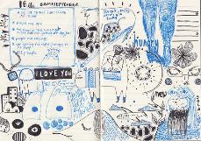

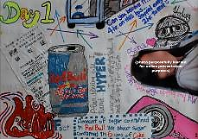
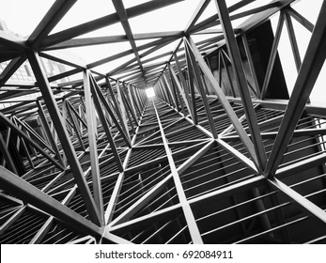
Theme: Structures
Your Photography transition work is based around Structures. This will allow you to go outside and practise your photography skills while you are on the go. You can complete this work in any time of sketchbook/notepad/jotter/powerpoint slides.
The most important part of your Photography Transition work is to make sure you are getting out and taking some exciting photographs ahead of Year 12.

Slide 4
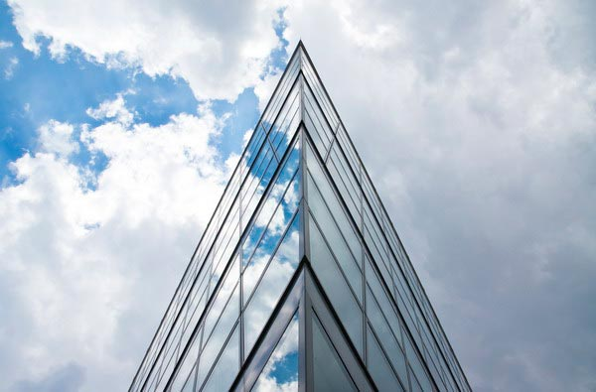
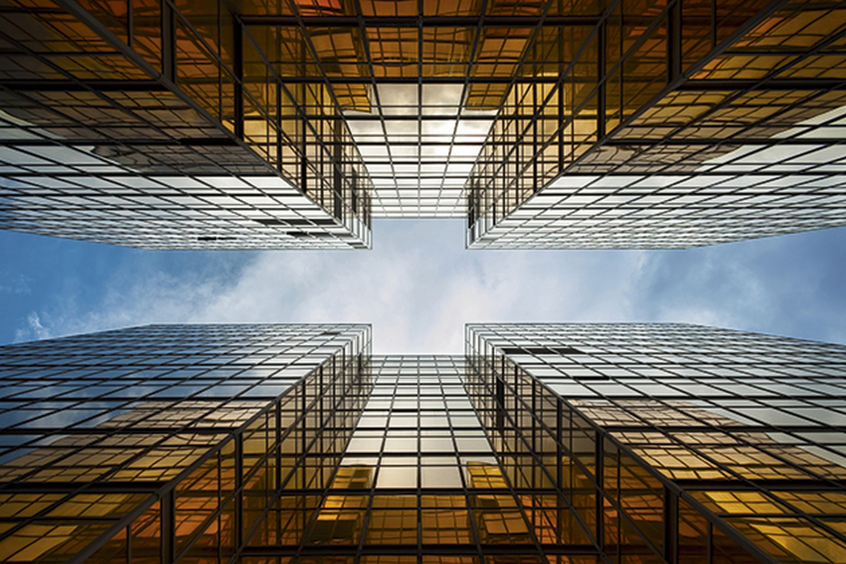
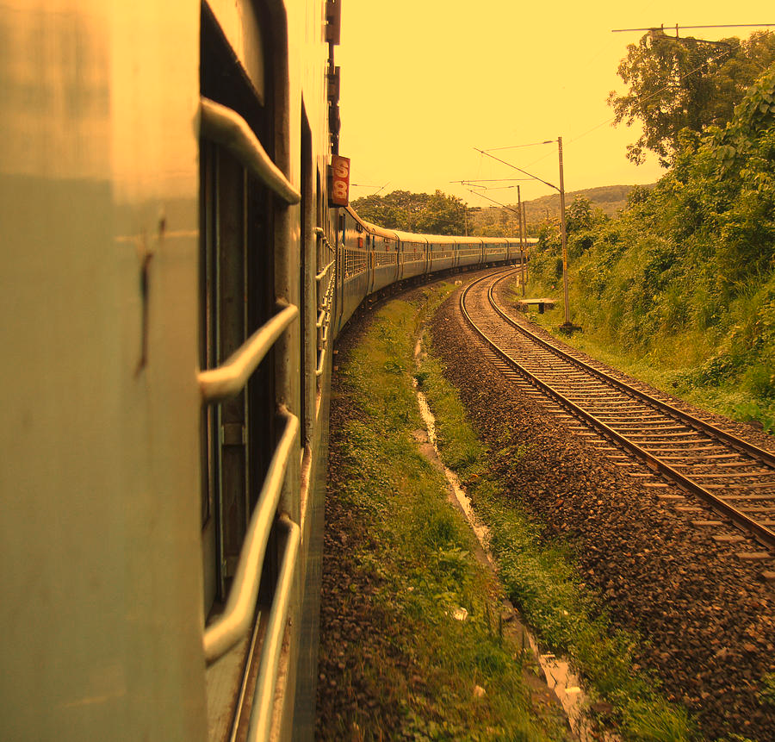
The following slides will hopefully give you some inspiration about how photographers have documented Structures.
Eventually, you will make a final series of experimental photographs to go with the theme.

Slide 5
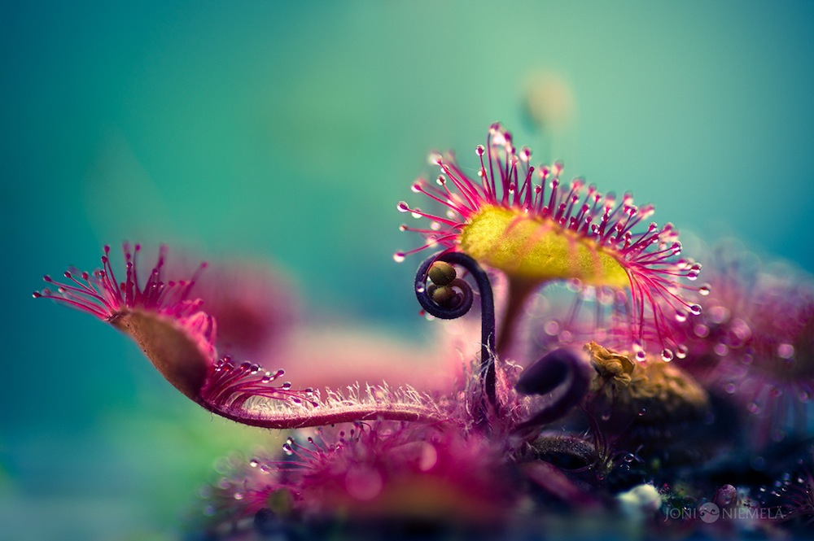
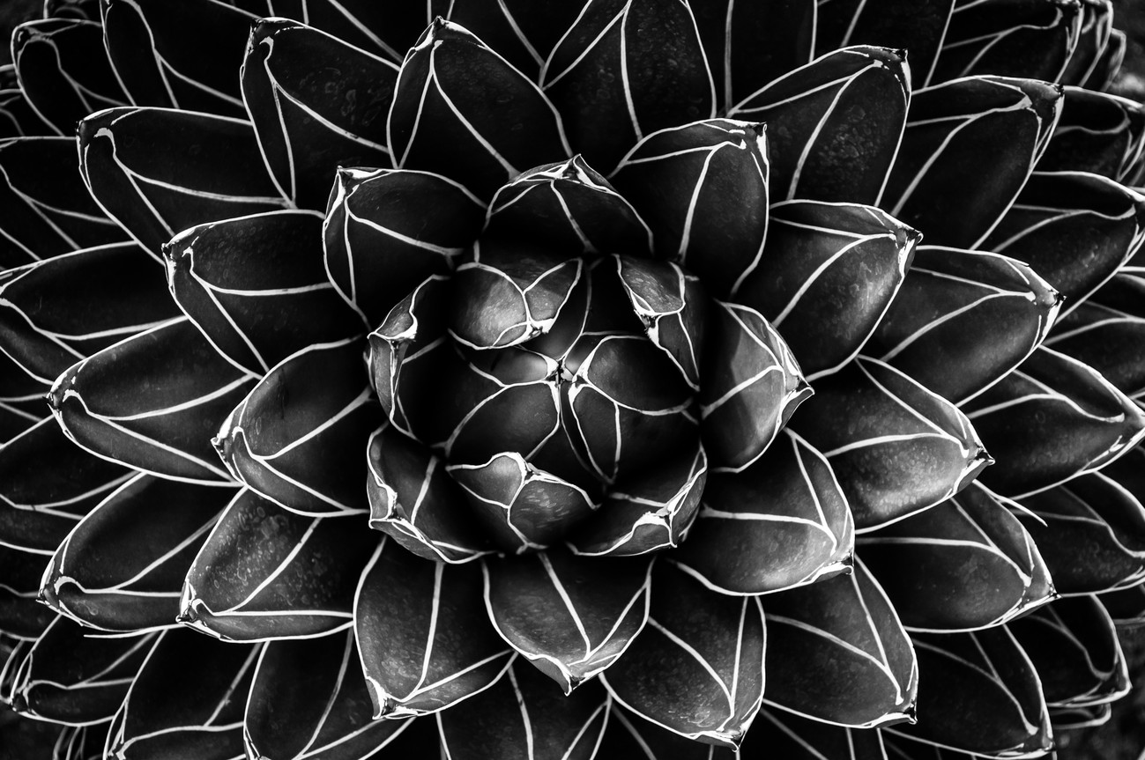
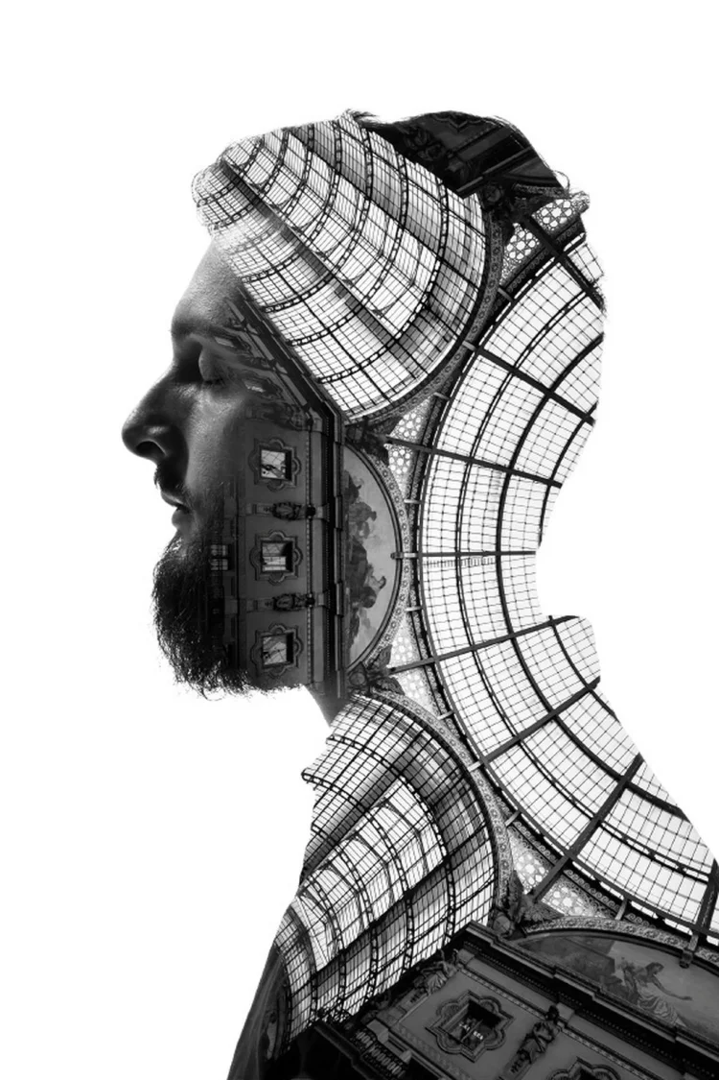
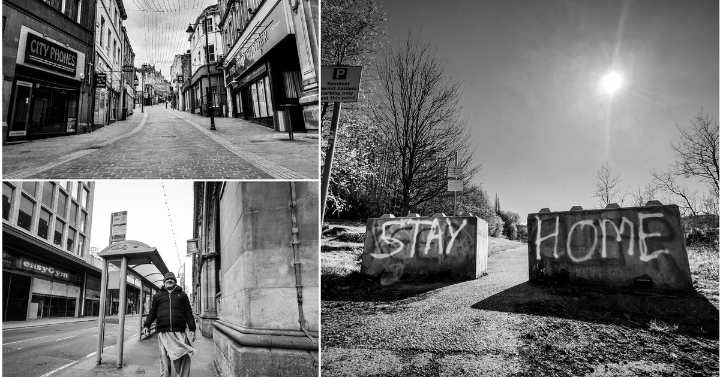
Natural Structures
Photos of Bradford in lockdown by John Cade

Slide 6
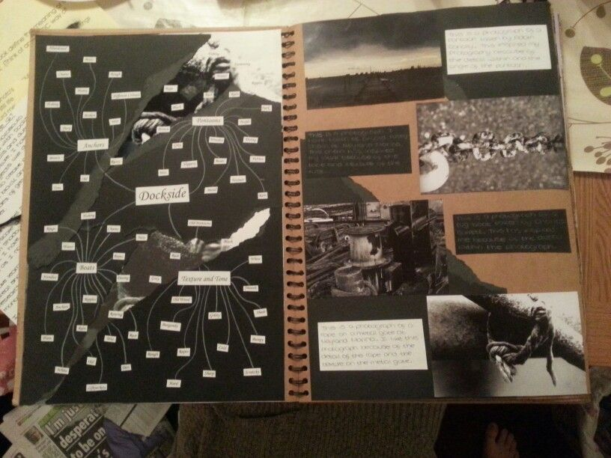
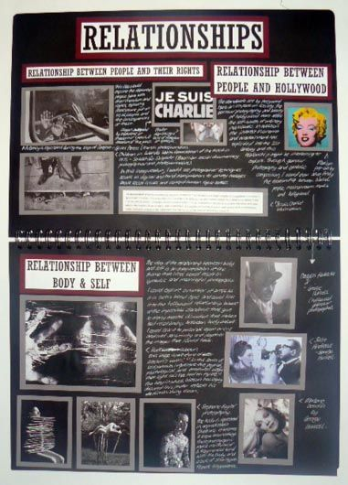
Task 1: Create a quick mind map for the theme ‘STRUCTURES’. (20 minutes)
You can add to your ideas over the next few weeks.
Consider
Large/Small structures
Different types of structures (man made/natural)
Landscapes/great views.
Where will you go to take photographs?
It is completely up to you how you present your ideas. These can be very rough ideas just to get you thinking about subjects and locations.

Slide 7
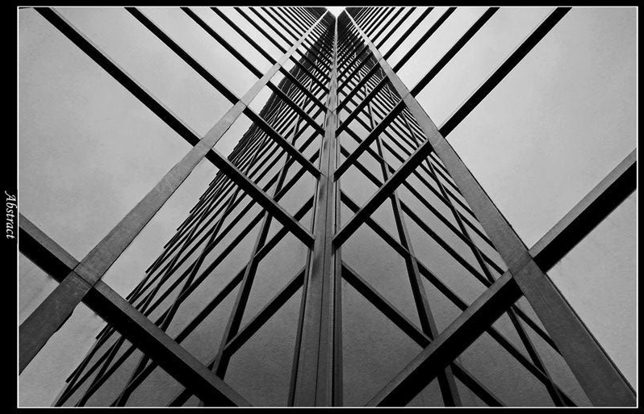
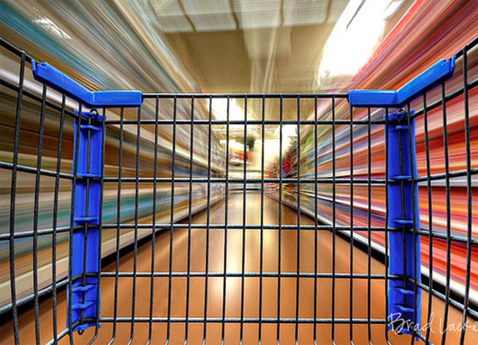
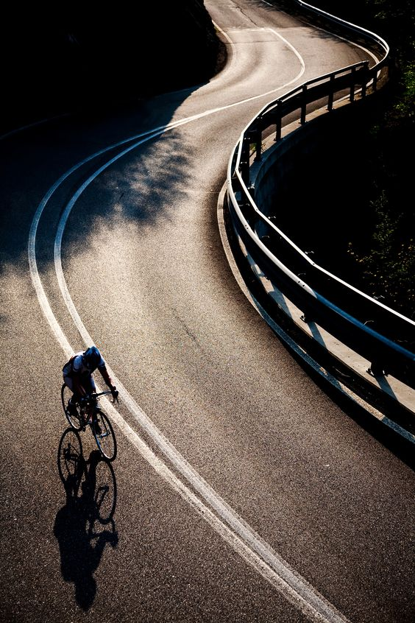
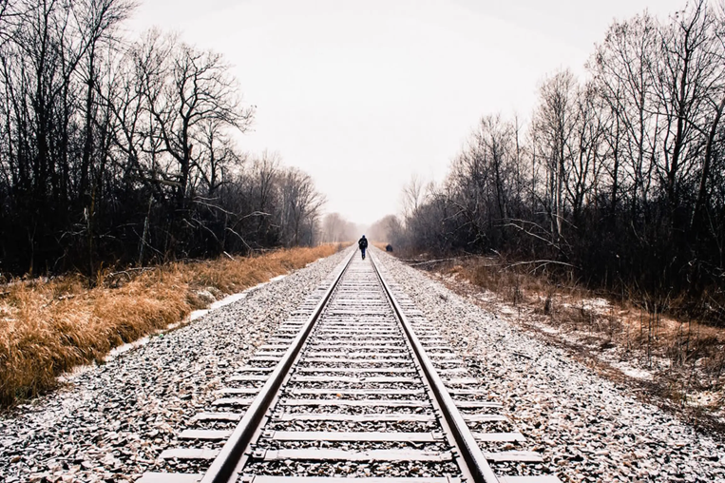
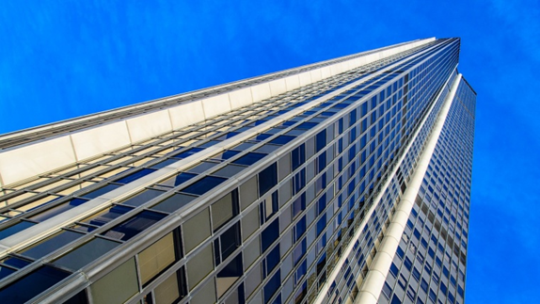
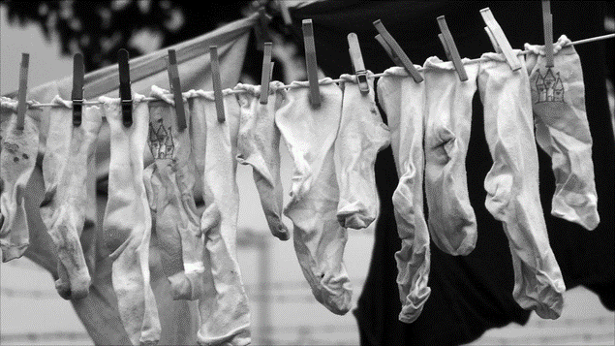
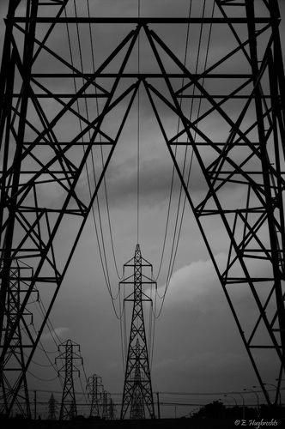
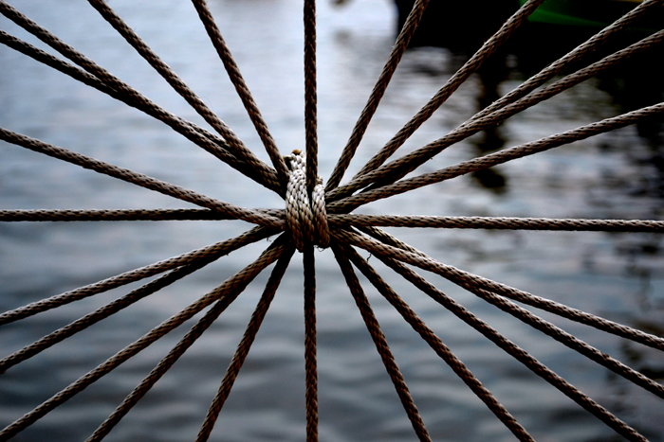
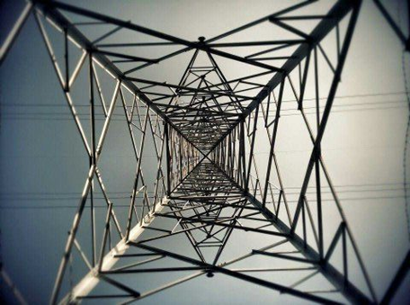
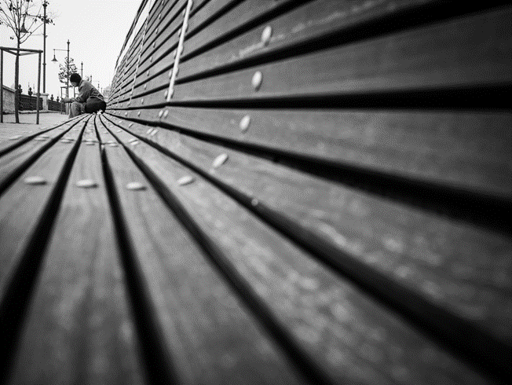
Looking for Lines in the landscape.
Line can help guide the viewer from one point to another.
Line can create distance.
Line can create height and pattern.

Slide 8
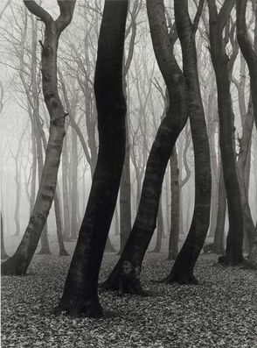
Task 2: Create your own set of photographs showing the different ways lines can be used.
LEADING LINES IN PHOTOGRAPHY IS A GREAT TECHNIQUE TO GUIDE THE VIEWER AROUND YOUR IMAGE.
Take photographs on a camera, phone or tablet.
Aim for approx. 15 images.
Consider:
Line
Curve Line
Man made line
Organic Lines appearing in nature
Distance
Height
Pattern
Repeat

Slide 9
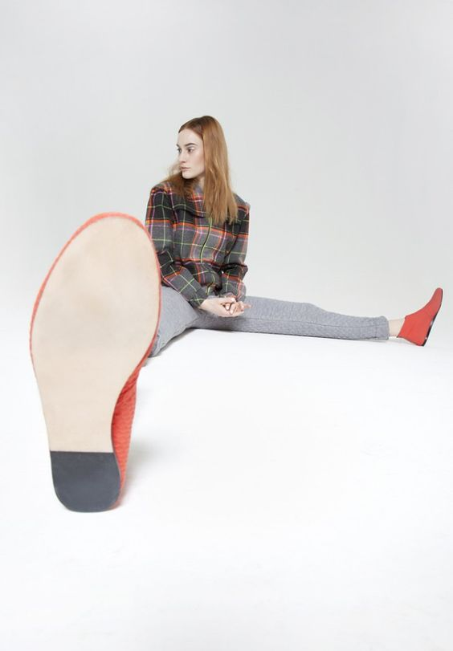
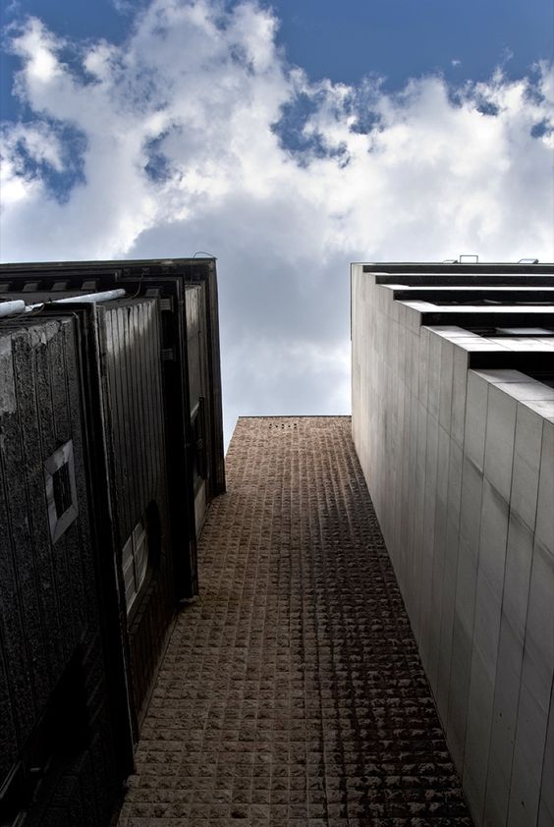
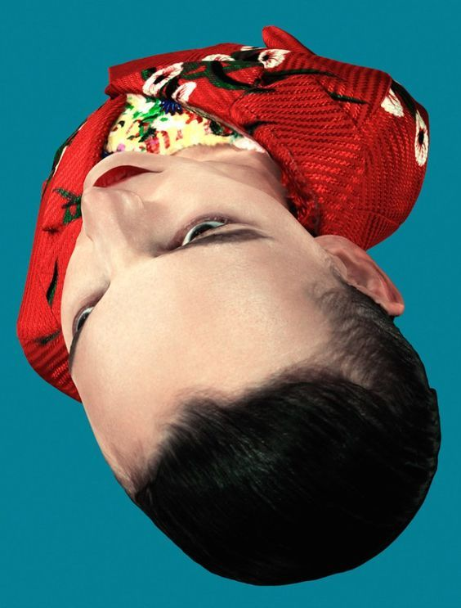
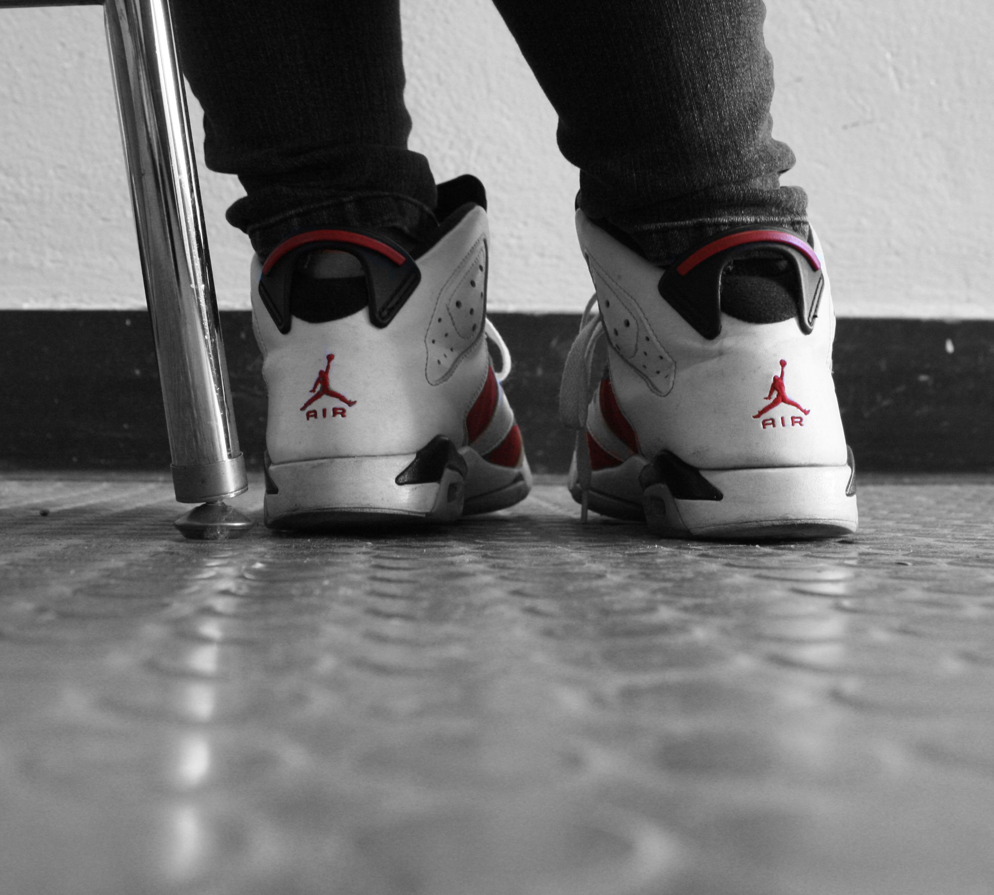
TASK 3 CHANGING THE VIEWPOINT & ANGLE
THINKING ABOUT YOUR THEME GO OUT ON A WALK/JOURNEY SOMEWHEREAND DOCUMENT THE JOURNEY USING A RANGE OF ANGLES.
AIM FOR 10-15 NEW SHOTS.
Change the angle that you shoot from
Lie down on the floor
Shoot under or below things
Birds eye view
Zoom right in on something
Take a photograph from a reflection
Take a photograph from above your subject.

Slide 10
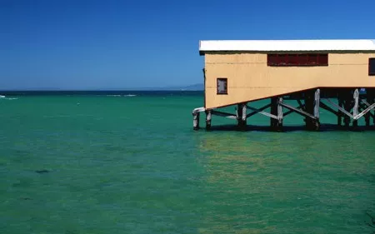
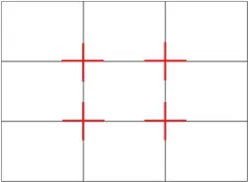
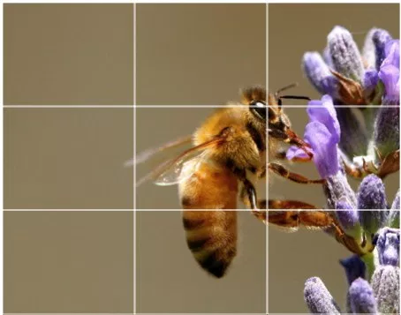
RULE OF THIRDS
Imagine breaking an image down into thirds (both horizontally and vertically) so that you have 9 parts.
The grid now identifies four important parts of the image that you should consider placing points of interest in as you frame your image. (your subject or important focal points)
You could place subjects on the intersections or whole lines.
Benefits:
Natural balance
Can be used to guide the viewer straight to the importance parts of your photograph.
Moves the eye around the WHOLE COMPOSITIONS
Studies have shown that when viewing images that people’s eyes usually go to one of the intersection points most naturally rather than the centre of the shot
What are the points of interest in this shot?
Where am I intentionally placing them?

Slide 11
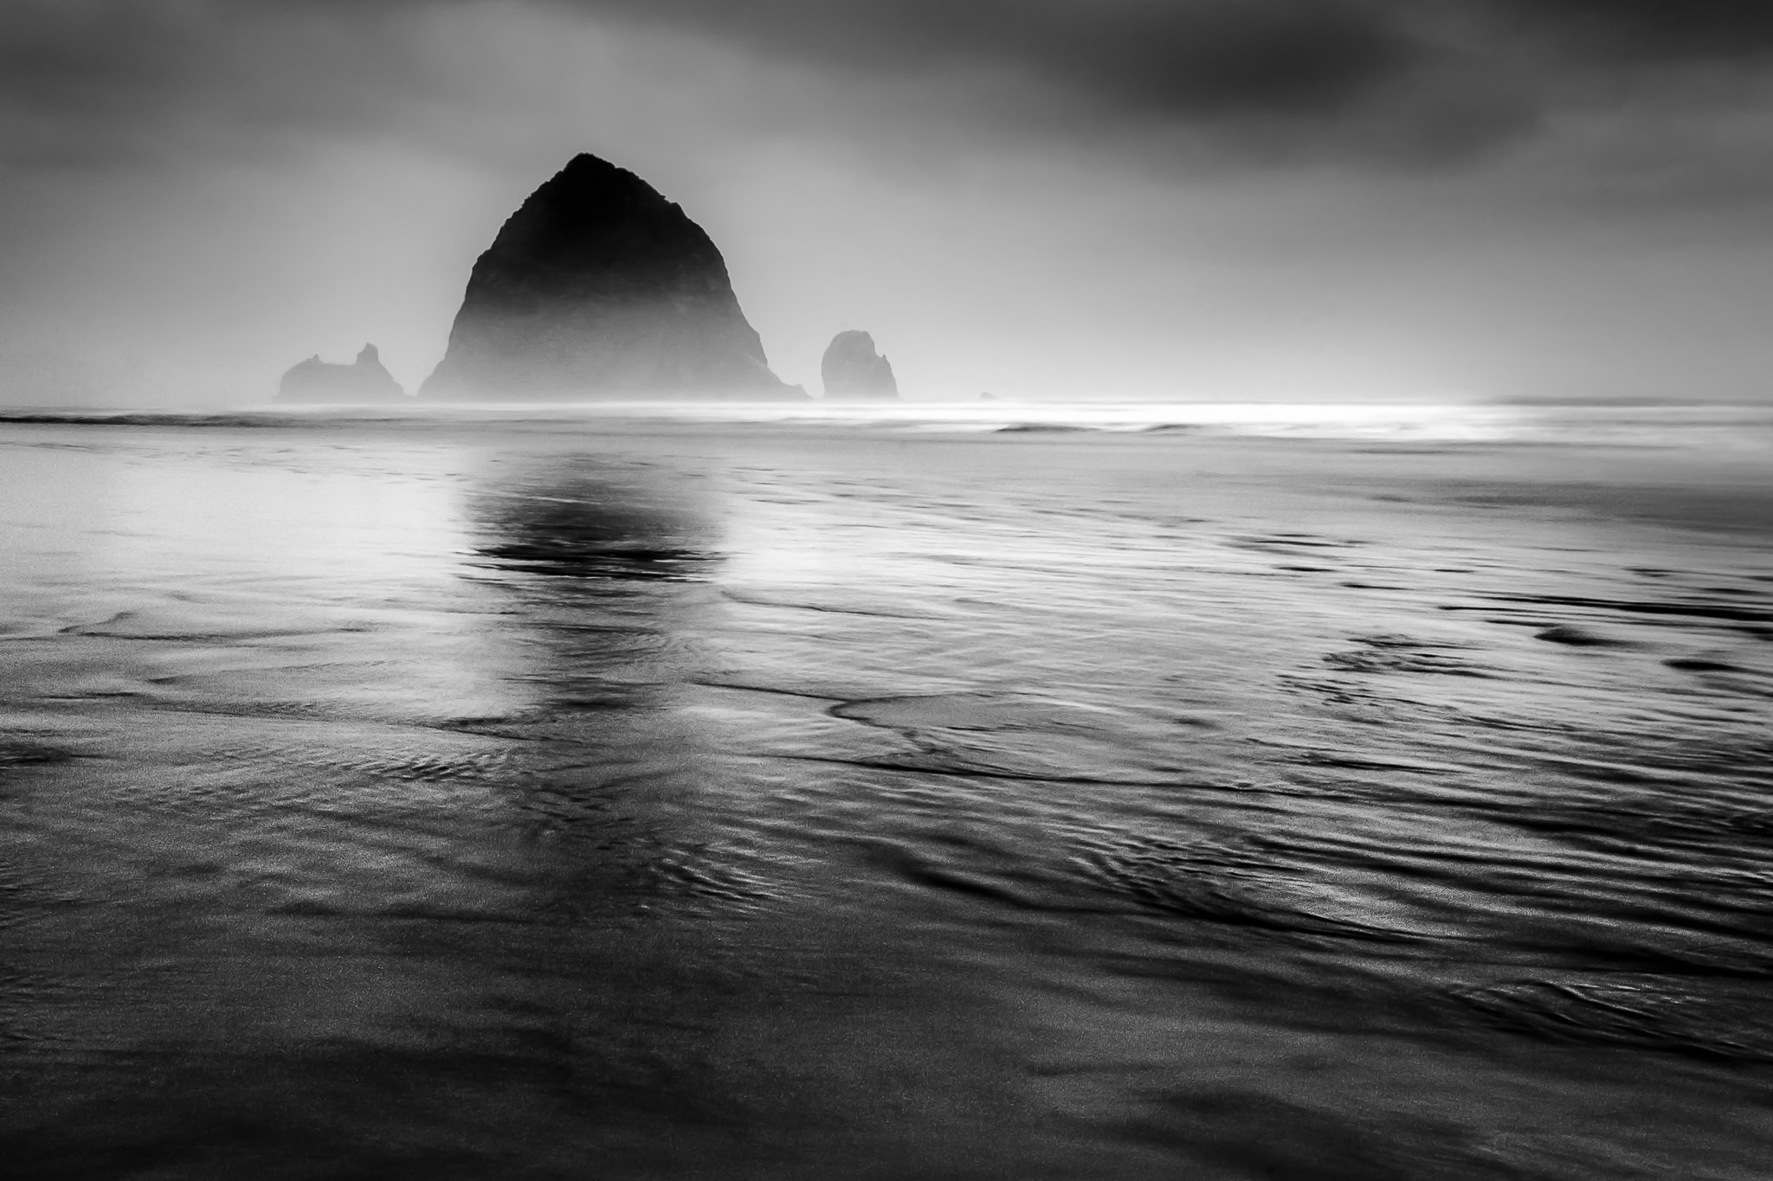
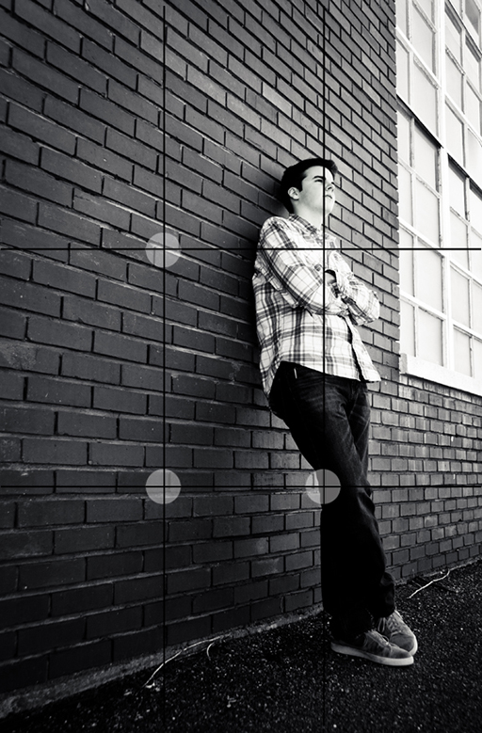
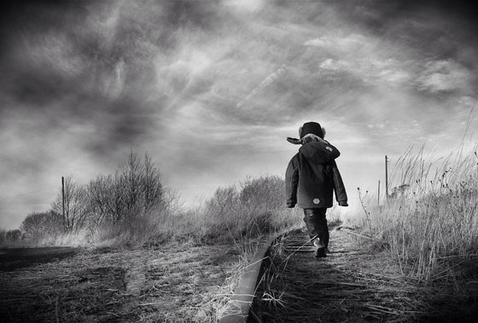
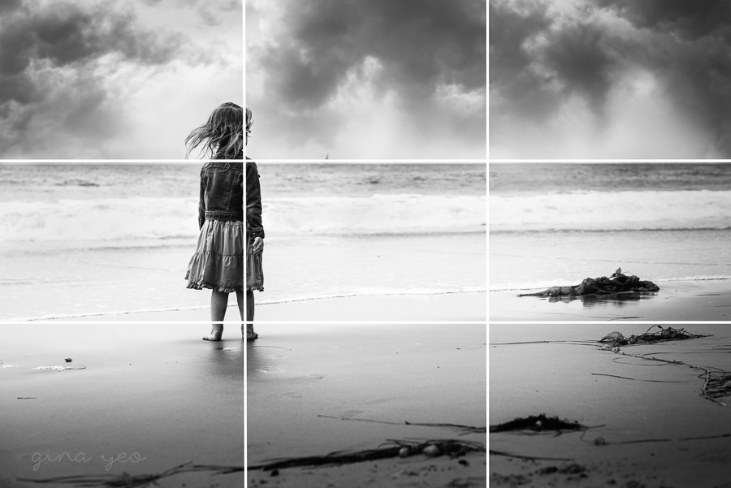
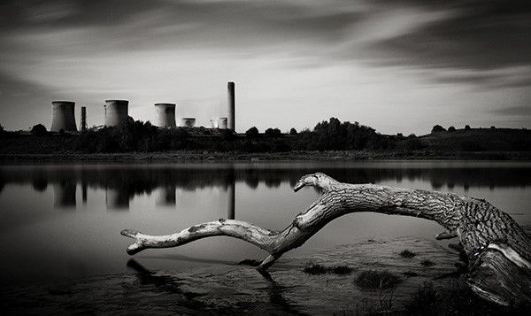
RELEVANT EXAMPLES FOR YOU
Task 5:
PHOTOGRAPH AN OBJECT OR FIGURE DEMONSTRATING THE RULE OF THIRDS. Think about where you will position your subject in the frame. Try to break the rule too!

Slide 12

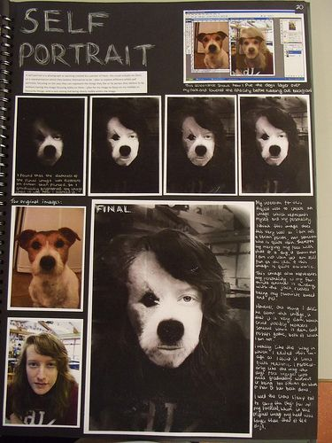
TASK 4 OPTIONAL
EDITING & PRESENTING YOUR PHOTOSHOOTS.
UPLOAD YOUR PHOTOGRAPHS TO THE COMPUTER.
b/ You can use free software PIXLR https://pixlr.com/e/ to edit your images. Spend some time familiarising yourself with the editing tools. There are lots of help videos available on YOU TUBE.
https://www.youtube.com/watch?v=Gu5ly-pN034 (CHANGING YOUR COLOUR IMAGE TO BACK & WHITE)
Save images as JPEG file and then organise them into a photography folder.
C) You can then present your originals and edits on powerpoint slides or you can print them off at home and arrange them in a sketchbook.
YOU SHOULD HAVE 3 SHOOTS TO UPLOAD, BUT NOT ALL IMAGES WILL NEED TO BE EDITED.
THINK ABOUT THE LAYOUT & ADDING TITLES TO YOUR WORK.
EXPLAIN ANY EDITS YOU’VE MADE.

Slide 13
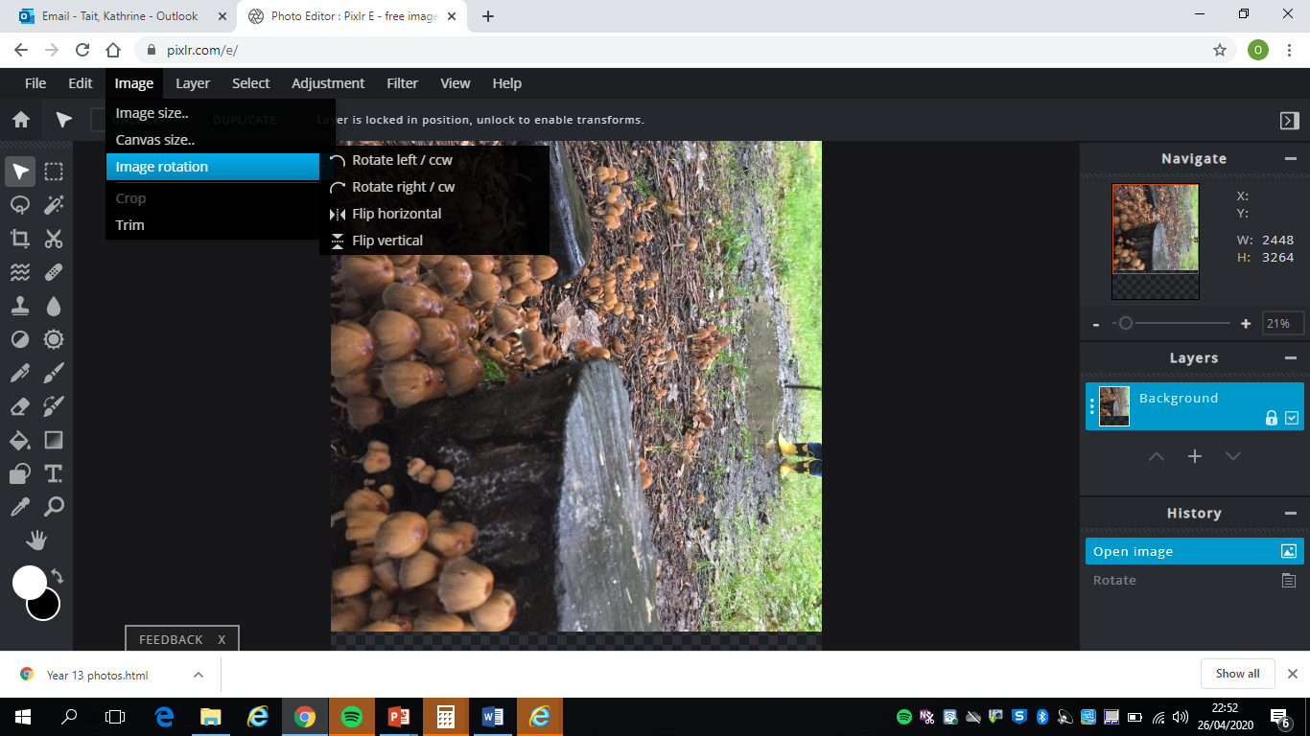
Rotate your image if needed

Slide 14
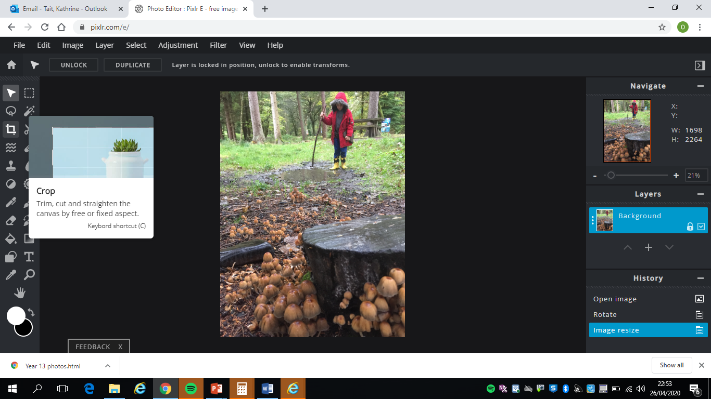
Crop your images if needed using the tabs at the side of the page

Slide 15
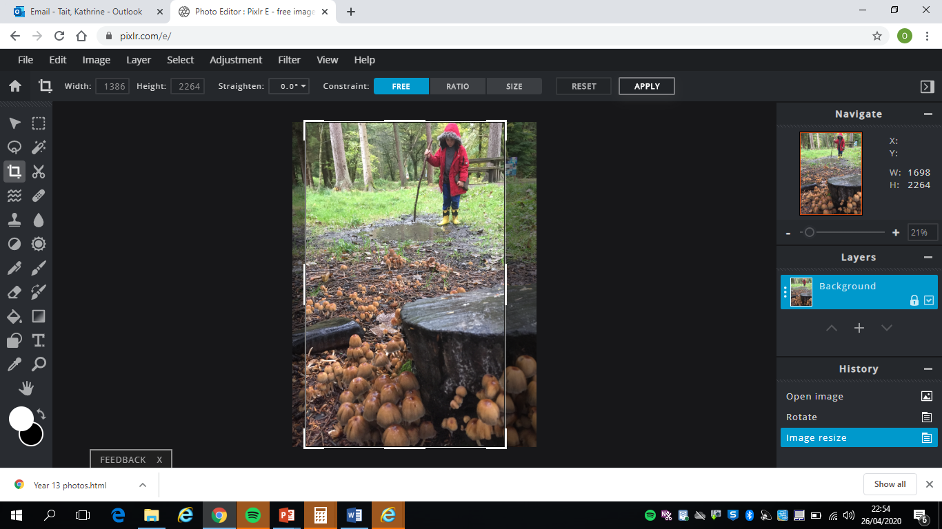

Slide 16
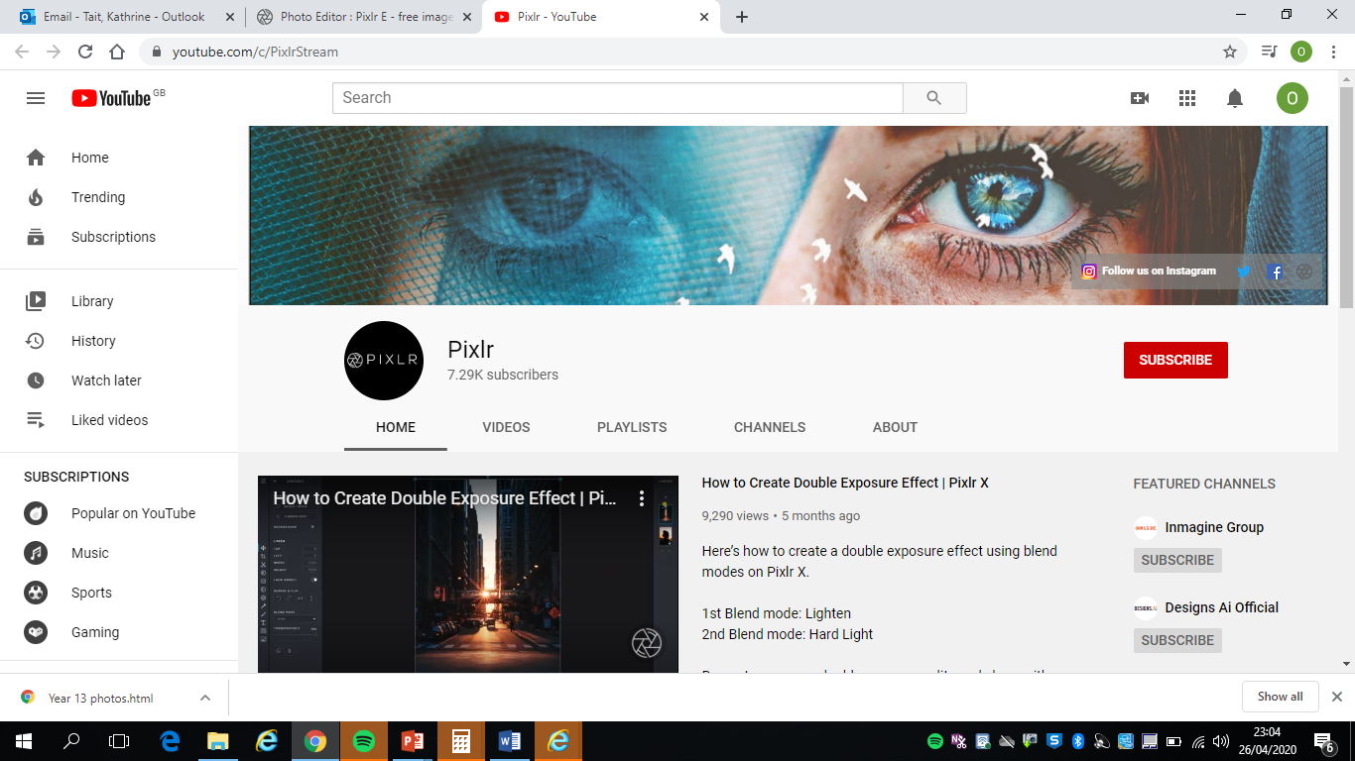
EXTRA RESOURCES & READING
PH LEARN WEBSITE
https://www.photopedagogy.com/
Pixlr Editing videos on YOUTUBE.
https://www.bjp-online.com/ British Journal Of Photography
Digital School
Digital-photography-school.com

