Slide 1

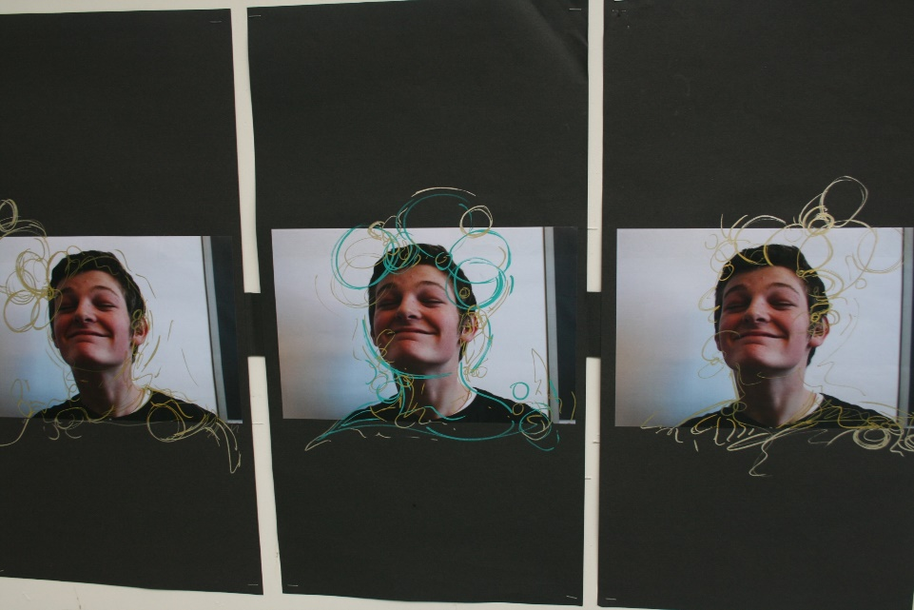
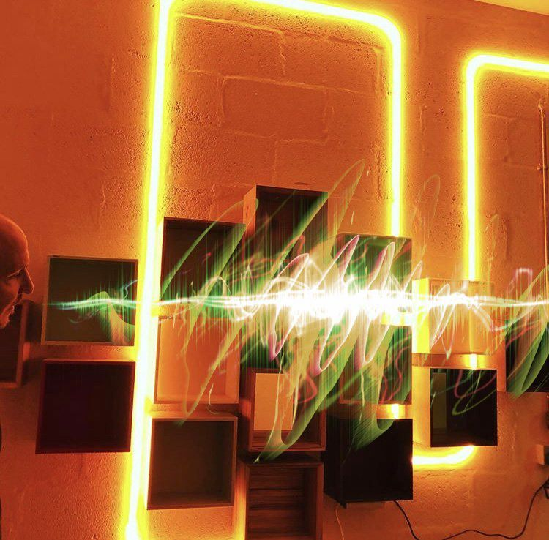
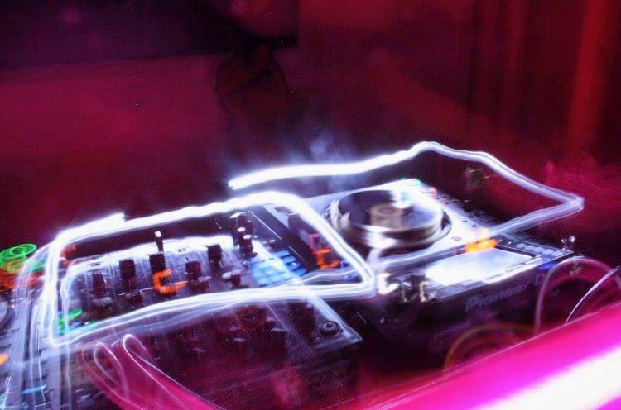
A Level Summer Work
There are a large number of tasks for you to try on the powerpoint slides, however, the most important thing is for you to do the following:
Photographers: Get out and start taking photographs and enjoy taking photographs from unusual angles and viewpoints!
Fine Artists: Keep up your drawing skills through sketching/painting. This can be done anywhere!
Don’t panic if you don’t complete all of the transition work, you can be selective with the tasks you choose to do.
When you start in September your theme will be Structures (Natural and Urban) so you might want to collect some ideas for this theme before the new school year.

