Slide 1
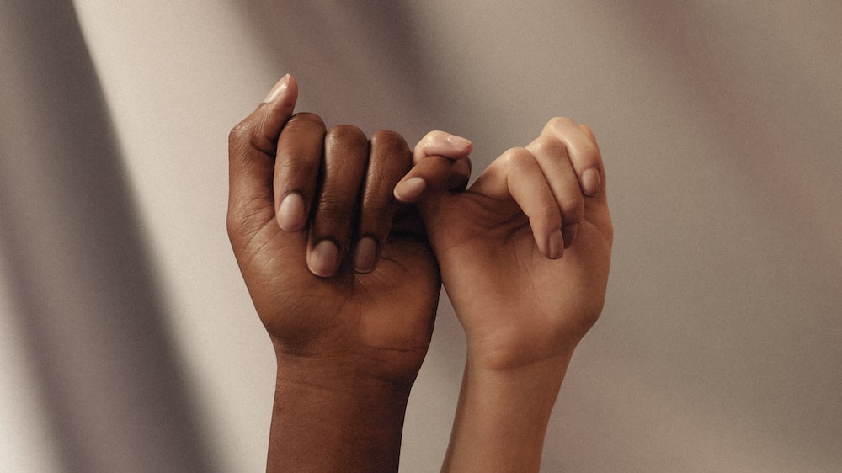
Promise
'This is my body, this is my blood, the blood of the covenant, which is poured out for many'
Thoughts and Prayers
Monday 5th June – Friday 9th June

Slide 2


Prayer In the Chapel This Week
Monday 5th June - 8A
Tuesday 6th June - 8I
Wednesday 7th June - 8N
Thursday 8th June -
Friday 9th June - 8T

Slide 3

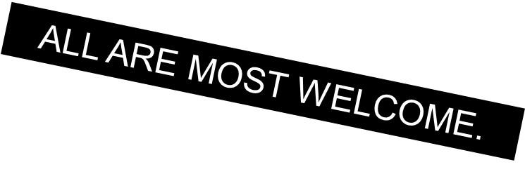
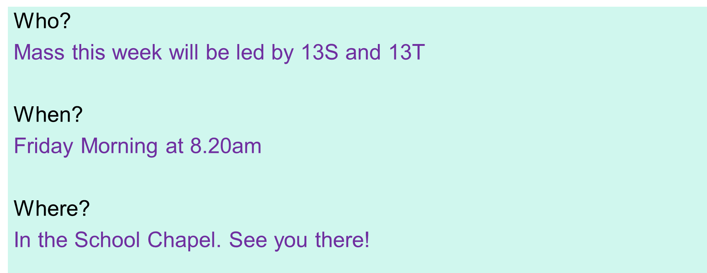

9M and 9N

Slide 4
Promise
'This is my body, this is my blood, the blood of the covenant, which is poured out for many'
Thoughts and Prayers
Monday 5th June – Friday 9th June

Slide 5
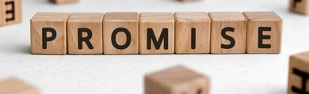
What is a Promise?
A promise is a commitment or assurance given by one person to another that they will do something, refrain from doing something, or make something happen in the future. A promise is essentially a pledge or guarantee of a future action or outcome, and it implies a certain level of trust between the parties involved. The person making the promise is expected to fulfill it to the best of their ability, and failing to do so may be considered a breach of trust or contract

Slide 6

On a piece of paper, write down one promise that you can make to yourself or others
Consider why you are making this promise and what you hope to achieve by making it
Think about what obstacles might be in your way when trying to keep this promise
Work Harder In School
Help More at Home
Take Up A Hobby That I Love
Be Kinder To Others
Persevere with something I find challenging

Slide 7
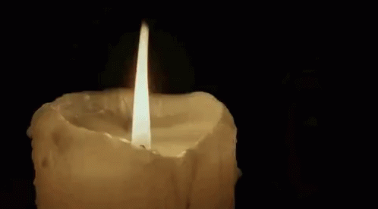
Dear God,
Thank you for the promises we make to ourselves and to others. Help us to have the strength and determination to keep those promises, even when it is difficult. Guide us to live with integrity and honor, so that our promises may be a source of joy and hope for ourselves and others. Amen.

Slide 8
Promise
'This is my body, this is my blood, the blood of the covenant, which is poured out for many'
Thoughts and Prayers
Monday 5th June – Friday 9th June

Slide 9
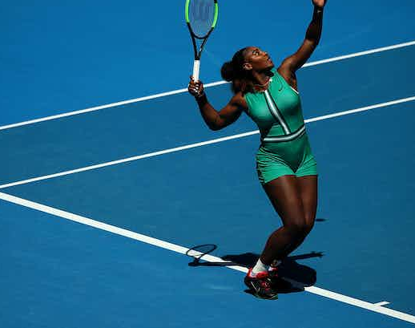
Serena Williams
Serena Williams is widely regarded as one of the greatest tennis players of all time.
Serena showed promise from a very young age, winning her first professional tournament at the age of just 14. She went on to win her first Grand Slam title at the age of 17, and has since won a total of 23 Grand Slam singles titles, the most by any player in the Open Era.
Despite her success, Serena has faced numerous challenges throughout her career, including injuries, personal setbacks, and discrimination. However, she has always been resilient and determined, and has never given up on her dreams. Her ability to overcome adversity has been a key factor in her success, and has helped her to fulfill the promise she showed as a young player.
Serena Williams 'Still I Rise'

Slide 10
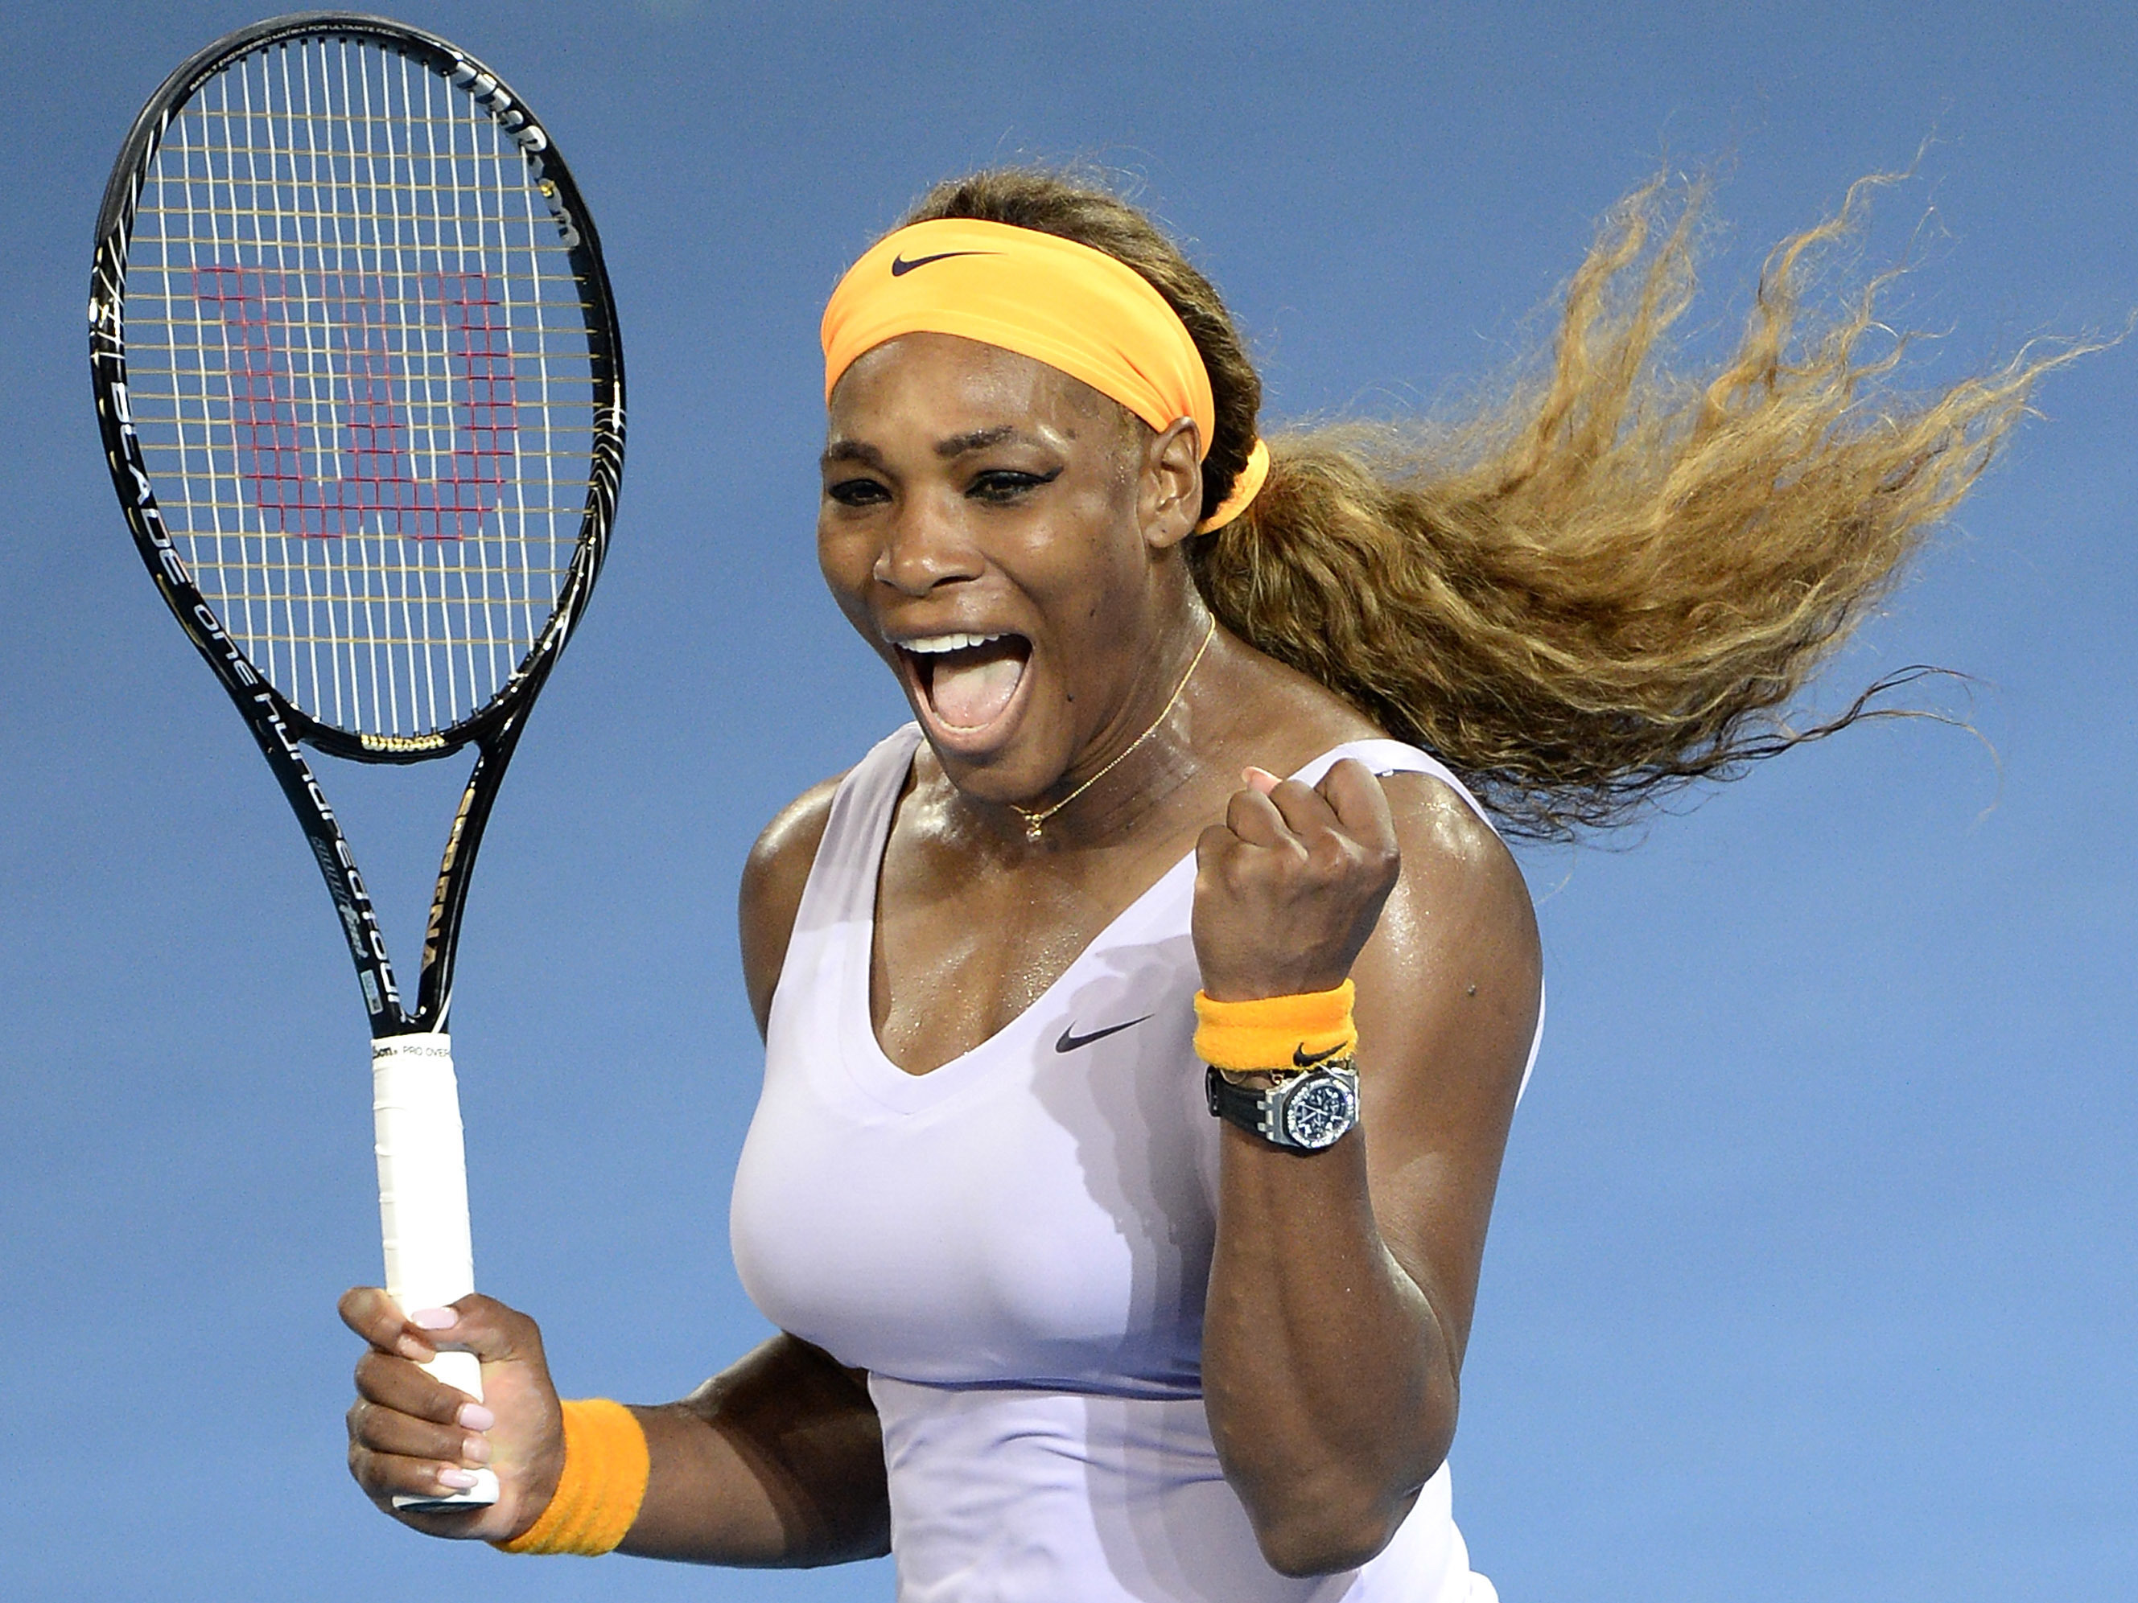
Serena has used her platform to inspire and empower others. She has been a vocal advocate for gender and racial equality, and has used her success to encourage young people to pursue their dreams. Through her actions and words, she has shown that with hard work and determination, anyone can fulfill their promise.
With the person next to you, discuss one thing that you could promise yourself to work hard at and/or overcome

Slide 11
Let Us Pray
Dear Lord,
I come before you today to ask for your guidance and strength as I strive to remain determined in my pursuits.
I know that challenges will arise and obstacles will appear in my path, but I trust that with your help, I can overcome them.
Grant me the clarity of mind to focus on my goals and the courage to pursue them with unwavering determination. Help me to find the motivation to keep going, even when the going gets tough. May my determination be fueled by a deep sense of purpose and passion, and may I always be mindful of the bigger picture.
I ask for your blessings on my journey, and for the support and encouragement of those around me. With your guidance and my determination, I am confident that I can achieve great things.
Thank you for hearing my prayer.
Amen

Slide 12
Promise
'This is my body, this is my blood, the blood of the covenant, which is poured out for many'
Thoughts and Prayers
Monday 5th June – Friday 9th June

Slide 13
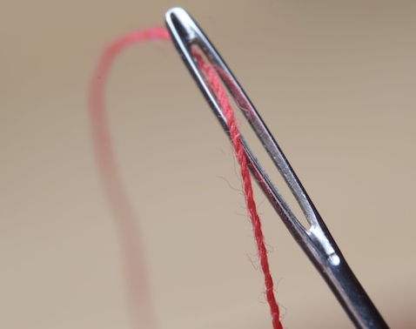
Promises are like fragile threads that weave trust and integrity into the fabric of our relationships. They hold immense significance, regardless of whether they are made between friends, family members, or even within the classroom. Unfortunately, we all find ourselves in situations where we are unable to fulfill the promises we make.
When we break a promise, it can have far-reaching consequences. It erodes trust, damages relationships, and can even lead to feelings of disappointment, betrayal, and resentment. Others may begin to doubt our reliability and question the sincerity of our intentions. These consequences highlight the importance of thinking carefully before making a promise and understanding the commitment involved.

Slide 14
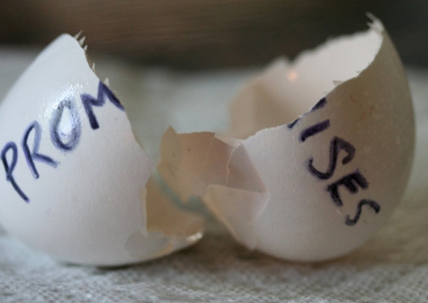
In pairs
Read the following scenarios on the next slides and discuss the questions below.
What was the promise made in the scenario?
What were the potential consequences of keeping or breaking the promise?
How did the promise impact the individuals involved?
What could have been done differently to maintain trust and integrity?

Slide 15
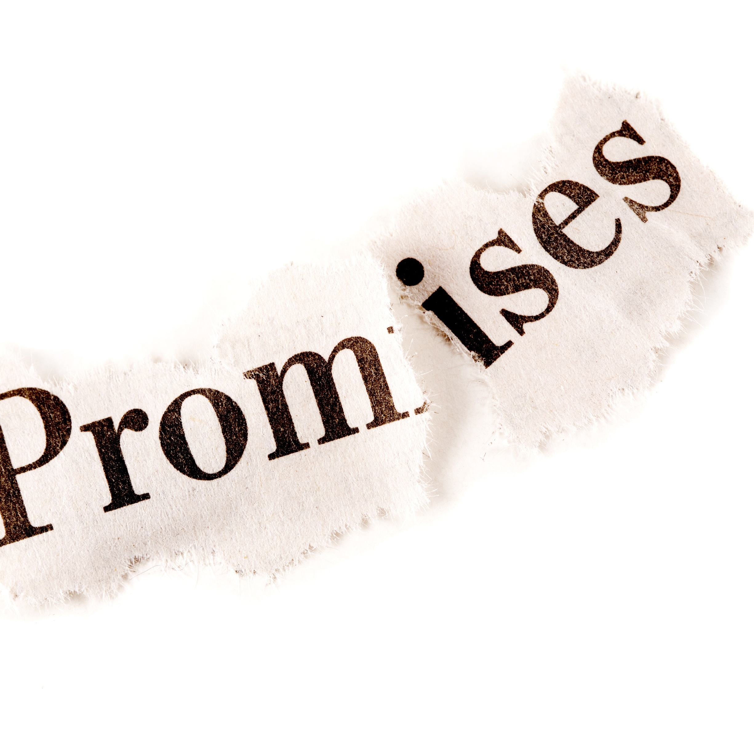
Scenario 1
The school's student council promises to organize a charity event to raise funds for a local orphanage. However, as the event approaches, the student council members fail to fulfill their responsibilities, resulting in a poorly organized event with low attendance and minimal donations.

Slide 16
Scenario 2
Mark promises his younger sister, Lily, that he will attend her school play. On the day of the performance, Mark forgets about the promise and goes out with his friends instead

Slide 17
Scenario 3
Ellie promises her parents that she will be home at 10pm from a friends party. She gets distracted and is still not home by 11.30pm

Slide 18
Scenario 4
Sarah promises her best friend, Emily, that she will help her prepare for an important math exam. However, on the day they planned to study together, Sarah cancels at the last minute to hang out with other friends.

Slide 19
Let Us Pray
Lord, I want to thank You for the gift of promises and the power they hold in our lives. I acknowledge that promises are not to be taken lightly, and I recognise the importance of honoring them.
I confess that I have fallen short in keeping my promises at times. I have made commitments that I have not fulfilled, and I ask for Your forgiveness. I understand that my actions have consequences, and I ask for Your grace to help me make amends where I have caused disappointment or hurt.
In Jesus name I pray,
Amen

Slide 20
Promise
'This is my body, this is my blood, the blood of the covenant, which is poured out for many'
Thoughts and Prayers
Monday 5th June – Friday 9th June

Slide 21
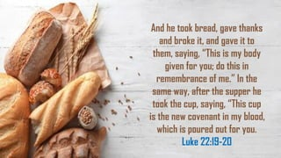

Slide 22
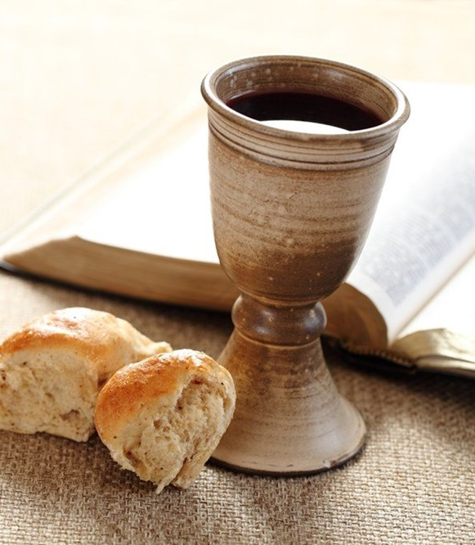
The scripture this week is taken from Mark 14:12-16
It records a significant event during the Last Supper, which was a meal shared by Jesus Christ and his disciples just before his crucifixion.
"And he took bread, gave thanks and broke it, and gave it to them, saying, 'This is my body given for you; do this in remembrance of me.' In the same way, after the supper, he took the cup, saying, 'This cup is the new covenant in my blood, which is poured out for you.'"
This passage describes Jesus' actions and words during the Last Supper. He takes bread, gives thanks, breaks it, and gives it to his disciples, telling them that the bread represents his body given for them. He then takes a cup, refers to it as the "new covenant in my blood," and explains that it is poured out for them.
Mark 14:12-16

Slide 23
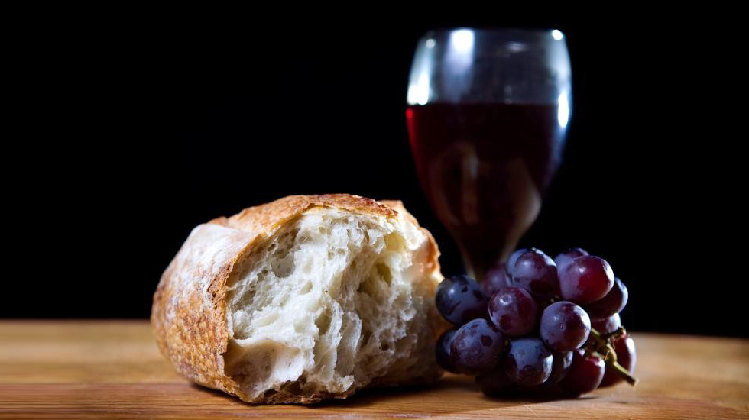
Promise
This passage relates to the theme of promise in a couple of ways:
Promise of Redemption: Jesus' words during the Last Supper signify a promise of redemption for humanity. He refers to the bread as his body, which he will give for his disciples. This signifies his impending sacrifice on the cross, where he offers himself as a payment for the sins of humanity. It is a promise of salvation and the fulfillment of God's plan for the redemption of humankind.
Promise of the New Covenant: Jesus also mentions the cup as the "new covenant in my blood." The concept of a covenant refers to a binding agreement or promise between God and his people. In this instance, Jesus establishes a new covenant through his blood, indicating a new relationship between God and humanity. This promise involves forgiveness of sins and a renewed connection with God, based on faith in Jesus' sacrifice.
The theme of promise in this passage highlights the faithfulness and trustworthiness of God. Jesus' words convey the assurance of his impending sacrifice, the hope of redemption, and the establishment of a new covenant relationship with God. It underscores God's commitment to fulfill His promises and invites believers to trust in the faithfulness of God's word.

Slide 24
Lord,
Your promises bring hope to my soul and strength to my spirit. In moments of doubt or uncertainty, I cling to Your Word, knowing that You are a God who keeps Your promises. Help me to fully trust in Your faithfulness.
Father, I pray that You would remind me daily of the promises You have spoken over my life. Strengthen my faith as I meditate on Your Word and enable me to walk in the assurance that Your promises are forever
Amen

