Slide 1
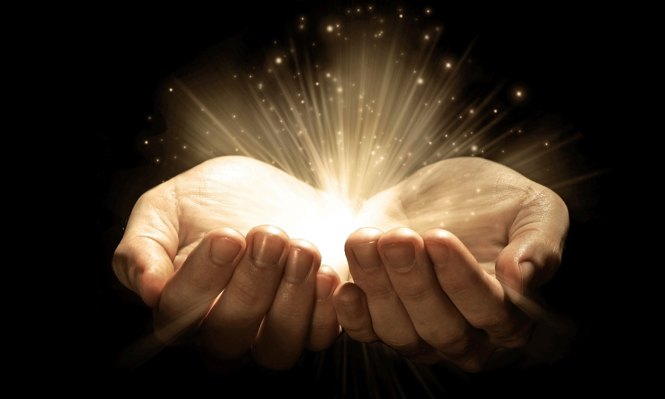
Energy
Thoughts and Prayers 22nd – 26th May

Slide 2
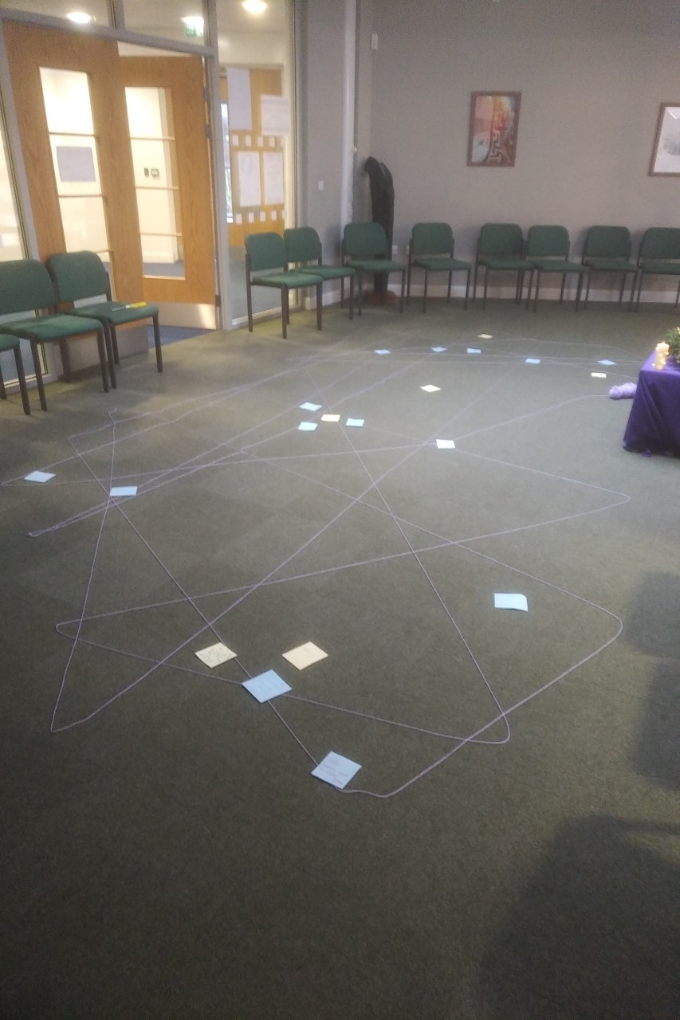
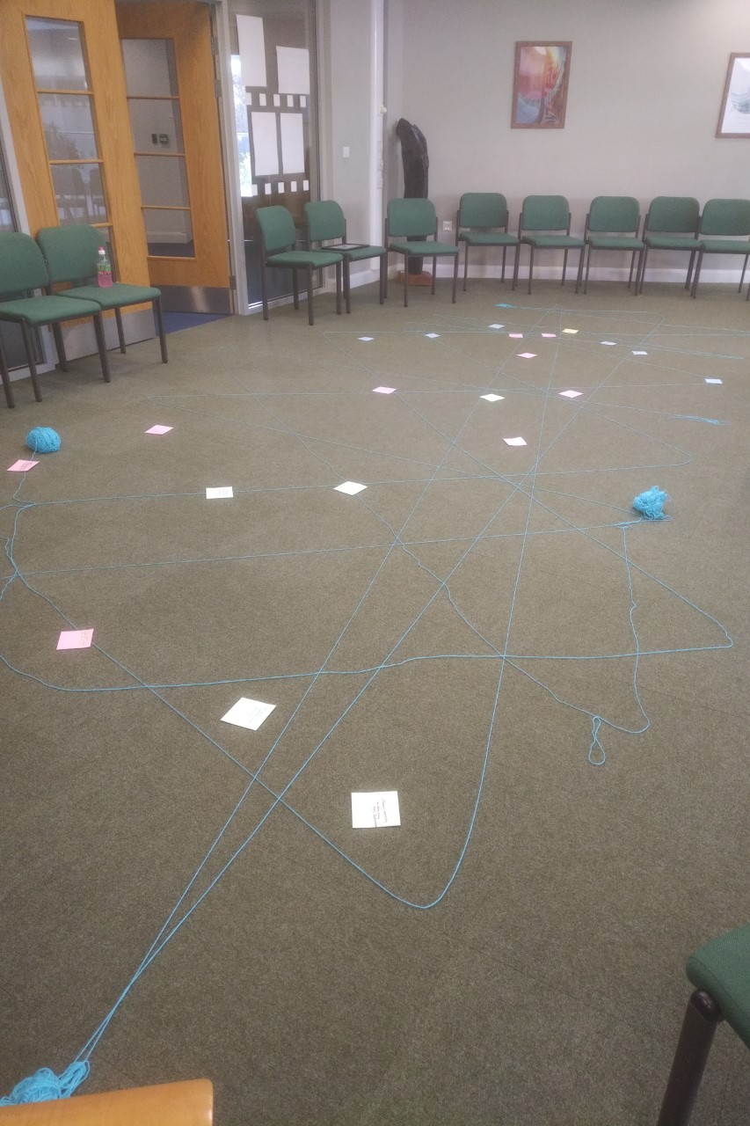
MORNING PRAYER IN THE CHAPEL THIS WEEK
Monday 22nd May - 7R
Tuesday 23rd May - 7Y
Wednesday 24th May - 7M

Slide 3
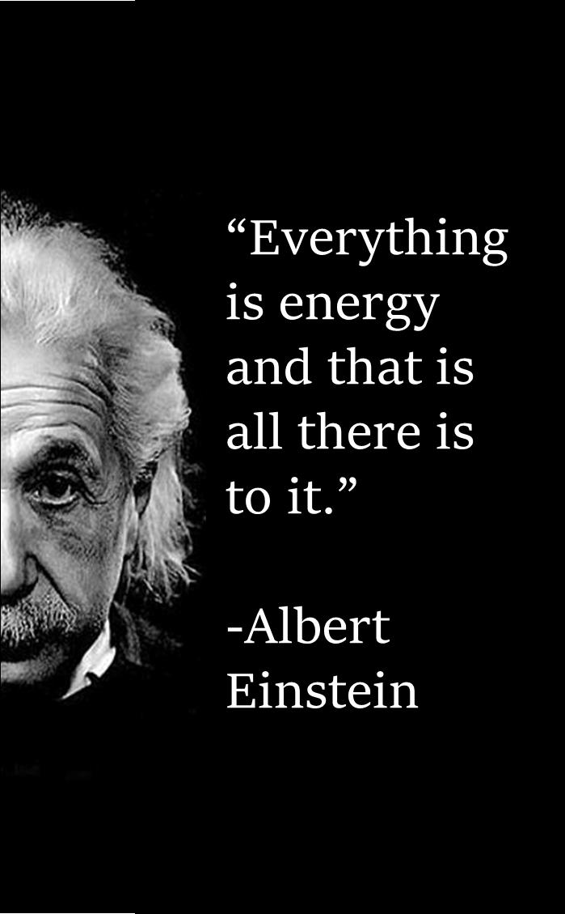

If we look in the dictionary, energy is defined as the ability to do work.
This is a scientific definition. How would you define it on a personal level? What does energy mean to you? How do you think it affects your daily life? Discuss your ideas.
Energy is a force that is present in everything around us, including our thoughts and emotions. We can use this energy to bring positive change into our lives and the lives of those around us. When we focus our thoughts and actions on positive energy, we can attract positive outcomes.

Slide 4
Dear God,
We thank you for the gift of energy in our lives.
Help us use positive energy to radiate love, compassion, and kindness.
Grant us strength to overcome negativity and fear, replacing them with positivity and hope.
May we be grateful for the interconnection of all things.
Amen.
Let us pray

Slide 5
Energy
Thoughts and Prayers 22nd – 26th May

Slide 6
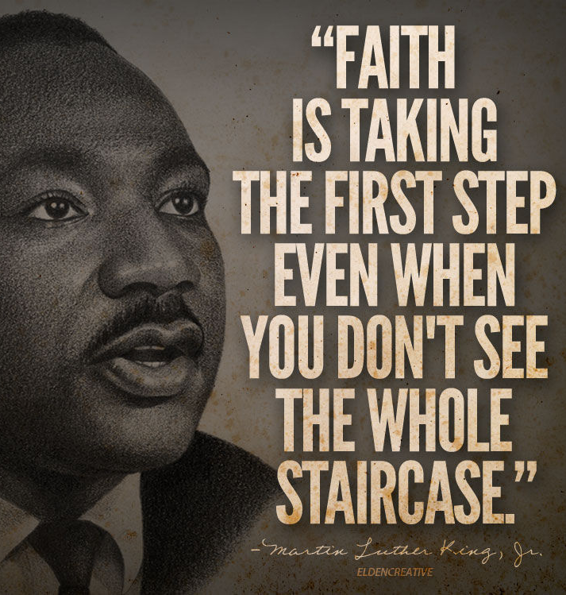
The Feast of St. Augustine is celebrated on May 27th. St. Augustine of Canterbury was a monk who was sent by Pope Gregory the Great to England. He arrived in Kent in the year 597 and was successful in converting King Ethelbert and many of his subjects to Christianity. He became the first Archbishop of Canterbury, and his mission paved the way for the spread of Christianity throughout England.
St. Augustine's mission required immense conviction. The energy of his faith propelled him to undertake a challenging journey, facing unknown territories and cultural differences. It motivated him to overcome obstacles and build bridges. The energy of his faith helped transform not only individuals but society as a whole.

Slide 7
Dear God,
Thank you for filling St. Augustine of Canterbury with the energy of faith.
Grant us the same strength to step forward in faith and make a positive impact in our lives and communities.
May the energy of our faith empower us to overcome challenges and spread the light of love and hope.
Amen.
Let us pray

Slide 8
Energy
Thoughts and Prayers 22nd – 26th May

Slide 9
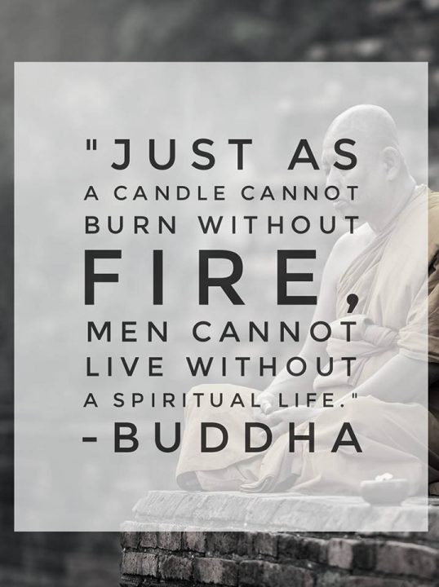
Discuss or quietly reflect: How can understanding energy help us on our spiritual journey?
In Buddhism, the concept of energy is closely tied to the understanding of interconnectedness. Energy, known as "prana" or "chi," flows through all living beings and the universe. By cultivating awareness of this energy, Buddhists seek to achieve balance, harmony, and spiritual awakening. Understanding energy can help us become more mindful of our thoughts, emotions, and actions, and how they influence our overall well-being.
We can all do this, regardless of our faiths and beliefs. By recognising the energy within and around us, we can all cultivate a deeper understanding of our experiences and develop compassion for all beings. Practices such as meditation, mindfulness and prayer help us tap into this energy, enabling us to find inner peace and live with greater awareness.

Slide 10
Dear God,
Help us to embrace the universal energy that flows through all existence.
May our understanding of energy guide us on a path of enlightenment and harmony.
As we cultivate awareness and inner peace, may we become a source of light and love in the world.
Amen.
Let us pray

Slide 11
Energy
Thoughts and Prayers 22nd – 26th May

Slide 12
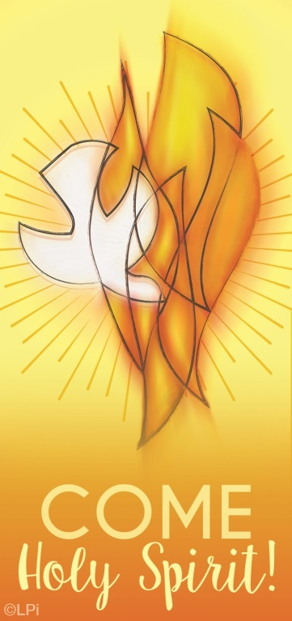
The Solemnity of Pentecost is celebrated on the seventh Sunday after Easter (28th May 2023) and marks the end of the Easter season. It is an important day in the Christian faith as it celebrates the gift of the Holy Spirit.
How can the concept of the Holy Spirit be related to energy? How can the Holy Spirit provide positive energy to guide us in our daily lives?
The Holy Spirit is a positive source of energy that can guide us and give us the strength to do God's work. When we invite the Holy Spirit into our lives, we can tap into its positive energy to help us make positive choices and actions in our lives.

Slide 13
Dear God,
As we approach Pentecost Sunday, fill our hearts, minds, and souls with the energy that empowers us to do your work in the world.
May the fire of your Spirit burn brightly within us, illuminating our path and enabling us to make a positive difference in our communities and beyond.
Amen.
Let us pray

