Slide 1

Theme of the week: Be Bold
Thoughts and Prayers 15th – 19th May

Slide 2


MORNING PRAYER IN THE CHAPEL THIS WEEK
Monday 15th May - 7I
Tuesday 16th May - 7N
Wednesday 17th May - 7T
Friday 19th May - 8S

Slide 3

Friday Mass
Who?
Mass this week will be led by 12S
When?
Friday Morning at 8.20am
Where?
In the School Chapel. See you there!
ALL ARE MOST WELCOME.
ALL WORDS ARE DISPLAYED ON THE SCREEN.

Slide 4
Theme of the week: Be Bold
Thoughts and Prayers 15th – 19th May

Slide 5
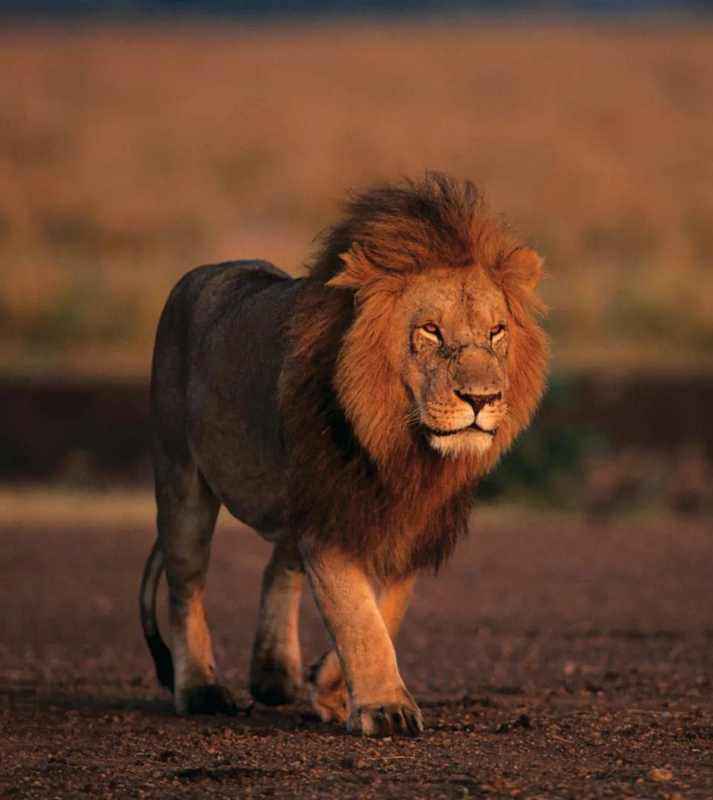
Embracing Courage
Being bold means embracing courage and stepping out of your comfort zone.
It takes courage to pursue your dreams, speak up for what is right, and take risks.
Remember the words of Joshua 1:9: "Be strong and courageous. Do not be afraid; do not be discouraged, for the Lord your God will be with you wherever you go."

Slide 6

Share a time when you had to be bold and take a courageous step.
Share your story in group discussion or write about it individually.
Who wants to BE BOLD and share their experiences and what they learned with the class?

Slide 7

Lord,
I come before You today seeking the strength to be bold. Grant me the courage to step out of my comfort zone, to pursue my dreams, and to speak up for what is right. Help me overcome fear and doubt, knowing that You are with me every step of the way. Fill me with Your Holy Spirit, that I may boldly face the challenges and opportunities before me. In Your name, I pray.
Amen

Slide 8
Theme of the week: Be Bold
Thoughts and Prayers 15th – 19th May

Slide 9
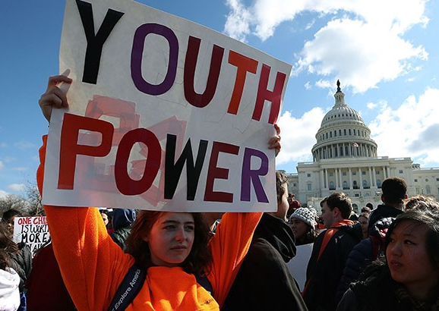
Taking a Stand
Being bold involves taking a stand for what you believe in, even when it's not popular. In the Bible, we see examples of individuals who stood up for their faith and convictions, like Daniel in the lion's den or Shadrach, Meshach, and Abednego in the fiery furnace.
Why do you think it is important for young people to stand up for what they believe in?

Slide 10

Working in small groups, you will be assigned a real-life scenario where YOU must take a stand for something you believe in.
It may be a moral issue or a social injustice.
Each group will present their scenario and discuss how they would approach it with boldness and integrity.

Slide 11

Group 2:
Cost of Living Crisis
Group 1:
Climate Crisis
Group 4:
Gender equality
Group 3:
Welcoming refugees and migrants

Slide 12
Almighty Father,
I humbly ask for the boldness to take a stand for what I believe in. Grant me the wisdom to discern truth from falsehood and the strength to defend justice and righteousness. Help me be a beacon of light in a world that often chooses darkness. May Your Holy Spirit embolden me to be a voice for the voiceless and a defender of the weak. In Jesus' name, I pray.
Amen

Slide 13
Theme of the week: Be Bold
Thoughts and Prayers 15th – 19th May

Slide 14

The theme this week comes from Mark 16:15-20 and is commonly known as the Great Commission. It occurs near the end of the Gospel of Mark and portrays Jesus' final instructions to His disciples before ascending to heaven. Let's explore the context and story behind this significant piece of Scripture.
Context: After His crucifixion and resurrection, Jesus appeared to His disciples, reassuring them of His victory over death.
The Great Commission:
"Go out to the whole world; proclaim the Good News to all creation." (Mark 16:15)
Jesus gives His disciples a vital command: to go out and share the Good News with everyone. The phrase "the whole world" emphasizes the universal scope of their mission. Jesus wants His disciples to spread the message of salvation to people of all nations, cultures, and backgrounds.

Slide 15

Stepping Into Boldness
Through the Great Commission, we are called to be God's ambassadors, representing Him in a broken and hurting world. This commission is not a suggestion but a divine mandate, and it requires boldness.
To be bold in proclaiming the Gospel means to step out of our comfort zones and overcome the fear of rejection or ridicule. As we boldly proclaim the Gospel, we are not alone. The Holy Spirit empowers us, equips us, and provides the words to speak. When we step out in faith, God works through us, touching hearts and transforming lives.
Being bold does not mean being forceful or confrontational. It means having the courage to speak up, to live out our faith authentically, and to love others with a selfless heart. Boldness is rooted in our confidence in Christ and His promises. It is a reflection of our trust in God's plan and His presence with us wherever we go.

Slide 16

Create personal affirmations or declarations of boldness. These can be written statements or artwork that you can keep as a reminder to walk in boldness every day.
Share your affirmations with one another and discuss how you can support each other in living boldly.
Remember that true boldness comes from a place of faith and reliance on God's strength.
Seek His guidance and trust in Him as you navigate your journeys with boldness and courage.

Slide 17
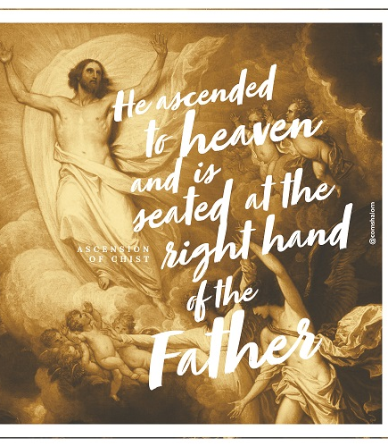
Thursday 8th May – Feast of the Ascension
The Feast of the Ascension, celebrated in the Catholic Church, commemorates the ascension of Jesus Christ into heaven. It is observed 40 days after Easter Sunday, signifying the completion of His earthly ministry. This significant event holds deep meaning and implications for the Catholic Church. Let's delve into its explanation and reflection.
Explanation: The Ascension of Jesus is described in the New Testament, particularly in the books of Luke and Acts. After His resurrection, Jesus spent 40 days with His disciples, appearing to them, teaching them, and reinforcing their faith. On the fortieth day, as the disciples gathered on the Mount of Olives, Jesus ascended into heaven before their eyes, leaving them with the promise of the Holy Spirit and the assurance of His continued presence.
The Feast of the Ascension celebrates this pivotal moment in salvation history. It affirms the divinity of Jesus and highlights His exaltation to the right hand of God the Father. It signifies the completion of His mission on earth and sets the stage for the coming of the Holy Spirit on Pentecost.

Slide 18
A Prayer for the Feast of Ascension
Lord,
Right before your Ascension into heaven you told your apostles to be His witnesses to the ends of the earth upon receiving the Holy Spirit. May I be similarly inspired to spread your Gospel message in word and deed, according to your will for me.
Amen

Slide 19
Theme of the week: Be Bold
Thoughts and Prayers 15th – 19th May

Slide 20

As final year students prepare to embark on their next steps in life, they have an opportunity to leave a bold and positive legacy behind.
In Philippians 3:14, the apostle Paul encourages us to press on toward the goal and the prize that God has set before us.
Whether you're in Year 7 or Year 13, this is your time to think about the legacy you want to leave behind.

Slide 21

Dear Me...
As we reach the final half term, spend some time this morning reflecting on your high school journey so far and consider the impact you have made on others.
Write a letter to yourself that represents the legacy you want to leave behind. This could be shared with your peers or younger students as a source of inspiration, or it could be something private that you look back on in years to come.

Slide 22
Gracious and Loving God,
We lift up the final year students who are preparing to leave this chapter of their lives and embark on new journeys. Grant them the boldness to embrace the unknown, to trust in Your guidance, and to step out in faith. Fill them with wisdom and discernment as they make decisions about their future. May they carry with them the lessons learned, the friendships formed, and the values instilled during their time in school. Surround them with Your love and grace, as they shine brightly in their next steps.
Amen

