Slide 1

Thoughts and prayers Monday 8th May – Friday 12th May

Slide 2
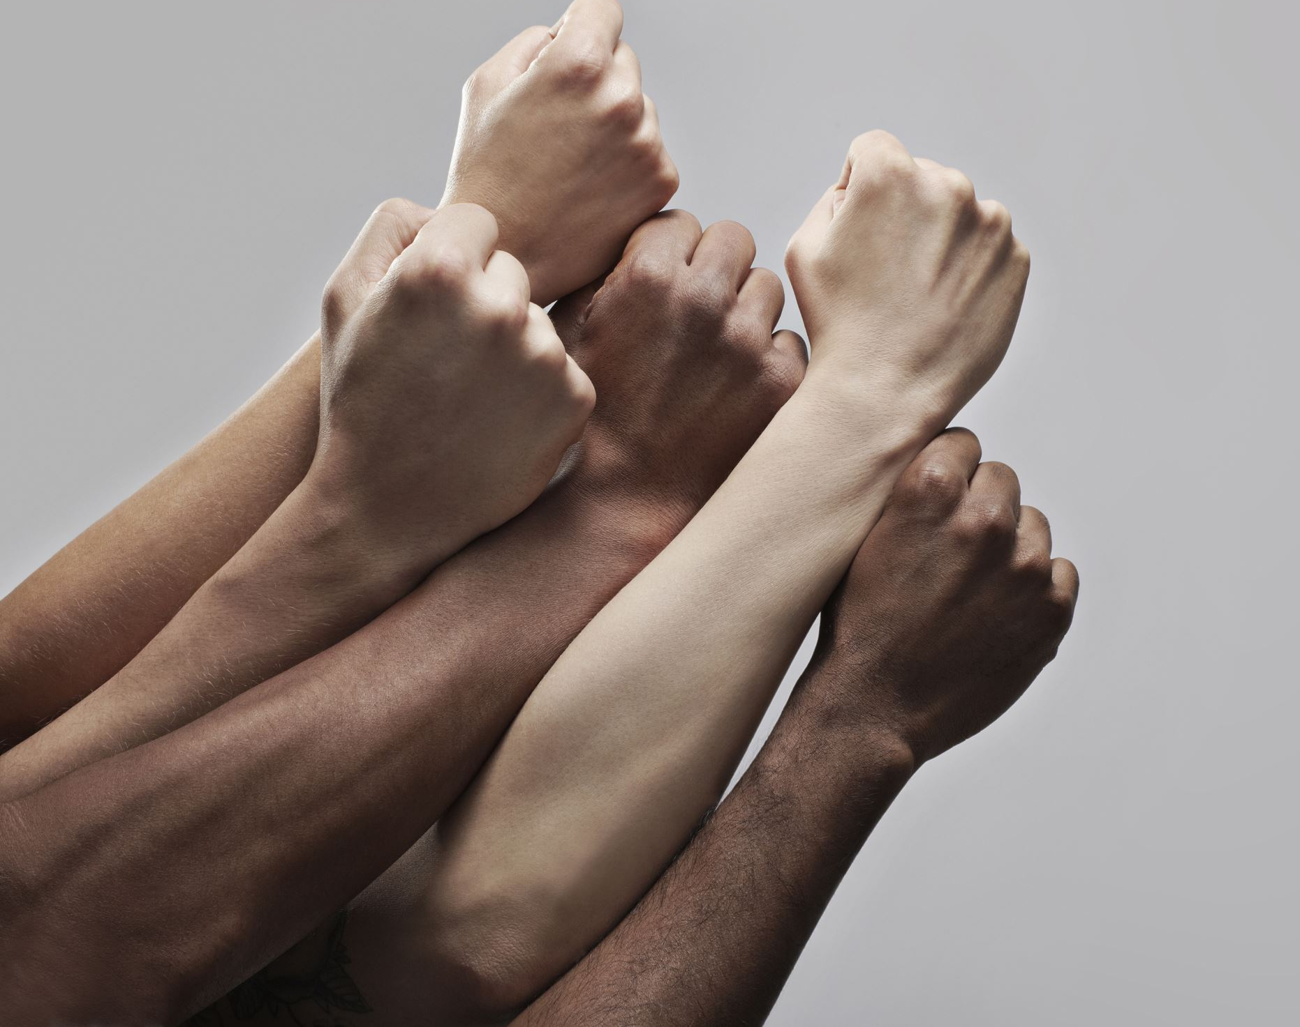
What is confidence?
Confidence can be defined as a belief or feeling of trust in one's abilities, qualities, judgments, or decisions. It's a sense of self-assurance that arises from one's perceived competence, experience, and past successes. Confidence is often associated with a positive attitude, assertiveness, and an ability to take risks and face challenges.
Confidence can have a significant impact on various aspects of our lives, including our personal relationships, academic success, and overall well-being. However, it's important to note that confidence is not the same as arrogance or overconfidence, which can lead to risky or harmful behavior.
Instead, true confidence is rooted in a realistic assessment of one's abilities and limitations, along with a willingness to learn and grow

Slide 3

With the person next to you, discuss the following questions
What does confidence mean to you? Describe how you feel when you are confident.
Think about a time when you lacked confidence. What were the circumstances, and how did you feel? What could you have done differently to feel more confident?
What are your strengths and weaknesses? How can you use your strengths to boost your confidence? How can you work on your weaknesses to build your confidence?
4. How do you handle failure and setbacks? How can you learn from these experiences and use them to build your confidence?
5. Who are some people in your life that support and encourage you? How can you surround yourself with positive influences and build a support system that helps you feel confident?

Slide 4
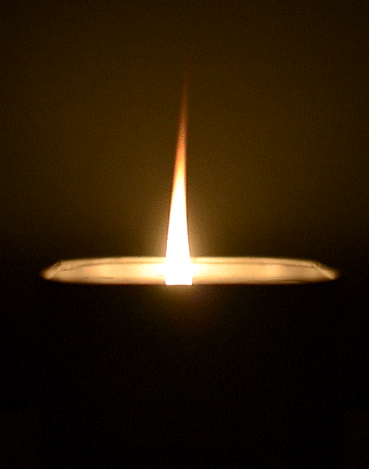
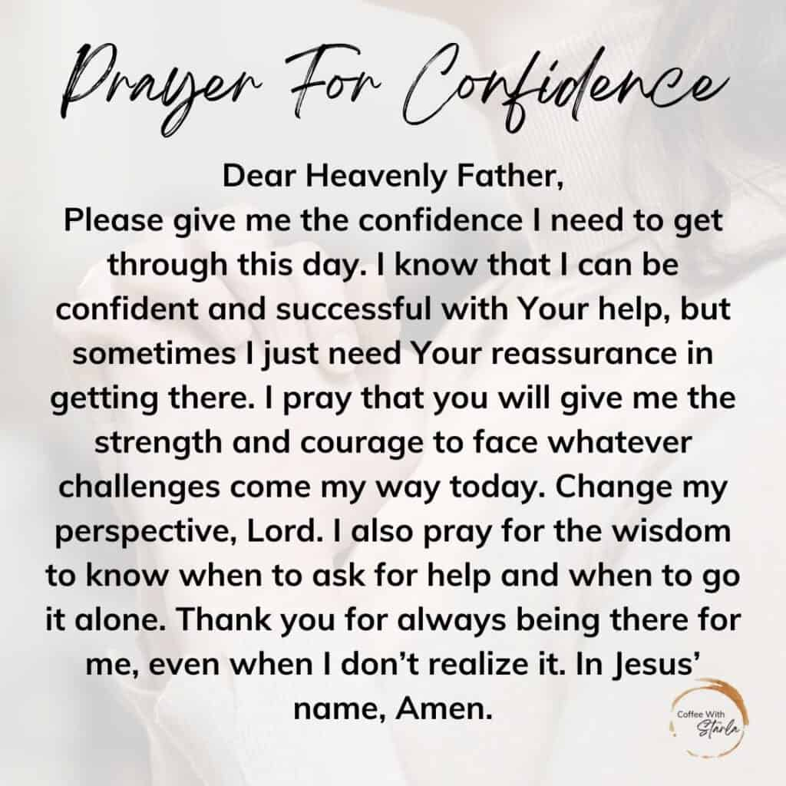
Let Us Pray

Slide 5
Thoughts and prayers Monday 8th May – Friday 12th May

Slide 6
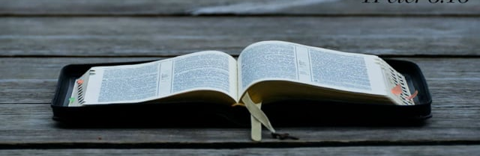

The scripture this week is taken from 1 Peter 3:15-18.
In this passage, Peter is exhorting Christians to be prepared to defend their faith when asked by others. This means being able to articulate the reasons for their hope in Christ, and doing so with gentleness and respect. Peter also encourages believers to maintain a clear conscience, so that those who speak against them may be ashamed of their false accusations

Slide 7
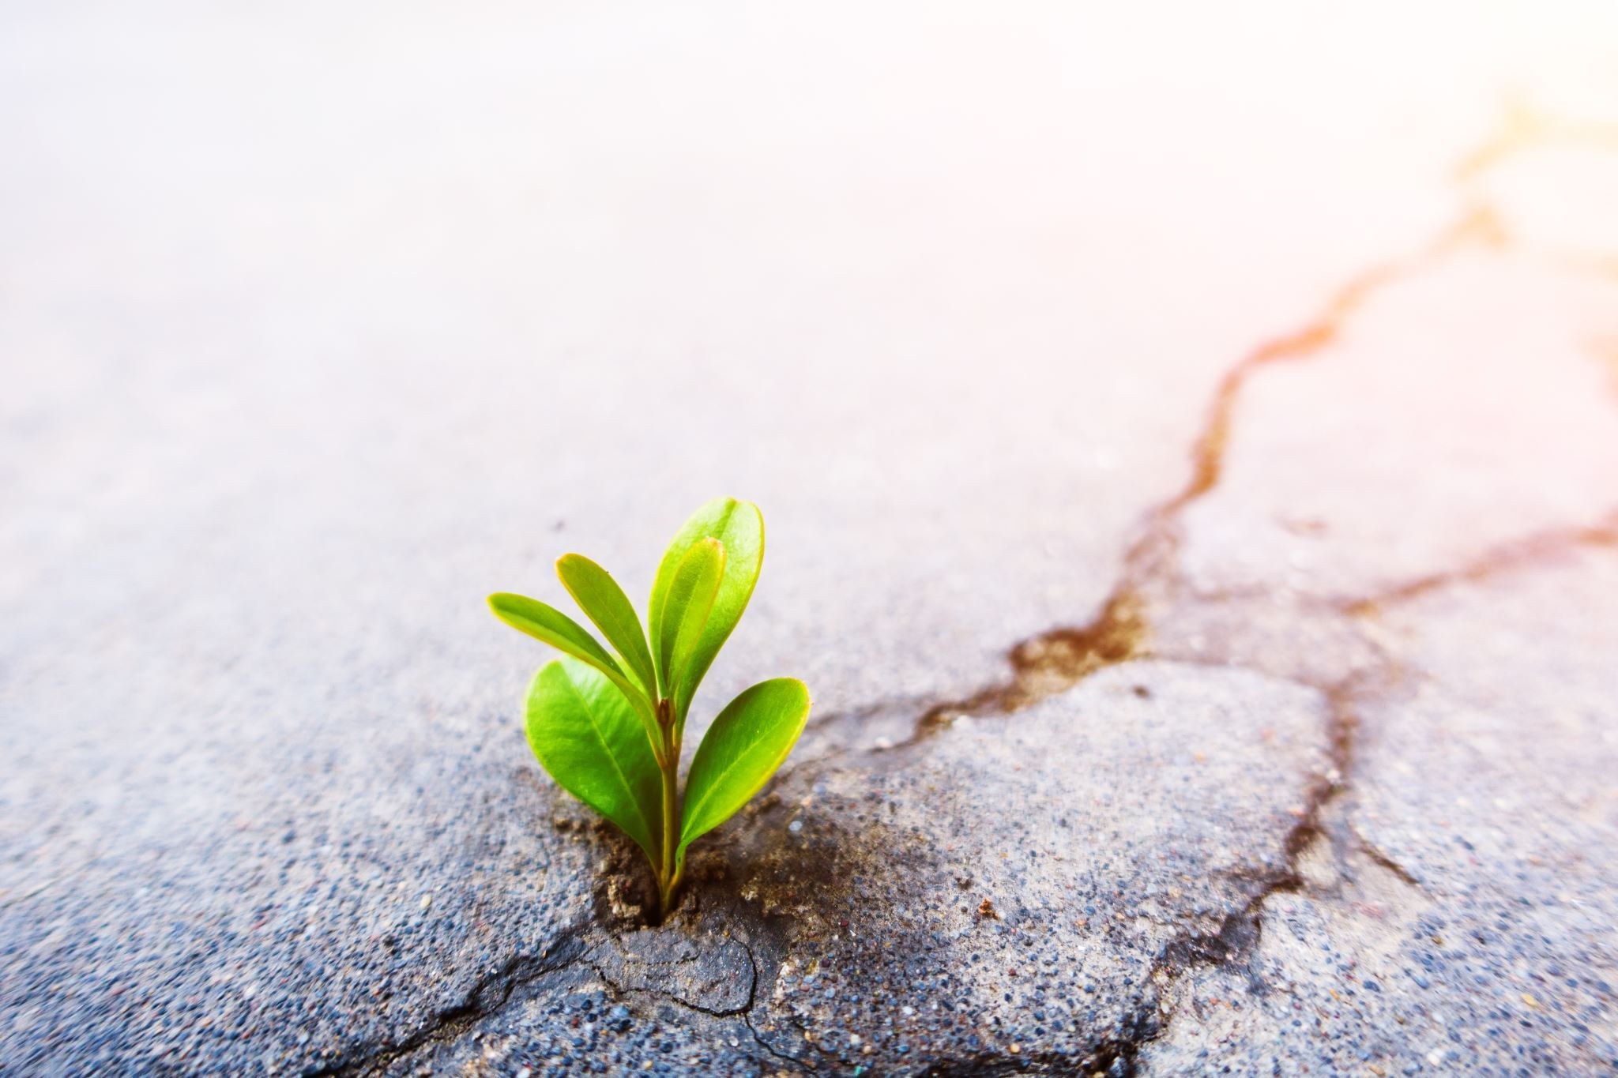
HOPE
The passage reflects the theme of confidence by encouraging Christians to have a deep and unwavering trust in their faith and in Christ, while also encouraging them to share their faith with others in a gentle and respectful manner
It encourages us to reflect on the reasons for our hope, challenging us to share our faith, reminding us of the power of Christ's resurrection, and acknowledging the possibility of suffering.
What are you hopeful for?
How can you find the confidence to maintain that hope?

Slide 8
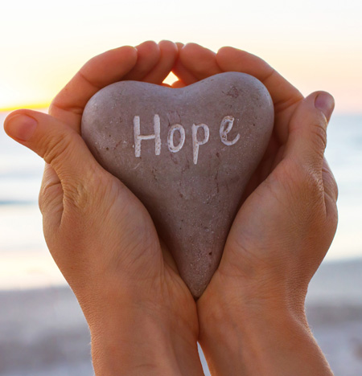
Finding confidence to keep unwavering hope can be challenging, especially during difficult times. Here are some suggestions that may help
Cultivate a positive mindset: One way to find confidence and maintain hope is to focus on positive thoughts and experiences. Try to cultivate a sense of gratitude by regularly reflecting on the things in your life that bring you joy and fulfillment. This can help you to stay positive and hopeful, even in the midst of challenges.
Practice self-care: Taking care of yourself physically, mentally, and emotionally can help you to build resilience and maintain confidence. This may involve getting enough rest, eating healthy foods, exercising regularly, and taking time to engage in activities that bring you joy.
Seek support: It can be helpful to seek out the support of others who share your beliefs or who can offer encouragement and empathy. This may involve joining a faith community, attending support groups, or confiding in friends or family members who you trust.
Focus on your values: Consider what is most important to you and focus on living in alignment with those values. When you live according to your values, you may find greater purpose and meaning, which can help to bolster your confidence and maintain hope.

Slide 9
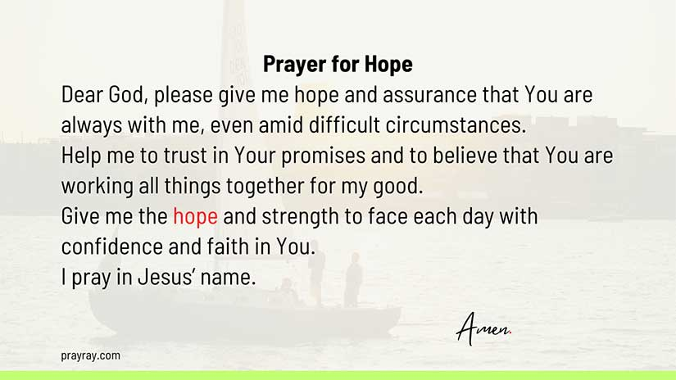

Slide 10
Thoughts and prayers Monday 8th May – Friday 12th May

Slide 11
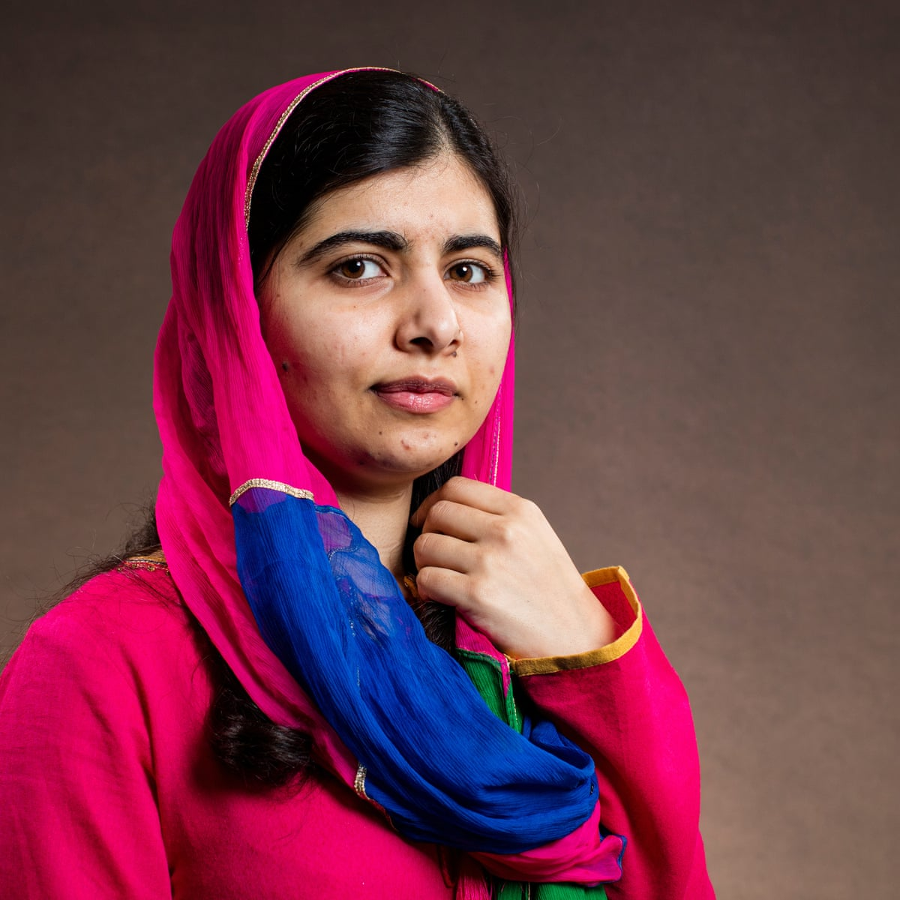
Malala Yousafzai
Malala Yousafzai is a young woman from Pakistan who became an advocate for girls' education and human rights. She was born on July 12, 1997, in Mingora, a small town in the Swat Valley of Pakistan.
When Malala was growing up, the Taliban had taken control of the Swat Valley, and they had banned girls from attending school. Malala was very passionate about her education, and she was determined to fight for her right to learn. She started speaking out against the Taliban's policies and gave interviews to the media, where she spoke about her desire to attend school.
In 2012, when Malala was just 15 years old, she was shot in the head by a Taliban gunman while she was on her way home from school. Despite being critically injured, Malala survived the attack and was flown to the UK for medical treatment.
After recovering from her injuries, Malala became an even stronger advocate for girls' education and human rights. She spoke at the United Nations and traveled the world, sharing her story and promoting education for girls everywhere. She co-founded the Malala Fund, a non-profit organization that advocates for girls' education and provides support to girls in need around the world.
Malala Yousafzai Video

Slide 12
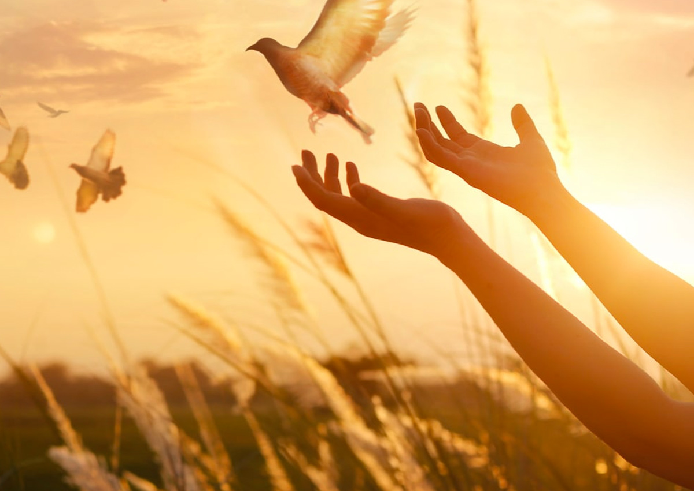
Malala Yousafzai demonstrated remarkable confidence throughout her life, especially in the face of adversity
Malala's confidence was evident in her determination to stand up for what she believed in, even in the face of danger and opposition. Her unwavering commitment to girls' education and women's rights has inspired millions around the world.
Think of one area of your life where you could show more confidence, determination and commitment.
The power to make a change is in YOUR hands

Slide 13
Let us Pray
Lord, I come before you with a humble heart, seeking your guidance and strength. I ask for your help in building my confidence so that I may face the challenges and opportunities that lie ahead with courage and conviction.
Please help me to believe in myself, to see my own worth, and to recognize my strengths and abilities. Help me to let go of my fears and doubts, and to trust in your plan for me.
Grant me the wisdom to know that I am capable of achieving my goals and the courage to take the necessary steps to make them a reality. Help me to embrace my uniqueness and to stand confidently in who I am.
May your loving presence fill me with the assurance and peace that comes from knowing that I am not alone. I trust that you will be with me every step of the way, guiding me and supporting me as I grow in confidence and faith.
Thank you for the blessings you have given me and for the promise of a bright and hopeful future. I pray all of these things in your holy name.
Amen

Slide 14
Thoughts and prayers Monday 8th May – Friday 12th May

Slide 15
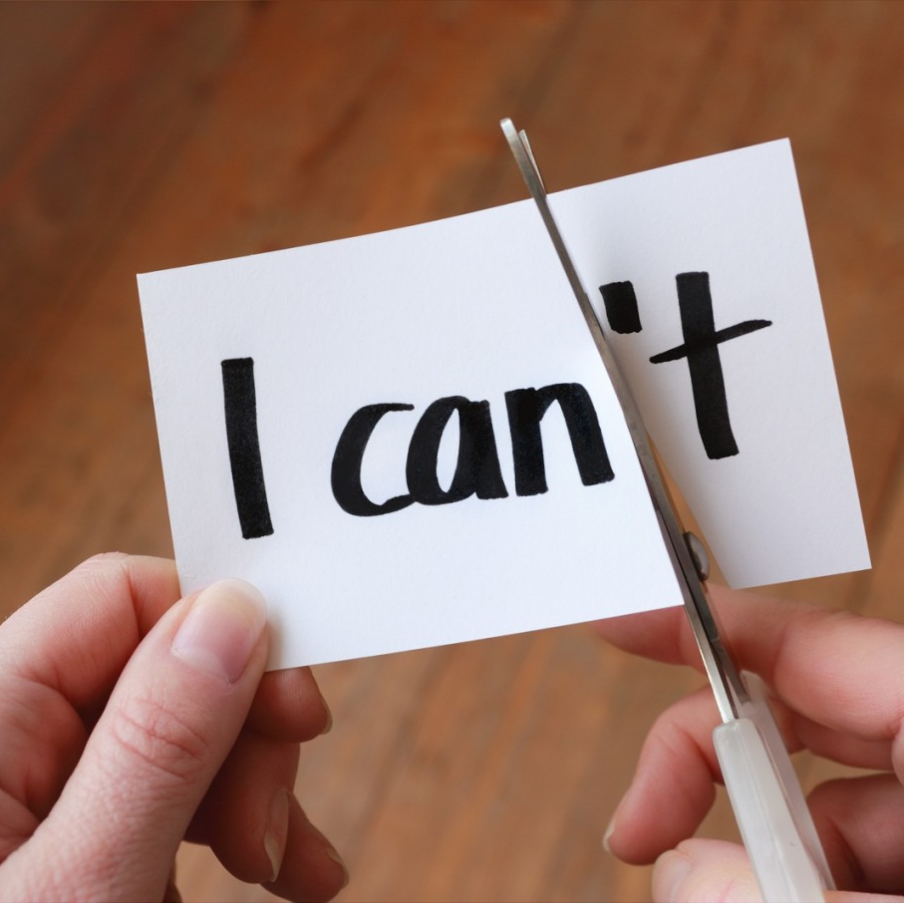
Positive Affirmations
A positive affirmation is a statement that is used to reinforce positive beliefs and increase confidence and self-esteem. It is a phrase or sentence that is repeated to oneself, often on a regular basis, with the intention of changing negative thought patterns and promoting a positive mindset

Slide 16
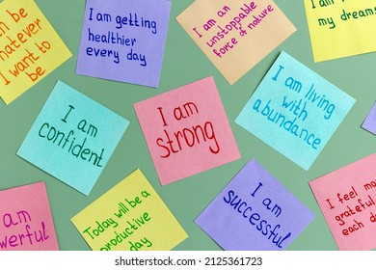
On a post it note write down positive affirmations for either yourself or someone you care about
Choose affirmations that are meaningful to you or others and that will inspire you to achieve your goals.
You could stick one into your planner as a regular reminder of how great you are!

Slide 17
Let Us Pray
Lord, in the morning I start each day,
By taking a moment to bow and pray.
Beginning with thanks,
I then give praise for all your kind and loving ways.
Today if sunshine turns to rain,
If a dark cloud brings some pain,
I won’t doubt or hide in fear.
For you, my God, are always near.
I will travel where you lead;
I will help my friends in need.
Where you send me, I will go;
With your help, I’ll learn and grow.
Hold my family in your hands,
As we follow your commands.
And I will keep you close in sight
When I crawl in bed tonight.

