Slide 1
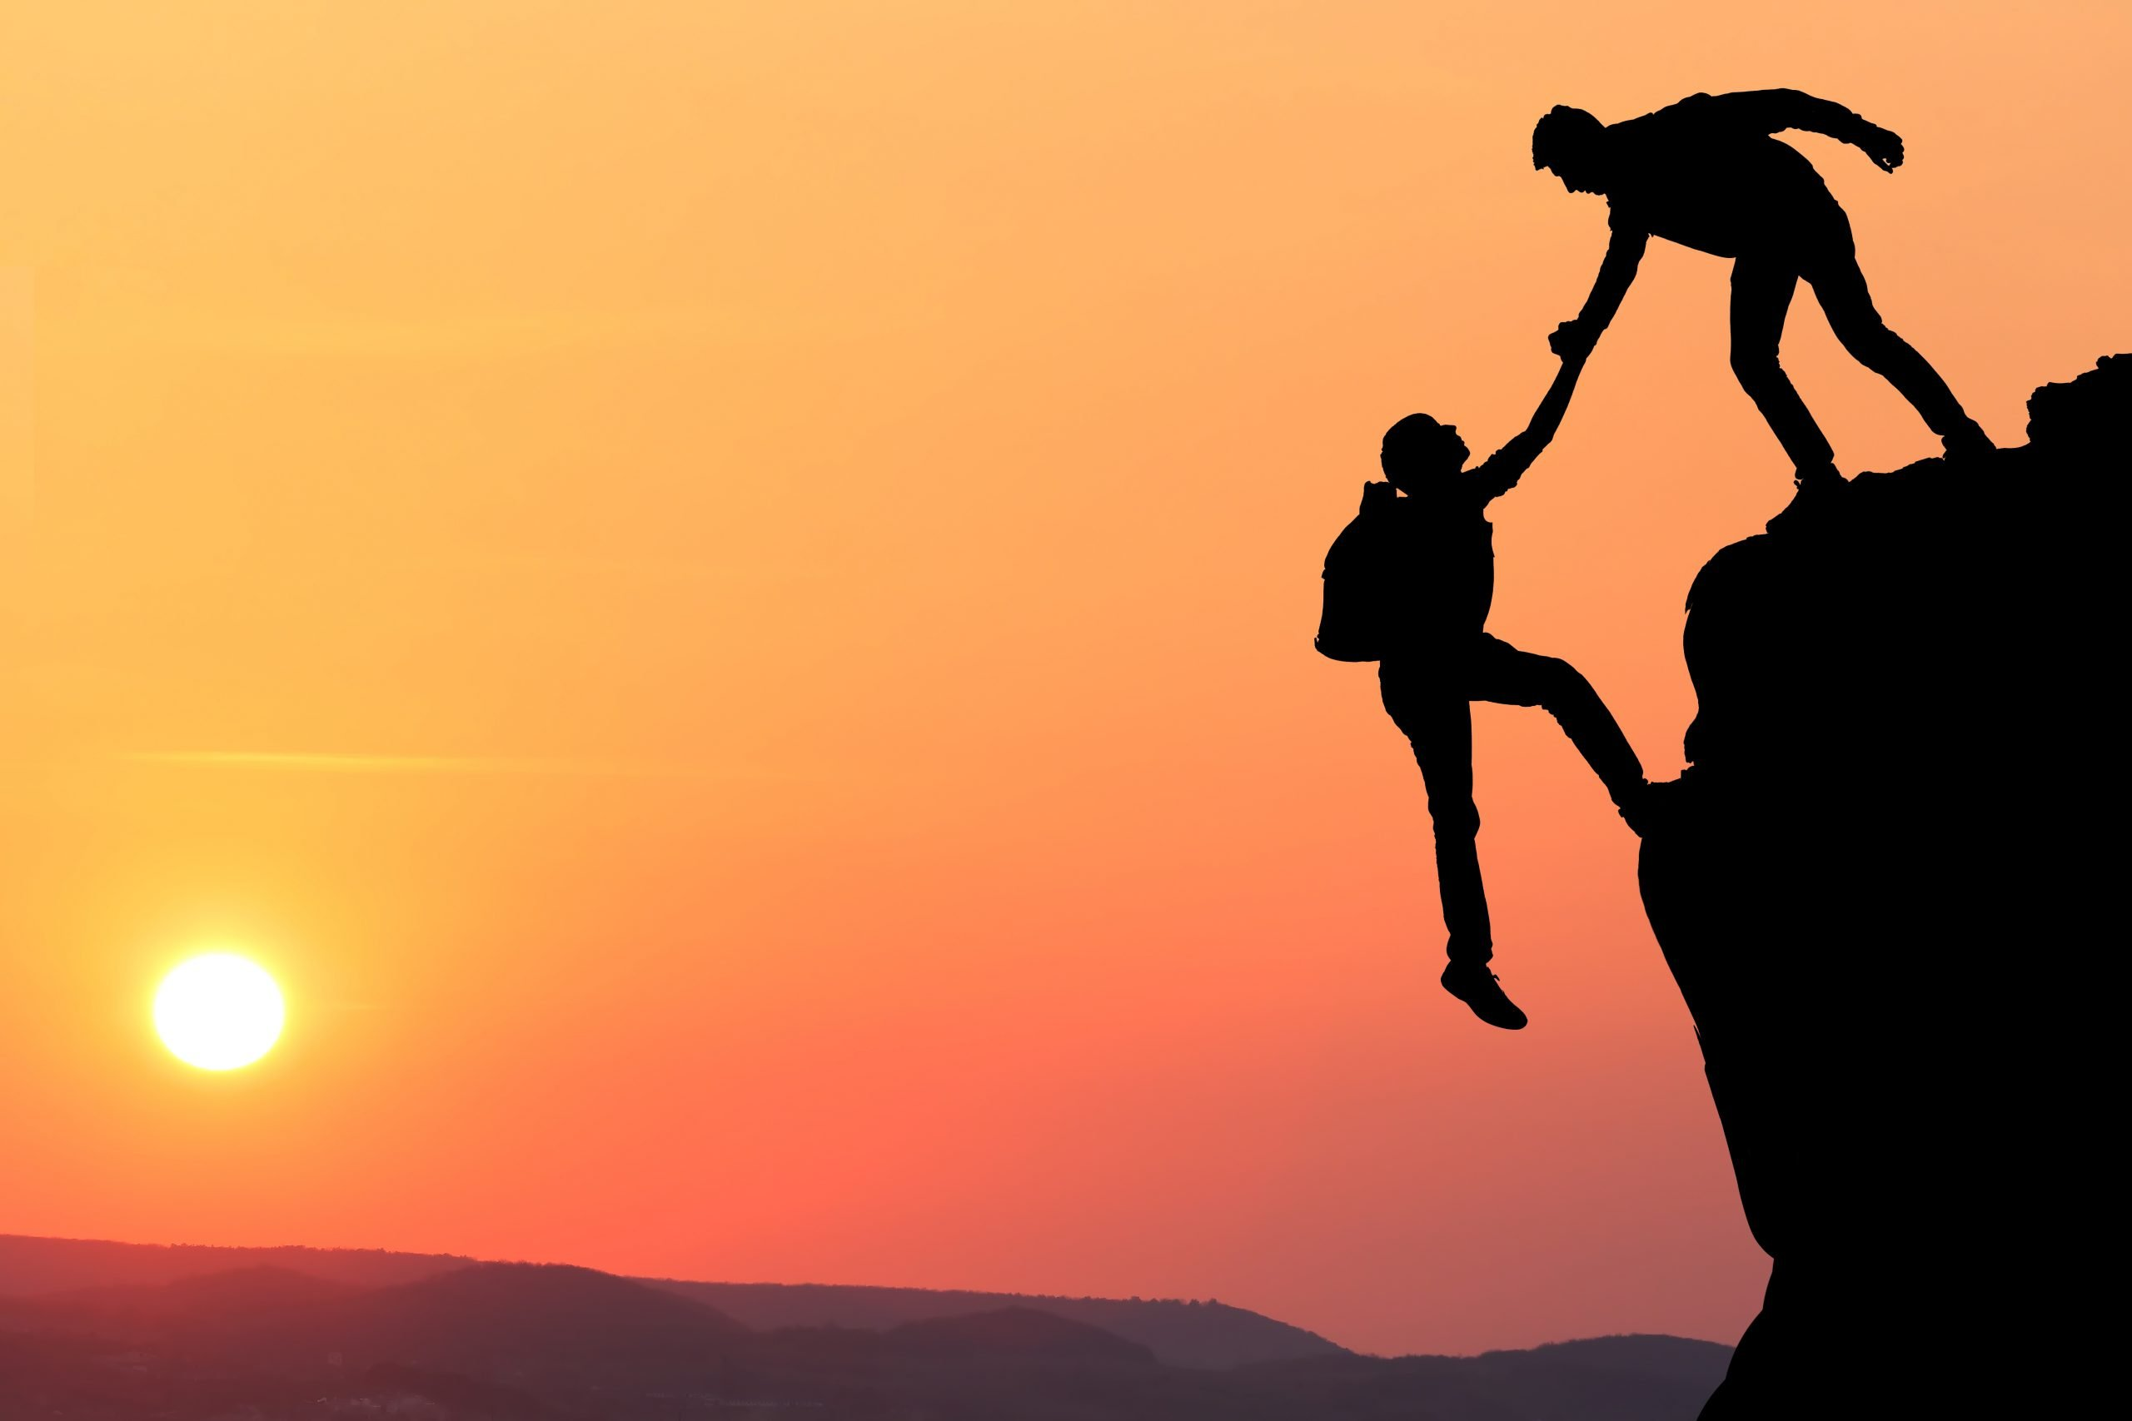
TRUST
Thoughts and Prayers 1st – 5th May

Slide 2


MORNING PRAYER IN THE CHAPEL THIS WEEK
Wednesday 3rd May - 10N
Thursday 4th May - 10T
Friday 5th May - 10M

Slide 3
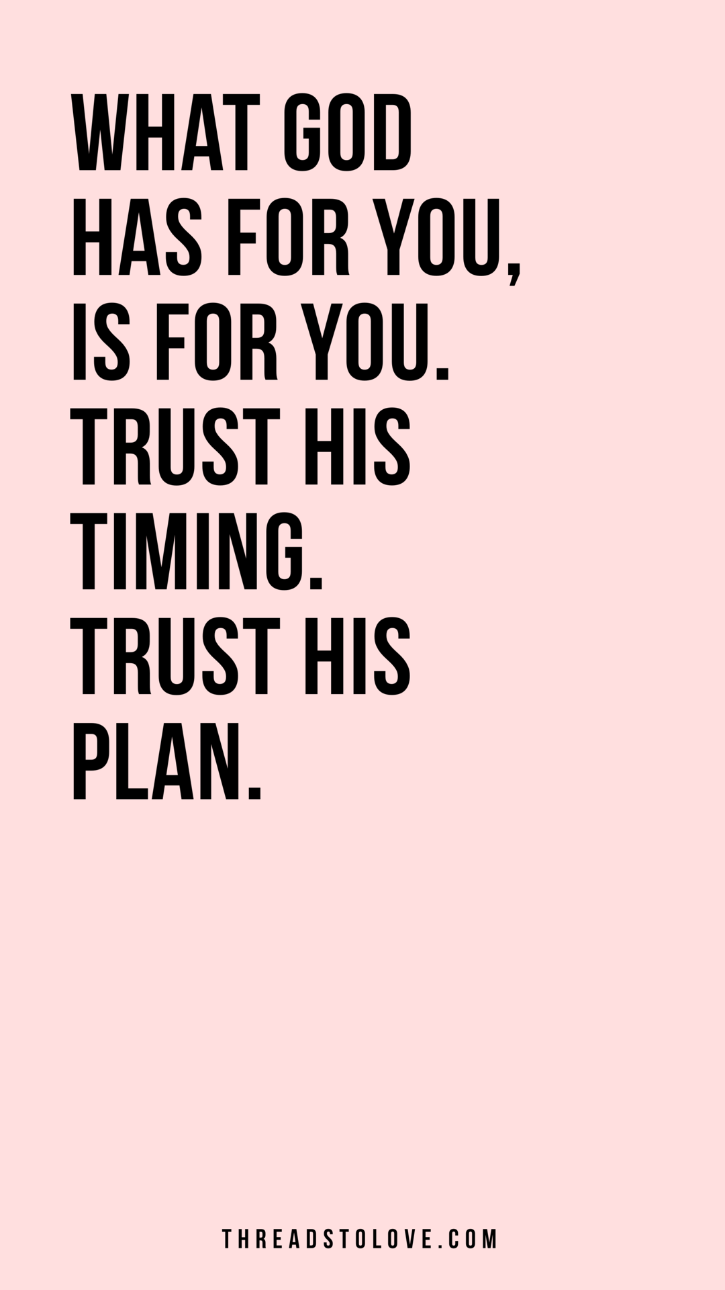
Jeremiah 29:11 says: "For I know the plans I have for you," declares the Lord, "plans to prosper you and not to harm you, plans to give you hope and a future."
Discuss: How does it make you feel, knowing that someone has a plan to help you succeed?
This verse reminds us that God has plans for our lives, and that those plans are good. It's a message of hope and reassurance that God has a purpose for each of us. It reminds us that we can trust in God's guidance, even when we may not understand the path that lies ahead.
In the Catholic calendar, 3rd of May is the Feast Day of St. Philip and St. James. As apostles, they were called to trust in God's plan for their lives and to share the message of Jesus with others, even in the face of persecution and hardship. Their lives serve as an example of the importance of trusting in God's guidance and providence, even when the path ahead may be uncertain or difficult.

Slide 4
Dear God,
Help us to trust in your plan for our lives, even when it may be difficult to understand.
Give us the courage to follow your path, knowing that you are always with us.
Amen.
Let
us
pray

Slide 5
TRUST
Thoughts and Prayers 1st – 5th May

Slide 6

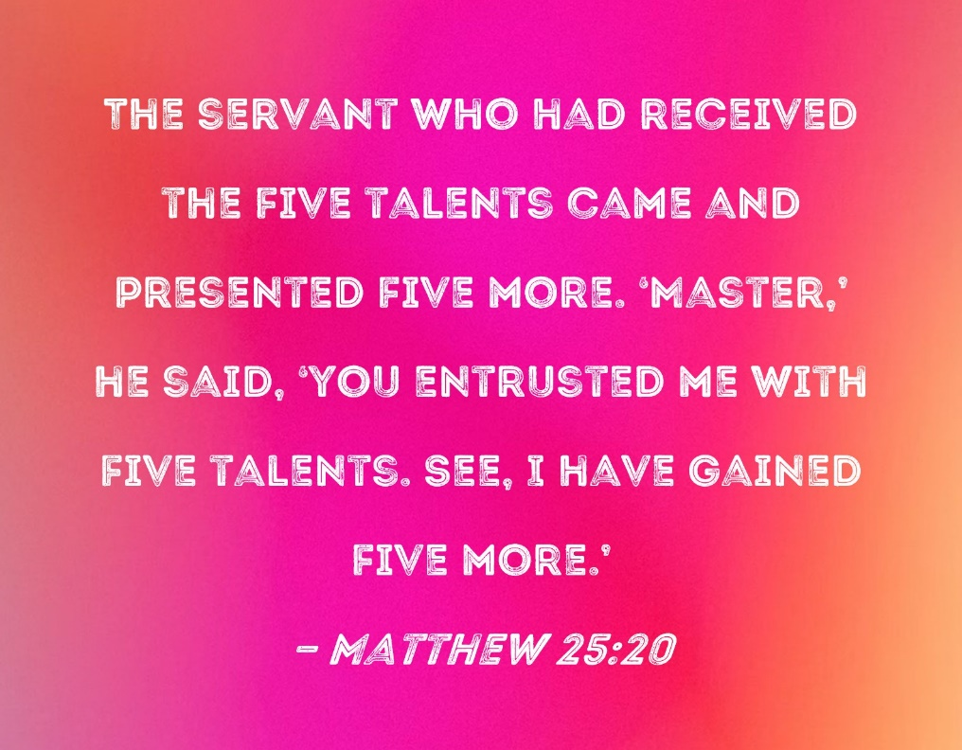
The Bible teaches us to put our trust in God rather than in ourselves. Proverbs 3:5-6 says, "Trust in the Lord with all your heart and lean not on your own understanding; in all your ways submit to him, and he will make your paths straight." This passage encourages us to rely on God's guidance and wisdom rather than our own understanding.
However, the Bible also teaches that God has given us unique talents and abilities that we can use to serve Him and others. Remember the Parable of the Talents? Jesus tells us about a master who entrusts his servants with varying amounts of money, and expects them to use their talents wisely to generate more wealth. This parable illustrates the importance of trusting and using the talents God has given us.
Think of a time when you have doubted yourself. How can you build your self-trust?
Building self-trust requires patience, self-compassion, and a willingness to take risks and learn from mistakes. With time and practice, it is possible to develop a stronger sense of self-trust and confidence in your abilities.

Slide 7
Dear God,
Help us to trust in ourselves and our abilities, knowing that you have given us unique gifts and talents.
Guide us as we strive to live up to our full potential and make a positive impact on the world.
Amen.
Let
us
pray

Slide 8
TRUST
Thoughts and Prayers 1st – 5th May

Slide 9
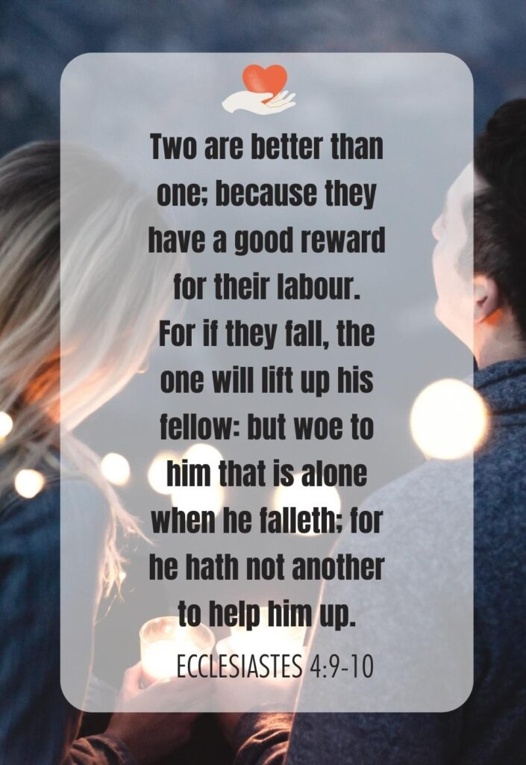
Read this bible passage.
Discuss: How does this link to our theme of trust?

Slide 10
This passage shows us the importance of trusting others which is important for several reasons:
It is essential for building strong relationships with others.
It is important for effective collaboration and achieving common goals.
Trusting others can reduce stress and anxiety by eliminating the need to constantly doubt others.
Trusting others fosters a sense of community and belonging.
Trusting others can be challenging, especially if we have been hurt or let down in the past. However, taking the risk to trust others can lead to great rewards, both personally and collectively.
Spend a moment reflecting quietly on a time when you have struggled to trust others. Going forward, how can work to build trust in your relationships?
It's important to communicate openly, be consistent in your actions, take responsibility for your mistakes, show empathy and understanding, and respect others.

Slide 11
Dear God,
Help us to trust in others and build strong, loving relationships.
Help us to forgive those who have betrayed our trust and work to restore broken relationships.
Amen.
Let
us
pray

Slide 12
TRUST
Thoughts and Prayers 1st – 5th May

Slide 13
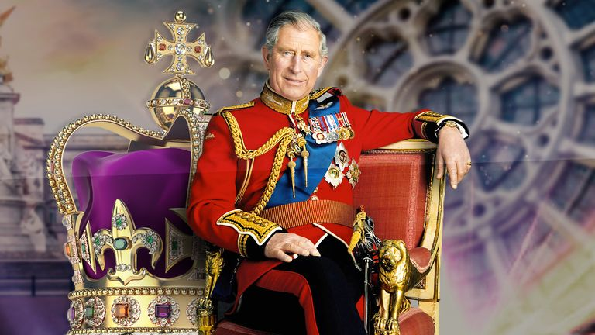
The coronation of King Charles will take place this Saturday.
Discuss with the person next to you:
How does this link to our theme of trust?

Slide 14
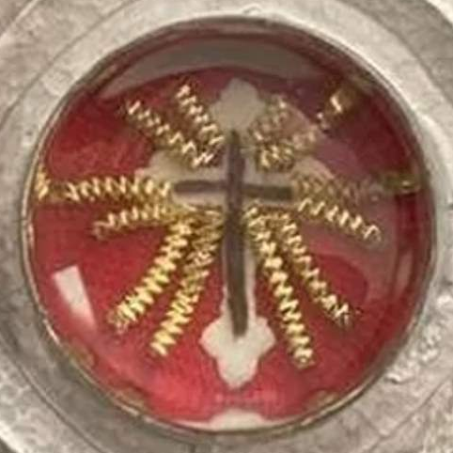
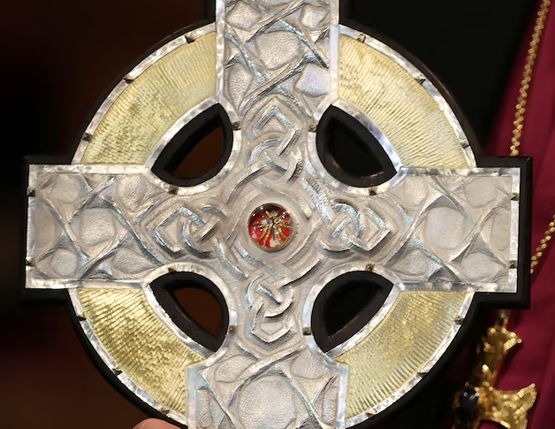
The coronation represents a moment of trust between the new King and his people. We place our trust in King Charles to lead us with wisdom and act in our best interests.
The coronation can also be seen as an act of trust in God. The new King will be anointed with oil and receive a blessing from the Archbishop. This act of consecration represents a trust in God's plan for the UK.
Pope Francis has gifted King Charles two shards of wood from the True Cross on which Jesus Christ was crucified, to be included in the ceremony. The shards have been incorporated into a new cross that will lead the coronation procession.

Slide 15
Dear God,
As we prepare for the upcoming coronation, we pray for a spirit of trust to fill our hearts.
Help us to trust in the new King to lead our nation with wisdom, courage, and compassion.
May this moment be a reminder that true leadership is built on a foundation of trust, both between leaders and their people and between us and you.
Guide us as we work together to build a brighter future for all.
Amen
Let
us
pray

