Slide 1

Theme of the week: Vocation
Thoughts and Prayers 24th – 28th April

Slide 2


MORNING PRAYER IN THE CHAPEL THIS WEEK
Monday 24th April - 9I
Tuesday 25th April - 9M
Wednesday 26th April – 10A
Thursday 27th April - 9R
Friday 28th April - 9Y

Slide 3

Friday Mass
Who?
Mass this week will be led by 8R
When?
Friday Morning at 8.20am
Where?
In the School Chapel. See you there!
ALL ARE MOST WELCOME.
ALL WORDS ARE DISPLAYED ON THE SCREEN.

Slide 4
Theme of the week: Vocation
Thoughts and Prayers 24th – 28th April

Slide 5

Vocation: a strong feeling that you are especially suited to do a particular job or to fulfil a particular role in life, especially one which involves helping other people.
Sometimes, people use the word 'calling' to describe a vocation – why might this be?

Slide 6

What is the difference between a job and a vocation?
Can you give examples of both?
Can your day-to-day job also be your vocation?

Slide 7

Lord,
Allow us to be open to your plan for us.
Sometimes, it can be difficult to hear your call among the noise of the busy world we live in.
Give us the ability to clearly see our place in the world and find our vocation.
We pray for the opportunity to continue your work in our own lives.
Reveal your plan for us.
Amen

Slide 8
Theme of the week: Vocation
Thoughts and Prayers 24th – 28th April

Slide 9
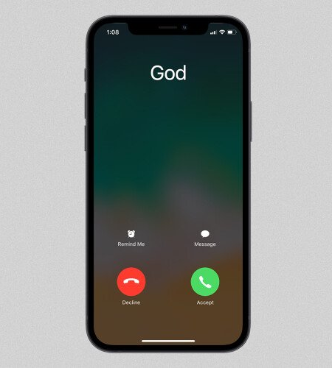

A vocation is something that you are called to do.
You may have felt a strong desire to pursue something in your life or you may feel like your path is still undetermined.
God works in mysterious ways and your calling may not always be obvious.
So how do you know what God is calling you to do?

Slide 10


Slide 11
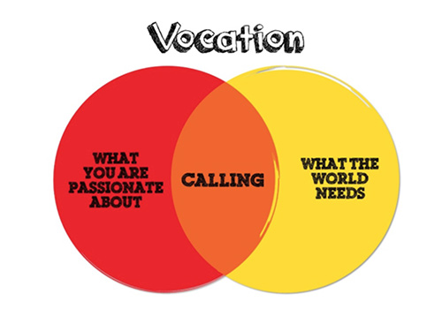
Discovering our calling can come from personal reflection.
God has a plan for us all but we must be open and ready to receive his call.
Sometimes, we need to look inwards to find out what it is that we are being called to do.
At the end of this week, we will have the opportunity to explore our purpose.

Slide 12
Almighty Father,
You have created for us some definite purpose.
Grant us the grace to know the path You have planned for us in this life and to respond with a generous “Yes.”
Make our school, parishes, homes and hearts fruitful ground for Your gift of vocations.
May our young people respond to Your call with courage and eagerness.
We trust in your plan Father.
Amen

Slide 13
Theme of the week: Vocation
Thoughts and Prayers 24th – 28th April

Slide 14
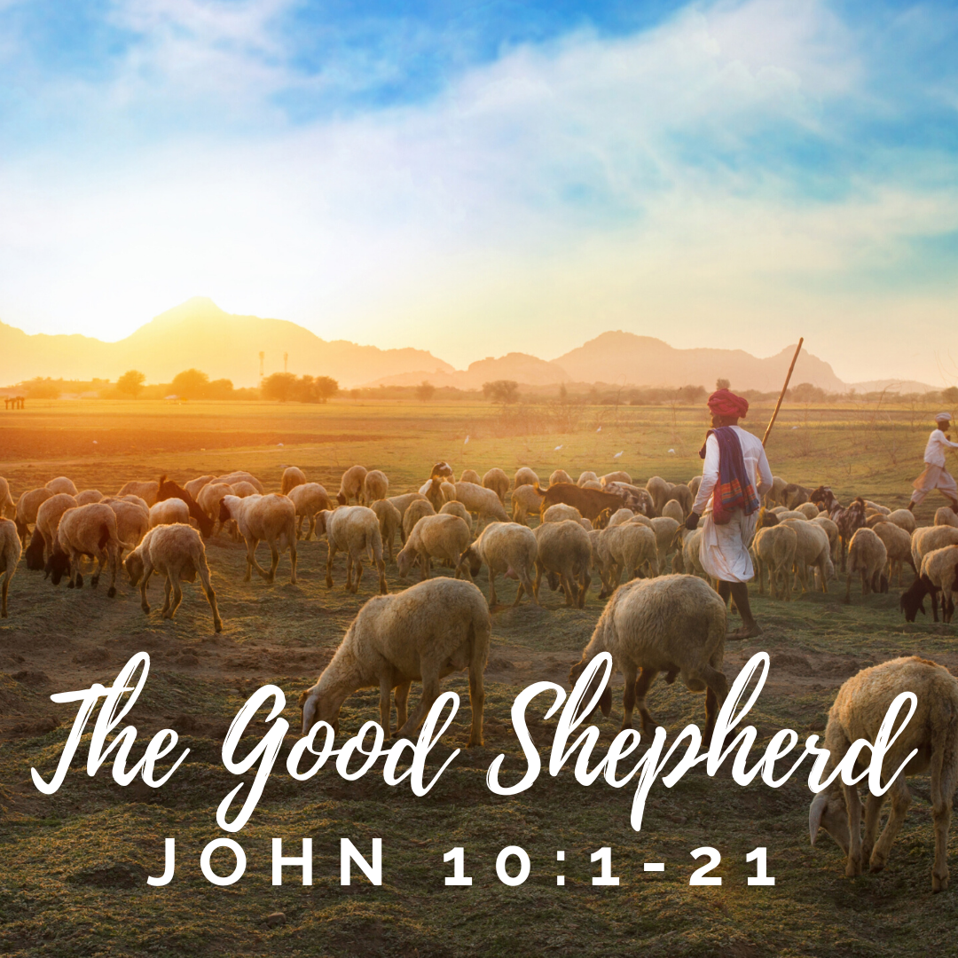
"One by one he calls his own sheep"
John 10:1-21
Our theme this week comes from the parable of the Good Shepherd in John's Gospel.
Jesus uses the metaphor of a flock of sheep to show how he cares for each of us.
The good shepherd takes his responsibility seriously and follows his calling from God.

Slide 15
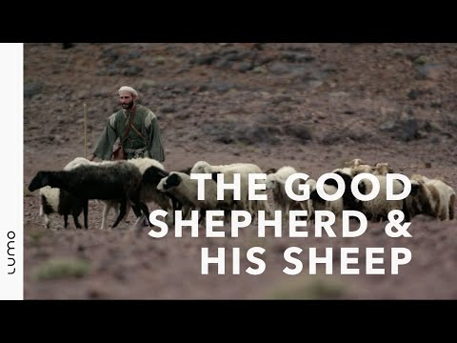

Slide 16
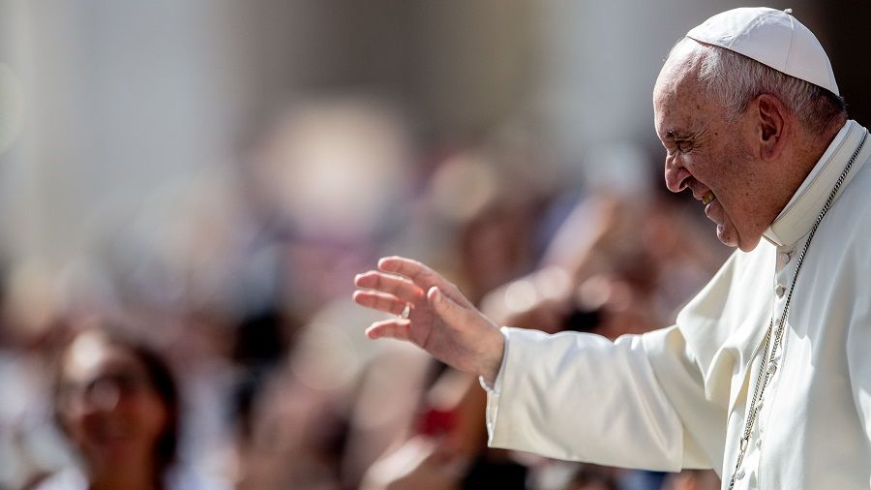
Pope Francis calls you all to pursue a 'noble profession'. He wants you to be the Good Shepherd. This means that your work is rooted in Gospel values. He has spoken of the important role that nurses, doctors, teachers and members of the clergy have in our society but it can also be argued that every profession can be 'noble' if the person follows their call to serve.
Give examples of how the following professions can do noble work.
Politician
Social worker
Journalist
CEO
Restaurant owner

Slide 17
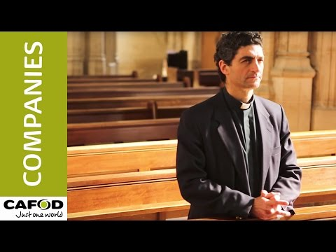

Slide 18
The Fourth Sunday of Easter is traditionally celebrated as Good Shepherd Sunday and Vocations Sunday. In the parable, Jesus speaks of himself as the Shepherd who is prepared to lay down his life for his sheep.
When a man becomes a priest, he chooses to follow Jesus and he aspires to become as Christ to others. In doing so, he answers Christ’s call to serve the Church and its people.
The vocation of a religious life is filled with sacrifice and commitment. Today, we pray for our religious leaders.
Gracious and Loving God,
We thank you for the gift of our priests and all who have chosen a religious life. Through them, we experience your presence in the sacraments. Help our clergy to be strong in their vocation. Set their souls on fire with love for your people.
Amen

Slide 19
Theme of the week: Vocation
Thoughts and Prayers 24th – 28th April

Slide 20
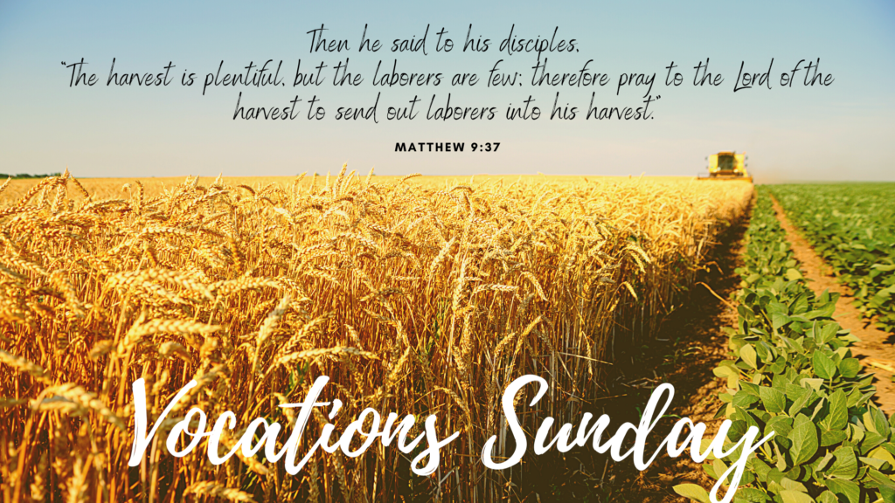
The Fourth Sunday of Easter is known as Vocations Sunday or Good Shepherd Sunday, and is marked as the World Day of Prayer for Vocations. The purpose of this day is to fulfil Jesus' instruction to “Pray the Lord of the harvest to send labourers into his harvest” (Matthew 9:38).

Slide 21
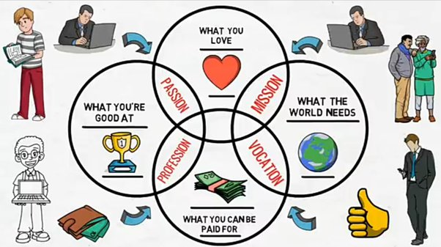
Earlier this week, we asked you to consider how your passions and the needs of the world can help you to discover your vocation. Today, you will spend some time exploring your purpose. Copy the venn diagram. The middle of your diagram is your purpose.

Slide 22
A Prayer for Vocation Sunday
Lord,
Help us to believe that we are all ordinary people made extraordinary through your vision and your power. Take our insecurities and feelings of inadequacy and give us the courage to see ourselves and others as you see us, with gifts and potential to transform your world and build your Kingdom.
Amen

