Slide 1
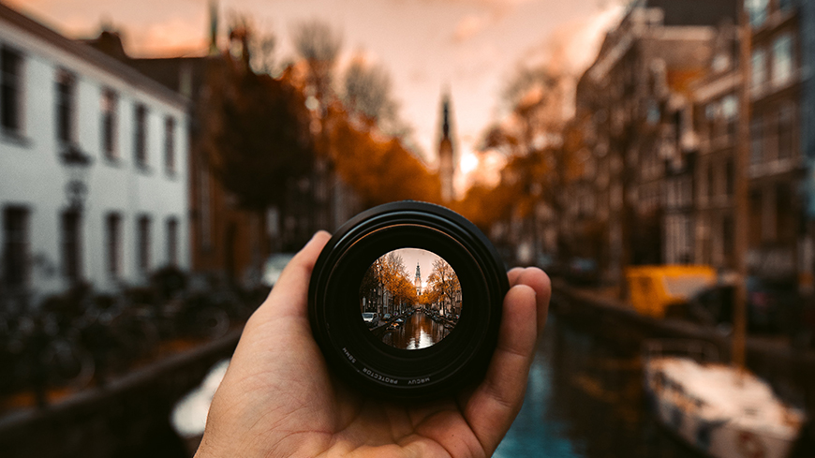
PERSPECTIVE
Monday 17th – Friday 21st April

Slide 2
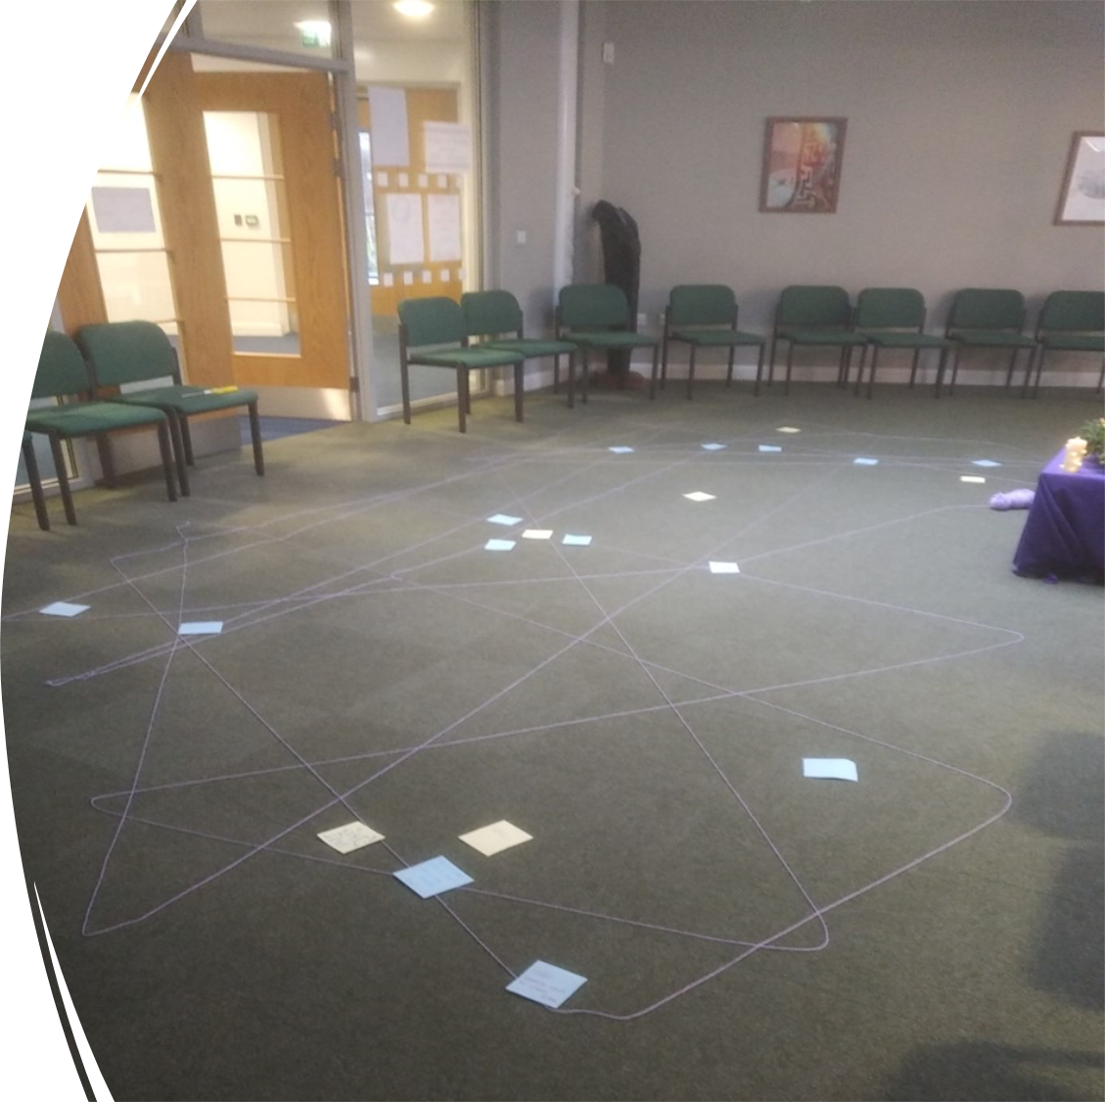
Prayer in the chapel this week
Mon: 9S
Tues: 9A
Wed: 10S
Thurs: 9N
Fri: 9T

Slide 3
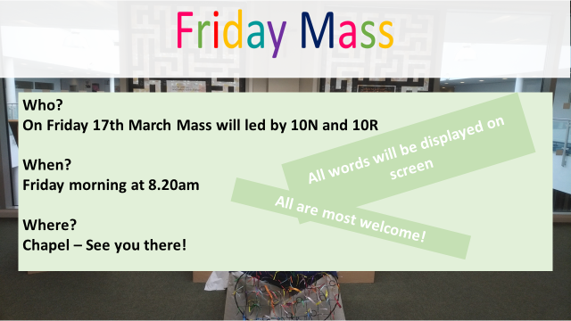

Slide 4
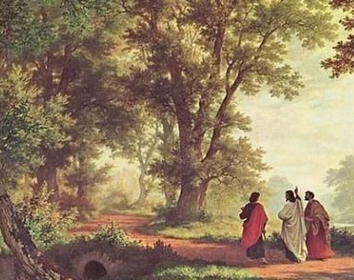
Our scripture this week comes from the book of Luke
The Road to Emmaus

Slide 5
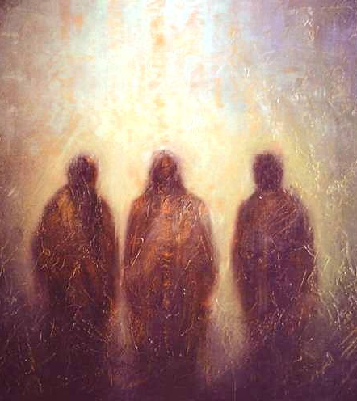
The story highlights the importance of perspective in understanding events and recognising the presence of God in our lives. The two disciples were walking to Emmaus, feeling disappointed and defeated after the death of Jesus. However, they encountered a stranger on the road who explained the scriptures to them and opened their eyes to a new perspective. When the stranger revealed himself to be Jesus, they realised that their disappointment had blinded them to the reality of God's plan.
This story illustrates the theme of perspective because it shows how our understanding of events can be limited by our own biases and emotions. The two disciples were unable to see the bigger picture until they encountered someone who could offer a different perspective.
We often need to step back and consider alternative viewpoints to gain a deeper understanding of our own lives and the world around us. The story also emphasizes the importance of having faith in the face of uncertainty, as the disciples' faith was strengthened when they recognised the presence of Jesus in their midst

Slide 6
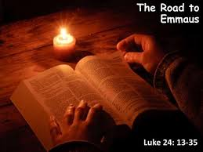
Let us Pray
Almighty Father,
in Your great mercy You gladdened the disciples with the sight of the risen Lord: give us such knowledge of His presence with us, that we may be strengthened and sustained by His risen life and serve you continually in righteousness and truth; through Jesus Christ your Son our Lord, who is alive and reigns with You and the Holy Spirit, one God, now and for ever.
Amen.

Slide 7
PERSPECTIVE
Monday 17th – Friday 21st April

Slide 8

Debating
Debates are a means of understanding the different perspectives that others can have about the same topic and how those perspectives are made. This helps to develop the capacity to view the same thing from varied perspectives and sometimes, a better perspective.

Slide 9
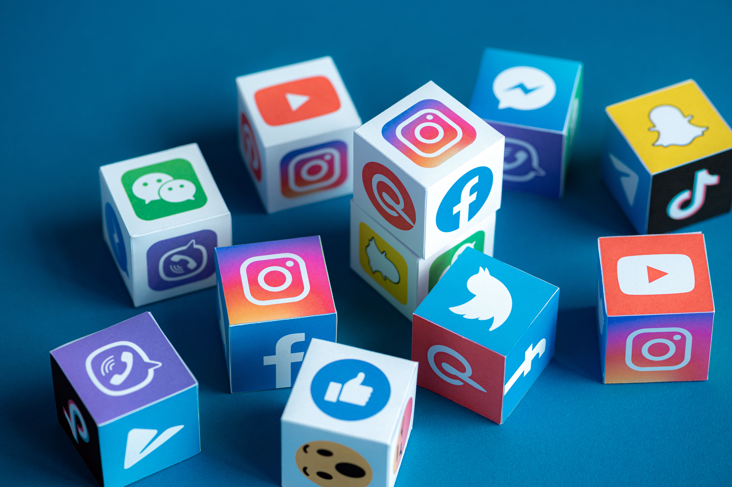
As a class choose one of the following topics to debate. Split the class in half. One side 'for' the argument and the other side 'against'
• Are violent video games appropriate entertainment for teenagers?
• Bullies should be prosecuted by the law
• All people should be vegetarians
• How essential is university education to getting a job?
• Do social media contribute to teenage low self-esteem?

Slide 10

Let Us Pray
Almighty God, through your Holy Spirit you created unity in the midst of diversity;
Empower us to recognize and celebrate different perspectives as your great gift to the human family.
Enable us to be the architects of understanding, of respect and love;
Through the Lord, the ground of all unity, we pray.

Slide 11
PERSPECTIVE
Monday 17th – Friday 21st April

Slide 12
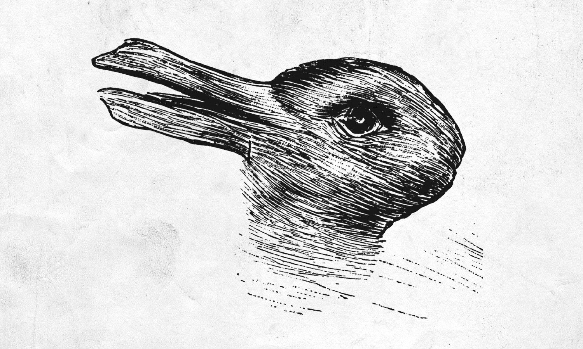
What do you see here?

Slide 13
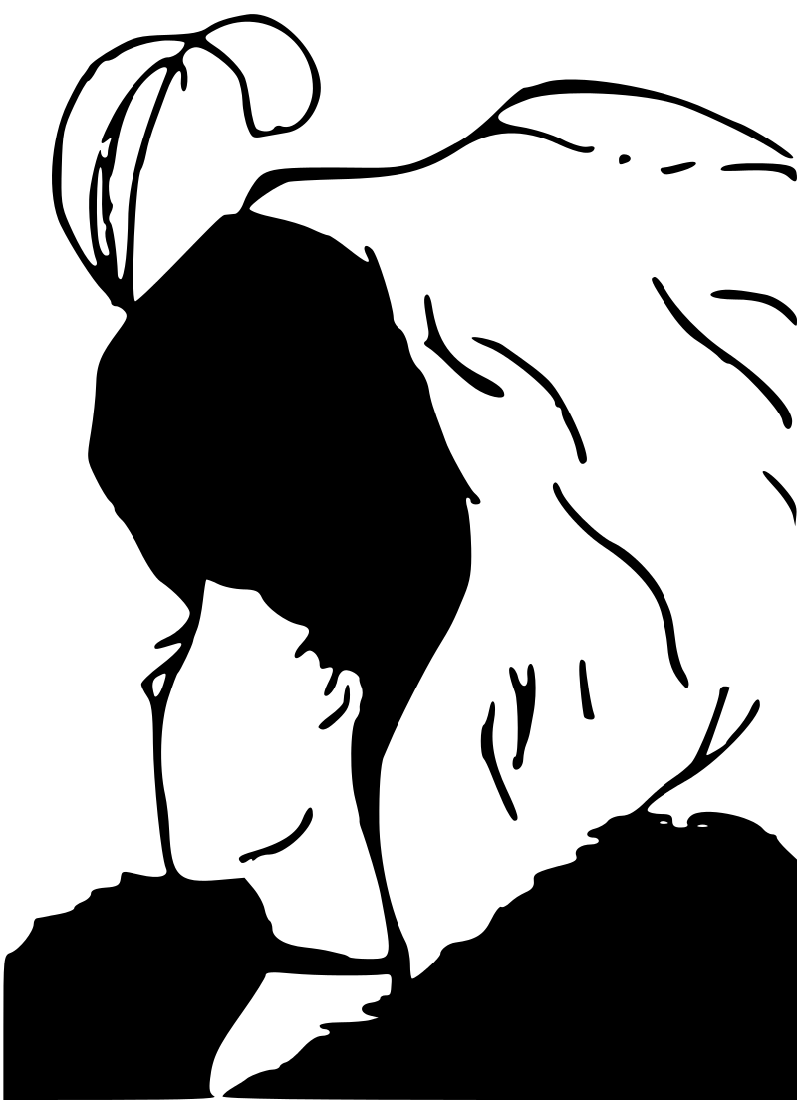
Is this an older woman facing the front or a younger woman turning her head away?

Slide 14

What is this a picture of?

Slide 15

Some questions to discuss with your form group
1. How does your perspective impact your relationships with others?
2. Have you ever changed your perspective on a certain issue or topic? What caused this change?
3. How can understanding different perspectives help with conflict resolution?
4. Can you think of a time when your perspective was not aligned with your family or friends? How did you handle it?
5. How does the media shape our perspectives on certain issues or events?
6. How can you develop a more open-minded perspective towards people or situations that are different from your own experiences?
7. Can you think of a time when your perspective was challenged by someone else? How did you respond?
8. How can your perspective influence your future goals or aspirations?

Slide 16
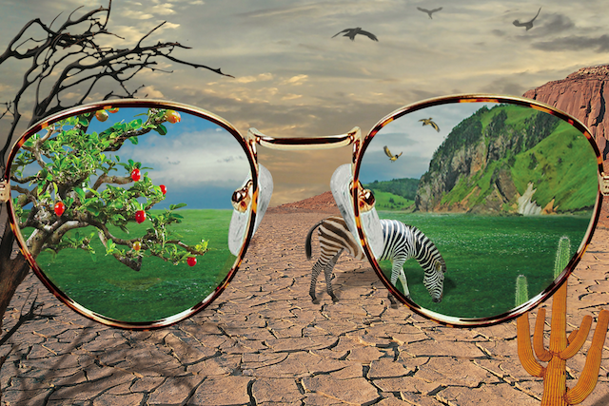
Perspective refers to the way in which we view and interpret the world around us. Our individual perspectives are shaped by our experiences, beliefs, and values.
It is important to remember that everyone has their own unique perspective, and that it is okay for our perspectives to differ from one another. In fact, it is through understanding and respecting each other's perspectives that we can learn and grow as individuals and as a community.
Sometimes, it can be easy to become stuck in our own perspective and forget to consider other viewpoints. This is where empathy comes in. Empathy is the ability to understand and share the feelings of others. It allows us to see things from a different perspective and gain a deeper understanding of those around us.
As we go about our day, let us keep in mind the importance of perspective and empathy. Let us strive to be open-minded, and to seek out new perspectives

Slide 17
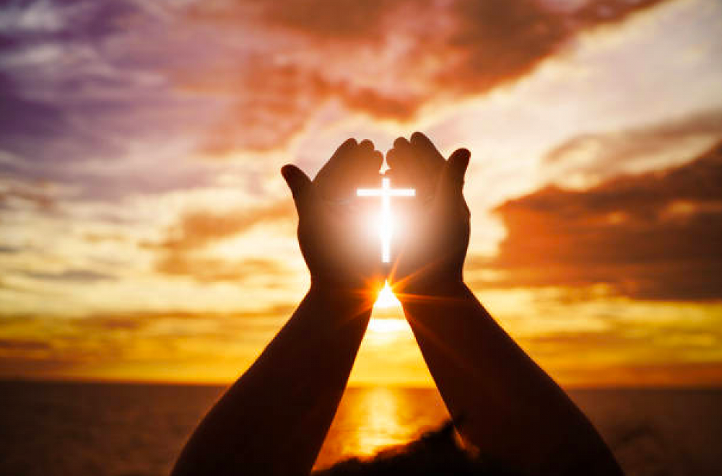
Let Us Pray
All-knowing God,
Help us to think about times when we believed
we were the only ones who knew the whole truth.
Help us to remember times when we felt our view was right
and everyone else was wrong.
Help us to recognize that all that we see
is affected by where we are seeing from - our point of view.
May we be ready to change places with others
and to respect their point of view.
Amen.

Slide 18
PERSPECTIVE
Monday 17th – Friday 21st April

Slide 19
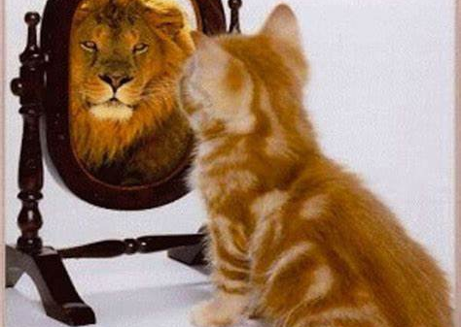
We each have a perception of ourselves; who we think we are
With the person next to you, discuss the following
Do others see you in the same way?
2. How do you want to be to be perceived?
By taking time to consider things differently we may make different choices.

Slide 20
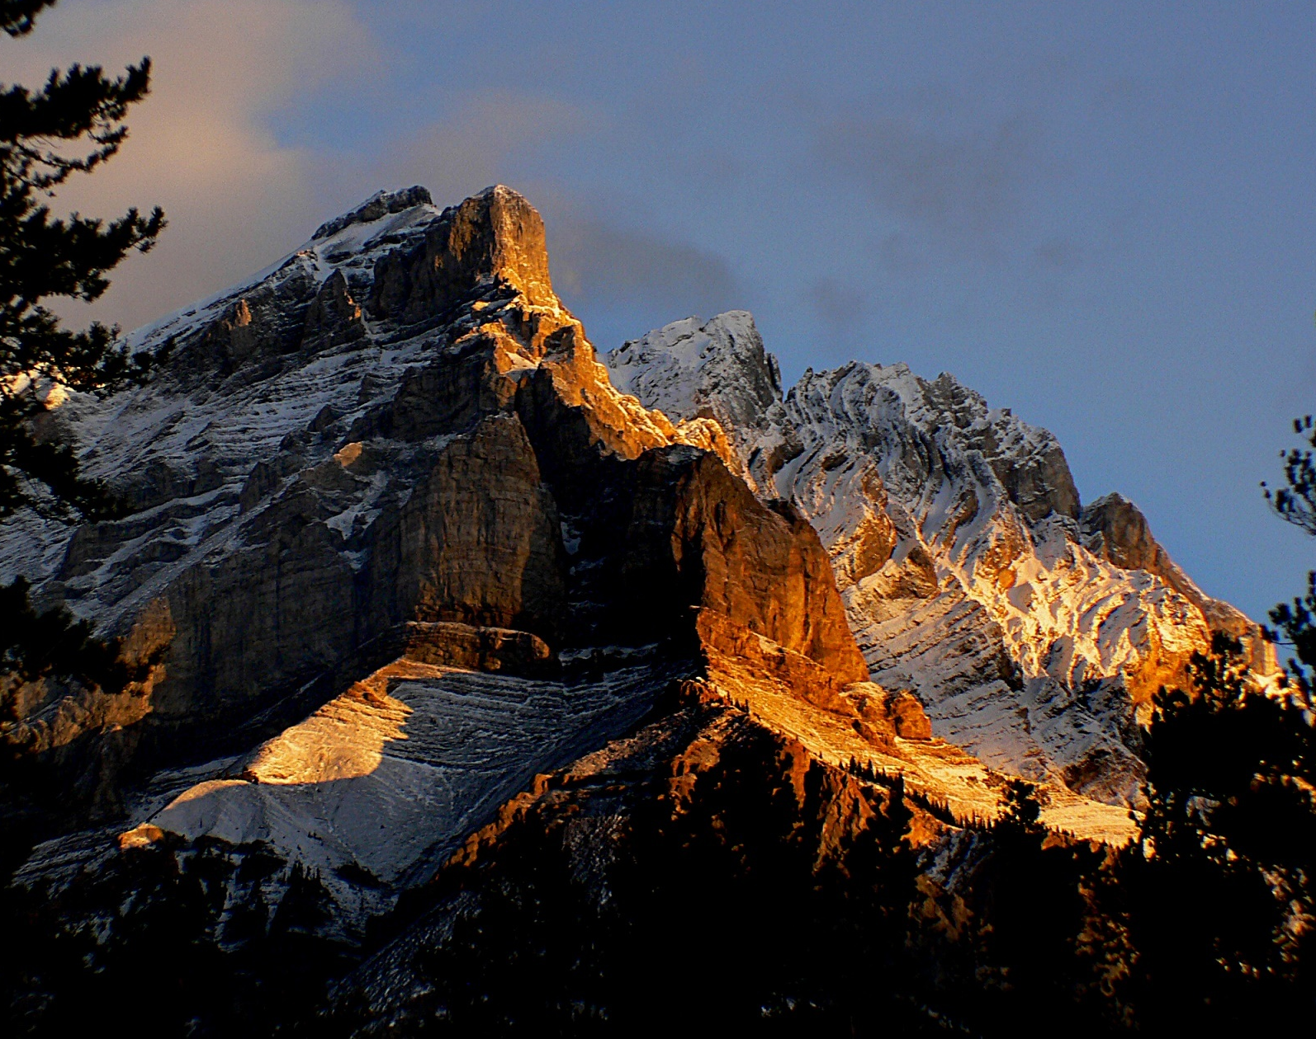
Life is full of challenges. Some appear easily attainable. Others tower over us like high mountains and form a barrier that separates us from where we really want to be.
The challenge may come in many different forms. It may be a person to confront, a performance to give, a task to complete, a request for help, an apology to make, a temptation to avoid. It would be tempting to take the easy way round, avoiding the challenge and the effort of overcoming it. Perhaps the situation would be forgotten in the not-too distant future.
However, there may be an opportunity wasted by taking the easy way. When we tackle an obstacle, life changes for us. We find out something about ourselves: our determination, our courage, our personal resources. We may find out something about others in the response they give to our words and actions.
By reaching the summit we gain a new perspective that we’d never have experienced by staying safe on the easy low ground. Mountain climbing is worth trying.

Slide 21
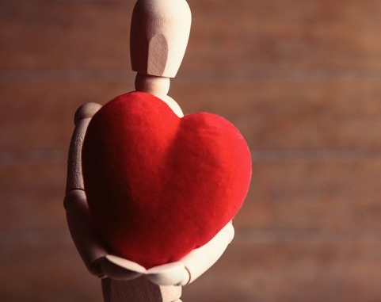
Let Us Pray
Dear Lord,
thank you for the challenges we are faced with.
May we see them not as obstacles
but as opportunities to see things from a different perspective.
May we have the determination and the anticipation to take up the challenge
and then to enjoy the transformed view.
Amen.

