Slide 1
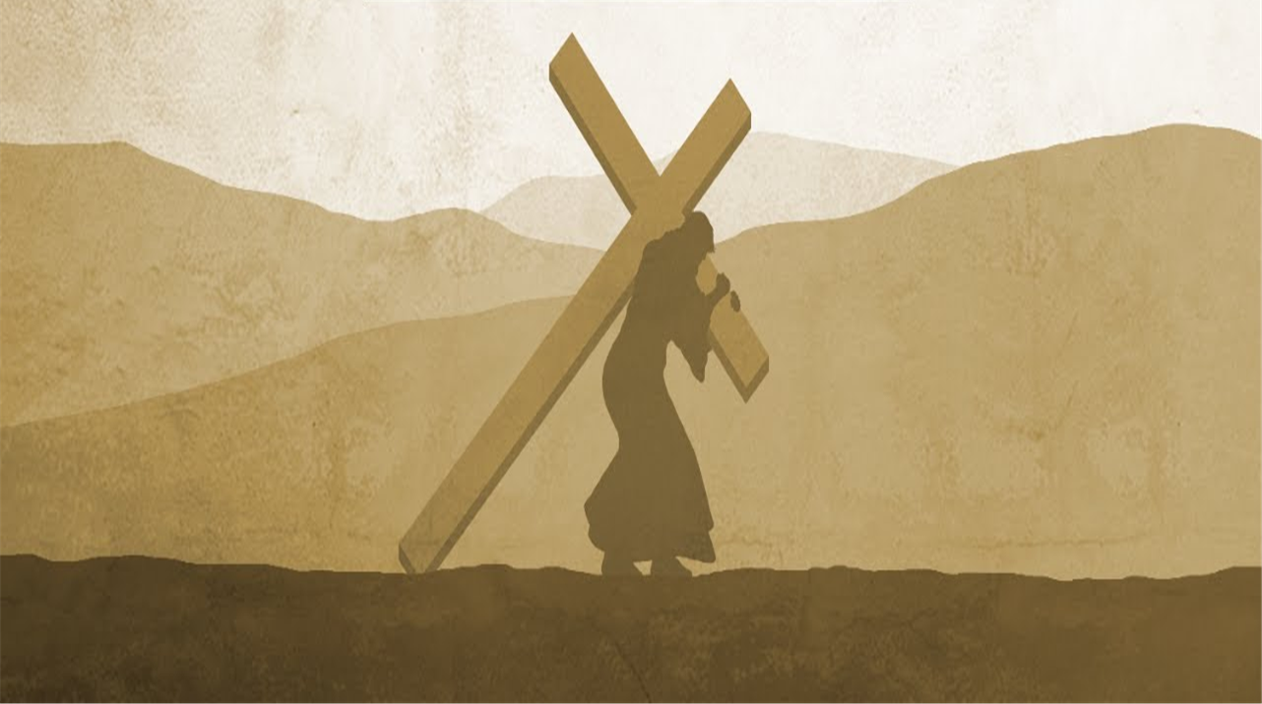

Slide 2
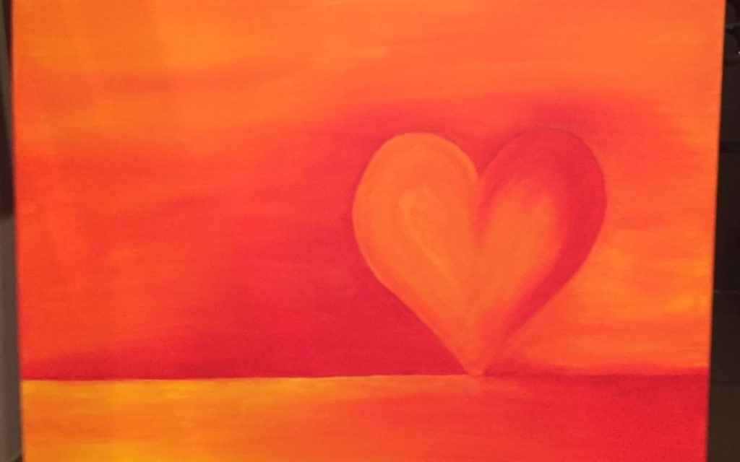
Be Full of Compassion

Slide 3
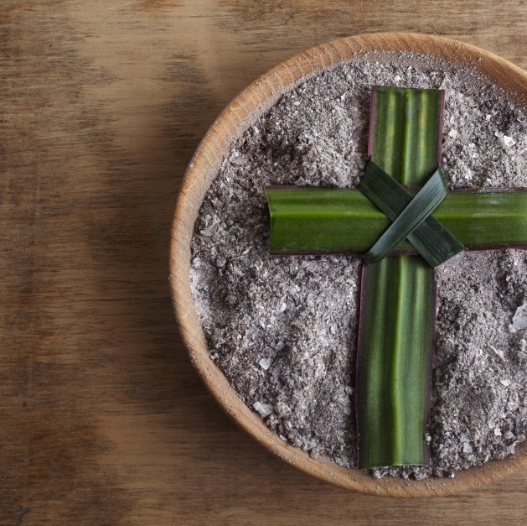
The Lord is kind and full of compassion,
Slow to anger, abounding in love.
How good is the Lord to all, how compassionate he is to all.
Psalm 144
The Lord is faithful in all his words and loving in all his deeds. The Lord supports all who fall.
The Lord is just in all his ways and loving in all his deeds. He is close to all who call him, who call him from their hearts.

Slide 4

A reading from the Gospel of Mark.
One of the scribes came up to Jesus and put a question to him, "Which is the first of all the commandments?" Jesus replied, "This is the first: Listen, the Lord our God is one, and you must love the Lord your God with all your heart, with all your soul, with all your mind, and with all your strength.
The second is this: You must love your neighbour as yourself. There is no commandment greater than these. "
The Word of the Lord.
All: Thanks be to God.

Slide 5
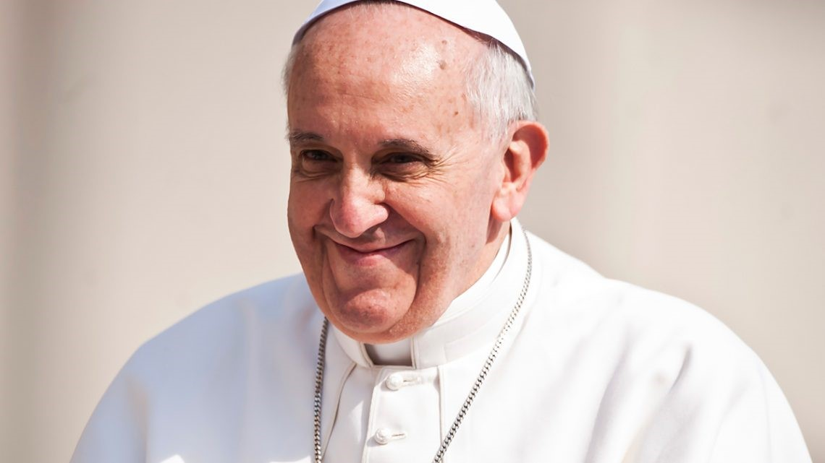

Slide 6
Be Full of Compassion
Notes:
Pope Francis there has a very clear message for you. Do not get comfortable. Do not hide behind your computers, phones or other things which are your comfort. These things are illusions. The happiness they promise is an illusion. Instead, get off our couches! Be the change you want to see. Later on in the speech he goes onto say, have your boots on laced and ready to go. Do not wait but be ready at all times to answer God’s call.
We are now going to hear from some students regarding their faith and what Lent means to them. We are also going to hear from a Muslim student about their faith. Ramadan has begun and so we shall hear a little about Ramadan, its importance and challenges.
(For this, the Christian students are live and so will be interviewed on the stage. The Muslim students have recorded their input so after the interview, the clip will play. Sit on the stage for the interview and leave the stage for the video.)
Welcome Josh, Charlotte, Tilly. Please can you introduce yourself to everyone.
What does faith mean to you?
Why do you think Lent is important? What does it mean to you?
Are there any challenges you face during Lent? How do you overcome them?

Slide 7


How do you show compassion to others?
Who has shown compassion to you?
Is there anyone you want to remember or think about?

Slide 8

Loving God, You taught us to show mercy and you ask us to go and do the same for others. May we be your hands and feet of mercy, helping those in need through our actions. May we be your ears of mercy, looking with compassion on the world. May our school continue to be a community of mercy, showing love to others in your name.
Lord in your mercy
Hear our prayer

Slide 9
Loving God,
We come, at this season of Lent,
To recall your goodness, to marvel at your grace and to commit ourselves to your service.
For the wonder of your love, we praise you.
Lord in your mercy
Hear our prayer.

Slide 10
Gracious God,
Help us to lift up our hands and hearts, our voices and souls.
Fill us with the power of your Spirit so that we may be full of compassion to others.
May we become the people you want us to be.
Lord in your mercy
Hear our prayer

Slide 11
Loving God,
We thank you for this season of Lent which invites us to pause and reflect.
We thank you for this time and the special moments you give to us.
We thank you that you give us hope and strength each day.
Lord in your mercy
Hear our prayer

Slide 12
A Prayer for Lenten Grace
During the sacred season of Lent, bring us closer to you.
Prepare a place in our home and heart for silence and solitude, so that we may re-discover the grace of a prayer-full life.
Enlarge our hearts so that we give to those in need and in, so doing, re-discover the grace of gratitude and generosity.
May this season be a grace-filled time to come to know you more.
Amen.

Slide 13

Be Full of Compassion
Notes:
End of Liturgy. Reminder of messages. Thanks. Dismissal. Reset.

