Slide 1
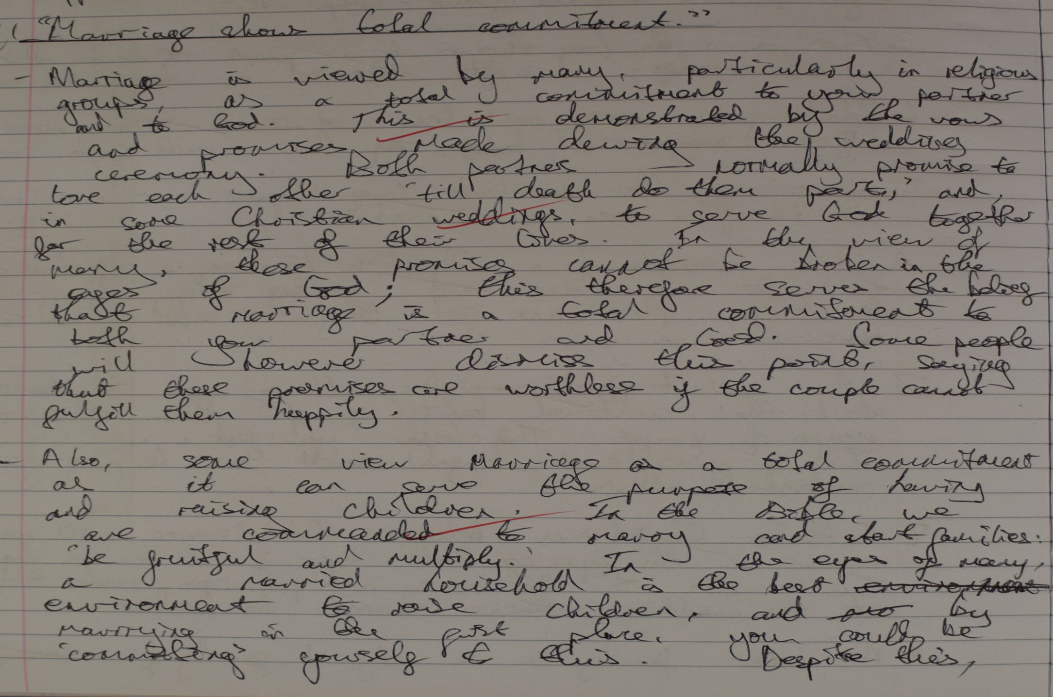
One key idea is taken and developed through the rest of the paragraph.
Clear link is made back to the question.
Consideration of an alternative point of view.
Accurate use of a source (Genesis) to support a point.

Slide 2
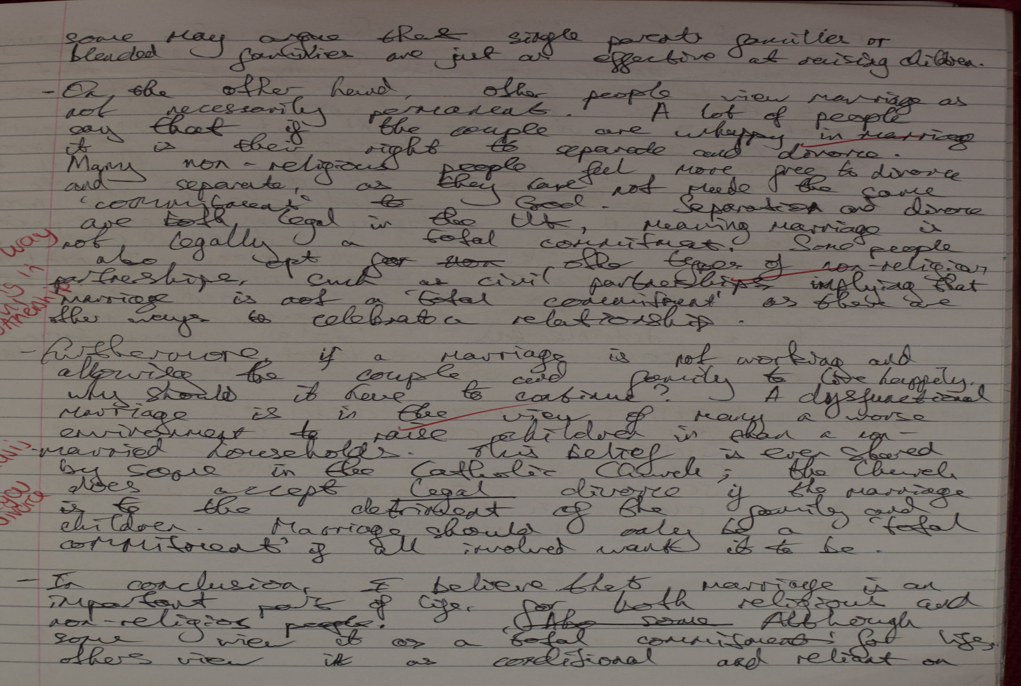
Breadth of knowledge shown: the student places the discussion in a broader context than simply the Catholic Sacrament of marriage.
Understanding of the complexity of the Catholic view on divorce.

Slide 3
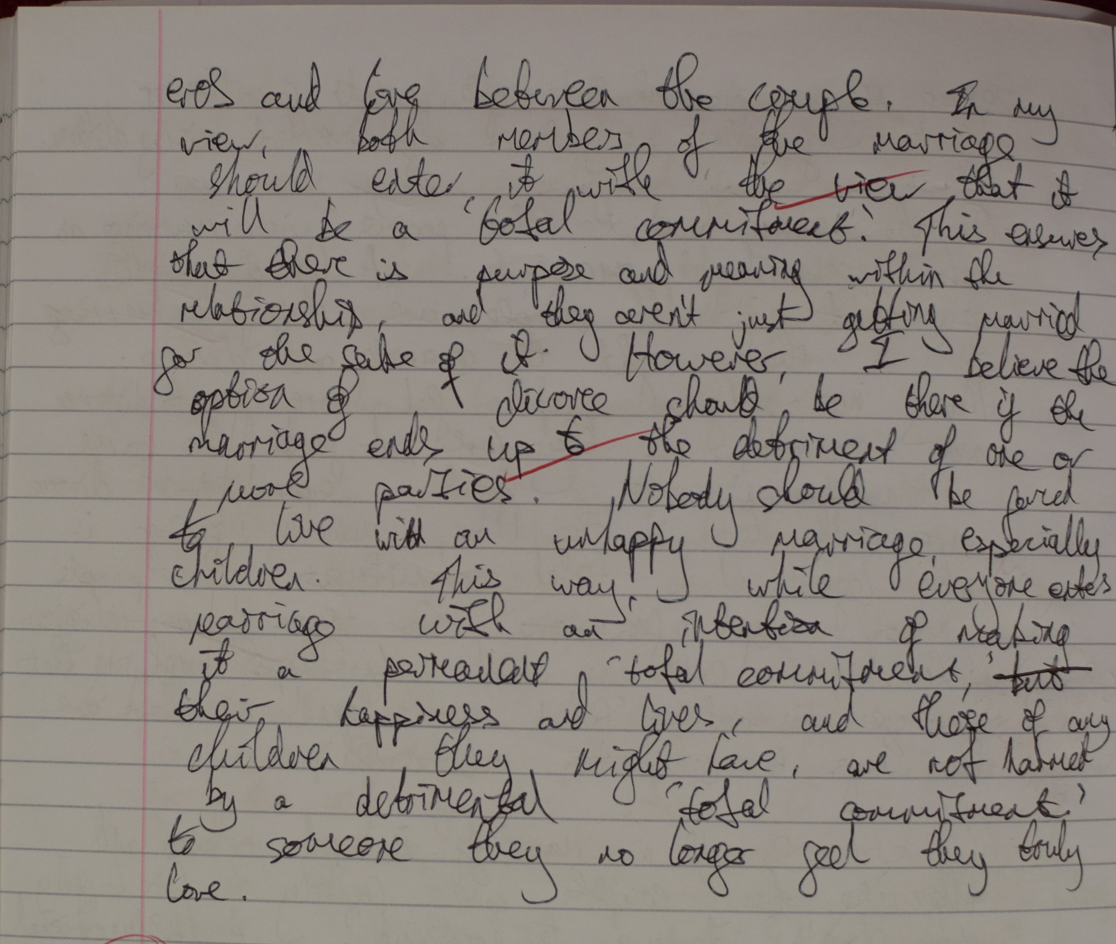
Conclusion is detailed and well justified.

