Slide 1
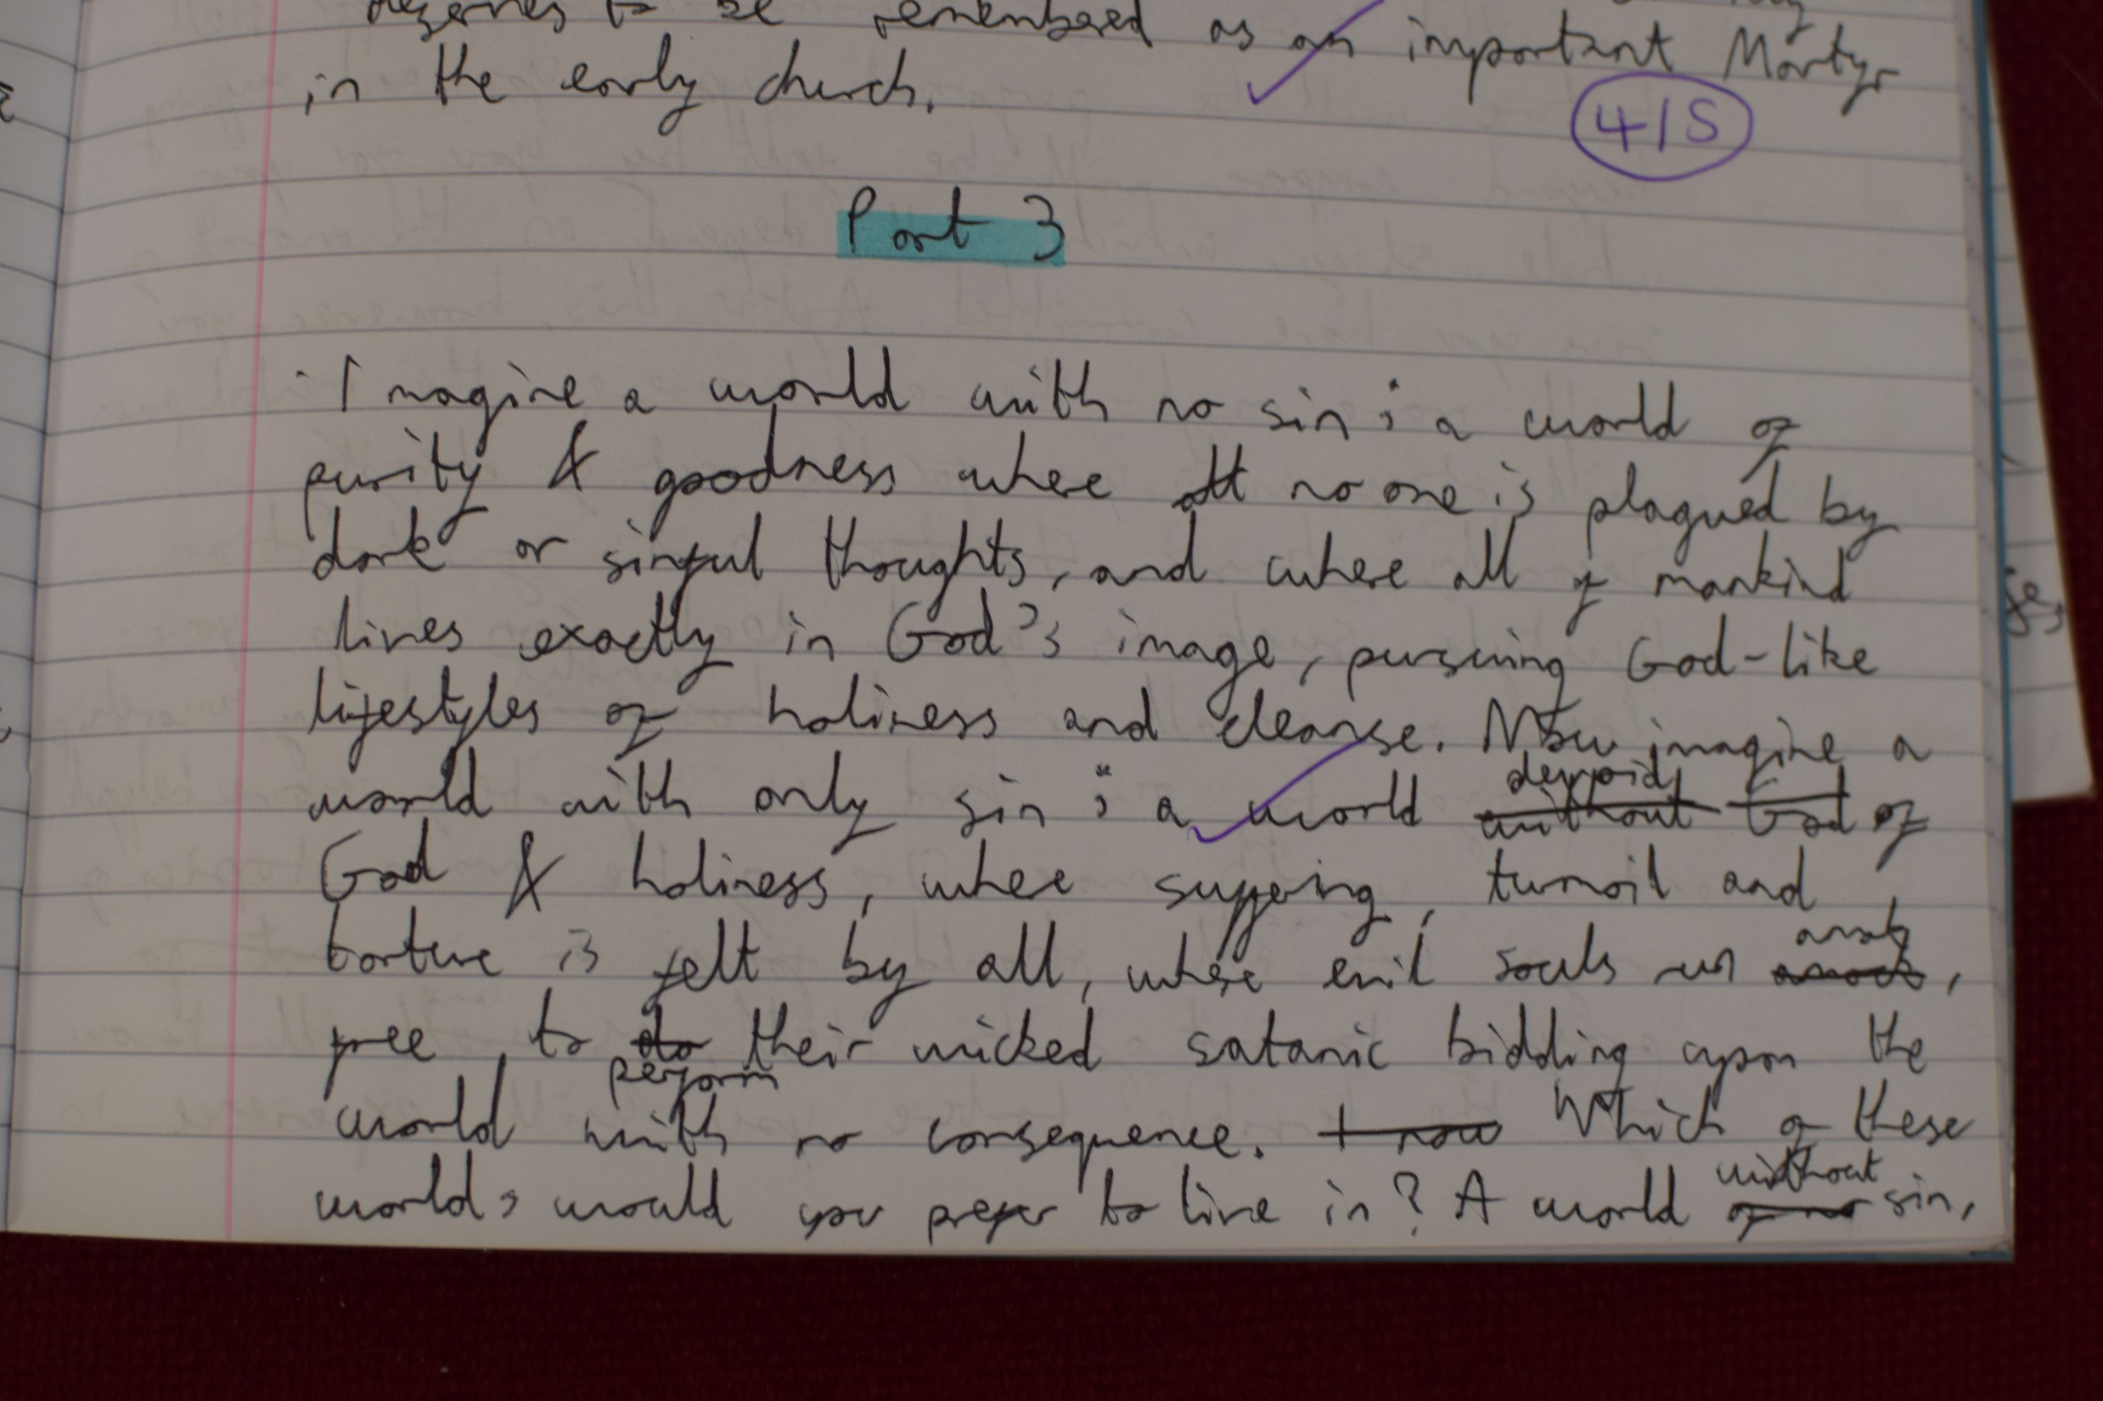
This opening paragraph sets the scene very well for this creative task.
This point shows an appreciation of the impact beliefs about life after death have on an individual believer.
Example of Year 8 Work

Slide 2
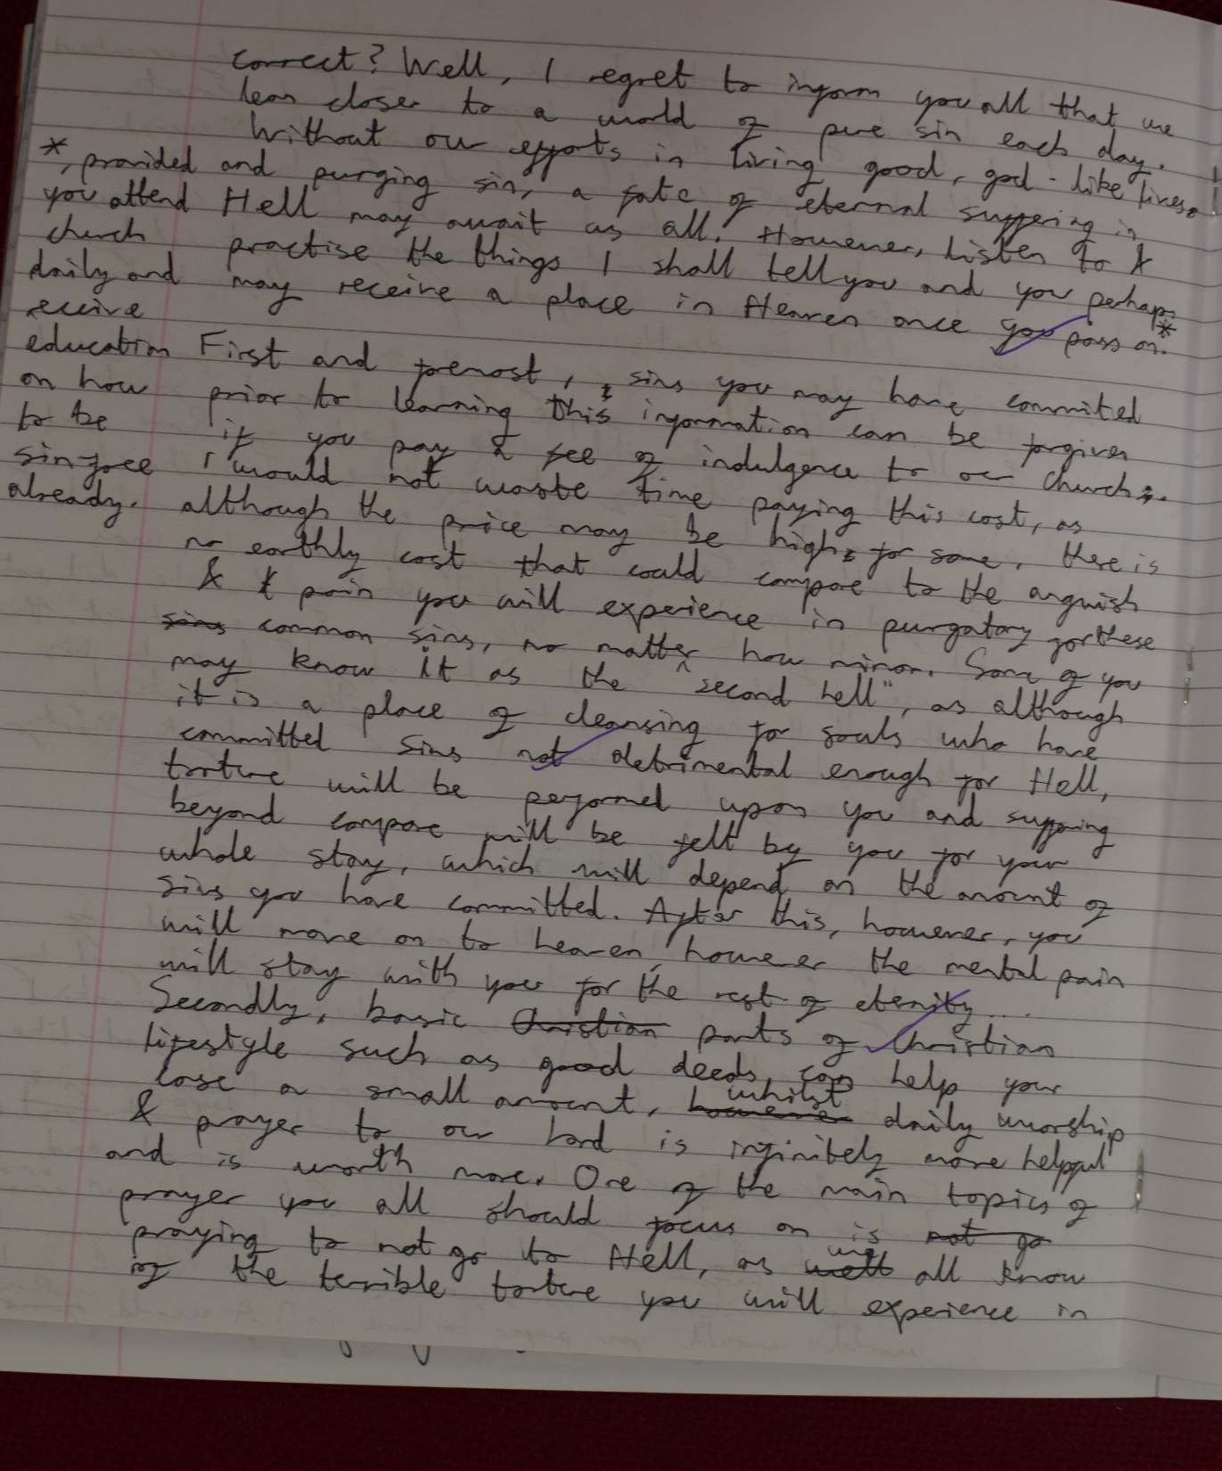
Excellent use of key religious terms – Indulgences.
Goes beyond simply stating what hell and purgatory are but rather describes the relationship between the two.
Example of Year 8 Work

Slide 3
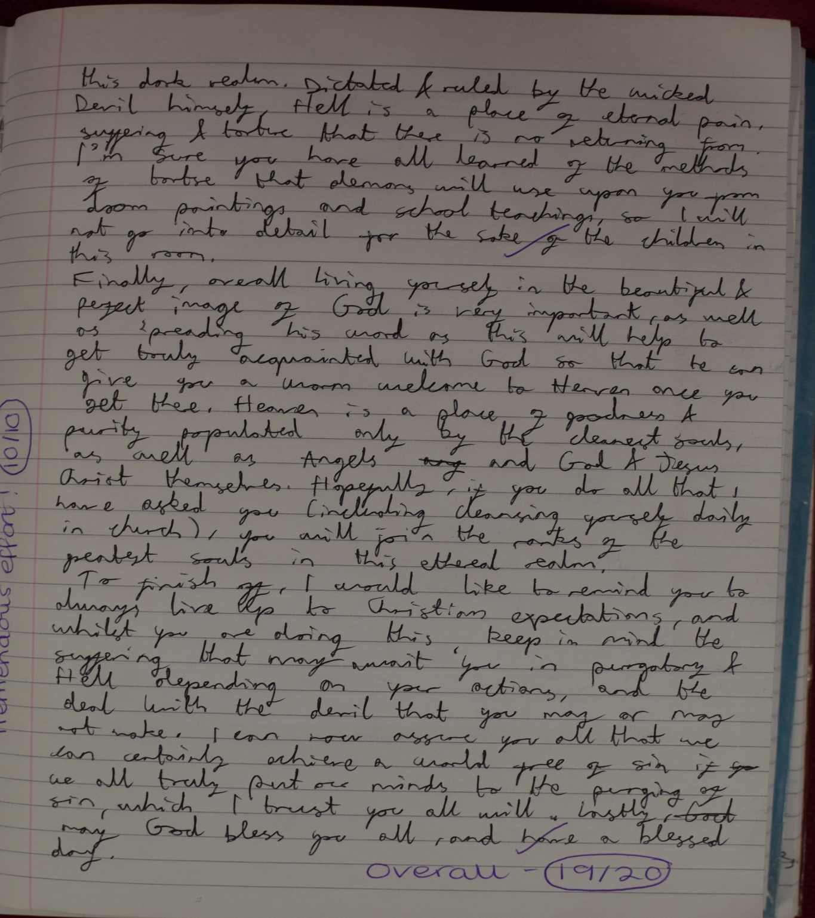
Shows an awareness of broader context of lives of medieval people.
Provides a source – Doom Paintings.
Appreciation of the centrality of the Church in people’s lives. “Cleansing yourself daily in Church.”
Example of Year 8 Work

