Slide 1
Exemplar work Y8 Spanish

Slide 2
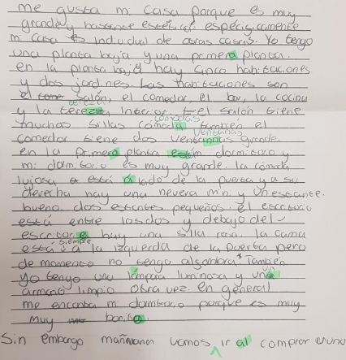
A very detailed, accurate writing, developing answers and giving excellent description of their house. Excellent spelling and great variety of language used.
Accurate spelling and formation of verbs in the present tense.
Excellent opinions and reasons.
Excellent connectives
Use of future tense

Slide 3
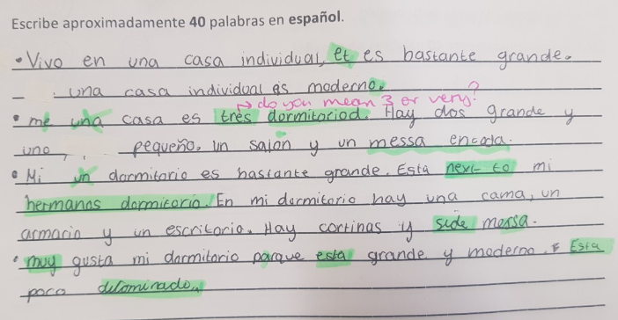
Accurate spelling in Spanish. Good connectives and some opinions given as well. Some development in answer and sentences.
Accurate spelling and formation of verbs in the present tense.
Some opinions given.
Good connectives

Slide 4
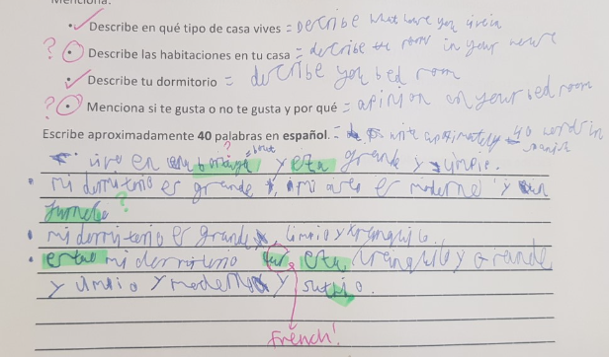
Some connectives and detail given. Good description of bedroom and where they live.
Some opinions and reasons given.
Some connectives
Accurate spelling and formation of verbs in the present tense.

