Slide 1
Year 8 Achievement check 1 resources
Please don't worry if you haven't covered some of this in lessons you will get to it soon.

Slide 2
Biology

Slide 3
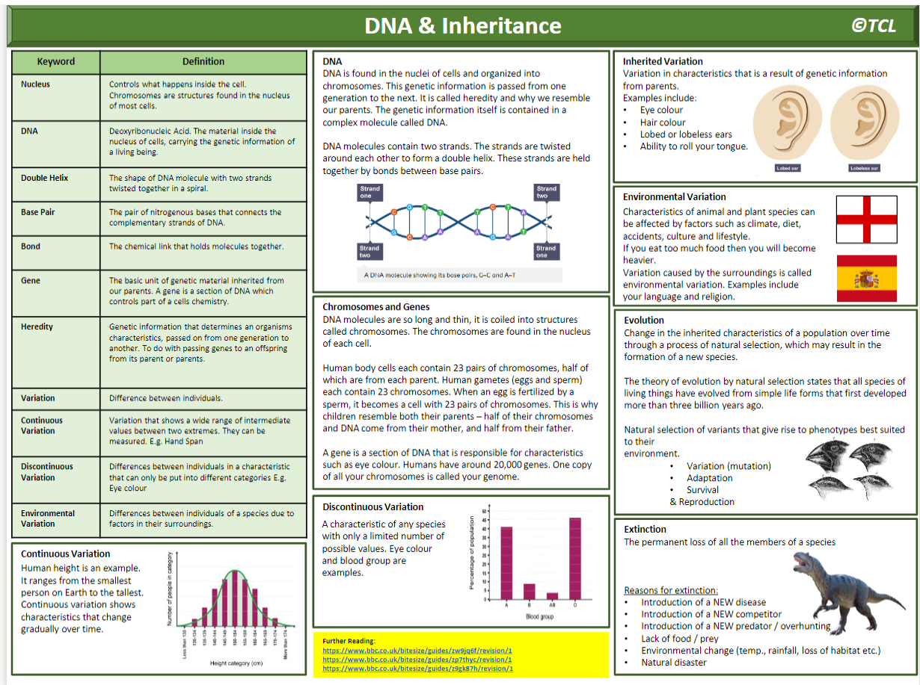

Slide 5
What is Biodiversity and how is it Maintained?
Biodiversity is
Deforestation and its Effect on Global Warming

Slide 6
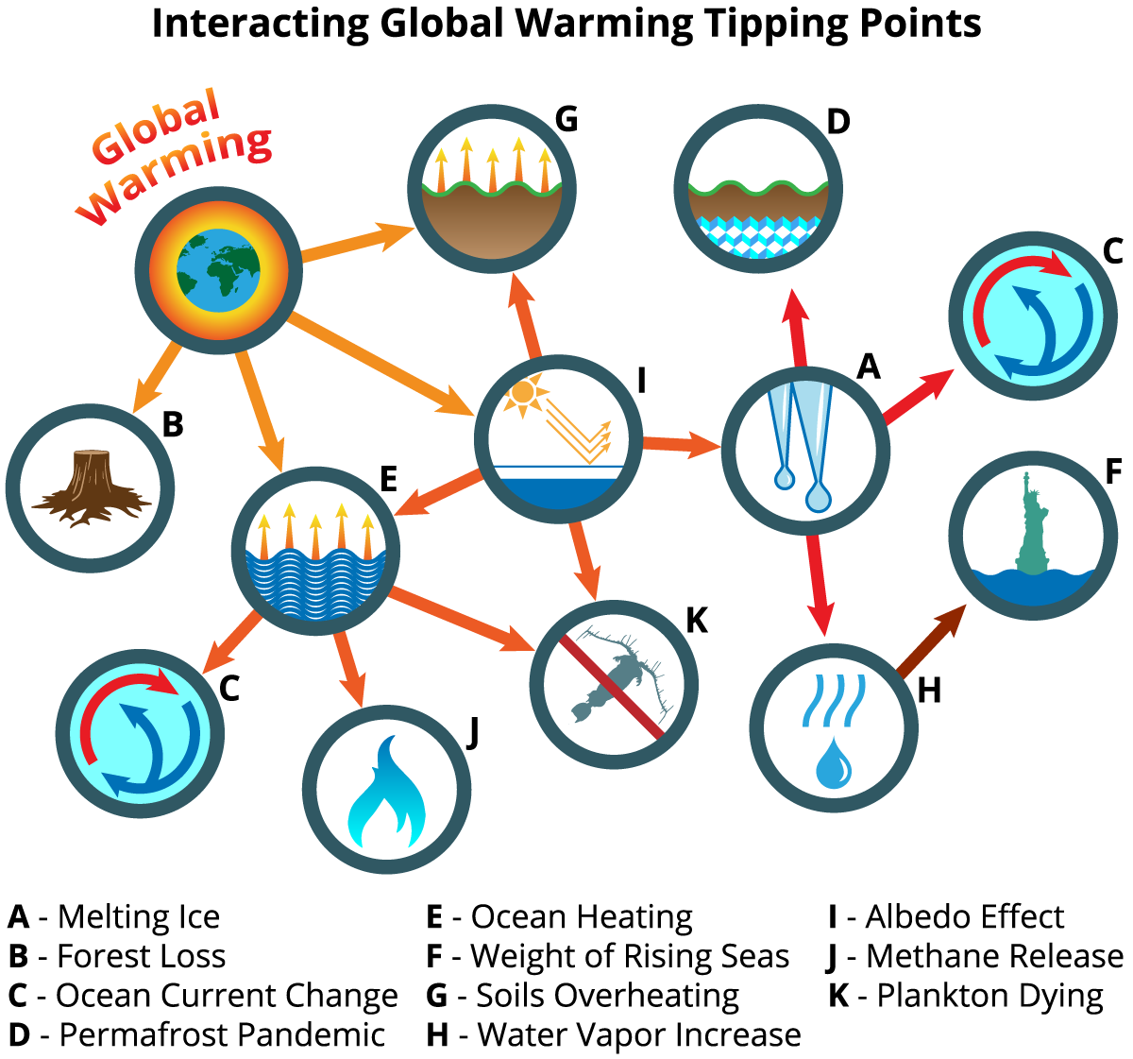
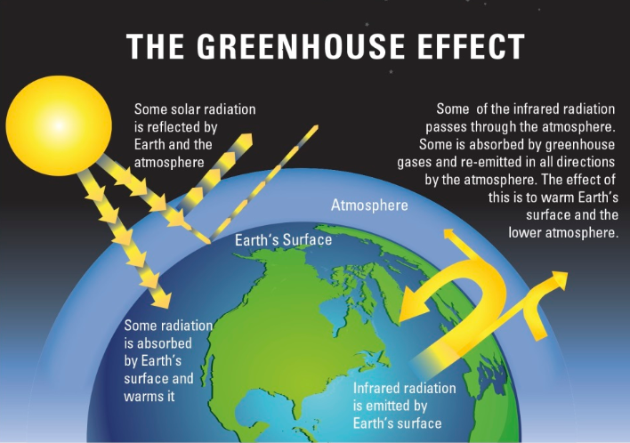
What is Biodiversity and how is it Maintained?
Biodiversity is the variety of all the different species of organisms on earth, or within an ecosystem. The future of the human species on Earth relies on us maintaining a good level of biodiversity. Many human activities are reducing biodiversity and only recently have measures been taken to try to stop this reduction. These include: • breeding programmes for endangered species • protection and regeneration of rare habitats • reintroduction of field margins and hedgerows in agricultural areas where farmers grow only one type of crop • reduction of deforestation and carbon dioxide emissions by some governments • recycling resources rather than dumping waste in landfill.
Deforestation and its Effect on Global Warming
Large-scale deforestation in tropical areas has occurred to: • provide land for cattle and rice fields • grow crops for biofuels
You should be able to describe some of the biological consequences of global warming. | Levels of carbon dioxide and methane in the atmosphere are increasing, and contribute to ‘global warming’.

Slide 7
Useful links for Biology:
These are more general links for Year 8 students, as they should be connecting content from last year to this year
https://www.bbc.co.uk/bitesize/topics/zxhhvcw
https://www.bbc.co.uk/bitesize/topics/zpffr82
(ignore DNA section)
https://www.bbc.co.uk/bitesize/topics/zhssgk7

Slide 8
Chemistry

Slide 9
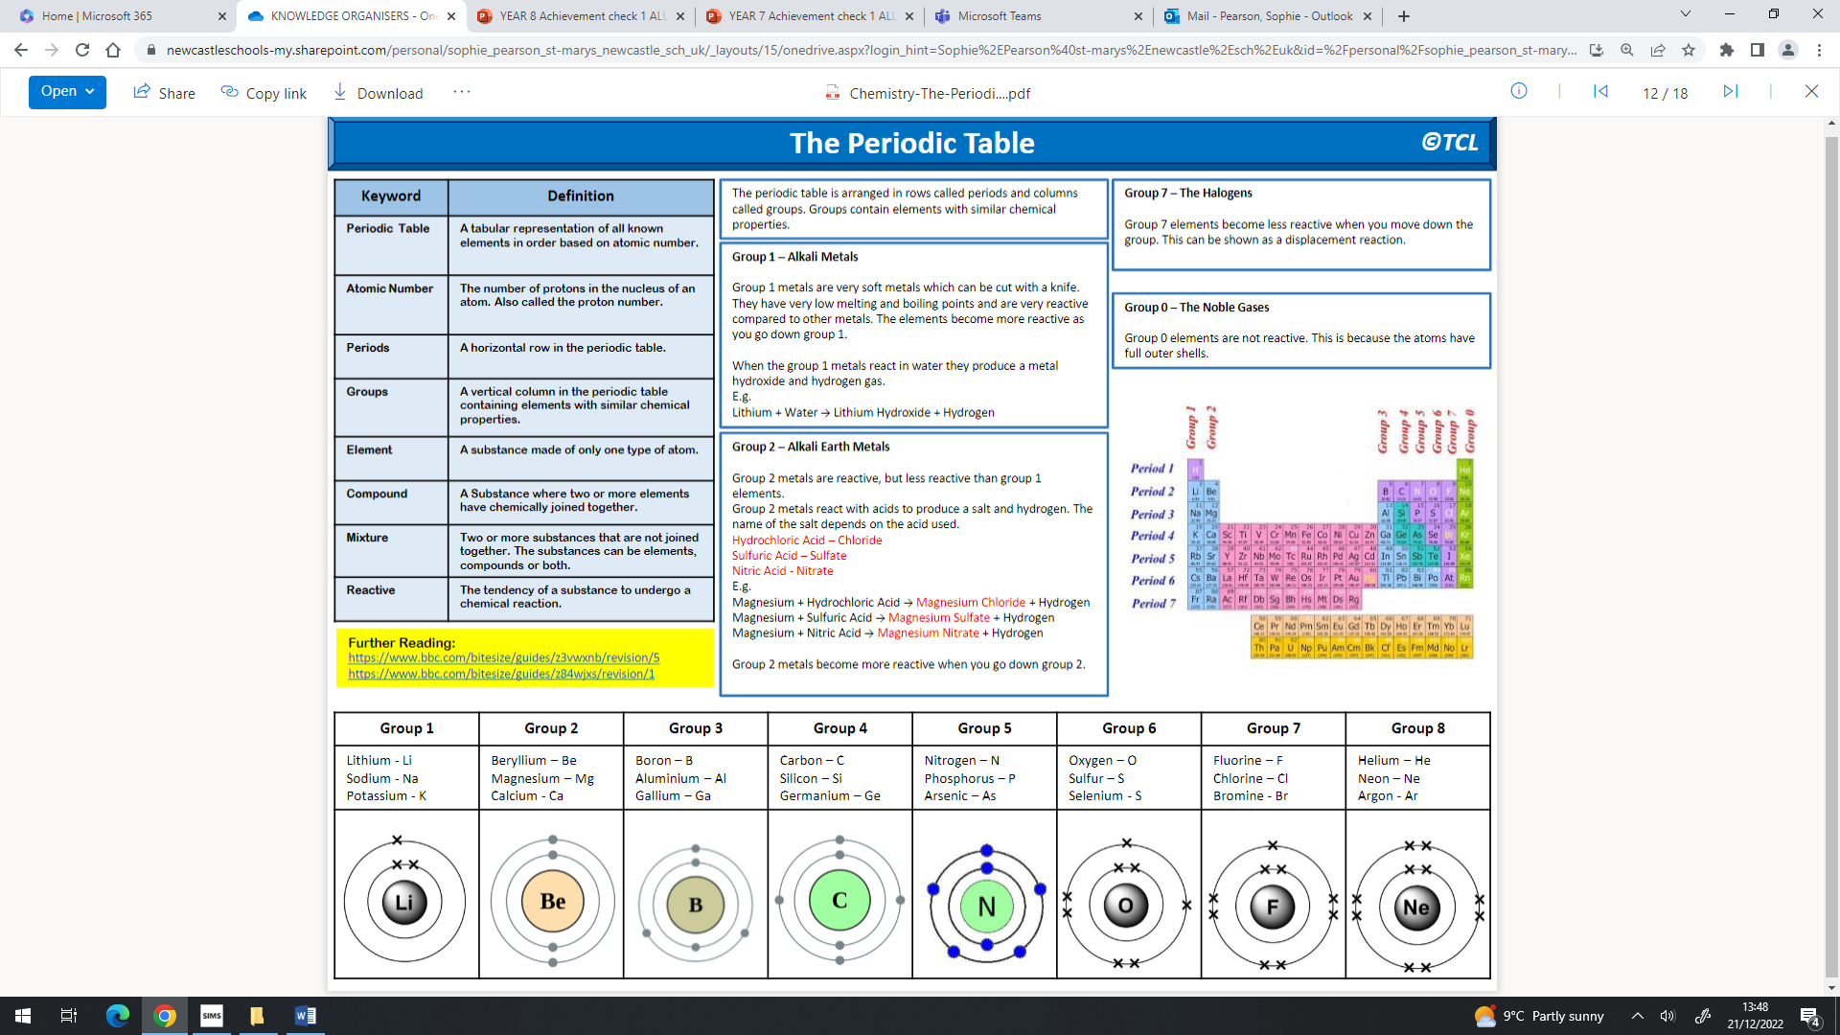

Slide 13
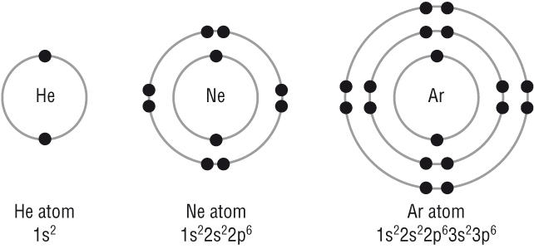
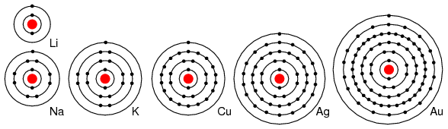
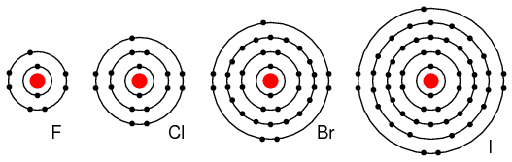
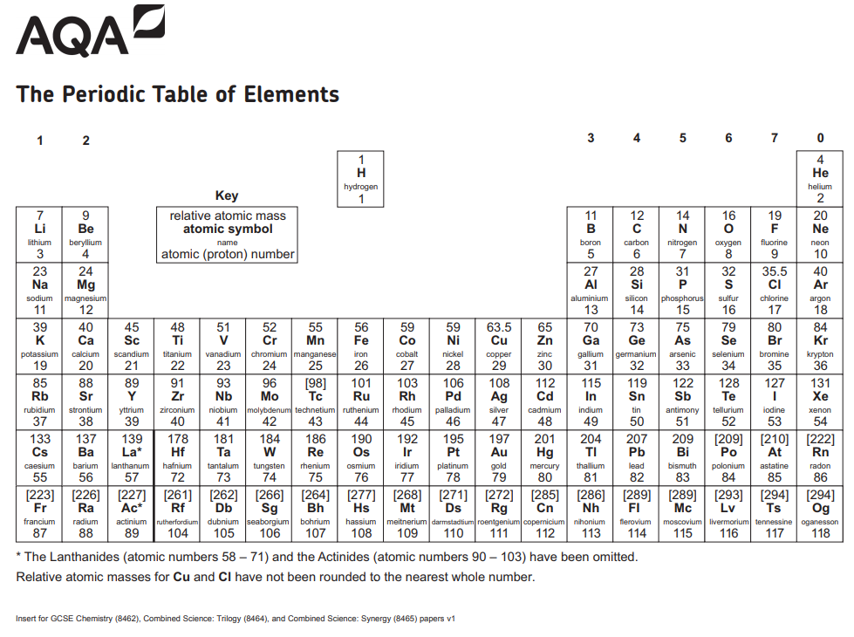
Group 0: The noble gases | Group 1: The alkali metals | Group 7: The halogens
All have full outer ________, which means __ electrons in their outer shell apart from Helium which only has __.
Full outer shell means they are ________ and do not easily form ________.
The ________ points of the noble gases ________ with increasing relative atomic mass (as you go ________ the group)
________ reactive
All of the elements in group 1 have __ electron in their outer shell this means they have ________ properties.
The reactivity of the elements ________ going down the group because the atoms get ________ and their outer electrons are ________ from the positive nucleus so they are more easily lost
________ reactive
All of the elements in group 7 have __ electrons in their outer shell this means they have similar ________.
The reactivity ________ going down the group because the atoms get bigger and it is ________ for them to gain an electron to fill their outer shell because the outer shell is further from the ________
________ reactive
Reaction with oxygen Example word equation: ________ + oxygen → lithium oxide Example symbol equation: 4Li + O₂ → 2Li₂O Observations: Freshly cut metal tarnishes/ goes from ________ to ________.
Reaction with water Example word equation: Sodium + water → ________ hydroxide + ________ Example symbol equation: 2Na + 2H₂O → 2NaOH + H₂ Observations: All ________/ bubble and move around the ________ of the water. All produce an ________ solution with the water. Potassium catches fire and has a ________ flame
Reaction with chlorine Example word equation: ________ + chlorine → potassium chloride Example symbol equation: 2K + Cl₂ → 2KCl
________ reactive
Non-metals
All exist as ________ ________ molecules eg) Cl₂
As you go down the group the relative molecular mass, ________ point and ________ point increase
Colour in the correct group
A more reactive halogen can ________ a less reactive halogen from an ________ solution of its salt.
Eg) Chlorine + sodium bromide → bromine + sodium chloride
But …Iodine + sodium bromide = no reaction
Colour in the correct group
Colour in the correct group

Slide 14
Group 0: The noble gases | Group 1: The alkali metals | Group 7: The halogens
All have full outer shells, which means 8 electrons in their outer shell apart from Helium which only has 2.
Full outer shell means they are unreactive and do not easily form molecules
The boiling points of the noble gases increase with increasing relative atomic mass (as you go down the group)
Least reactive
All of the elements in group 1 have 1 electron in their outer shell this means they have similar properties.
The reactivity of the elements increases going down the group because the atoms get bigger and their outer electrons are further from the positive nucleus so they are more easily lost
Most reactive
All of the elements in group 7 have 7 electrons in their outer shell this means they have similar reactions.
The reactivity decreases going down the group because the atoms get bigger and it is harder for them to gain an electron to fill their outer shell because the outer shell is further from the nucleus
Most reactive
Reaction with oxygen Example word equation: Lithium + oxygen → lithium oxide Example symbol equation: 4Li + O₂ → 2Li₂O Observations: Freshly cut metal tarnishes/ goes from shiny to dull
Reaction with water Example word equation: Sodium + water → sodium hydroxide + hydrogen Example symbol equation: 2Na + 2H₂O → 2NaOH + H₂ Observations: All fizz/ bubble and move around the surface of the water. All produce an alkaline solution with the water. Potassium catches fire and has a purple flame
Reaction with chlorine Example word equation: potassium + chlorine → potassium chloride Example symbol equation: 2K + Cl₂ → 2KCl
Least reactive
Non-metals
All exist as diatomic covalent molecules eg) Cl₂
As you go down the group the relative molecular mass, boiling point and melting point increase
A more reactive halogen can displace a less reactive halogen from an aqueous solution of its salt.
Eg) Chlorine + sodium bromide → bromine + sodium chloride
But …Iodine + sodium bromide = no reaction

Slide 15
Useful links for Chemistry:
https://www.bbc.co.uk/bitesize/topics/z9r4jxs
https://www.bbc.co.uk/bitesize/topics/zstp34j/articles/zngddp3
https://www.bbc.co.uk/bitesize/topics/zstp34j/articles/zc86m39
https://www.bbc.co.uk/bitesize/topics/zstp34j/articles/zmsk4xs
https://www.bbc.co.uk/bitesize/topics/zstp34j/articles/zqr4tv4
https://www.bbc.co.uk/bitesize/topics/zych6g8
https://www.bbc.co.uk/bitesize/topics/zv9nhcw/articles/zf4pp4j
https://www.bbc.co.uk/bitesize/topics/zv9nhcw/articles/z8qrr2p

Slide 16
Physics

Slide 17
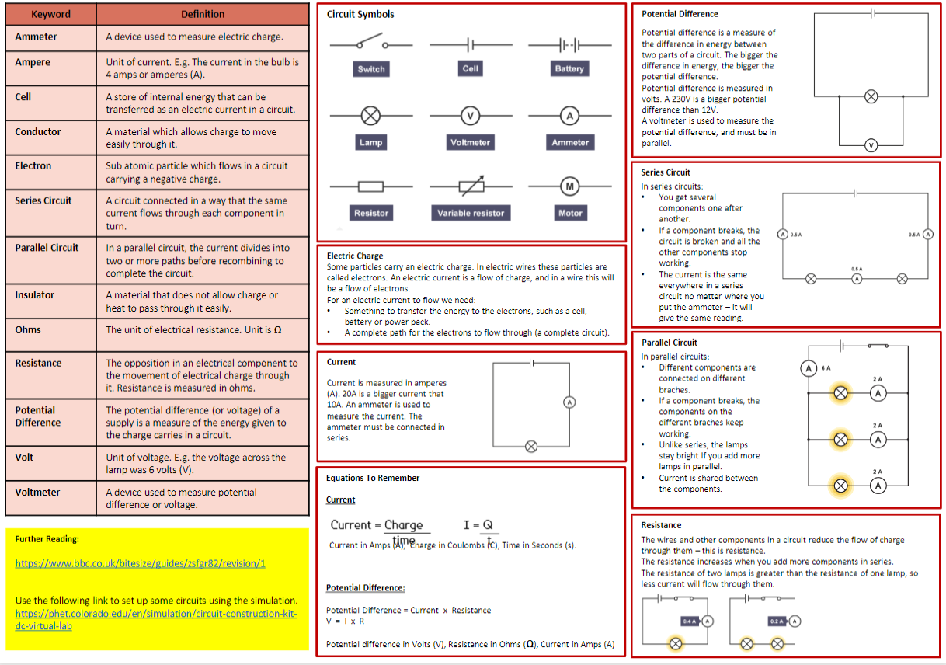

Slide 19
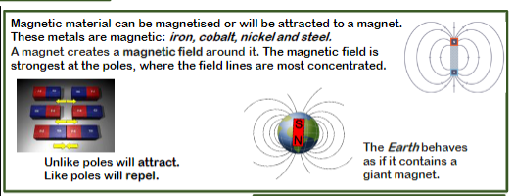
Magnetic materials …
The Earth is a big . . .
Unlike poles will . . .
Like poles will …

