Slide 1
All three sciences require similar skills, see the next pages for an example in each science of a skill

Slide 2
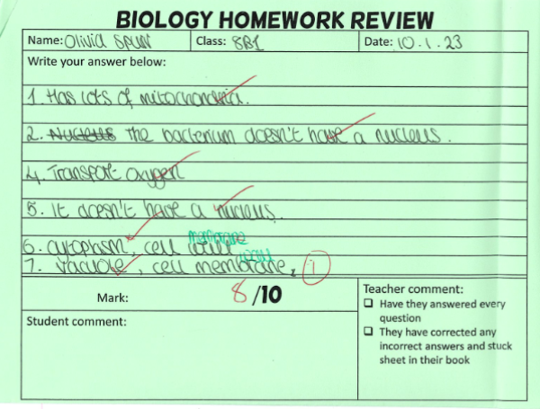
1. Homework review
Students complete a homework review for each science every 2 weeks. They are given a homework to review a section of the topic. They then test their knowledge and understanding in class. It is teacher marked and then reviewed in class.

Slide 3
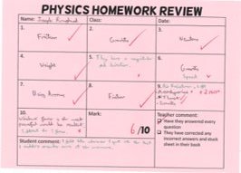
This is a great example because they have included detailed corrections that will help their learning long term! Fantastic work!

Slide 4
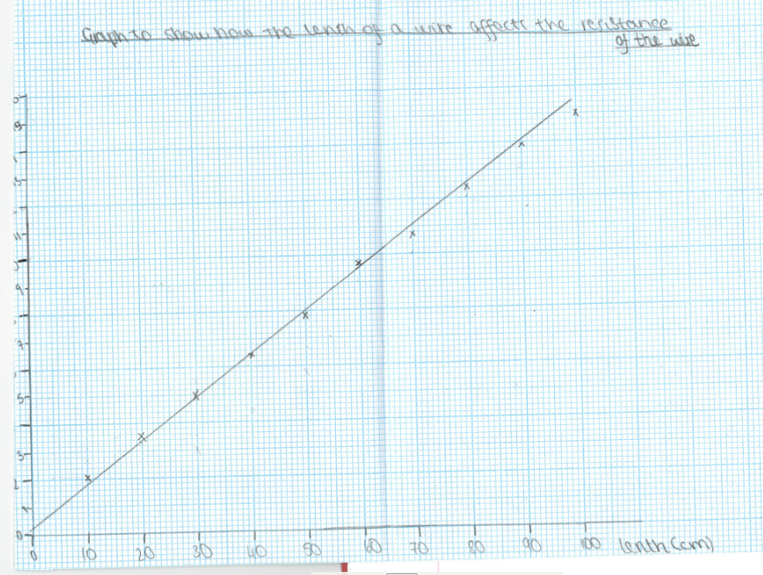
2. Graph drawing skills
Draw with a ruler and pencil
Suitable scale
Accurately plotted bars
Great labelled axis (name and units)

Slide 5
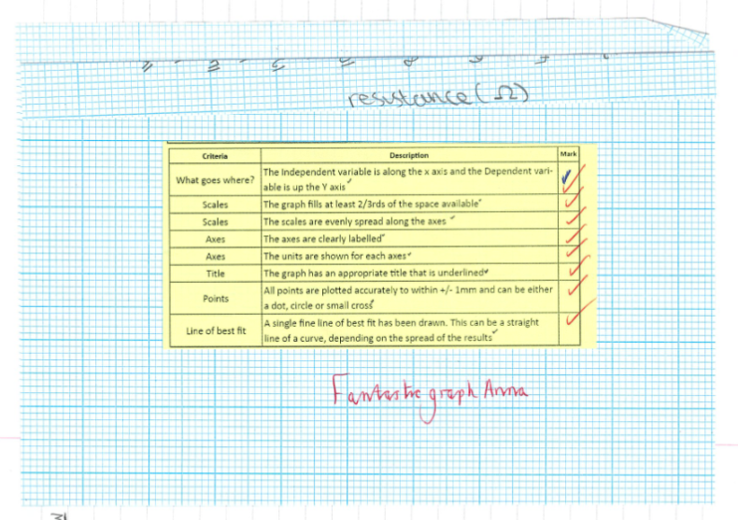

Slide 6
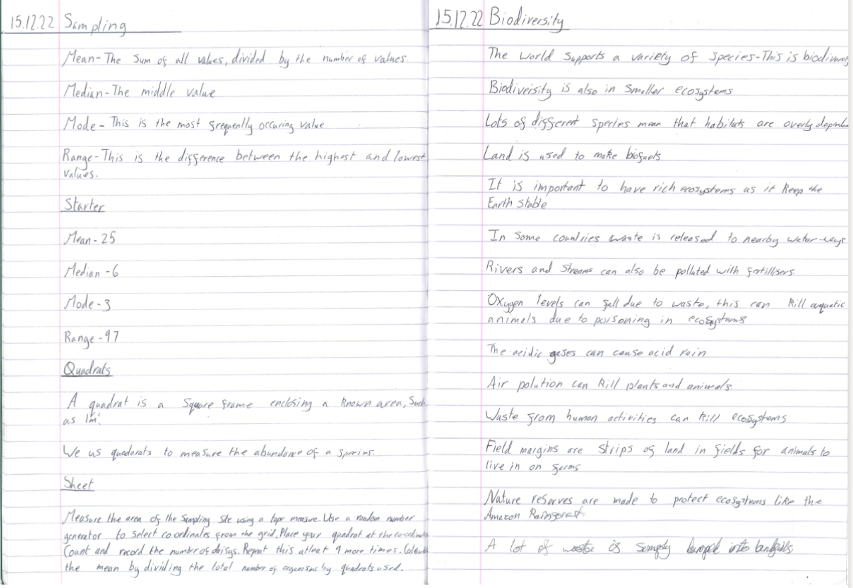
3. Clear, neat and organised notes
Notes from class are incredibly important, they allow our students to process and learn the information. They can then be used for revision!

Slide 7
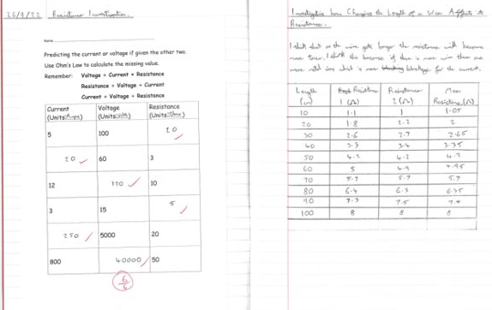
They are good examples because they are well laid out in terms of the date, key words and quality of teacher and student feedback.

Slide 8
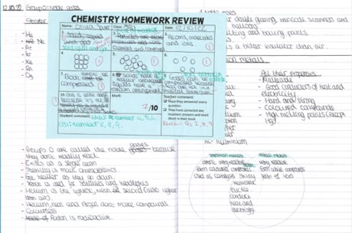

Slide 9
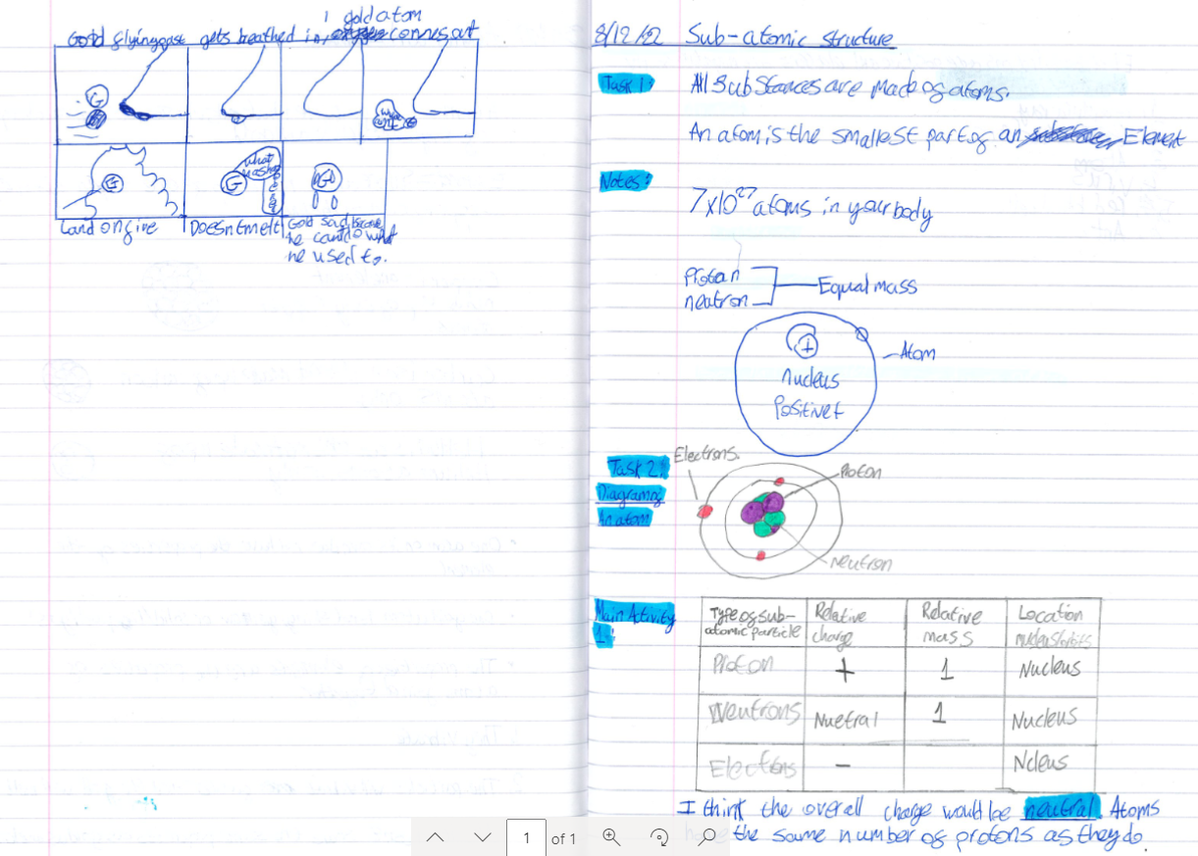
Detailed and clear notes are vital for science. They are required to ensure good understanding and so you can use your book for revision.

