Slide 1


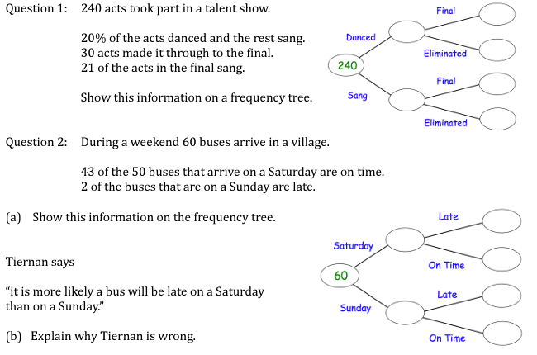
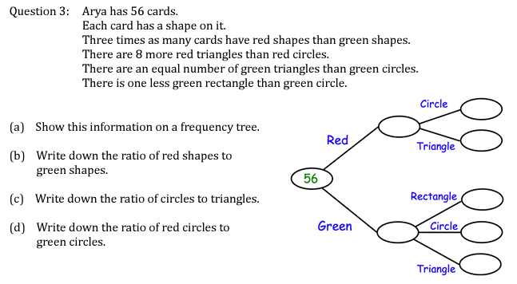
Using Frequency Trees to record outcomes of probability experiments
Follow this link to watch a video on “frequency trees”
https://corbettmaths.com/2017/03/26/frequency-trees/
Work through the questions below to check your understanding (solutions on next page):

Slide 2
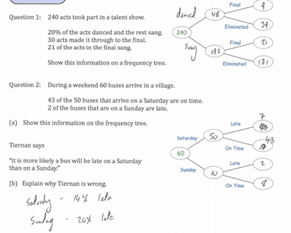
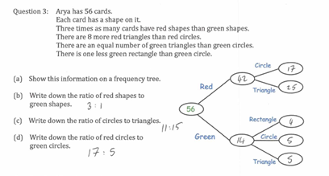
Solutions:

