Slide 1


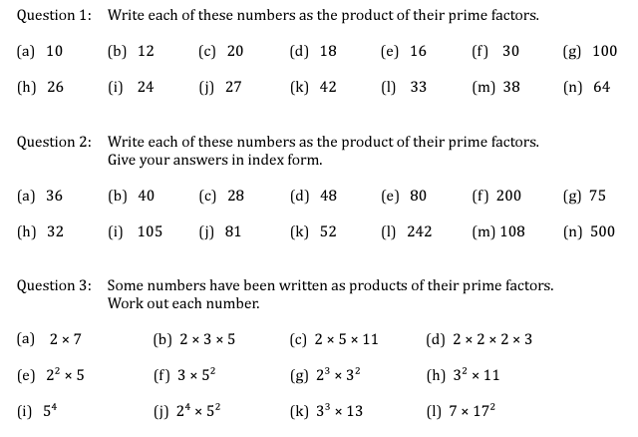

Finding the prime factor decomposition of a number
Follow this link to watch a video on “Finding the prime factor decomposition of a number”
https://corbettmaths.com/2012/08/20/product-of-primes/
Work through the questions below to check your understanding (solutions on next page):

Slide 2
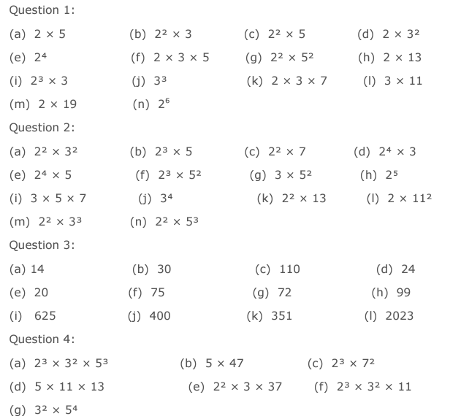
Solutions:

