Slide 1



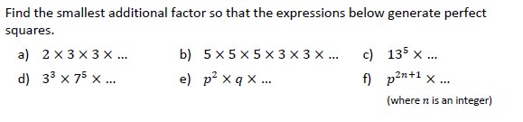
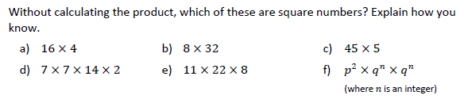

Using the prime factor decomposition to identify square numbers, cube numbers and roots
Follow this link to watch a video on “product of primes”
https://corbettmaths.com/2021/11/18/product-of-primes-next-square-or-cube-video/
Work through the questions below to check your understanding (solutions on next page):
1.
2.
3.
4.

Slide 2
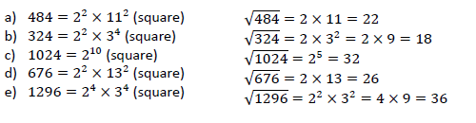
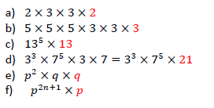
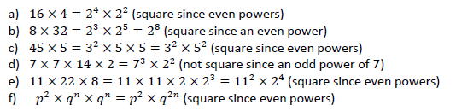
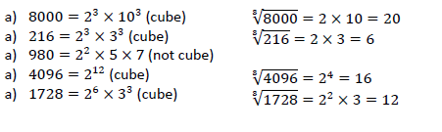
Solutions:

