Slide 1


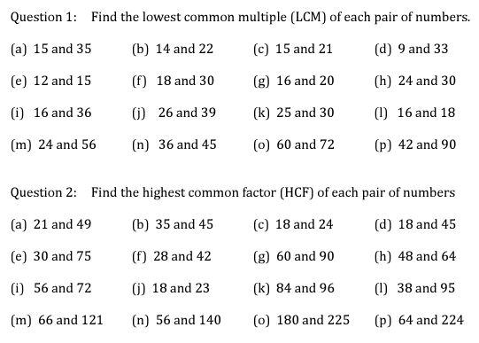
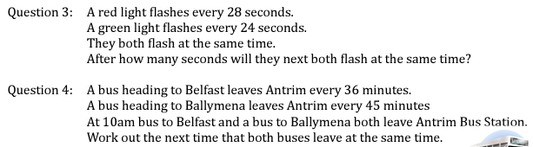
Using the prime factor decomposition to identify factors and multiples
Follow this link to watch a video on “product of primes”
https://corbettmaths.com/2012/08/20/lcm-and-hcf-using-product-of-primes/
Work through the questions below to check your understanding (solutions on next page):

Slide 2
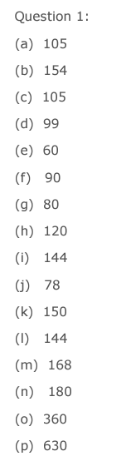
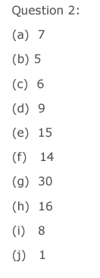

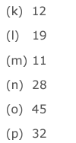
Solutions:

