Slide 1


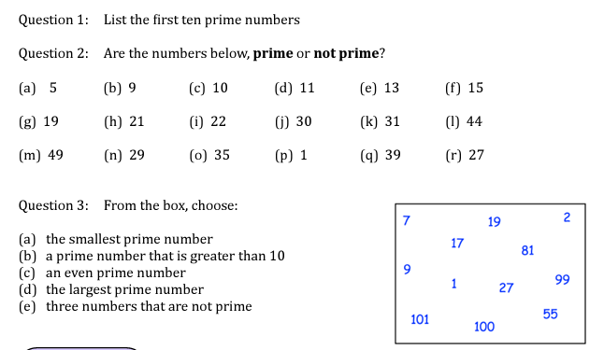
Know how to test if a number up to 150 is prime
Follow this link to watch a video on “Prime numbers”
https://corbettmaths.com/2013/03/24/prime-numbers/
Work through the questions below to check your understanding (solutions on next page):

Slide 2
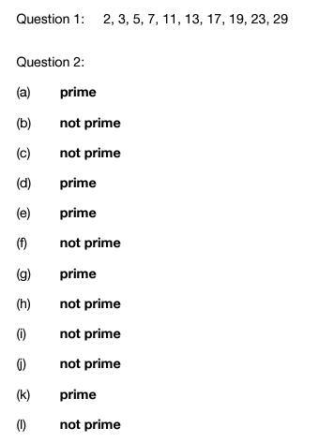
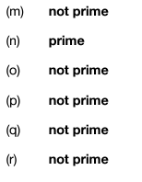

Solutions:

