Slide 1
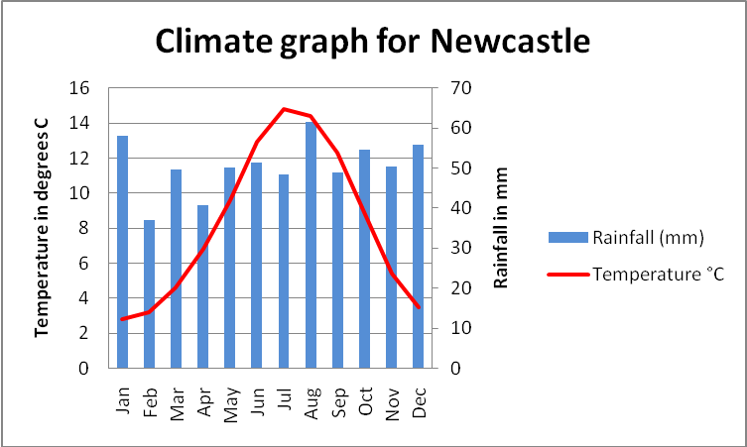
Climate Graphs
Temperature LINE GRAPH
Precipitation BAR CHART
Precipitation AXIS
Temperature AXIS
Temperature RED
Precipitation BLUE

Slide 2
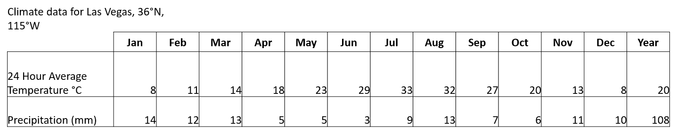
Climate Data
Climate data is used when plotting climate graphs.
In the Year column the average temperature and total precipitation are given.
The graph for Las Vegas’ climate data is shown on the next slide

Slide 3
PLOT A CLIMATE GRAPH FOR LAS VEGAS USING THE DATA PROVIDED
Climate data for Las Vegas, 36°N, 115°W
 | Jan | Feb | Mar | Apr | May | Jun | Jul | Aug | Sep | Oct | Nov | Dec | Year
24 Hour Average Temperature °C | 8 | 11 | 14 | 18 | 23 | 29 | 33 | 32 | 27 | 20 | 13 | 8 | 20
Precipitation (mm) | 14 | 12 | 13 | 5 | 5 | 3 | 9 | 13 | 7 | 6 | 11 | 10 | 108

Slide 4
What does the graph show?
Climate data for Las Vegas, 36°N, 115°W
 | Jan | Feb | Mar | Apr | May | Jun | Jul | Aug | Sep | Oct | Nov | Dec | Year
24 Hour Average Temperature °C | 8 | 11 | 14 | 18 | 23 | 29 | 33 | 32 | 27 | 20 | 13 | 8 | 20
Precipitation (mm) | 14 | 12 | 13 | 5 | 5 | 3 | 9 | 13 | 7 | 6 | 11 | 10 | 107

Slide 6
What does the graph show?
Climate data for Las Vegas, 36°N, 115°W
 | Jan | Feb | Mar | Apr | May | Jun | Jul | Aug | Sep | Oct | Nov | Dec | Year
24 Hour Average Temperature °C | 8 | 11 | 14 | 18 | 23 | 29 | 33 | 32 | 27 | 20 | 13 | 8 | 20
Precipitation (mm) | 14 | 12 | 13 | 5 | 5 | 3 | 9 | 13 | 7 | 6 | 11 | 10 | 107
Temperature
The overall temperatures in Las Vegas is high with an average temperature of 20⁰C.
The Highest or Maximum temperature in Las Vegas is 33ºC during the month of July
The Minimum or lowest temperature is 8ºC during the months of January and December
Compared to London this make Las Vegas warmer by 14.3ºC.
Precipitation
The maximum precipitation or rainfall in Las Vegas is 14mm in January.
The minimum precipitation is 3mm in June
This means that overall Las Vegas is very dry with a total rainfall for the year of only 107mm.
Compared to London the precipitation of Las Vegas is extremely dry.
Overall, Las Vegas seems to have a hot and dry climate. This would make it an improbable place as it is classified as a desert. This means that there will be very little vegetation growth and so there is little food availability and crop growth for animals and people living there. This lack of food as well as low levels of water would make living in Las Vegas very hard to live in without technology.

