Slide 1
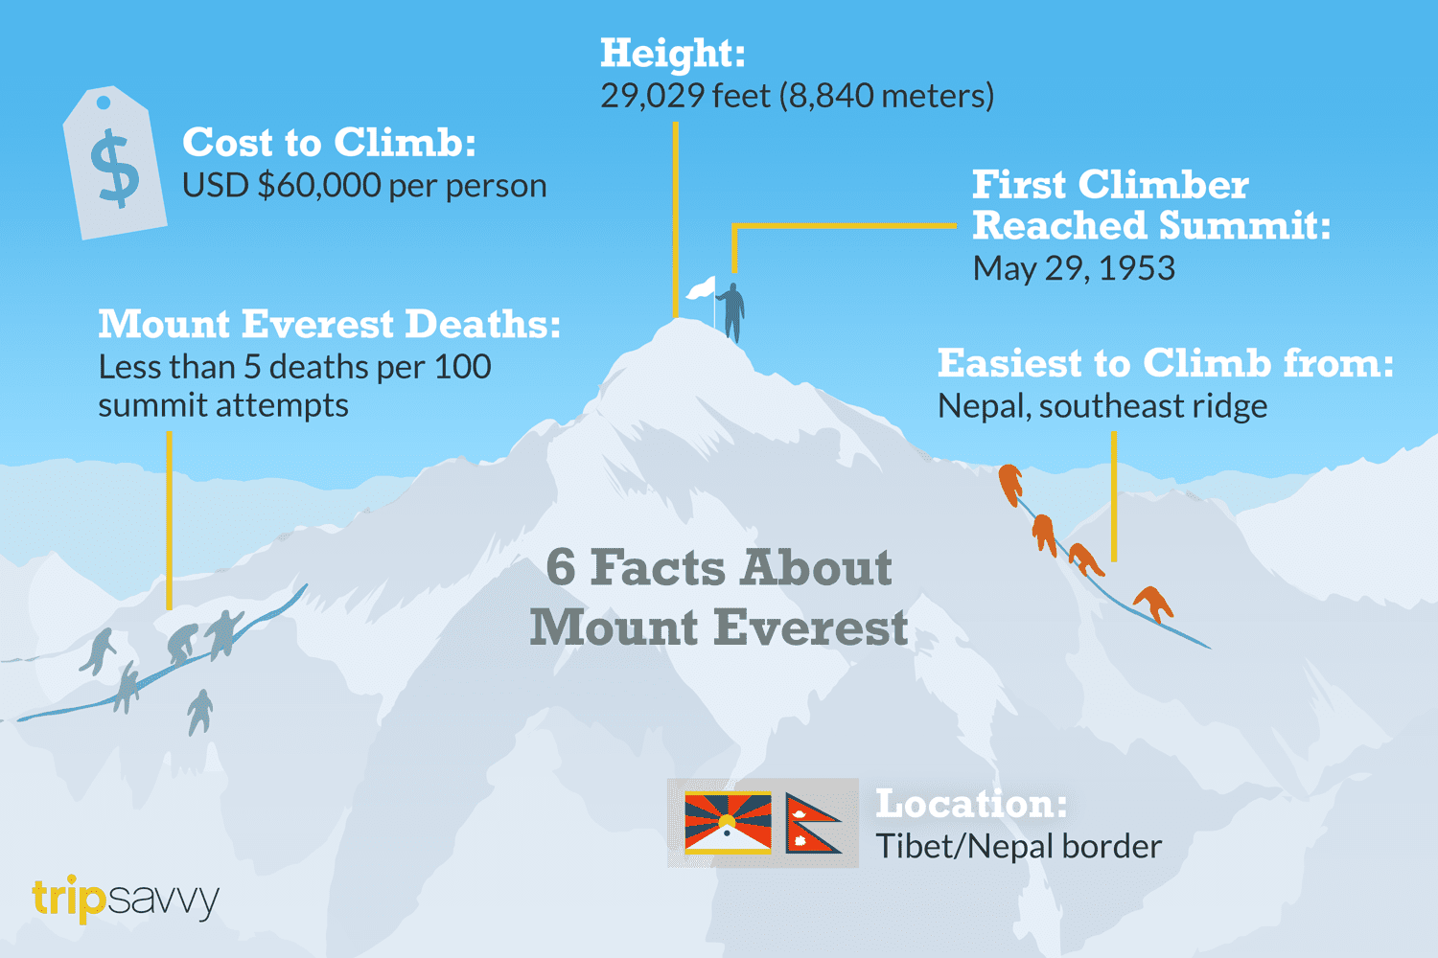
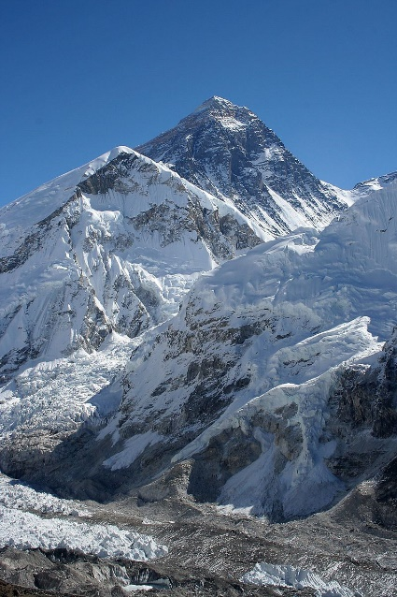
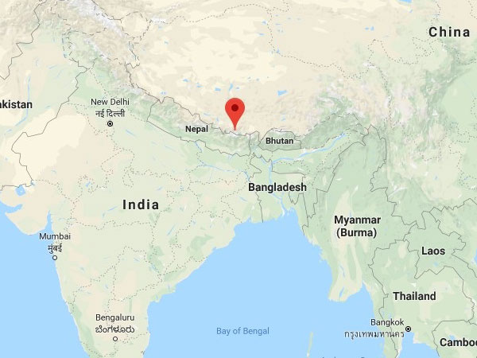
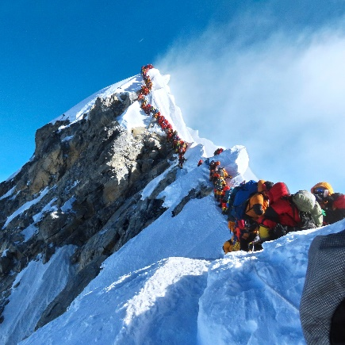
Should commercial climbs of Mount Everest be stopped?
What makes a good answer to this?
Follow the mark scheme and guidance given by your teacher.
Structure your paragraphs using PEEL – Point, Evidence, Explanation and Link
It doesn’t matter whether you chose “yes” or “no”, it’s how you justify yourself that matters!
Start your opinion being clear about whether you are choosing yes or no. e.g. I believe commercial climbs of Mount Everest should be stopped because…
You should then try to make 3 clear PEE paragraph points to support what you have stated
You should the come to a clear conclusion.

Slide 2

Should commercial climbs of Mount Everest be stopped? Example paragraph
Point | There are several reasons why commercial climbs should be allowed to continue on Mount Everest. Firstly, they greatly benefit the economy of Nepal.
Evidence | Nepal is an incredibly poor country, with a GDP of £1049.68. Much of the population of Nepal live in poverty unable to afford essentials such as food and education.
Explain (with stakeholders) and link back to the question. | Commercial climbs bring money into the economy of Nepal in several ways. Firstly, climbers spend $4million in permit fees alone, which will go to the Government of Nepal. This allows the government to develop their infrastructure and public services, which includes transportation, education and healthcare. This will improve the quality of life for local people around Nepal. 54,000 local people, such as Sherpa’s, are employed due to commercial climbs alone. This provides a secure income for local people allowing them to provide for their families and get out of poverty. Locals will also be able to pay for education for their children, allowing them to gain qualifications, secure a job and break the cycle of poverty. This highlights the social and economic benefit that commercial climbing can bring to the Sherpa’s and their families as well as the wider people of Nepal.

Slide 3
Sometimes there might be 2 points within the same paragraph – keep the same PEE structure.
One reason why commercial climbs should not be allowed to continue on Mount Everest is because of the environmental impacts. Large amounts of waste are left on the mountain by climbers, both litter and human waste. In a recent CNN article, it was claimed that the Everest Cleaning Company cleared 6613 pounds of trash in their first year. Waste left on Mount Everest causes environmental issues as new materials are being introduced to habitats affecting wildlife. Due to the isolated areas, this trash is very difficult to clear up, and will remain in the area indefinitely ruining the natural beauty of the area for the Nepali and the climbers. Human waste is just as much an environmental issue. In Gorak Shep alone, 26,000 pounds of human waste has been dumped in the area. At such a high altitude and such cold temperatures, human waste does not decompose and so will stay in the environment for a very long time contaminating the water supply for the locals. It is impossible to stop the production of human waste while humans are climbing, and because Mount Everest is such an isolated area, it isn’t possible to create a sewage system. For both litter and human waste, Sherpas have to climb the mountain and bring large containers back down. This is a very dangerous job for them.

