Slide 1
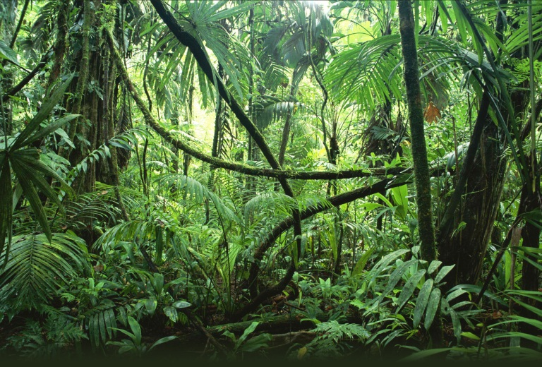
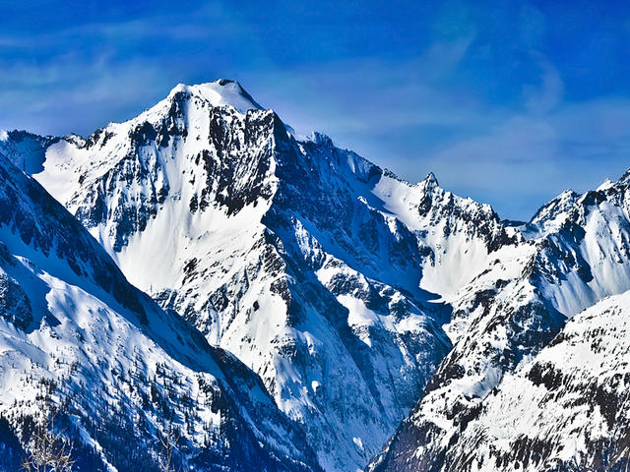
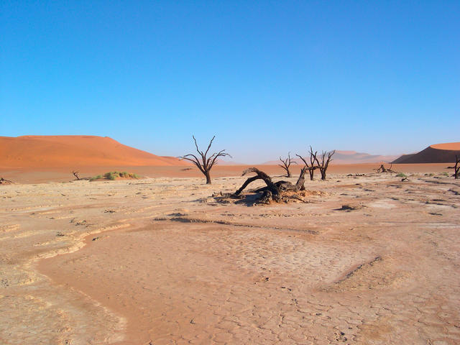
Improbable and forbidden places
An improbable place is a place where human beings should not really be able to live naturally without technological help.
This can be because of physical reasons such as climate, relief and vegetation type or human reasons such as war and pollution.
Some examples include the Arctic where it is too cold all year round, there is very little plant growth so finding food is hard, there is little water as it is frozen or salt water, there are dangerous animals. The Sahara desert is hot and very dry so again our bodies are not designed to cope with these conditions and there will be very little food or water to help us survive. The Amazon rainforest is another improbable place as it is so densely covered by vegetation it would be very hard to make shelter and navigate around. There are also lots of dangerous animals that might hurt people.
A forbidden place is a place where people are not allowed to go. For example Area 51 which is closed for military testing or Chernobyl in Ukraine as the land is contaminated from the nuclear explosion in 1986.

