Slide 1
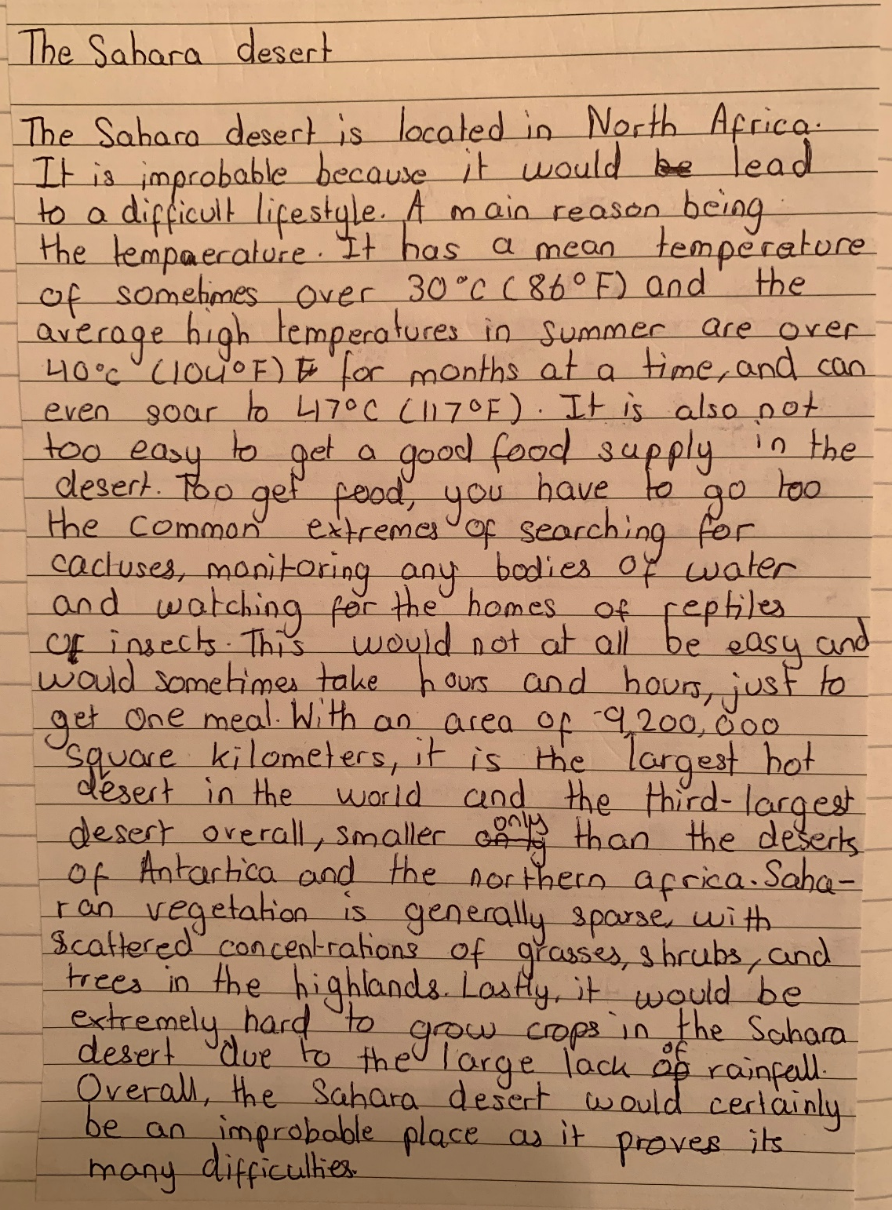
Improbable places example
Location is identified
Climate of the area is described with data
The difficulty of finding food is explained with specific examples from the Sahara
It is clear from this piece of work why the Sahara desert is an improbable place. There is evidence the student has researched this location and included their findings in this work.

Slide 2
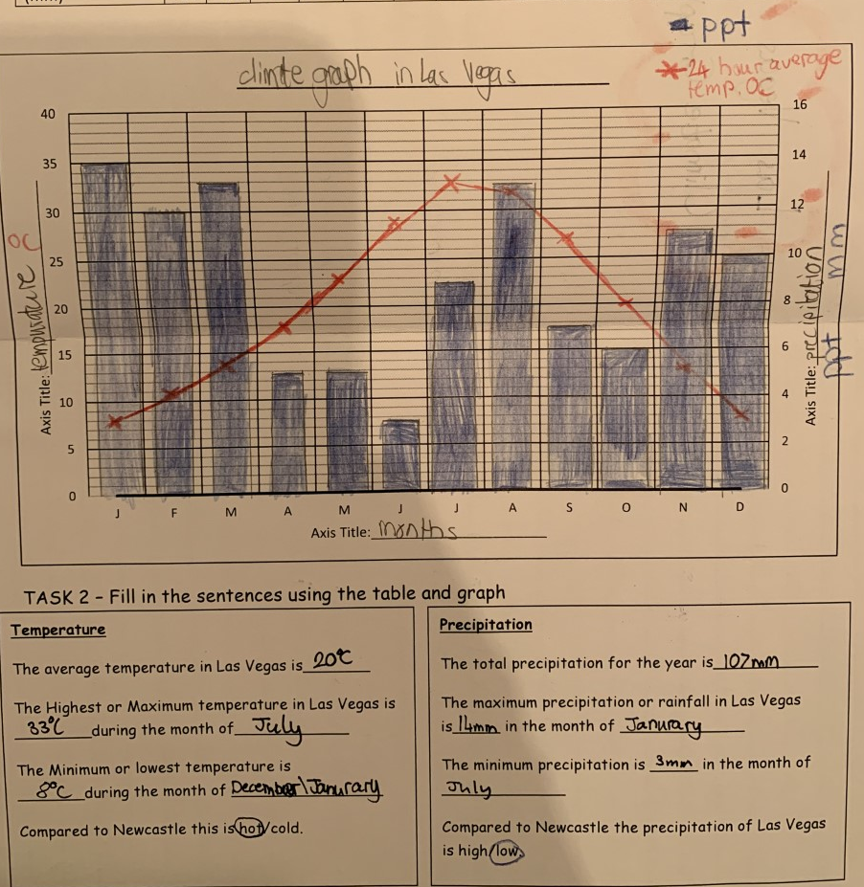
Climate graph example
Sensible title is added to the graph with the location for the data.
Key is completed with symbols
Axis are labelled correctly
Axis are labelled correctly
Temperature is plotted as a line graph. Points are in the middle of the month and a ruler is used to connect the points together and it does not connect to the axis
Precipitation is plotted as a bar graph and a ruler is used so the lines are straight and accurate. These are coloured in to make it even clearer the location of the bar
Precipitation description is completed accurately using data from the graph
Temperature description is completed accurately using data from the graph

Slide 3
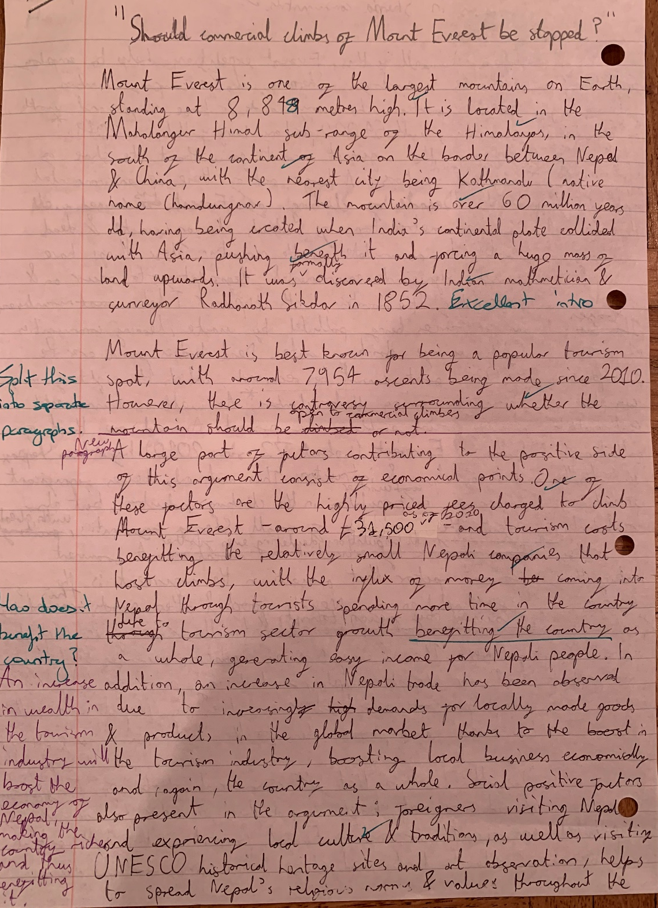
Writing an evaluation
Introduction to the answer showing clear knowledge of Mount Everest characteristics and its location
Essay is outlined and clear why this is an issue that can be discussed
First point introduced and mentions that it is an economic point.
Evidence is used to support the point
The point is then explained in detail – why will it bring benefits to the economy and the wider impacts this has.
Stakeholders are also mentioned – who will be affected by the economic gains from commercial climbing
Second point introduced and mentions that it is a social point.
Evidence is used to support the point

Slide 4
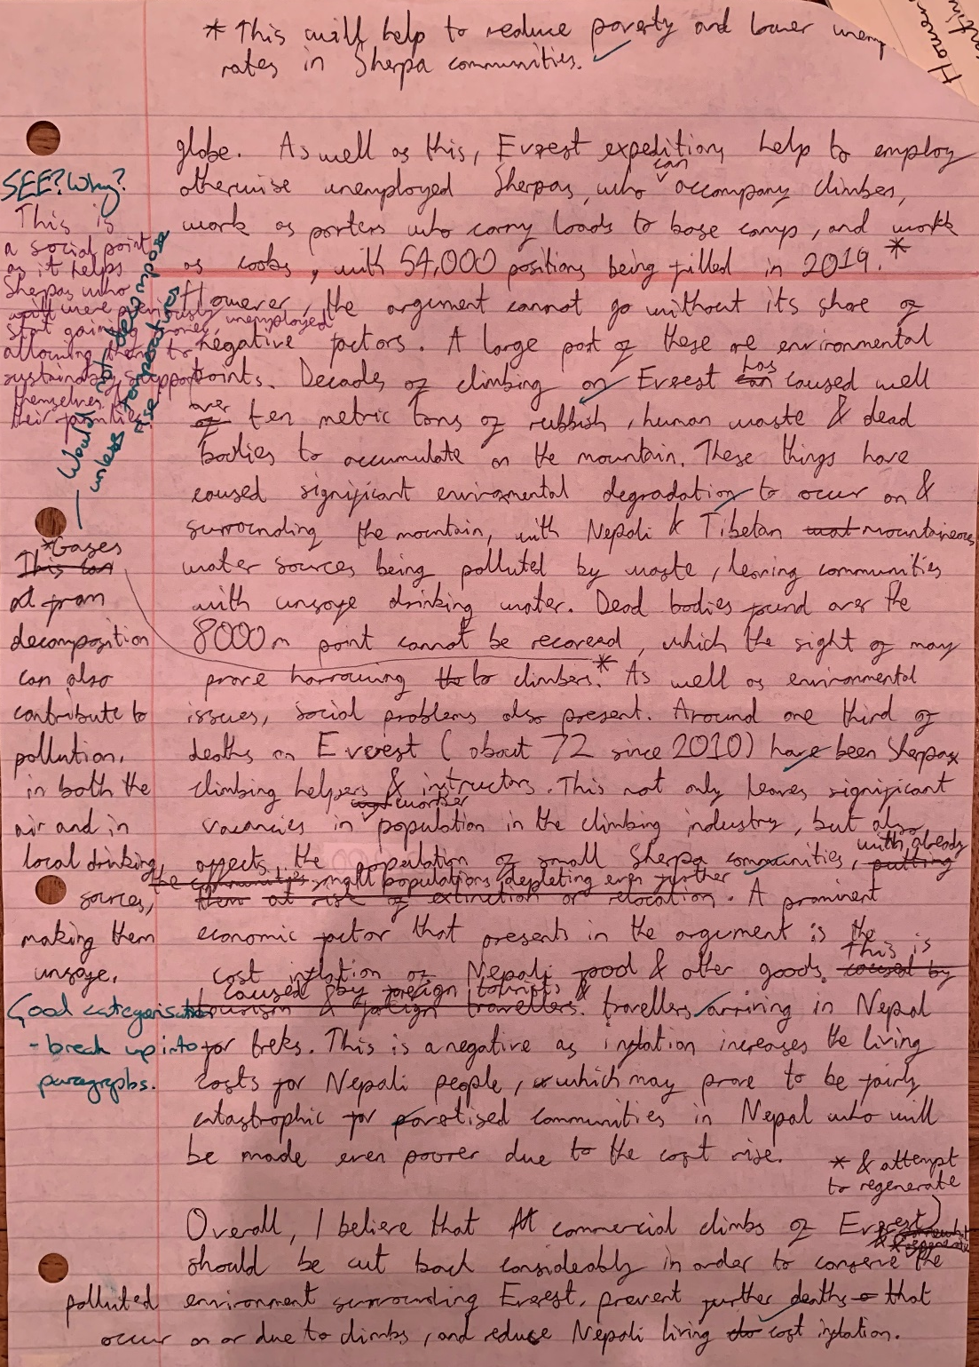
Another strong explanation using evidence throughout
Other side of view (negatives of expansion) is given to provide balance to the argument. This shows the student has considered both sides before coming to their decision.
Points are made, mentioning whether they are a social, economic or environmental point.
Explanation of the point with who is affected by this (stakeholders)
Evidence is used to support the point
Again explanation of the point with who is affected by this (stakeholders)
A clear decision is made that supports the answer written above. The key points made are summarised in this conclusion.

Slide 5
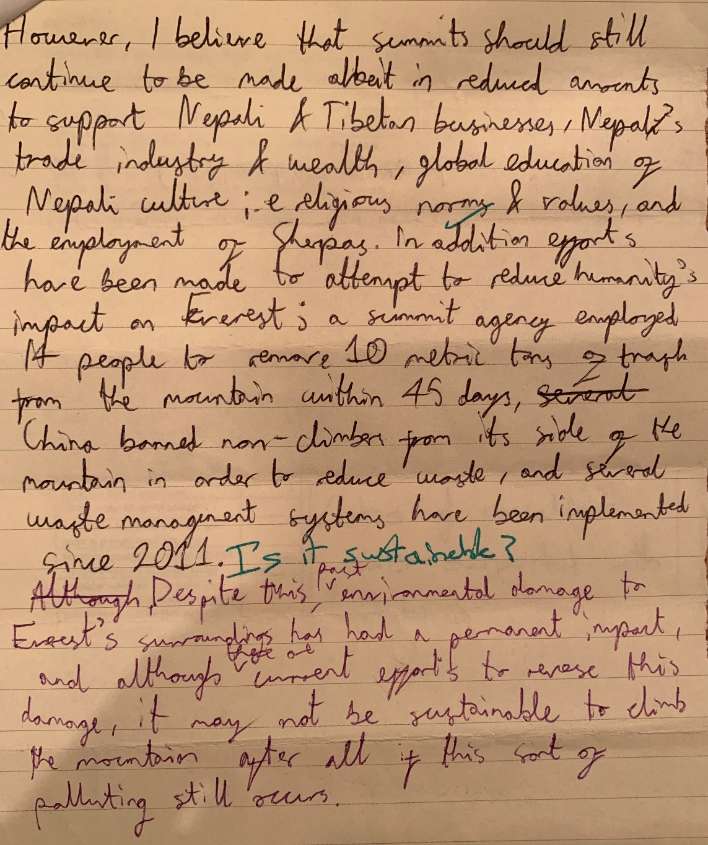
Conclusion is has clearly reflected on the positives and negatives to lead to a decision that commercial climbing should continue but in reduced numbers.
No new information is added. The key points from the answer are summarised well.
A summary of some of the attempts made to reduce the impacts are mentioned.
Lots of key geographic terminology and evidence is used throughout the answer.
Student has responded to feedback and tried to improve their work.

