Slide 1
Exemplar work Y8 French

Slide 2
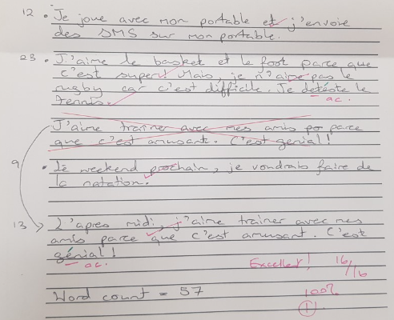
Very accurate writing into French. Accurate spelling and very good knowledge of free time activities. Using ‘je voudrais + infinitive very accurately.
Accurate spelling and formation of verbs in the present tense.
Excellent opinions
Excellent connectives

Slide 3
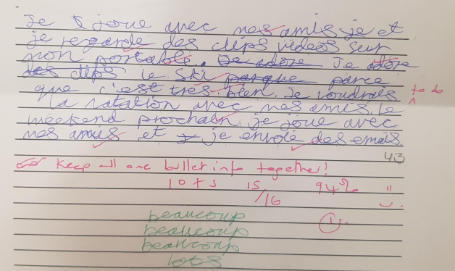
Accurate spelling in French. Good connectives and detail given.
Some opinions given.
Accurate spelling and formation of verbs in the present tense.
Good connectives

Slide 4
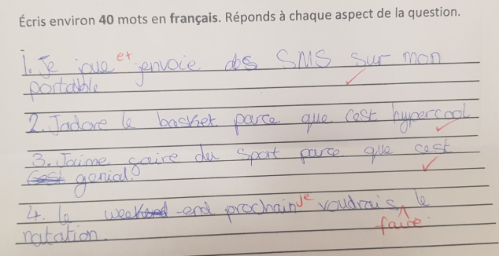
Accurate spelling in French. Some connectives and detail given.
Some opinions given.
Good connectives
Accurate spelling and formation of verbs in the present tense.

