Slide 1
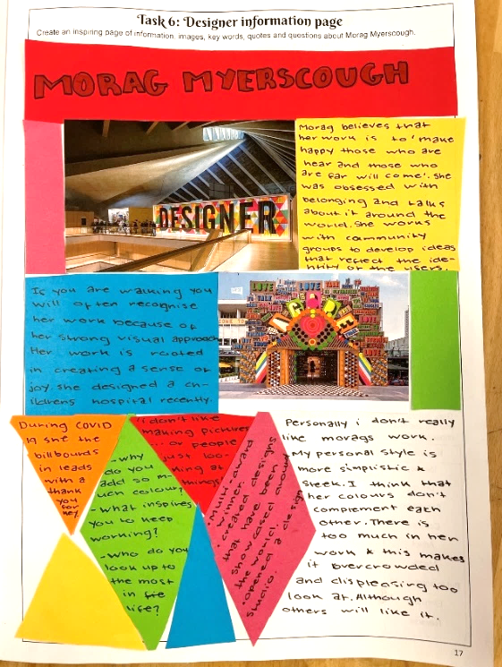
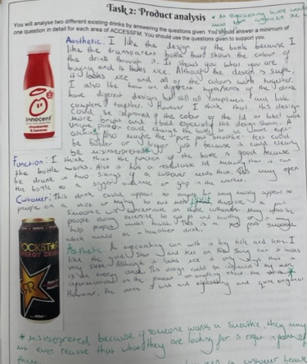
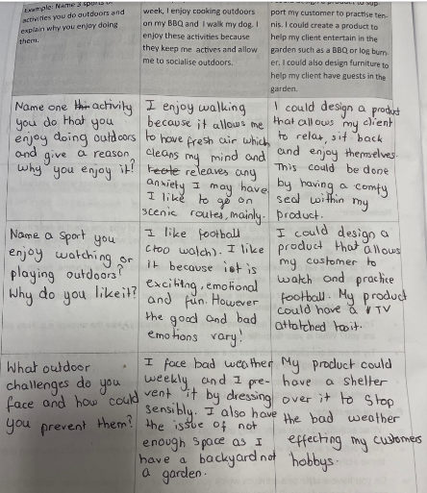
In year 8, students conduct several forms of market research to help them understand their customer and the market which they product will fit into.
Students will:
Investigate the work of Morag Myerscough
Research and evaluate inspiration products which are already on sale.
Research in store point of purchase stands
Plan and conduct a customer interview
Analyse the responses from their customer interview to identify design possibilities.
Conducting Market Research

Slide 2
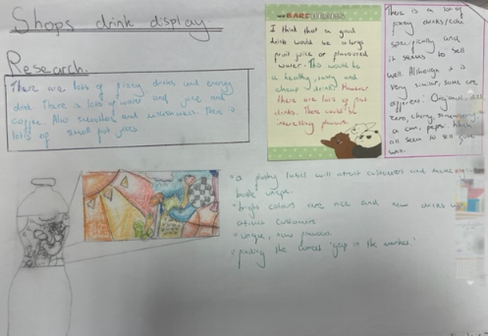
Existing Product Analysis
The selected products have bee thoroughly analysed using all the support questions provided to guide their analysis.
High quality vocabulary has been used throughout the analysis.
All responses are fully explained / justified with links to possible users, function, cost etc.
Presentation has been considered.
The research carried out informs future design and project decisions.

Slide 3
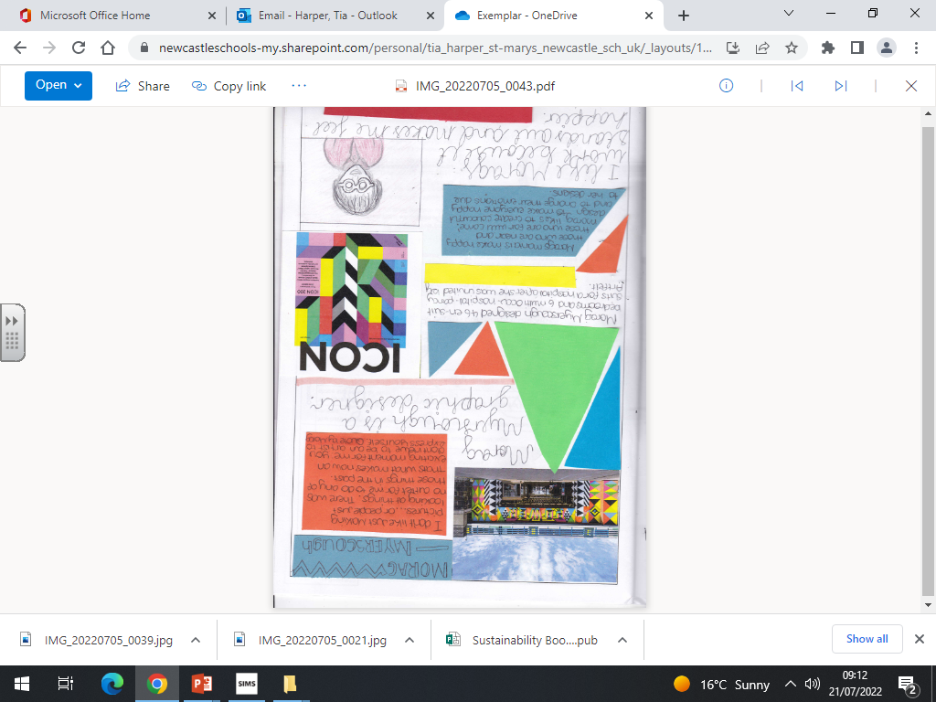
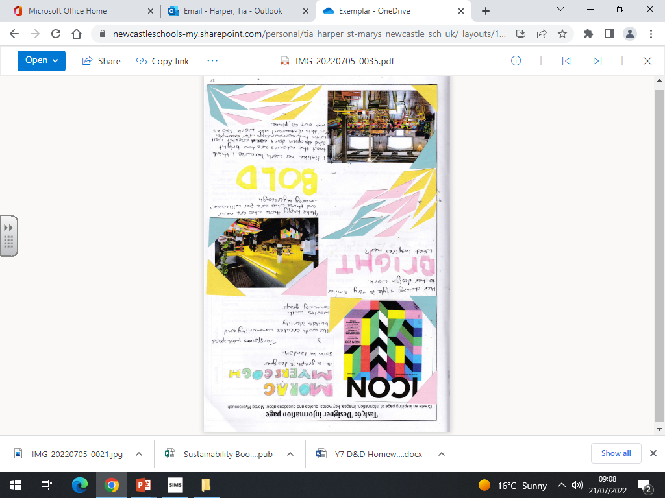
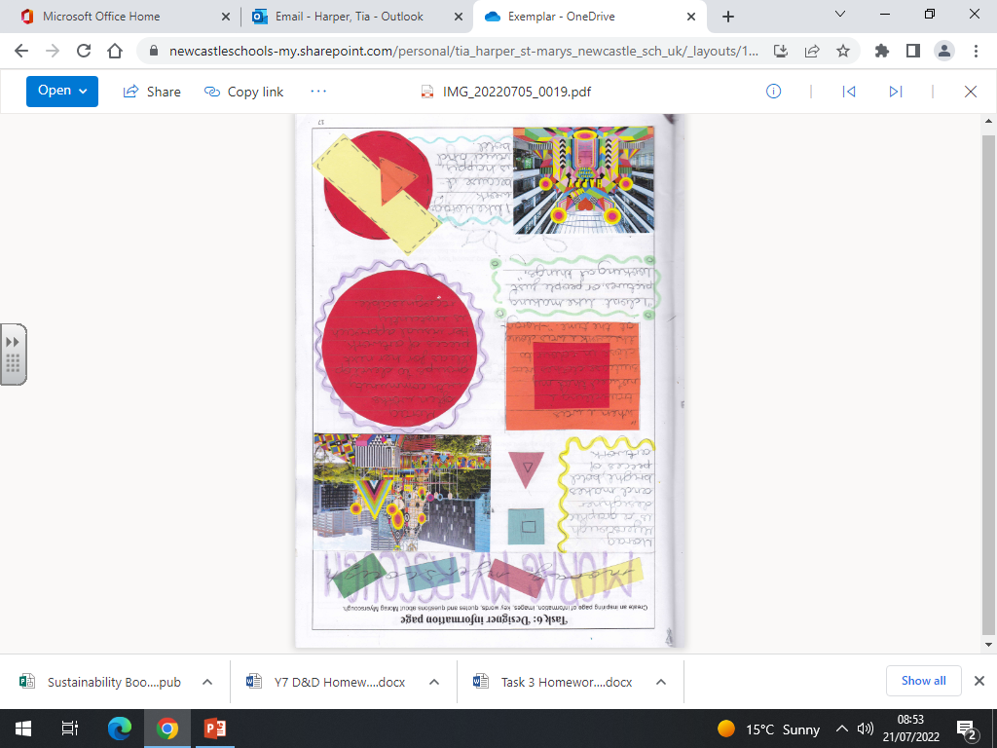
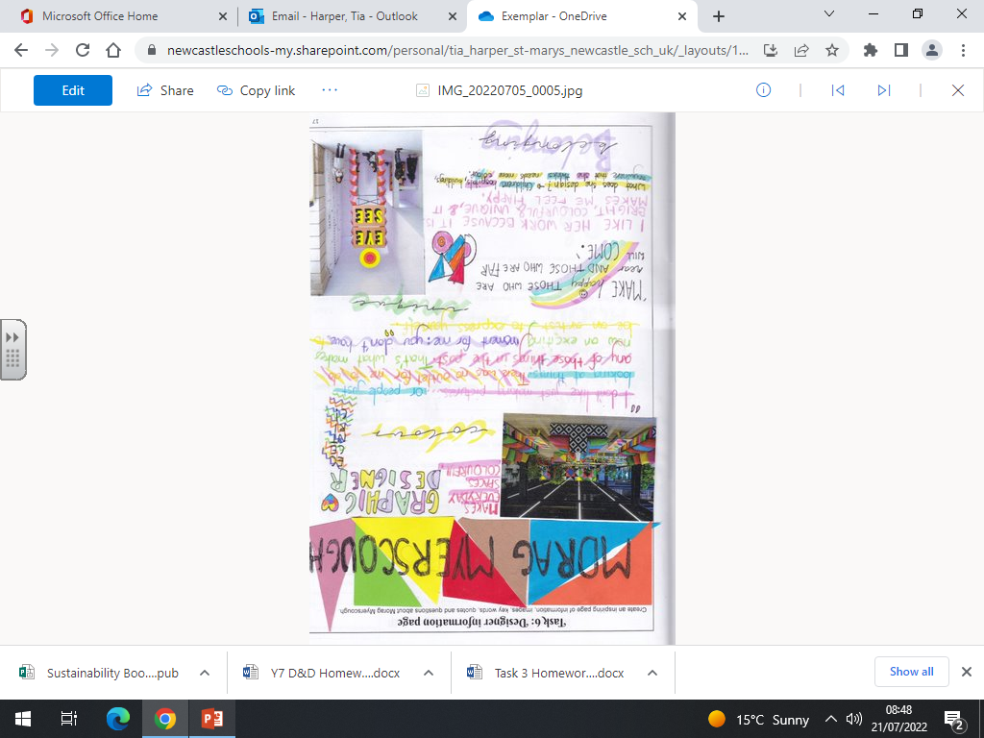
The Work of Others – Designer Research
Without copying the work of the designer, students have been able to represent the style of the designer in their own work.
Students have shown a creative flare for presenting their work. Different materials, collage techniques and additional pattern have been added to create an exciting page.
High quality vocabulary has been used in their work.
Students have carried out detailed research at home to explore the work of Morag Myerscough. This knowledge has been used to answer questions about the designer.
Students have responded to the provided questions about the designer in detail, explaining and justifying their comments.

Slide 4
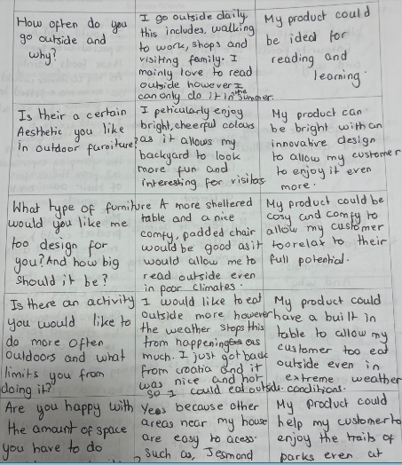
Plan & Conduct A Client Interview
Relevant and useful questions have been planned. The student has considered what information they need to find out and how useful the questions will be to their project.
The customer’s responses have been recorded in detail.
The student has been able to analyse the responses given and draw design possibilities from their responses. Possible products and product features have been identified.
Students will use this information to guide the development of a design brief, specification and product ideas.

Slide 5
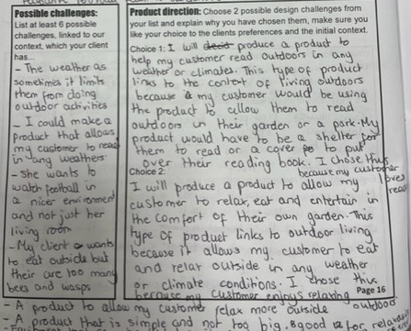
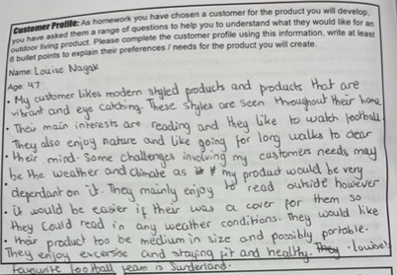
Profiling The Customer &
Defining The Design Challenge
Students use their interview responses to create a customer profile and identify possible design challenges which could be addressed for their customer.
The customer profile is detailed and allows the reader to understand who the customer is, their interests, hobbies, challenges and all relevant information for the contextual challenge.
A wide variety of possible design challenges have been identified using the previous research and customer profile.
All design challenges are broad and do not identify a specific product, this allows the student to design a range of different products to resolve the challenge.
The chosen product directions are broad, link to the context of the project and the decisions are fully explained with links to the customer.

Slide 6
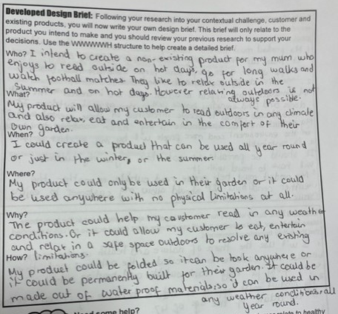
Writing a Design Brief
In year 8, students work with live design challenges. This allows them to select a customer and design a product for that specific person. After they have carried out market research they can then develop their own brief and specifications. The design brief should state their intentions for their designs and the specification should give guiding rules to ensure the products meet the customer’s and contextual requirements. Some students are also able to justify / explain the rules which they set and how they relate to their market research.
All the WWWWWH questions have been responded to, this allows the brief to be comprehensive and thorough.
All decisions have been written in full sentences.
All decisions link to the previous research e.g. customer interview, existing product analysis, contextual analysis.
All decisions are explained.

Slide 7
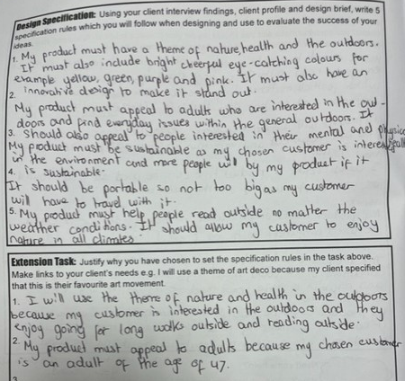
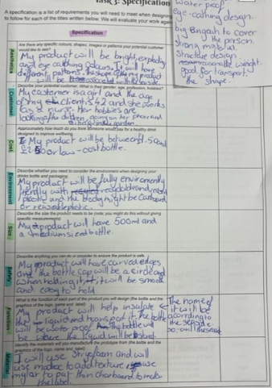
Writing a Design Specification
In year 8, students work with live design challenges. This allows them to select a customer and design a product for that specific person. After they have carried out market research they can then develop their own brief and specifications. The design brief should state their intentions for their designs and the specification should give guiding rules to ensure the products meet the customer’s and contextual requirements. Some students are also able to justify / explain the rules which they set and how they relate to their market research.
A variety of rules have been written to guide the development of a product which will meet the customer’s needs.
All decisions are based upon previous research, such as the customer interview and existing product analysis.
All rules are focused and distinct.
Some rules have been justified with links to previous research or the customer’s needs.

Slide 8
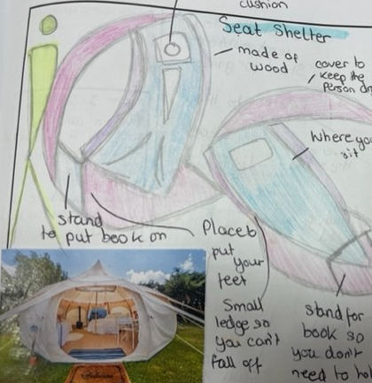
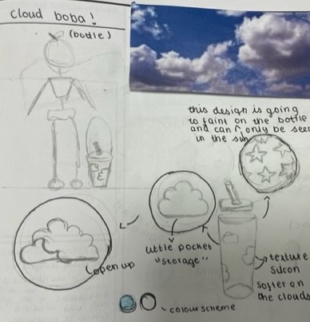
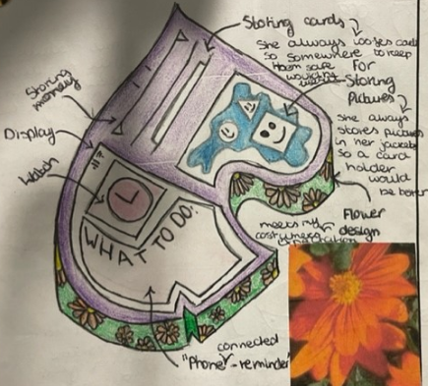
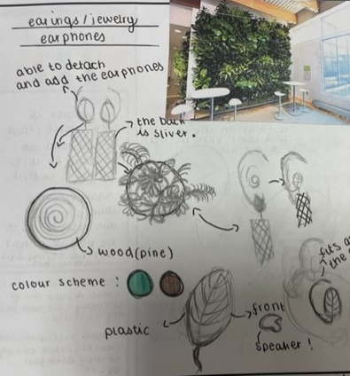
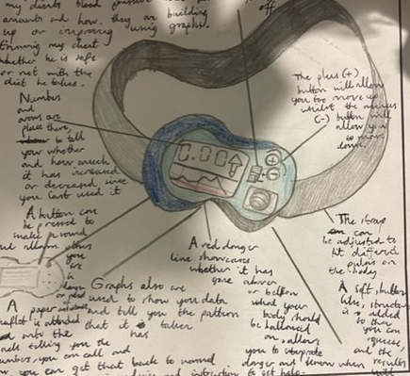
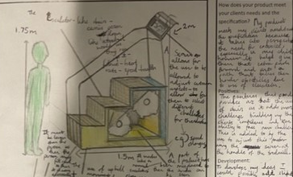
Generating Design Ideas
Students have been able to create wide range of designs to resolve their design brief .
Students have been able to show innovation, creating new, interesting and exciting design concepts.
Designs are clearly communicated using 3D and 2D sketches
Designs are often shown from multiple views to help communicate the ideas clearly.
Designs are thoroughly annotated to explain material choices, functions, design features, dimensions etc.
2 Design strategies have been used to generate the ideas – Jack Straws and Inspired Designs.

Slide 9
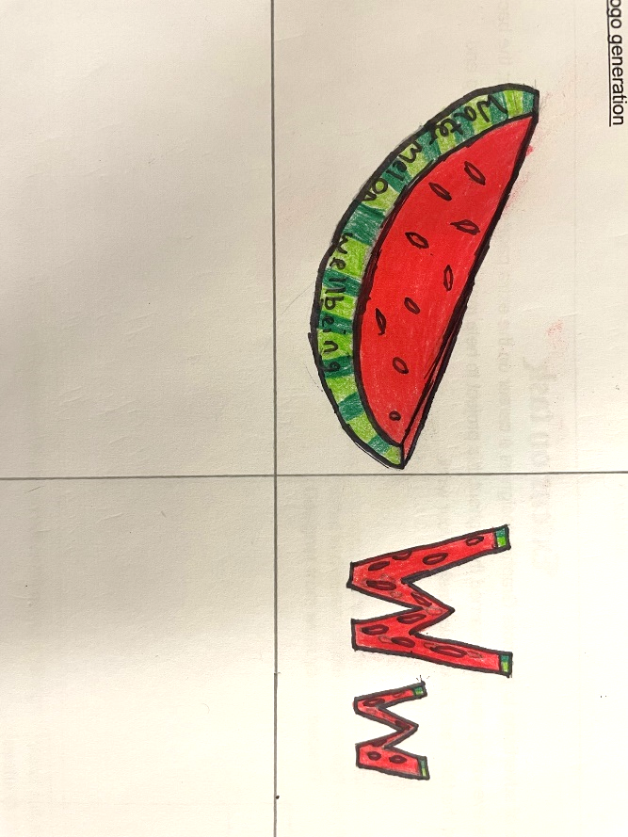
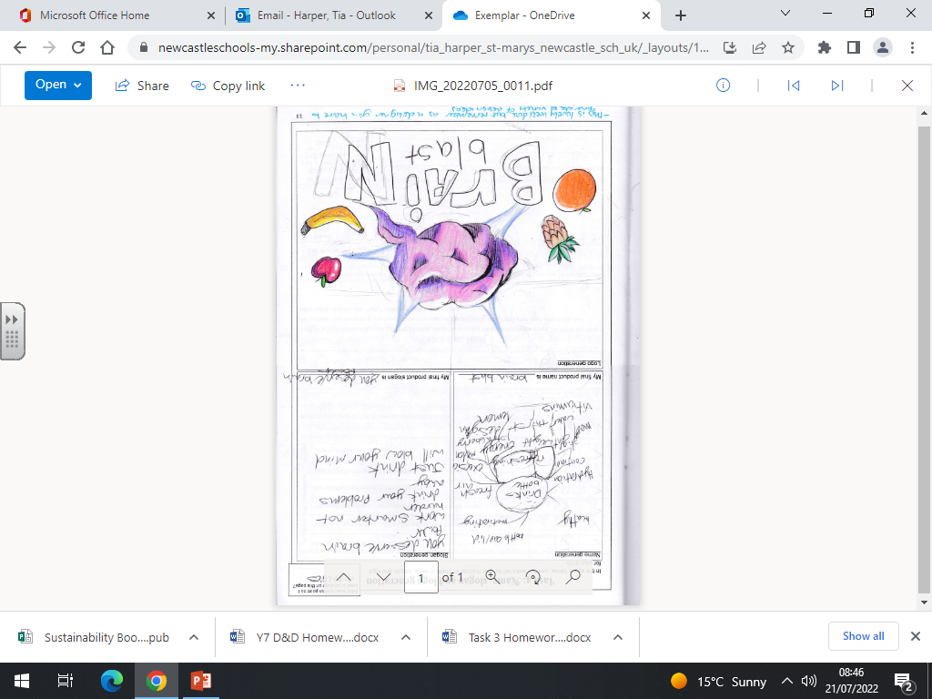
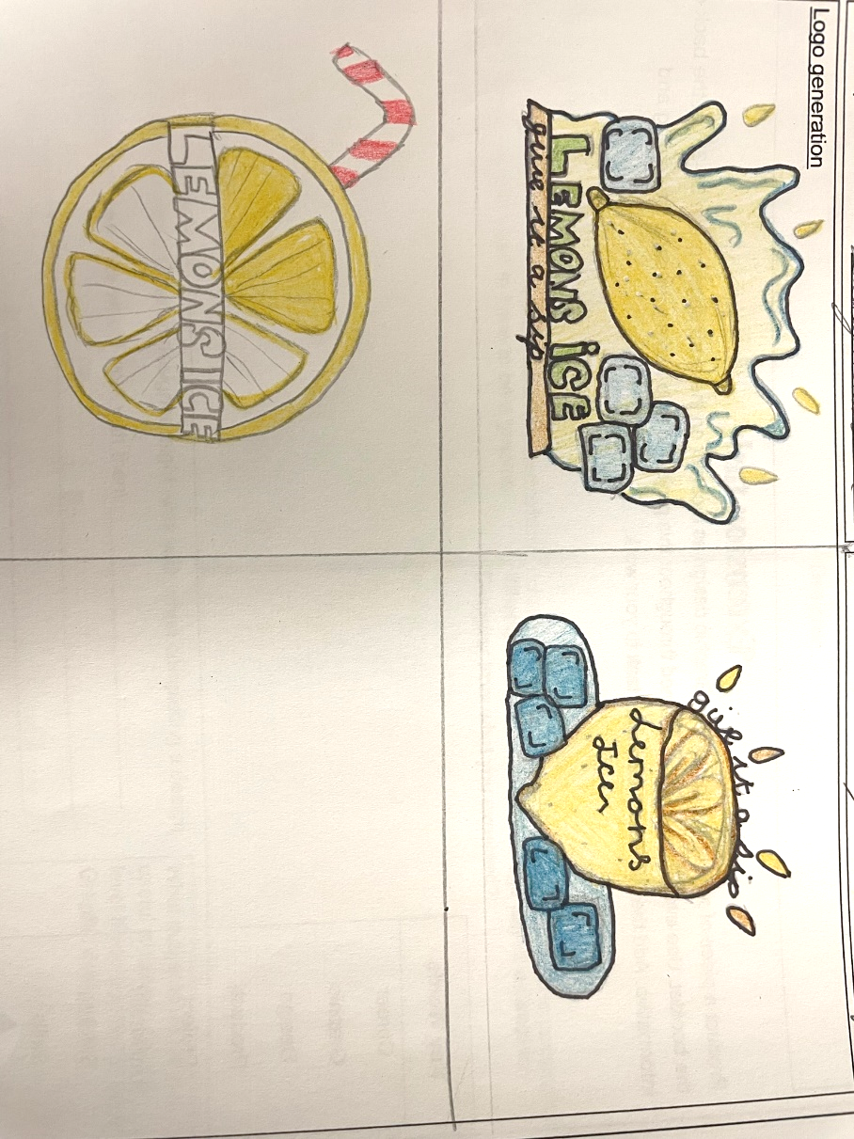
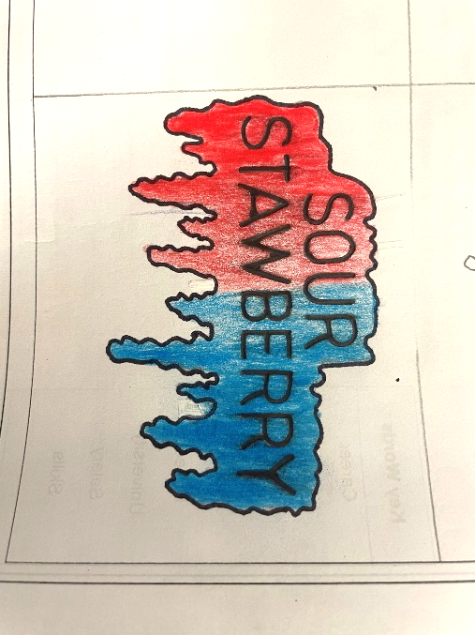
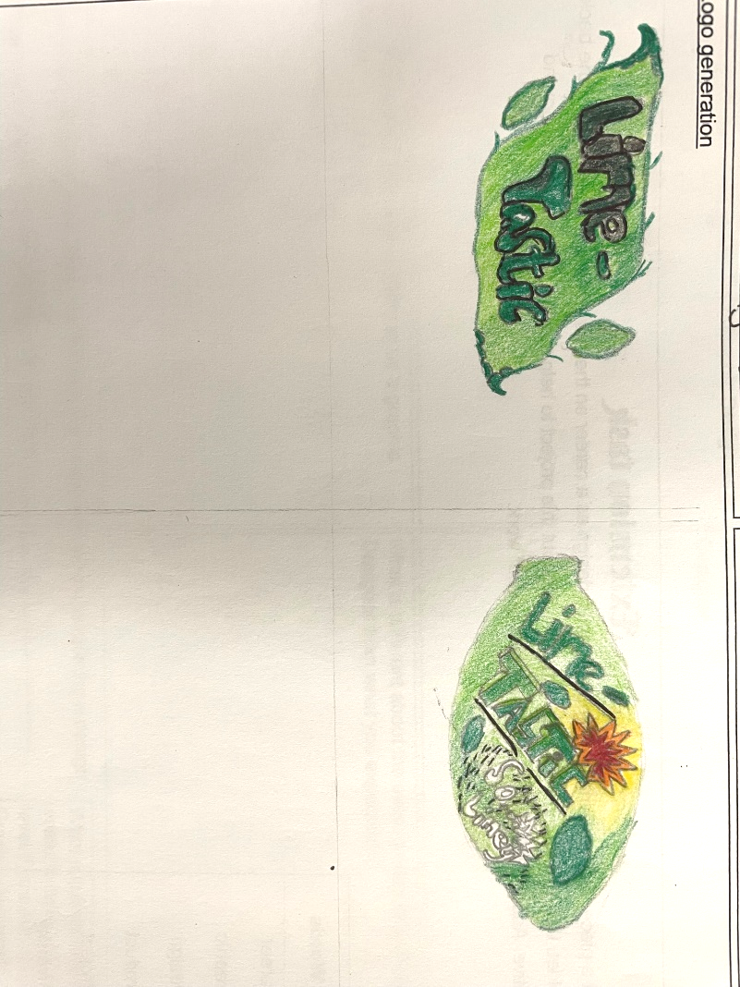
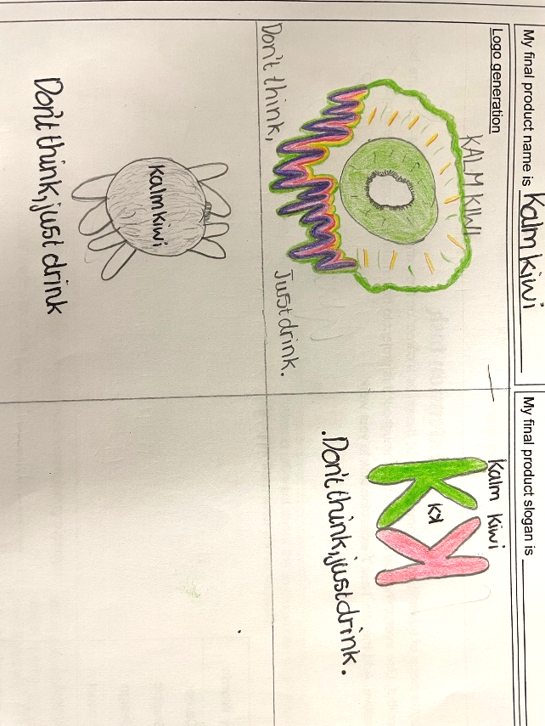
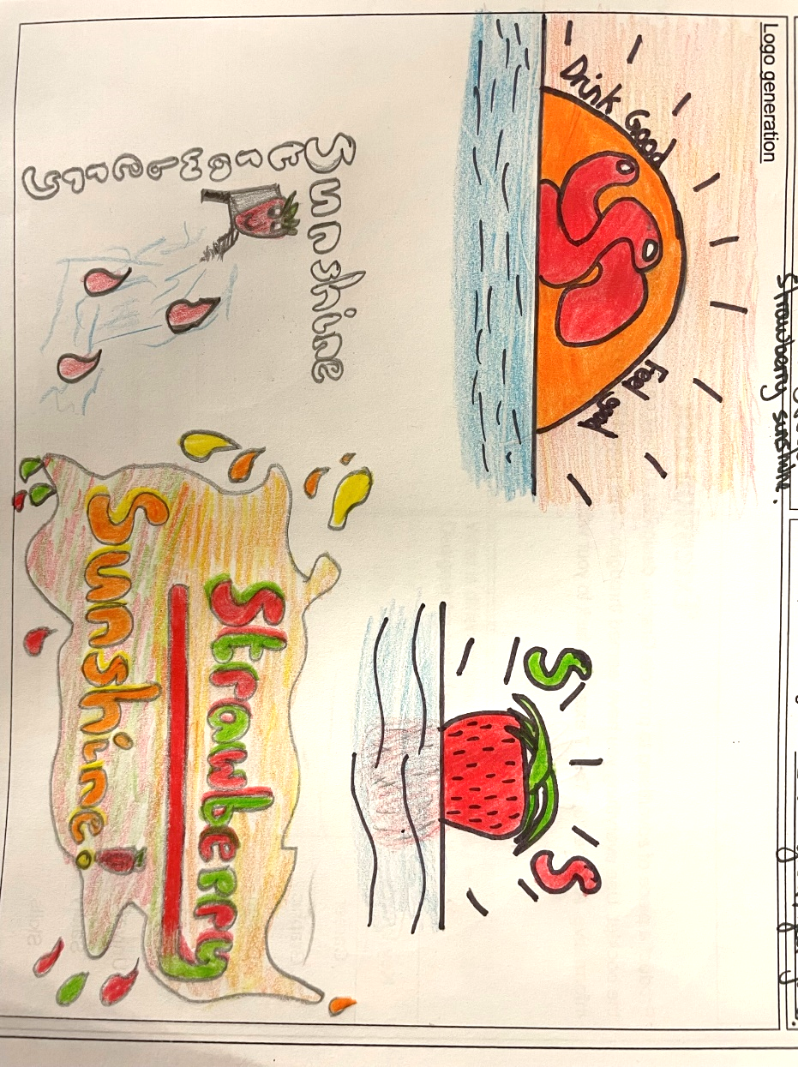

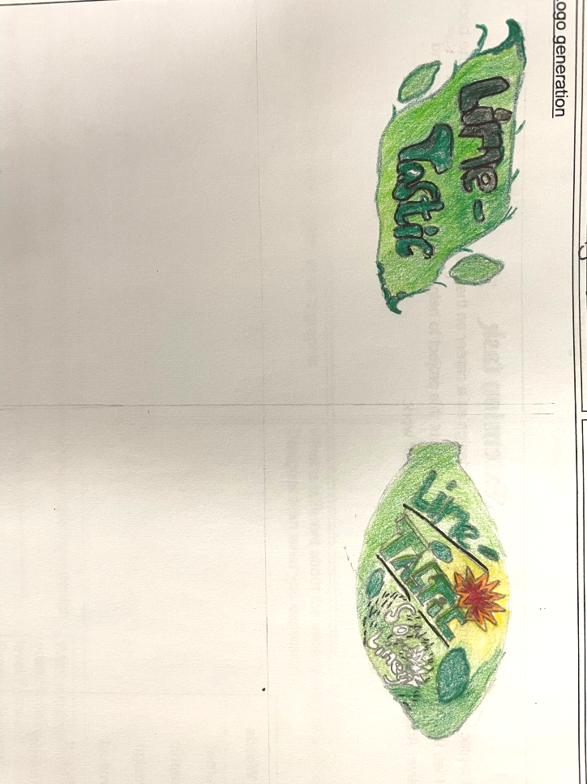
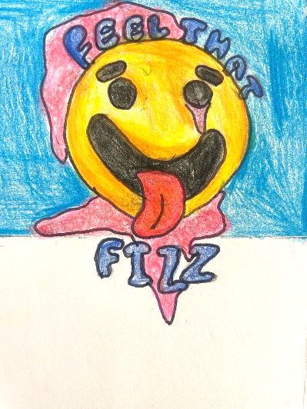
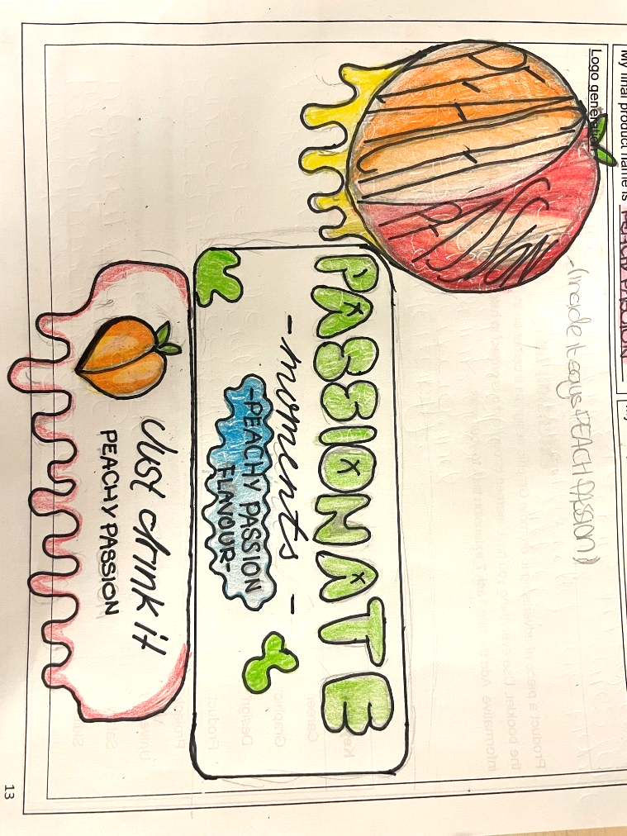
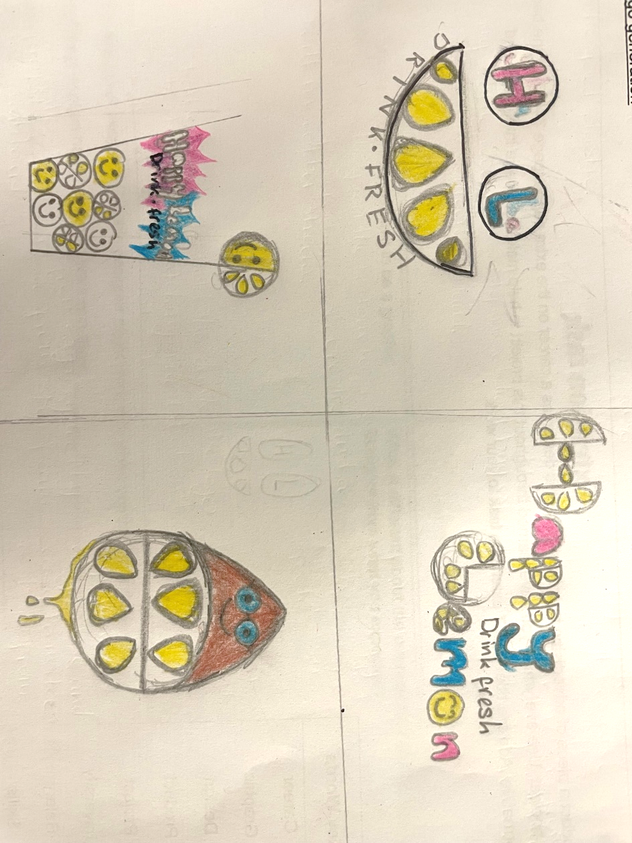
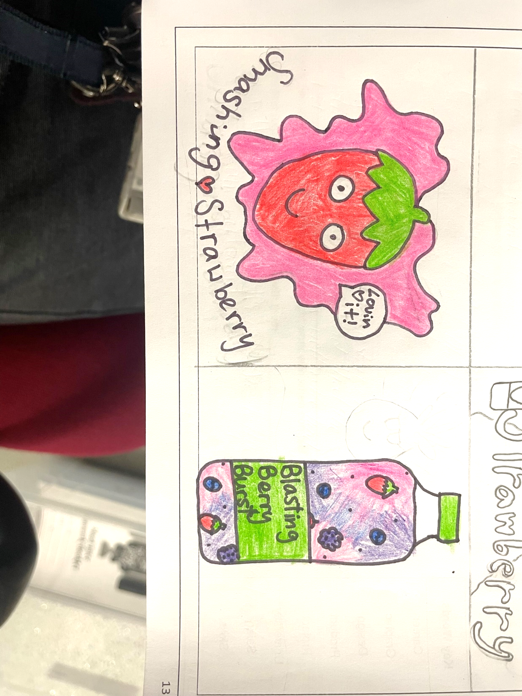
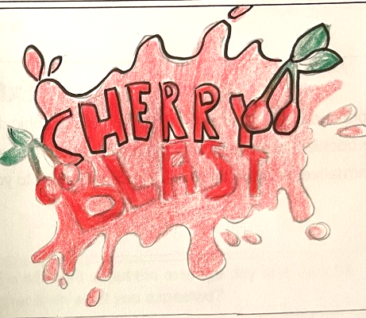
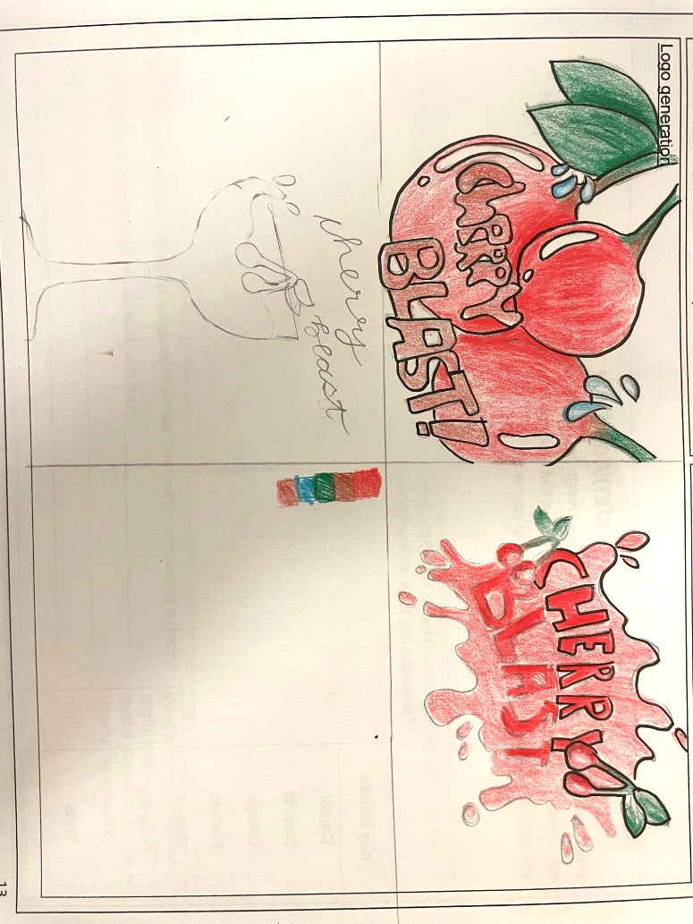
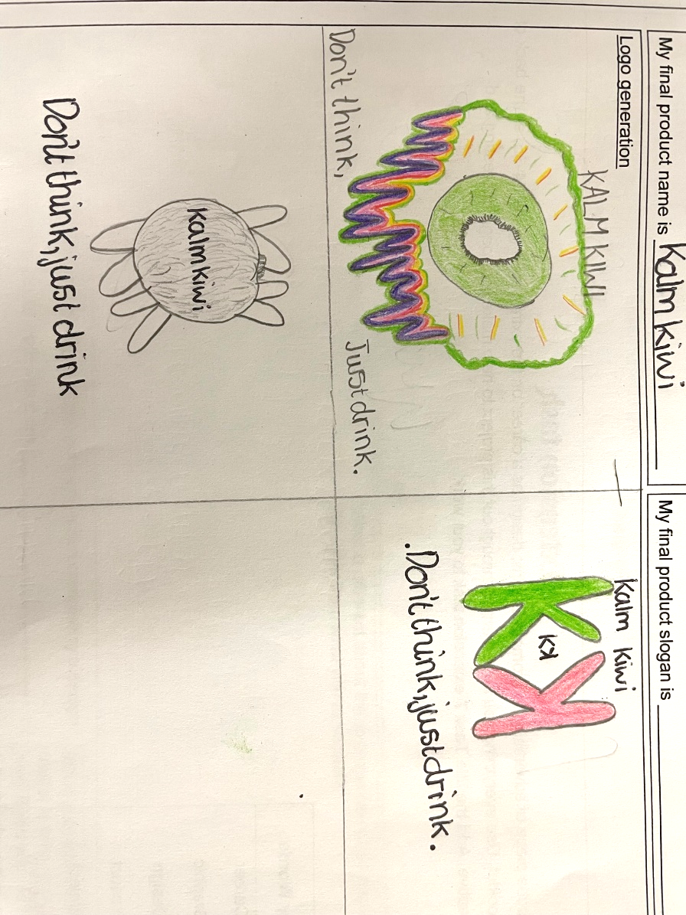



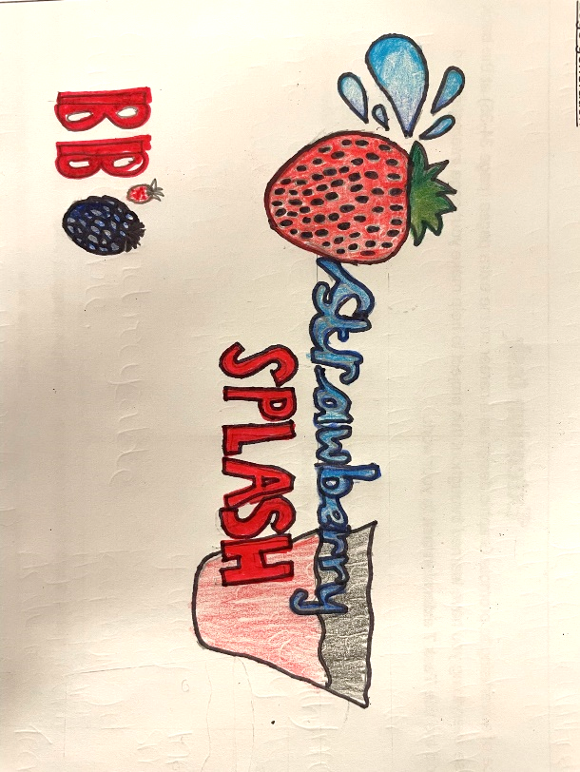

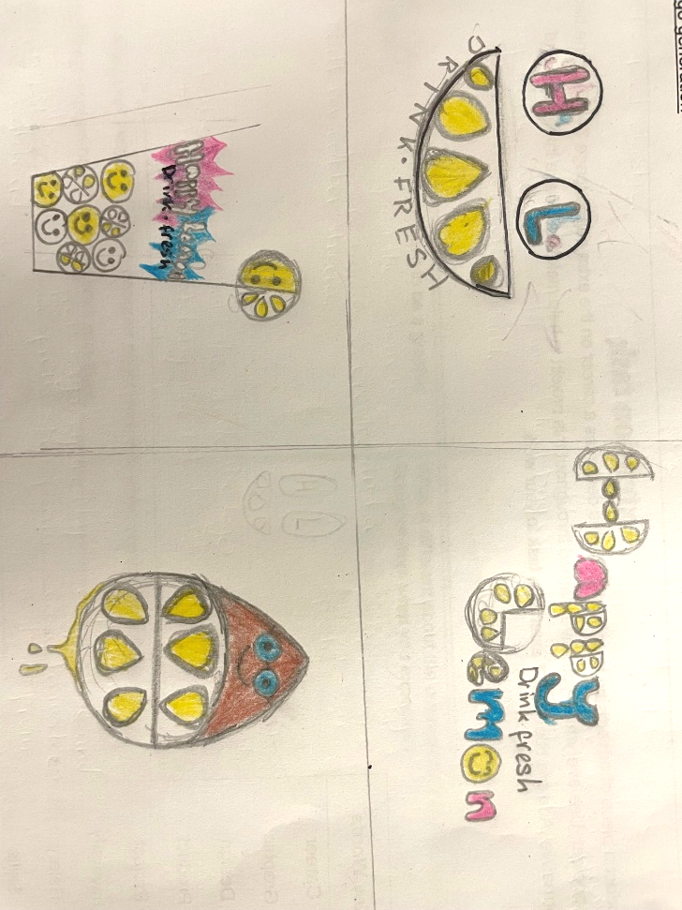
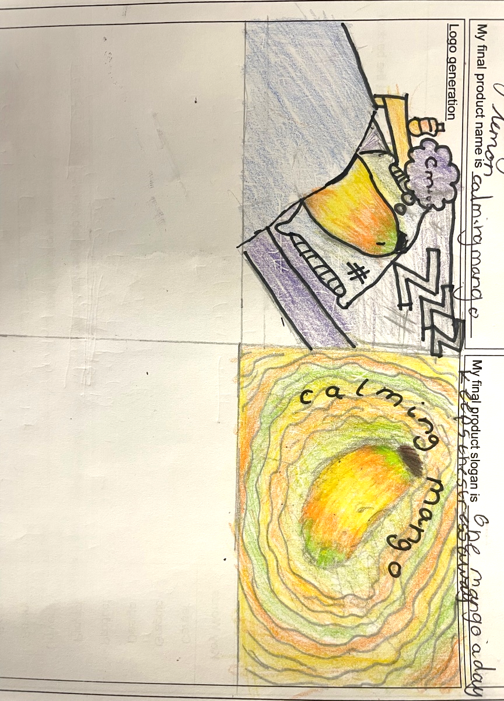
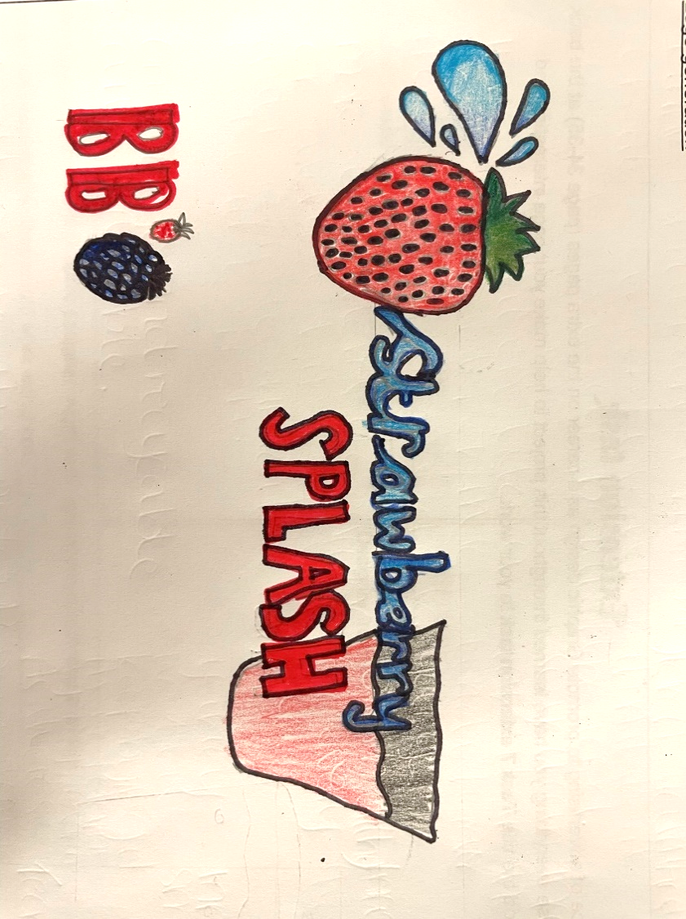
Generating Design Ideas
Students have been able to create wide range of logo designs for their brand.
Designs are creative and aesthetically pleasing.
The logo designs show an understanding of how a successful logo should be made – simplicity, universal nature, limited colour scheme, brand message.
Colours have been added with care and skill.
The brand identify is shown in the design of the logo and the images included.
The logos have been designed to appeal to the chosen target customer / audience.

