Slide 1
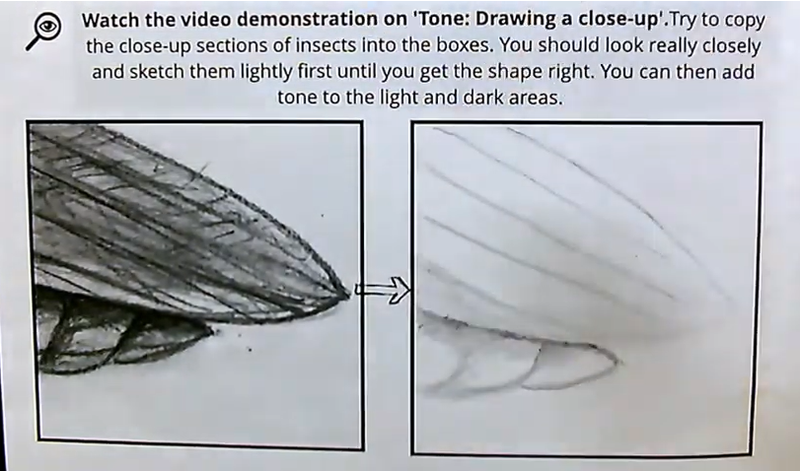
Aim: To notice more surface detail in the objects you are drawing and record them in your work.
1/ Watch the video of how you should approach the task. (1 min 7 sec)
https://www.youtube.com/watch?v=yJQihxdz4UY
2/ Draw a small box on your page in pencil and select a close up images from the following slides.
3/Only record the lines, marks and shadows that you see. Avoid making anything up.

Slide 2


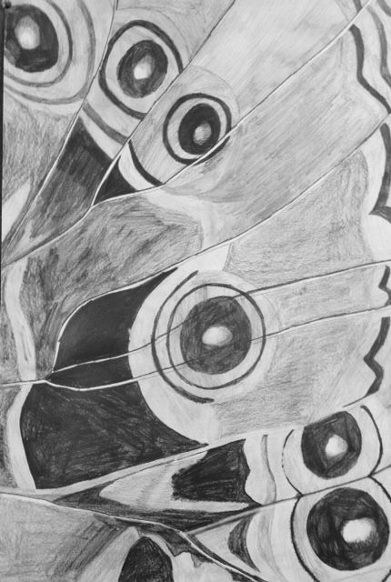

Slide 3
