Slide 1
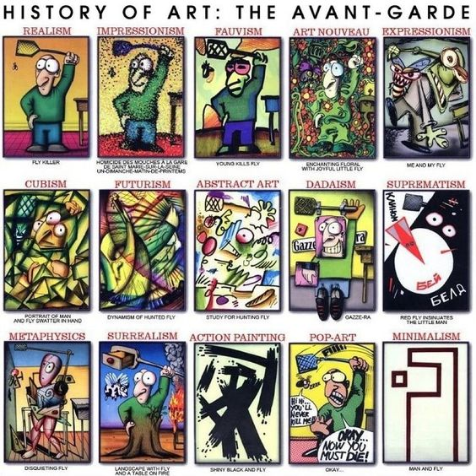
Exploring & developing your drawings into different styles.

Slide 2
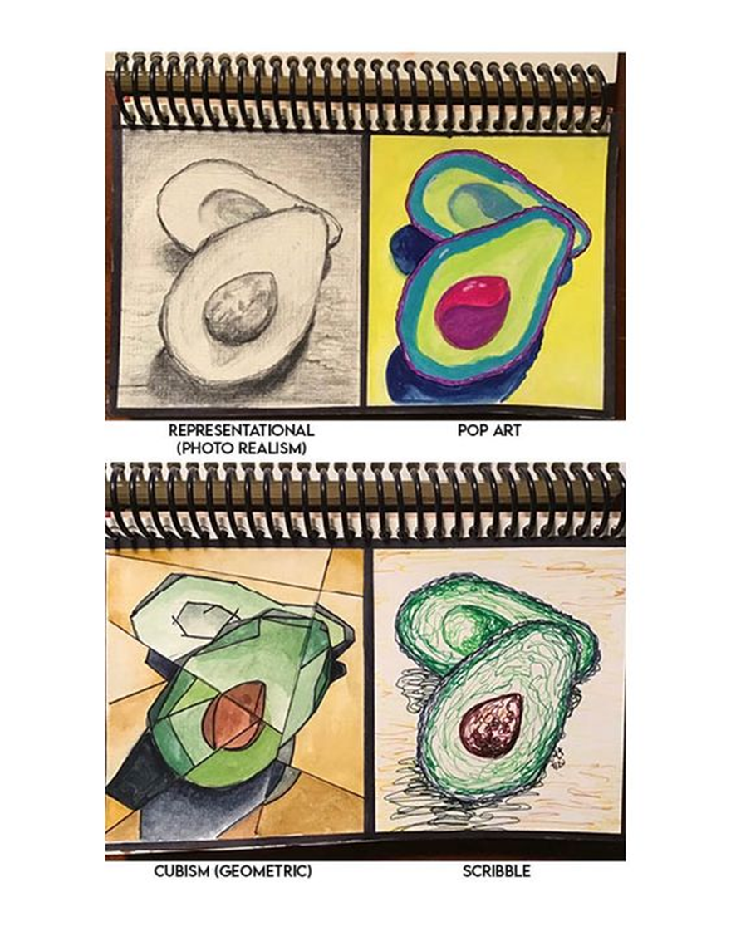
Task : Recording and experimenting with different styles of drawing.
Pick an object with an interesting shape. This could be any still life object.
Carefully draw the shape/outline of the object lightly in pencil
Split the drawing into 4 sections.
In each of the 4 sections use a different drawing technique to practice or apply a different artistic style to your work.
SEE THE NEXT SLIDES FOR EXTRA DRAWING STYLES YOU COULD USE.
SCRIBBLES
KNTTING LINE
SMOOTH BLENDING
POINTALISM

Slide 3
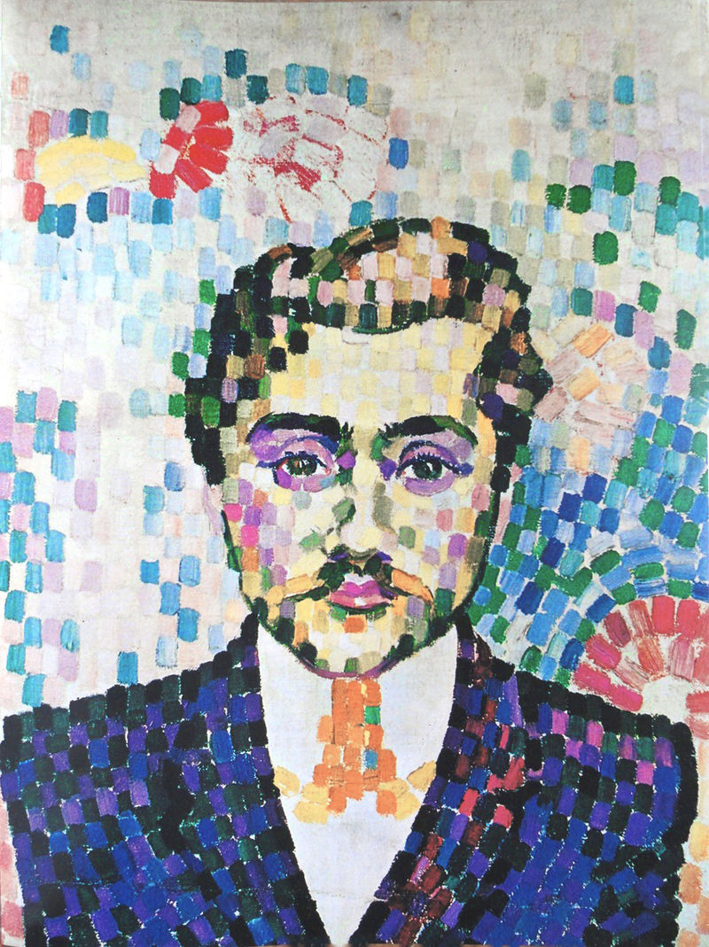
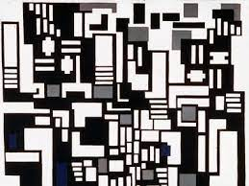
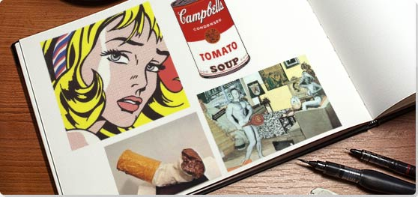
Different Styles
Artistic Styles
Ancient Egyptian
Ancient Greek Vase Painting
Byzantine Art
Medieval Illuminated Manuscripts
Impressionism
Pointillism
Cubism
Fauvism
Suprematism
Constructivism
Expressionism
Pop Art
Surrealism
Art Nouveau
Minimalism
Cubism
De Stijl
Graffiti
Collage
Mosaic
Art Deco
Dada
Abstract Expressionist - Action Painting

