Slide 1
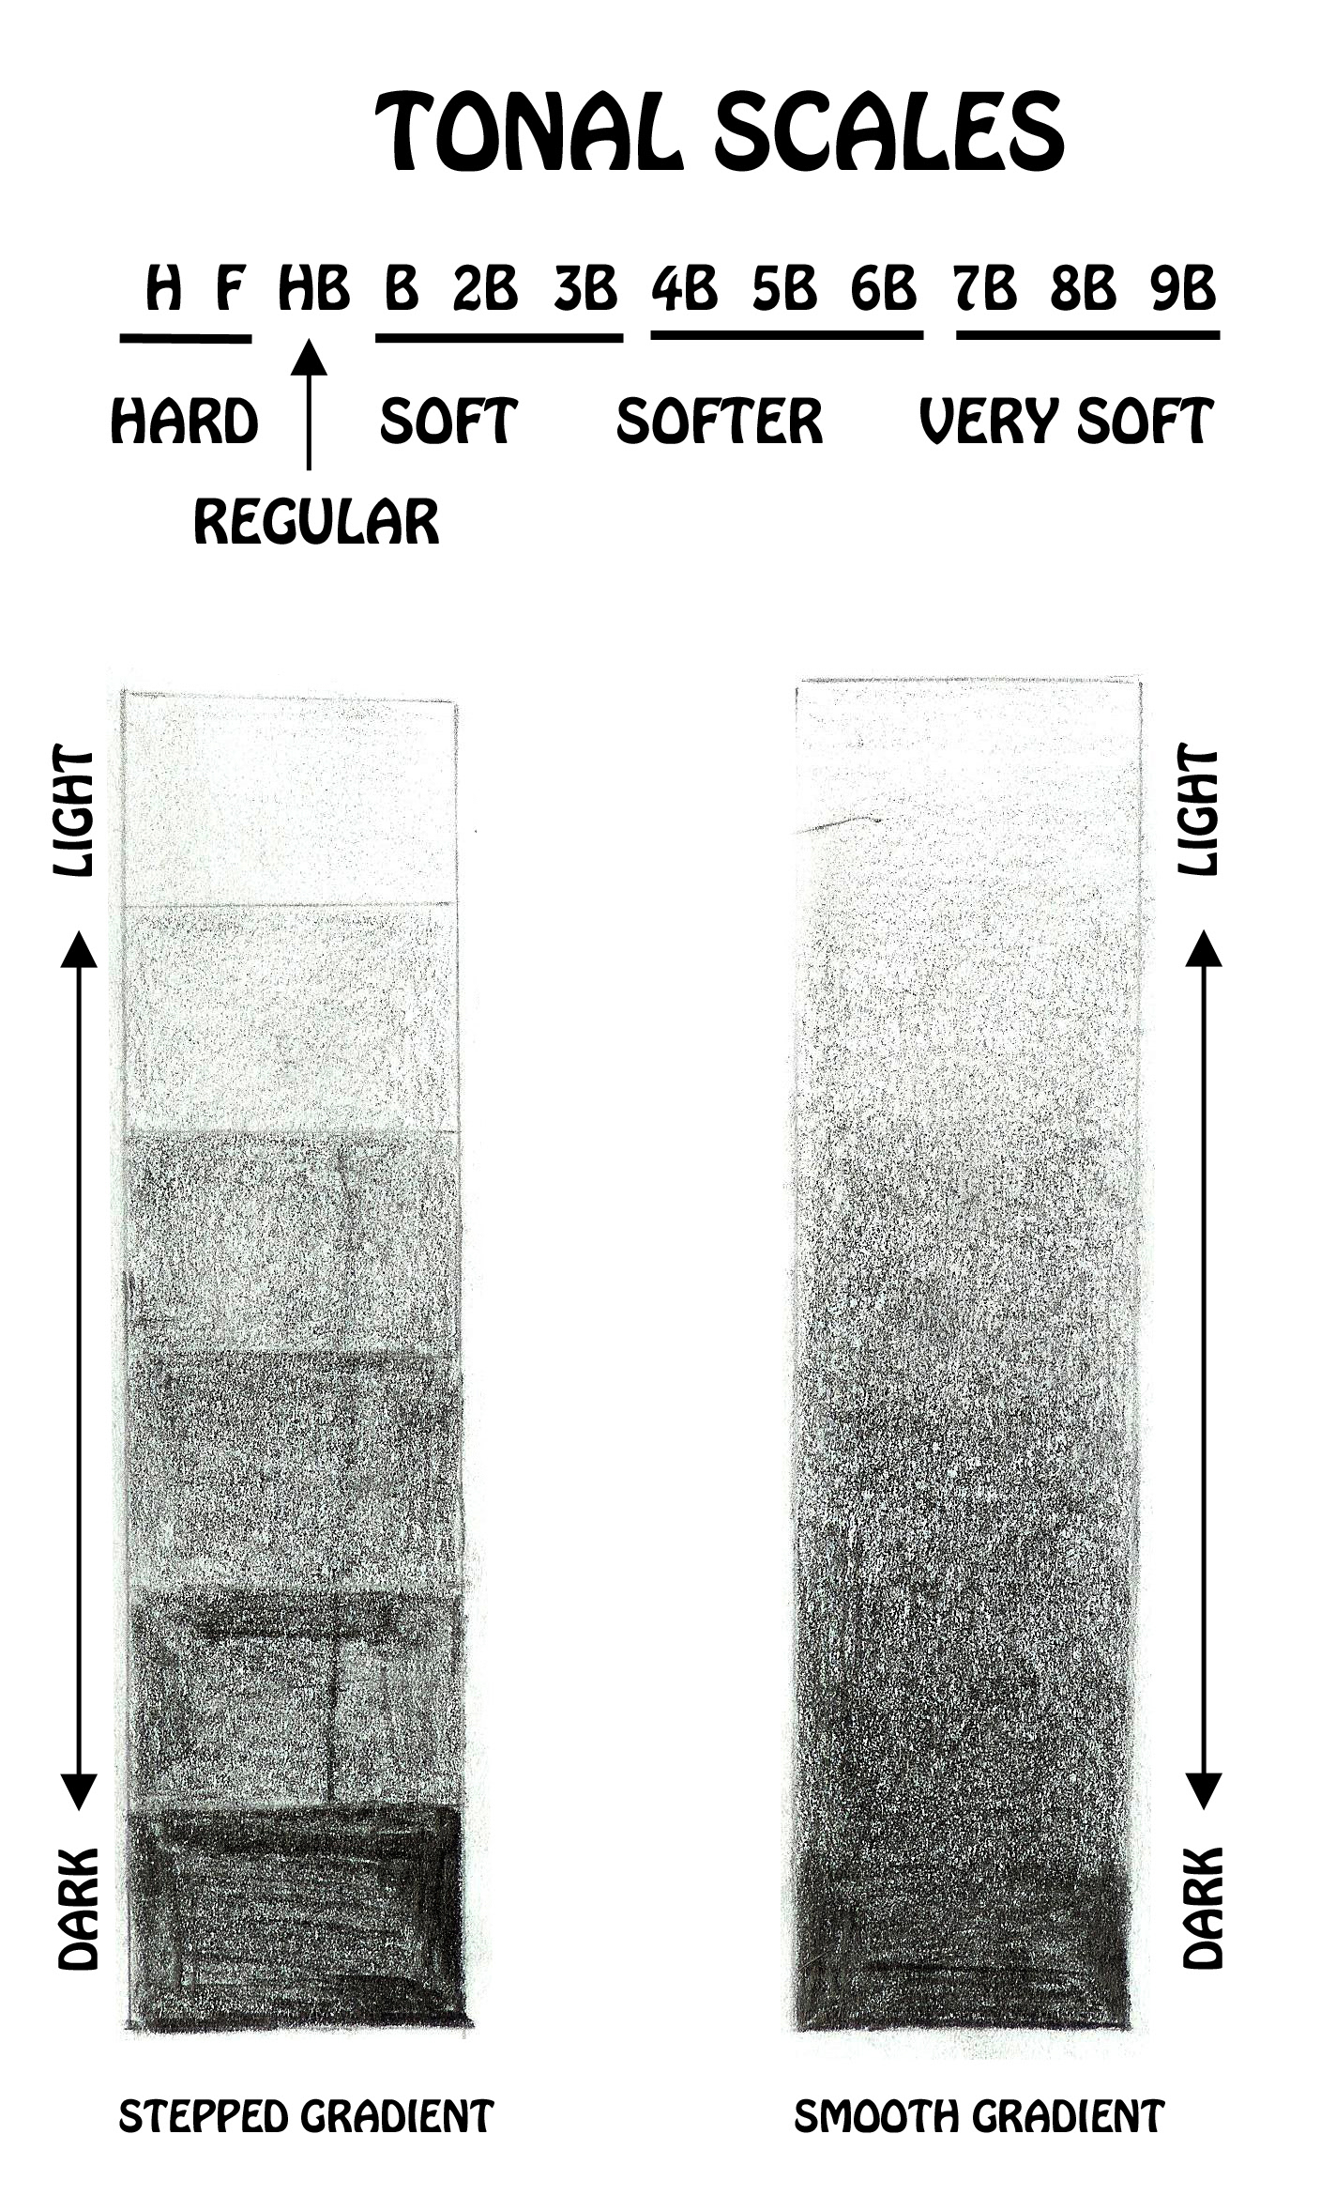
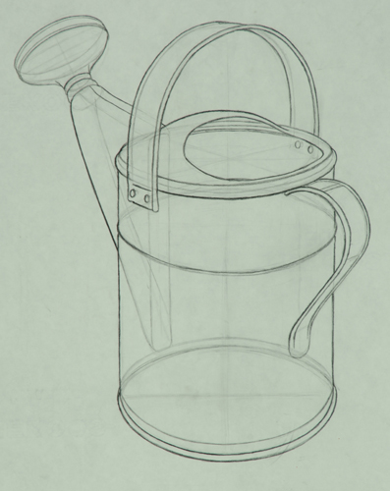
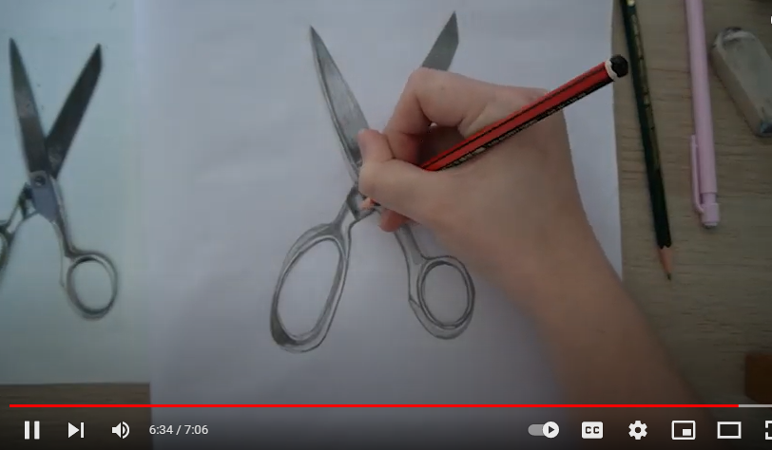
Learning to record accurate proportions from still life objects.
Watch the video
https://www.youtube.com/watch?v=QyZs4alERCA
(7 minutes how to video)
1/ Select your own object image or object and plot out the scaffolding/guidelines light in pencil
2/ Check sizes of each part of your object
3/ Once you are happy with the sizing begin to add tonal areas to your object. Begin with darker areas – mid – highlights.

