Slide 1
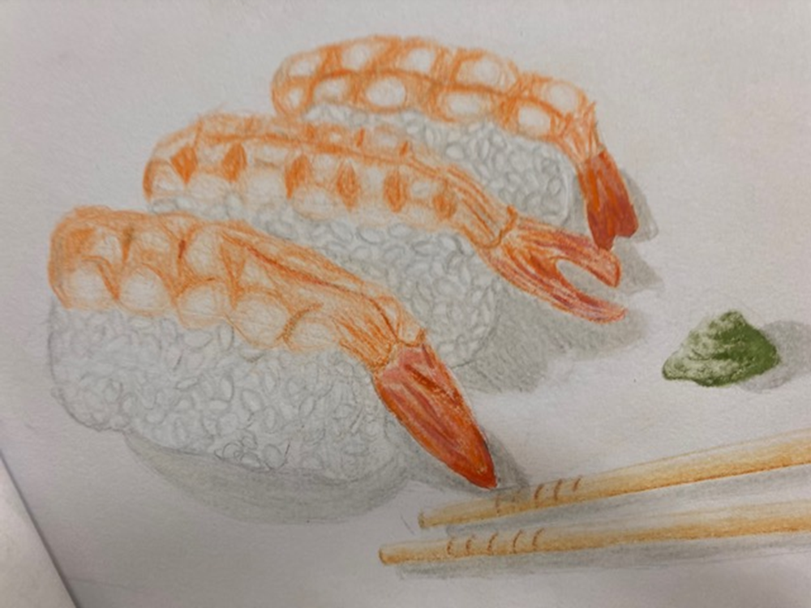
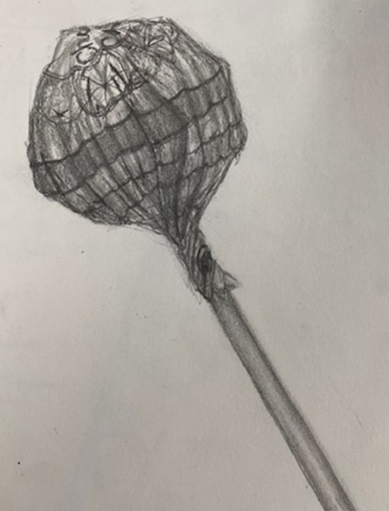
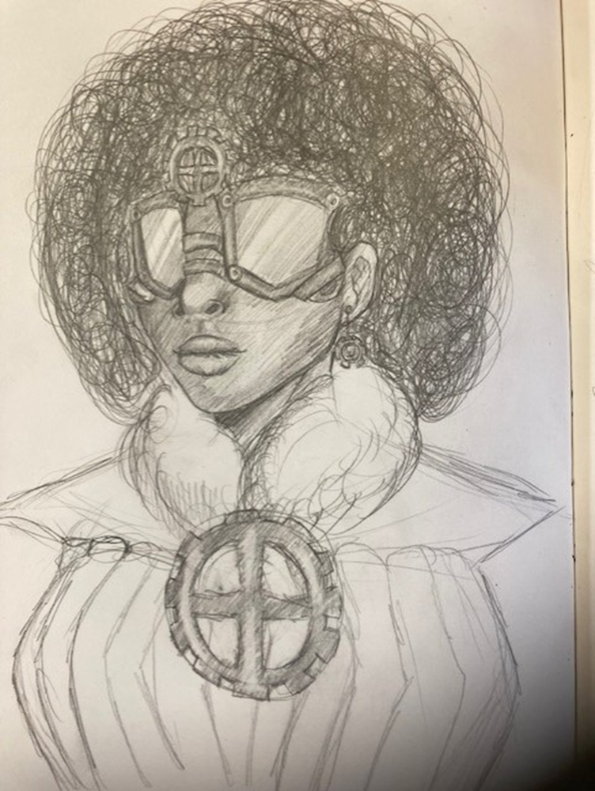
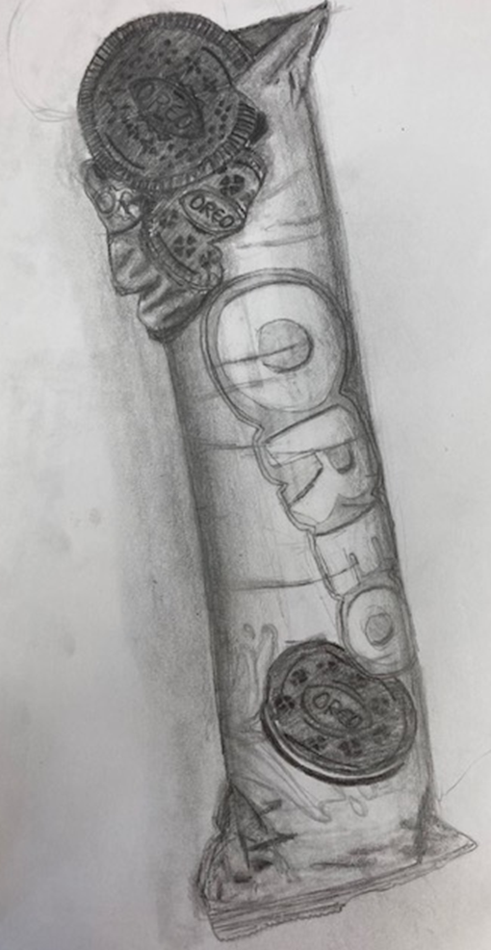
Observational Drawing
Shape & proportions of the sushi is carefully observed with a mix of subtle tonal changes recorded across the different objects. Student has composed the image themselves, cleverly including a range of textures in the piece.
Shadows are used to add depth the biscuits and packaging. The student worked closely from a secondary image while creating this piece. Subtle pencil details and highlights create roundness on the biscuit packet.
Confident use of pencil techniques to create a high level of detail and depth in the work. The student has captured the creases in the packaging. A mixture of heavy and more subtle line and tonal shading adds to the quality of the work.

Slide 2
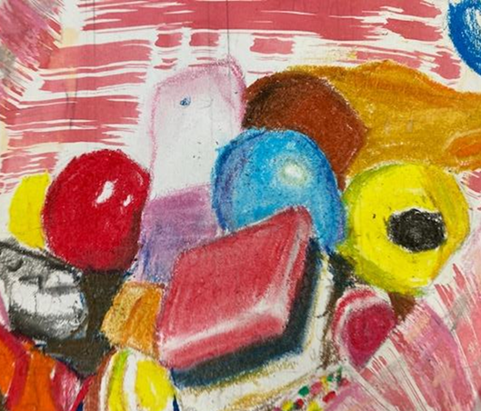
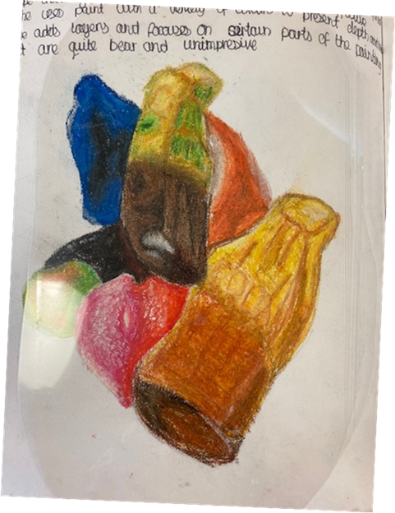
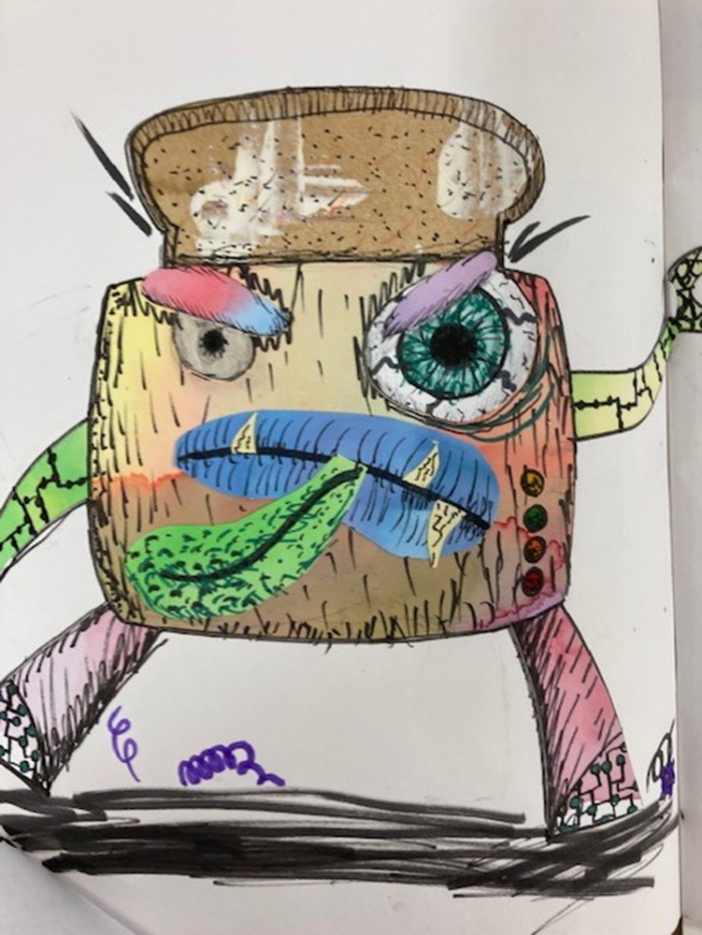
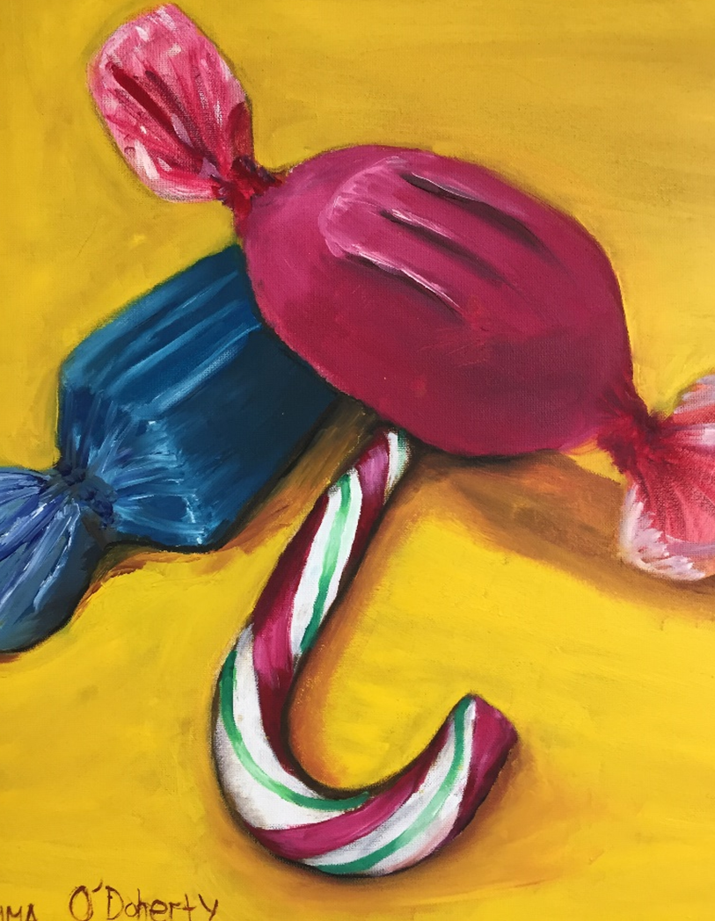
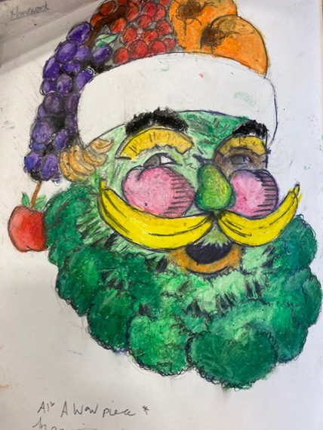
Colour work
The student has developed this painting from their chosen artist’s style. Confident colour mixing to create a range of different blue and pink tones on the sweets.
Very controlled brush control and excellent understanding of shadow.
Oil Pastel Pieces
Compositions created after looking at the work of Sarah Graham. Students demonstrate an excellent grasp of the material to create layered work with a subtle approach to highlight and shadow.
The student has developed collage work using a mixture of papers and pen work. Texture and design is inspired by secondary resource images as well as the student's imagination.
A well thought out composition piece making strong links to the theme and artists studied.

Slide 3
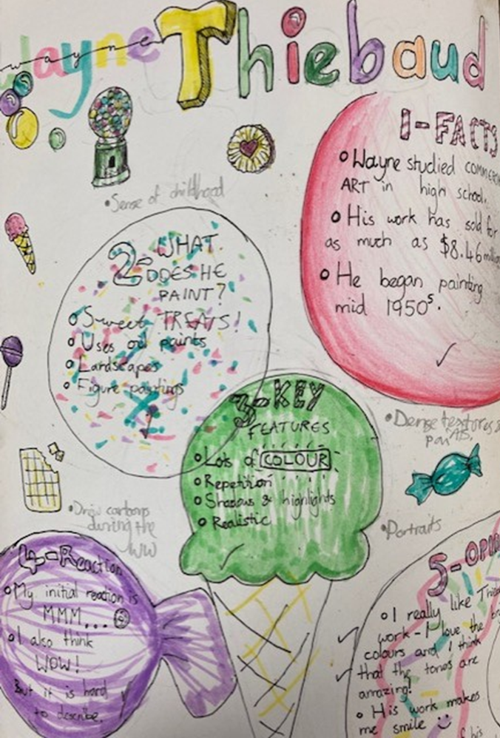
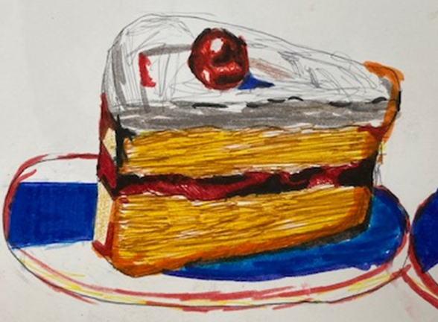
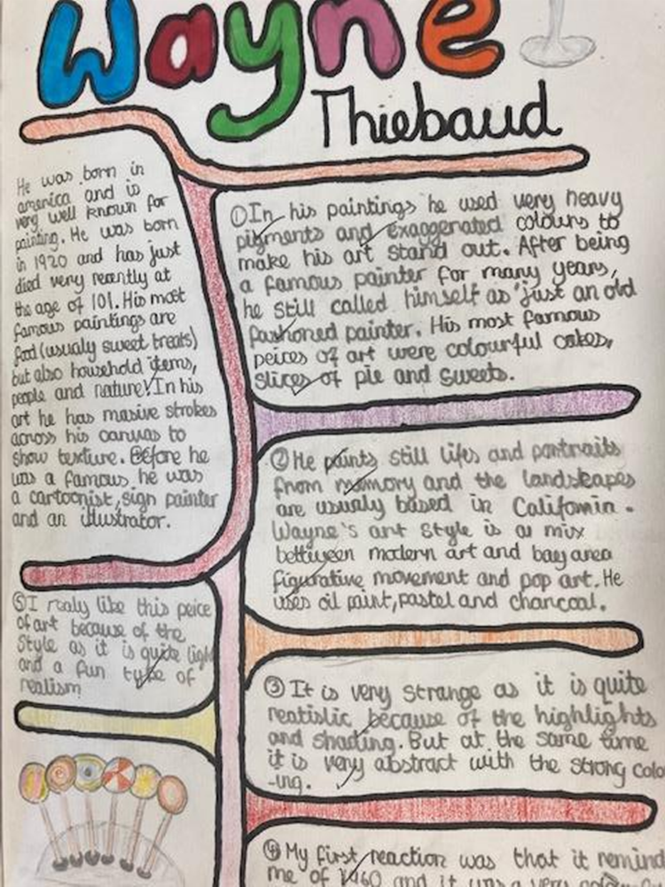
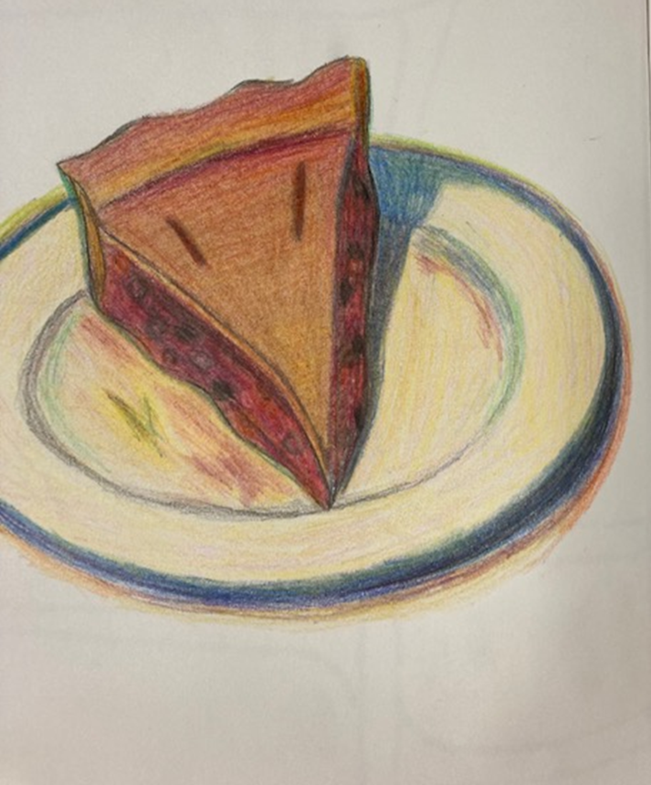
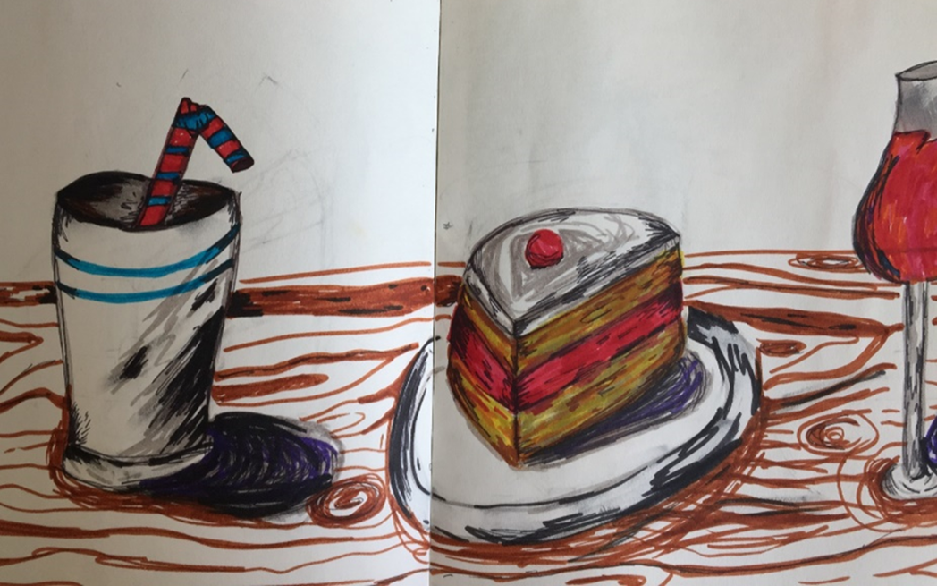
Artist Research
Students have imitated their chosen artist’s style; selecting similar application techniques, themes and compositions.
Written analysis also demonstrates the student's in depth knowledge of the artist’s work.
Key elements of the artist’s work is clearly documented in the written and visual communication.

Slide 4
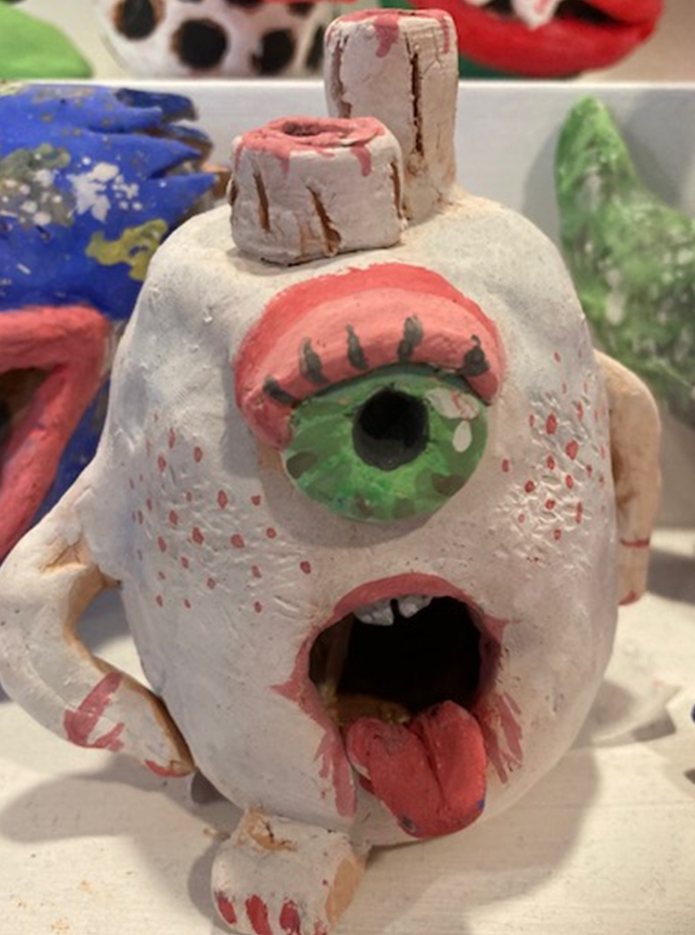
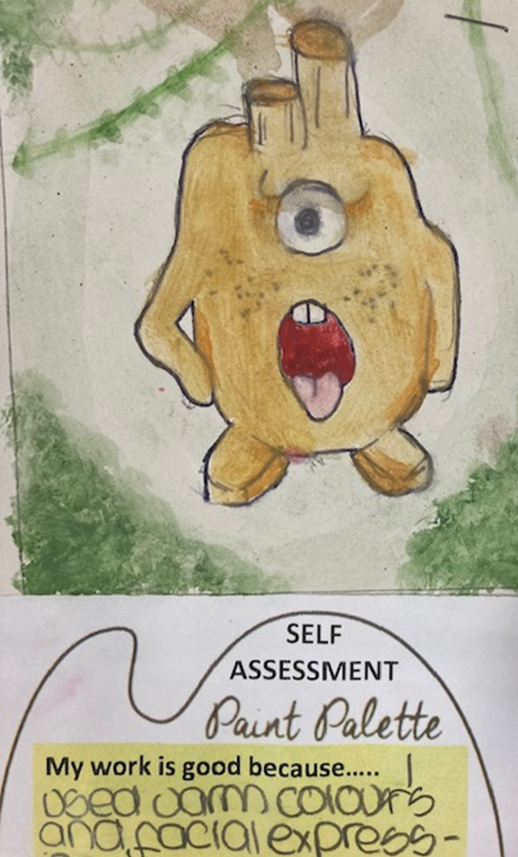
Sculpture
Finished outcome is simple in design, but it is clear the student has developed and refined this idea with confidence.
The students has developed this 3D piece from their 2D sketchbook design drawing.
The sculpting process has been followed closely to ensure each part of the sculpture is secured in place and can withstand the firing process.

