Slide 1
Exemplar work Y7 Spanish

Slide 2
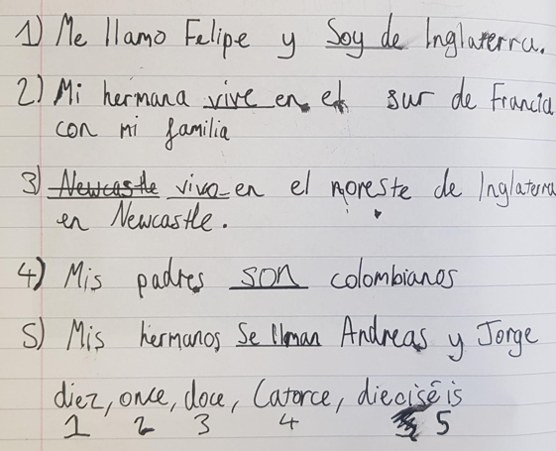
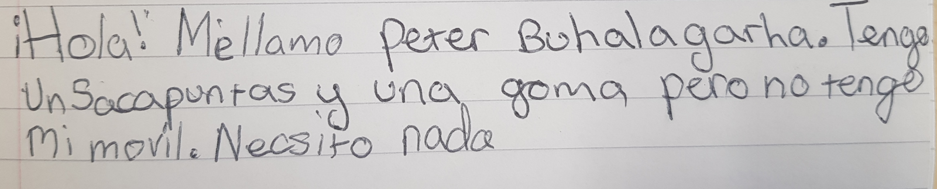
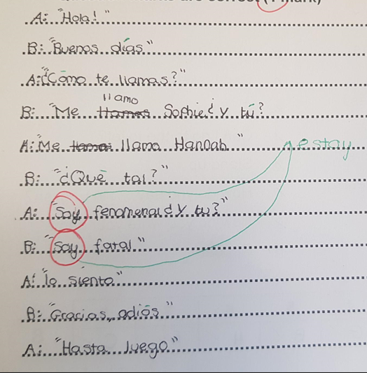
Accurate spelling and formation of verbs in the present tense, first person. Accurate negatives as well and using connectives to link sentences together.
Very accurate writing and conversation in Spanish. Very few minor mistakes. Can introduce themselves in the target language and ask questions also.
Very accurate writing and conjugation of verbs not only in the first person, but third person also.

Slide 3
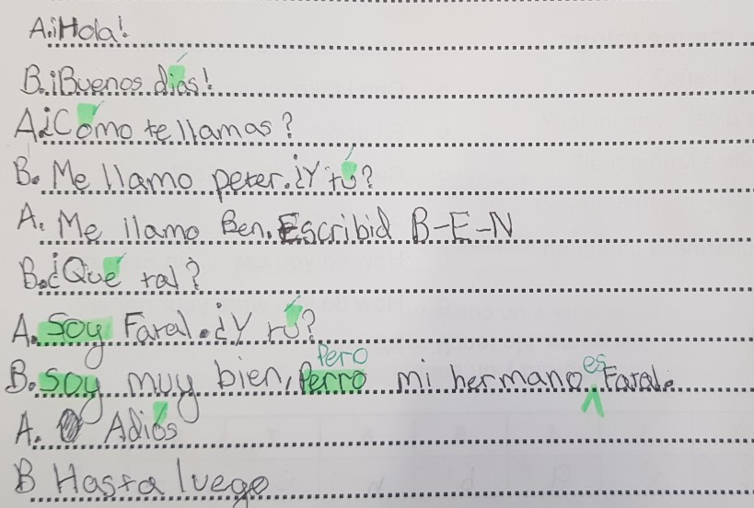
Accurate writing and conversation in Spanish. Few minor mistakes in spelling and verbs. Can introduce themselves in the target language and ask questions also.

Slide 4
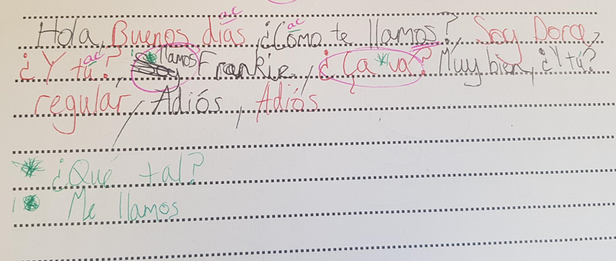
Can ask questions in Spanish and can answer some of them also. Can spell most words accurately.

