Slide 1
Year 7 Achievement check 1 resources
Please don't worry if you haven't covered some of this in lessons you will get to it soon.

Slide 2
Biology

Slide 3
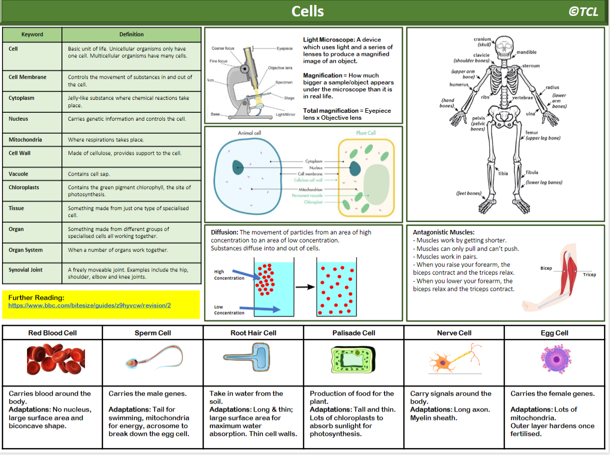
Light microscope:
Magnification:
Total magnification:
Draw an animal and plant cell and label them.
What is diffusion? Try and include a diagram and some examples.
For each of the specialised cells: draw a picture and label it, say what features it has and why they are useful for that cell's job

Slide 5
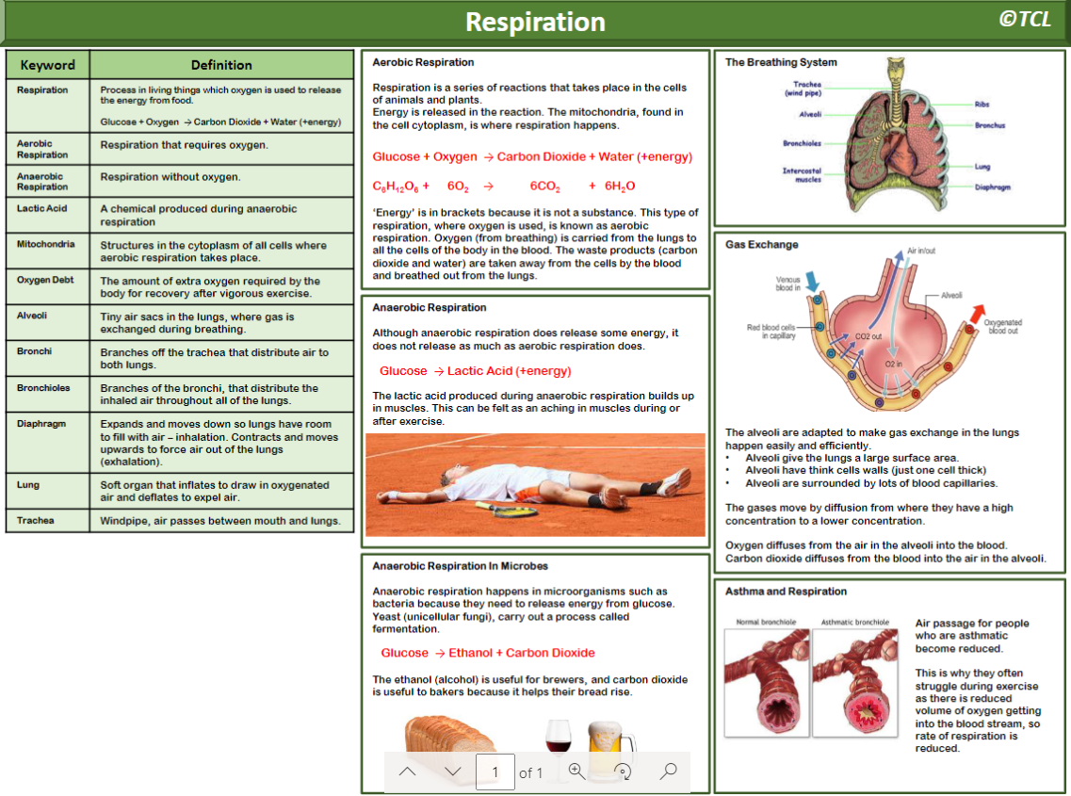
Draw the human breathing system
Draw an alveoli and label how they are adapted
Draw an alveoli and label how they are adapted

Slide 7
Useful links for Biology:
https://www.bbc.co.uk/bitesize/topics/znyycdm/articles/zkm7wnb
https://www.bbc.co.uk/bitesize/topics/znyycdm/articles/zfj3rwx
https://www.bbc.co.uk/bitesize/topics/znyycdm/articles/z2vrr2p
https://www.bbc.co.uk/bitesize/topics/znyycdm/articles/zbm48mn
https://www.bbc.co.uk/bitesize/topics/znyycdm/articles/zrp3ydm
https://www.bbc.co.uk/bitesize/topics/znyycdm/articles/zr3vsk7
https://www.bbc.co.uk/bitesize/topics/znyycdm/articles/z8cqqfr
https://www.bbc.co.uk/bitesize/topics/zvrrd2p/articles/zk9t6g8
https://www.bbc.co.uk/bitesize/topics/zvrrd2p/articles/zbhcg7h
https://www.bbc.co.uk/bitesize/topics/zvrrd2p/articles/zdqx2v4
https://www.bbc.co.uk/bitesize/topics/zvrrd2p/articles/zcsbmsg
https://www.bbc.co.uk/bitesize/topics/zvrrd2p/articles/ztdmrwx
https://www.bbc.co.uk/bitesize/topics/zvrrd2p/articles/zkq7wnb
https://www.bbc.co.uk/bitesize/topics/zvrrd2p/articles/z3tb3j6
https://www.bbc.co.uk/bitesize/topics/zvrrd2p/articles/zctyqhv

Slide 8
Chemistry

Slide 9
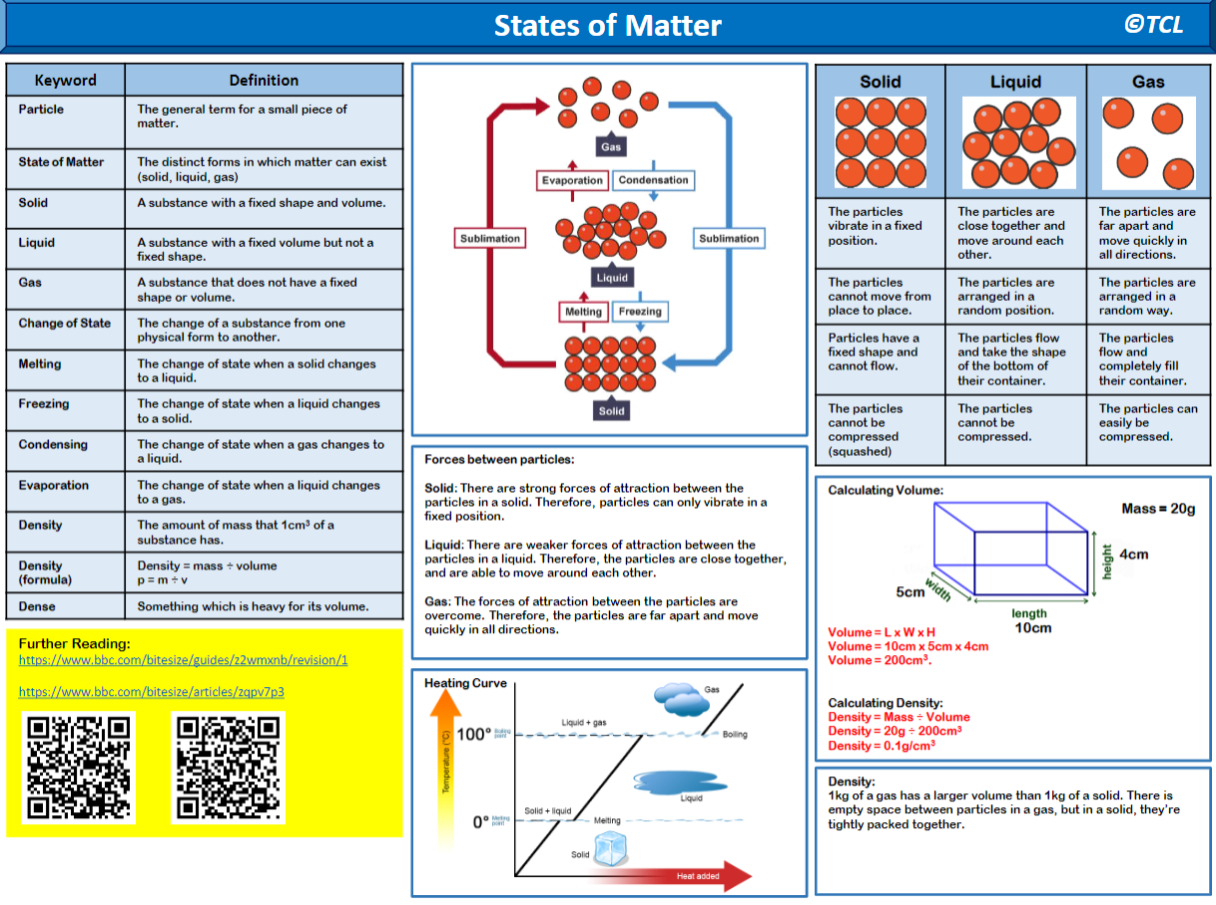
What are the changes of state?
What characteristics does each state have?
What does a heating curve look like?

Slide 11
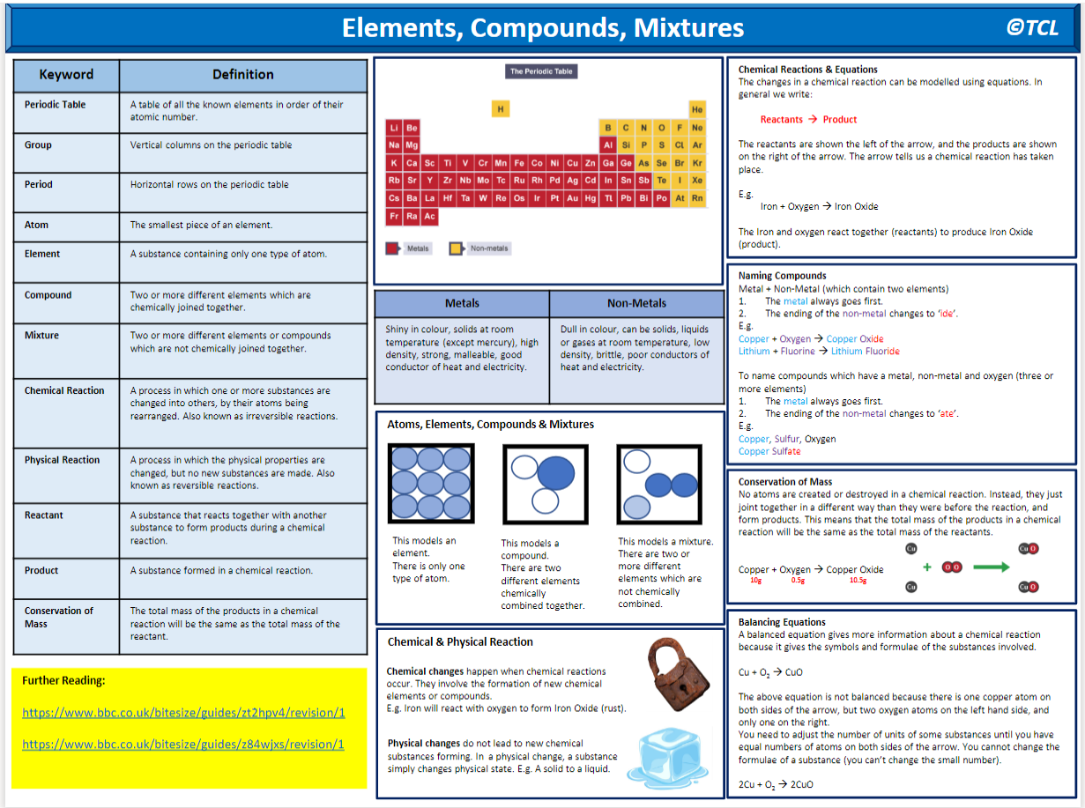
How is the periodic table organised?
Metals vs non-metals
Draw a picture and label it for the above.

Slide 13
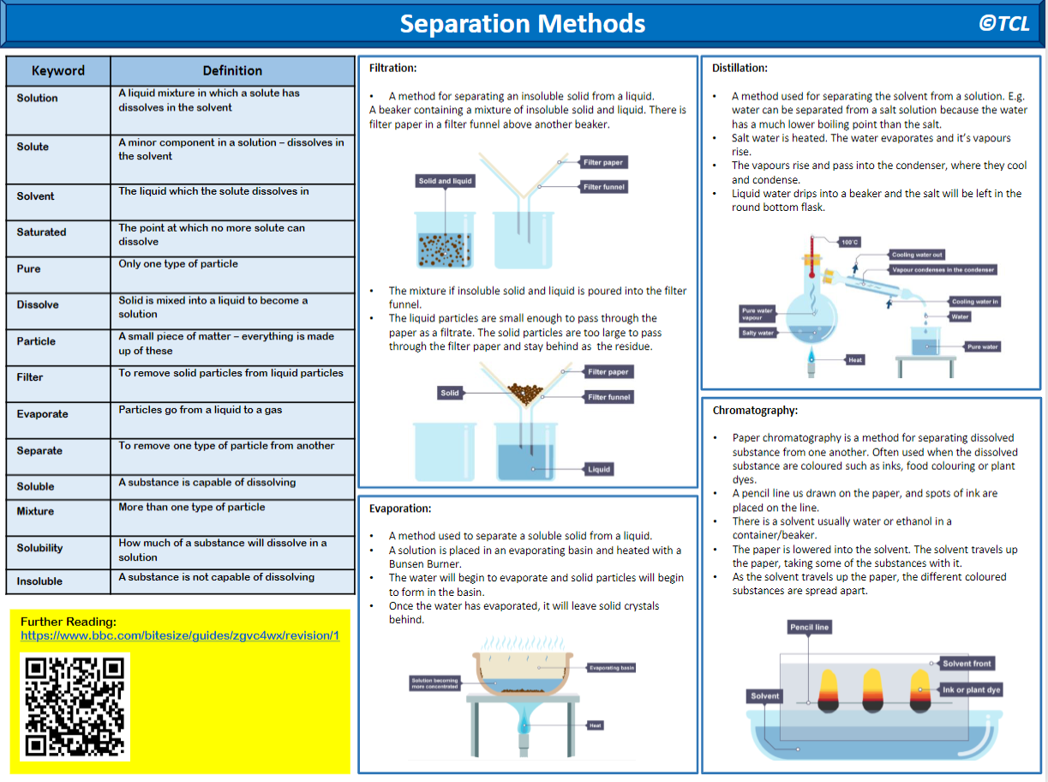
Write a method
Write a method
Write a method
Write a method

Slide 15
Useful links for Chemistry:
https://www.bbc.co.uk/bitesize/topics/z9r4jxs
https://www.bbc.co.uk/bitesize/topics/zstp34j/articles/zngddp3
https://www.bbc.co.uk/bitesize/topics/zstp34j/articles/zc86m39
https://www.bbc.co.uk/bitesize/topics/zstp34j/articles/zmsk4xs
https://www.bbc.co.uk/bitesize/topics/zstp34j/articles/zqr4tv4
https://www.bbc.co.uk/bitesize/topics/zych6g8
https://www.bbc.co.uk/bitesize/topics/zv9nhcw/articles/zf4pp4j
https://www.bbc.co.uk/bitesize/topics/zv9nhcw/articles/z8qrr2p

Slide 16
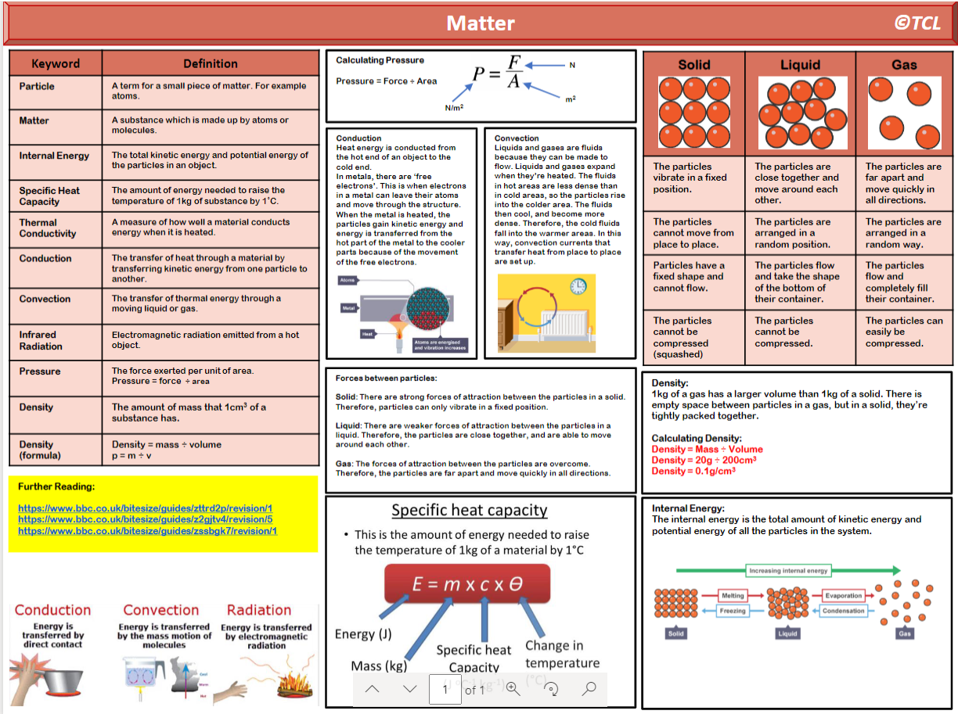

Slide 18
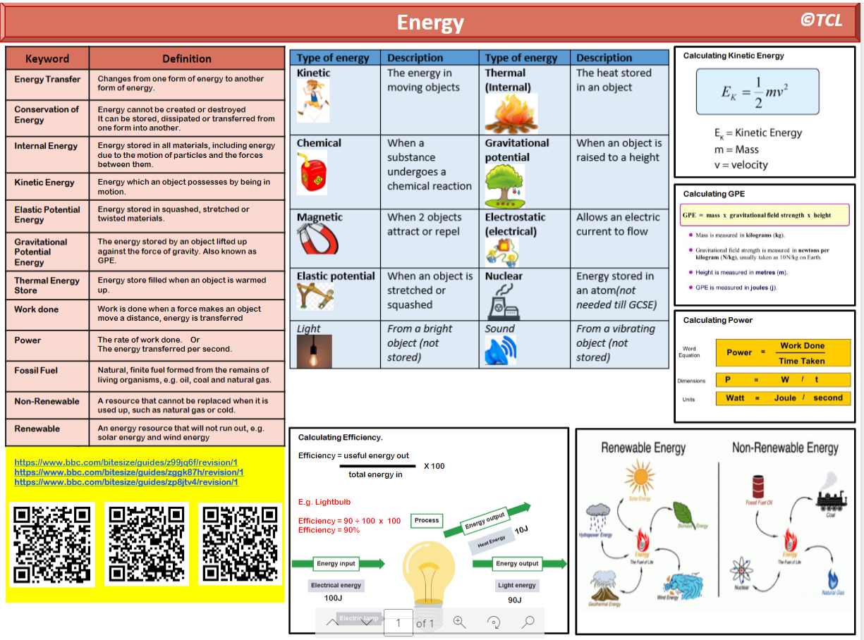

Slide 20
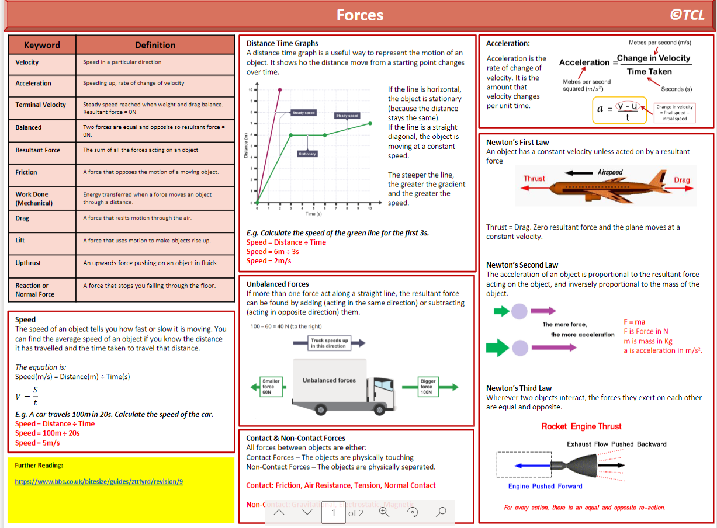

Slide 22
Useful links for Physics:
https://www.bbc.co.uk/bitesize/topics/z4brd2p/articles/zs3896f
https://www.bbc.co.uk/bitesize/topics/z4brd2p/articles/zhnfp4j
https://www.bbc.co.uk/bitesize/topics/z4brd2p/articles/zw9qwnb
https://www.bbc.co.uk/bitesize/topics/z4brd2p/articles/z2b6m39
https://www.bbc.co.uk/bitesize/topics/z4brd2p/articles/z6s4r2p
https://www.bbc.co.uk/bitesize/topics/z4brd2p/articles/zvg7jsg
https://www.bbc.co.uk/bitesize/topics/zc3g87h

