Slide 1


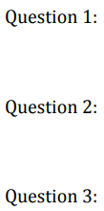
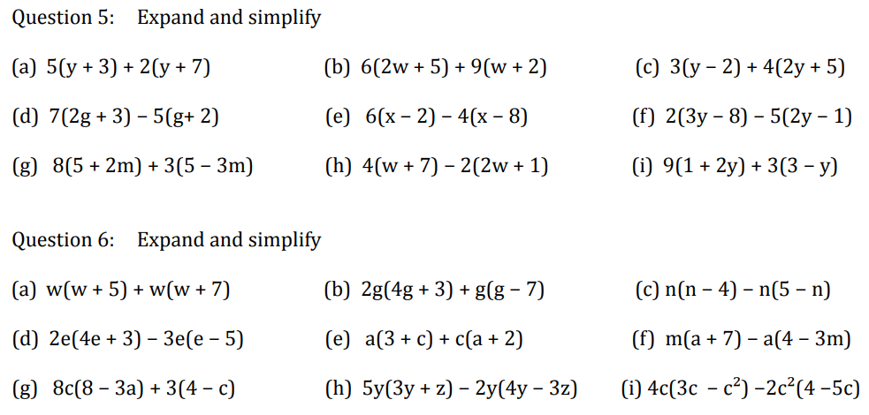
Expand brackets and simplify expressions
Follow this link to watch a video on “More Expanding Brackets”
https://www.youtube.com/watch?v=QXE8W-AD8pw
Work through the questions below to check your understanding (solutions on next page):

Slide 2
