Slide 1


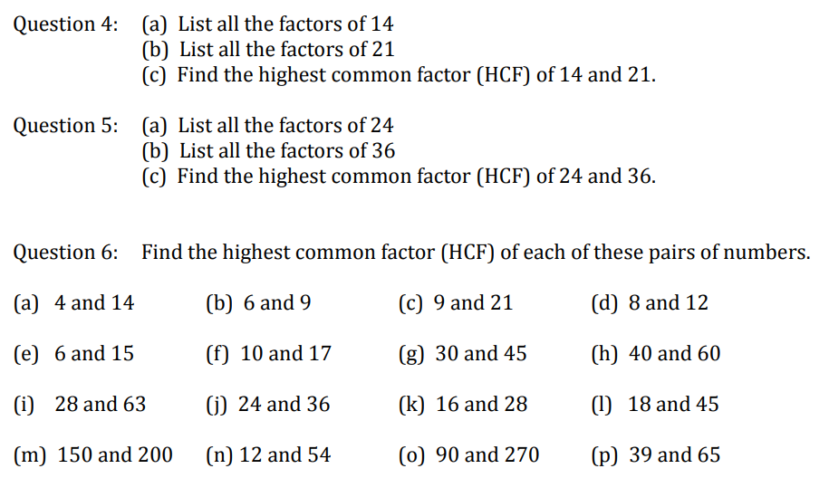
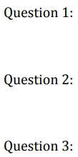
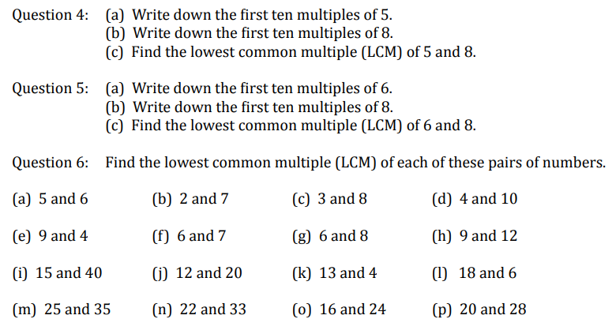
Finding the Highest Common Factor and Lowest Common Multiple of numbers
Follow this link to watch a video on “Highest Common Factor”
https://corbettmaths.com/2012/08/24/common-factors-and-hcf/
Work through the questions below to check your understanding (solutions on next page):
Follow this link to watch a video on “Lowest Common Multiple”
https://corbettmaths.com/2012/08/11/lcm-and-common-multiples/
Work through the questions below to check your understanding (solutions on next page):

Slide 2
