Slide 1


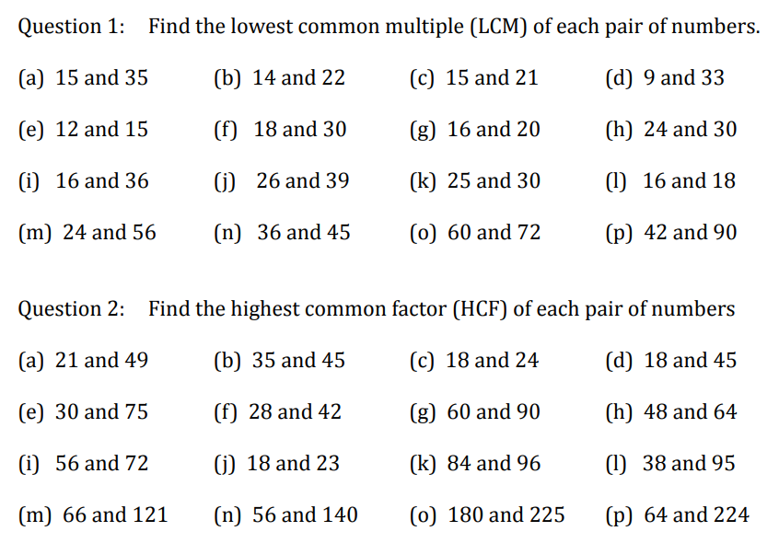
Using the Prime Factor Decomposition to find the HCF and LCM of two numbers
Follow this link to watch a video on “HCF and LCM from prime factor decomposition”
https://corbettmaths.com/2012/08/20/lcm-and-hcf-using-product-of-primes/
Work through the questions below to check your understanding (solutions on next page):

Slide 2
