Slide 1


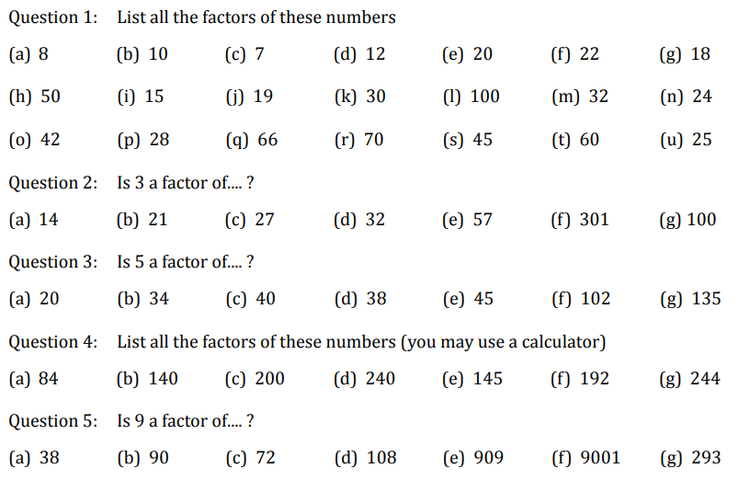

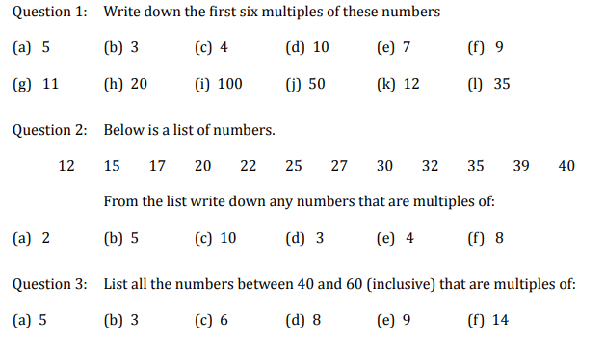
Identifying Factors and Multiples
Follow this link to watch a video on “Factors”
https://corbettmaths.com/2012/08/24/factors/
Work through the questions below to check your understanding (solutions on next page):
Follow this link to watch a video on “Multiples”
https://corbettmaths.com/2012/08/11/1335/
Work through the questions below to check your understanding (solutions on next page):

Slide 2
