Slide 1
Examples of excellent work in year 7 maths

Slide 2
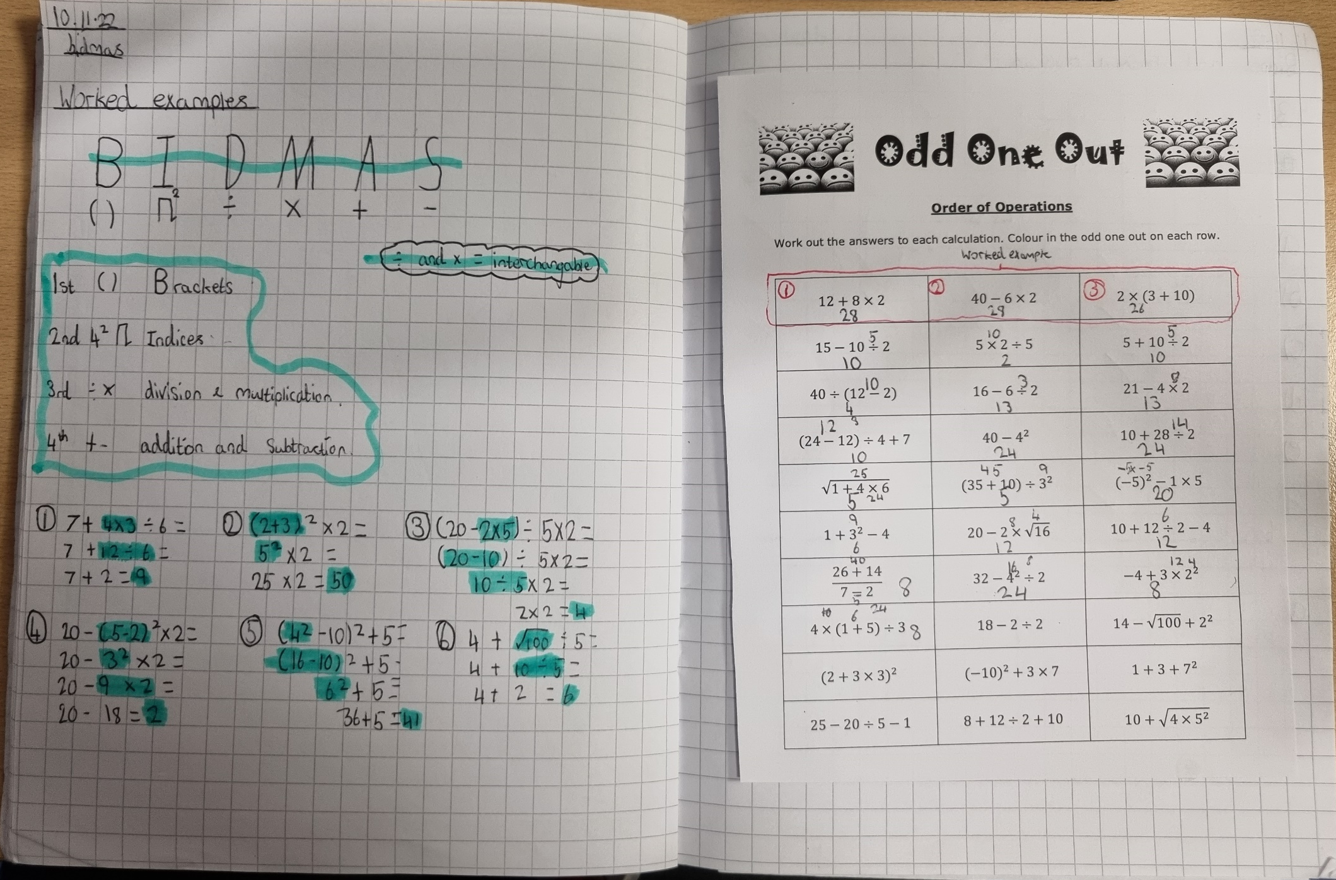
Class Work
Notes and definitions written clearly and highlighted to stand out for future revision
Examples copied carefully and clearly labelled as such to make it easier to refer back to for support when working independently
Working out clearly shown alongside answers

Slide 3
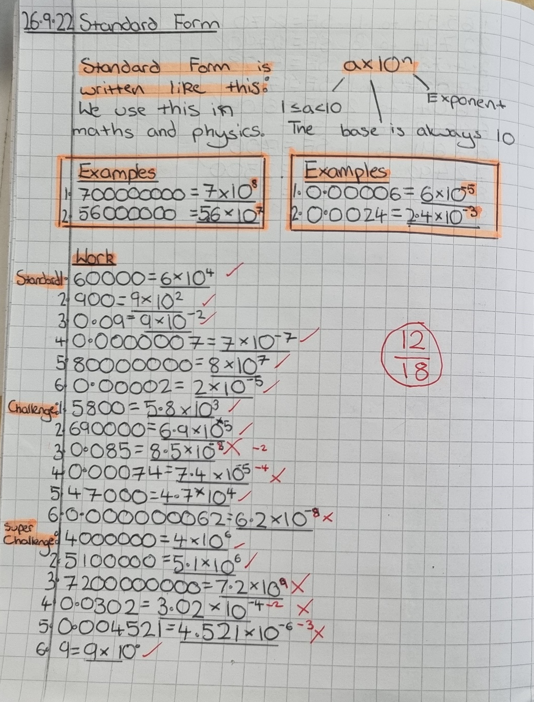
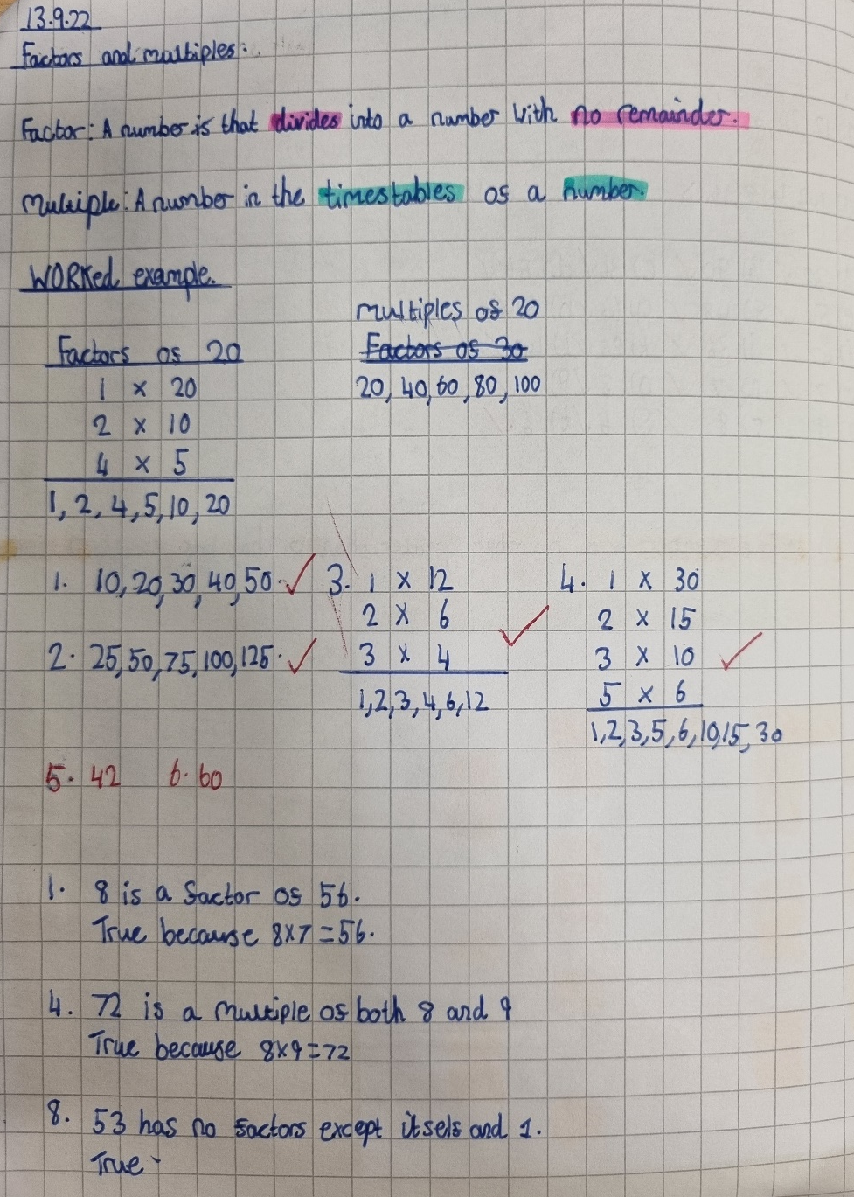
Class Work
Note and examples clear
All classwork marked and corrected where mistakes have been made

Slide 4
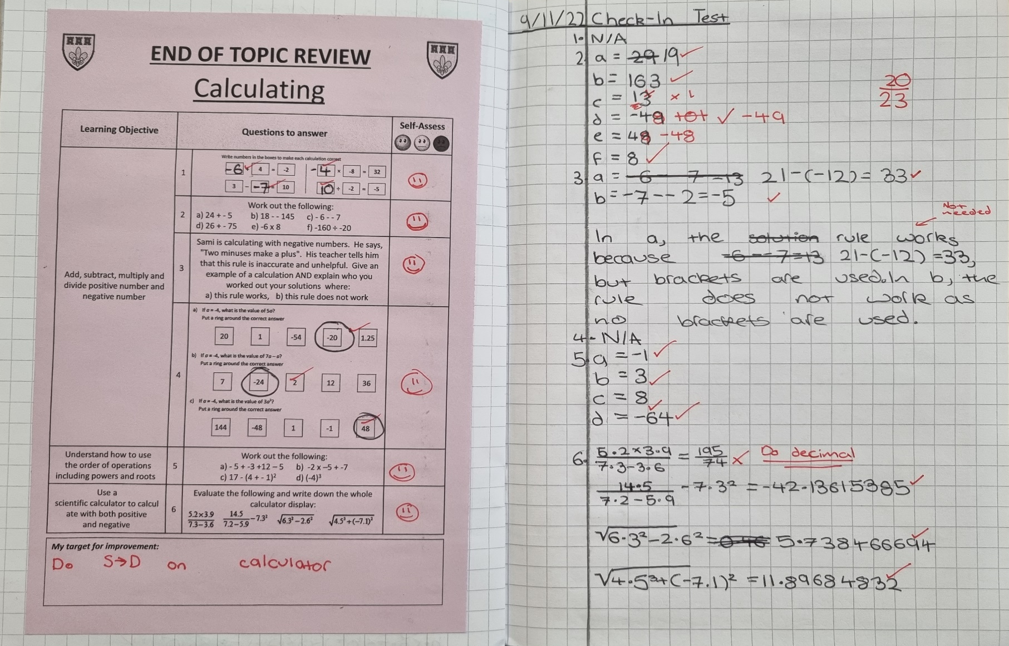
Class Work – End of topic test
Topic test stuck on left page with working out and answers displayed clearly on the right
Work self-marked and mistakes corrected, not just marked with a cross
Self-reflection of areas of improvement needed

Slide 5
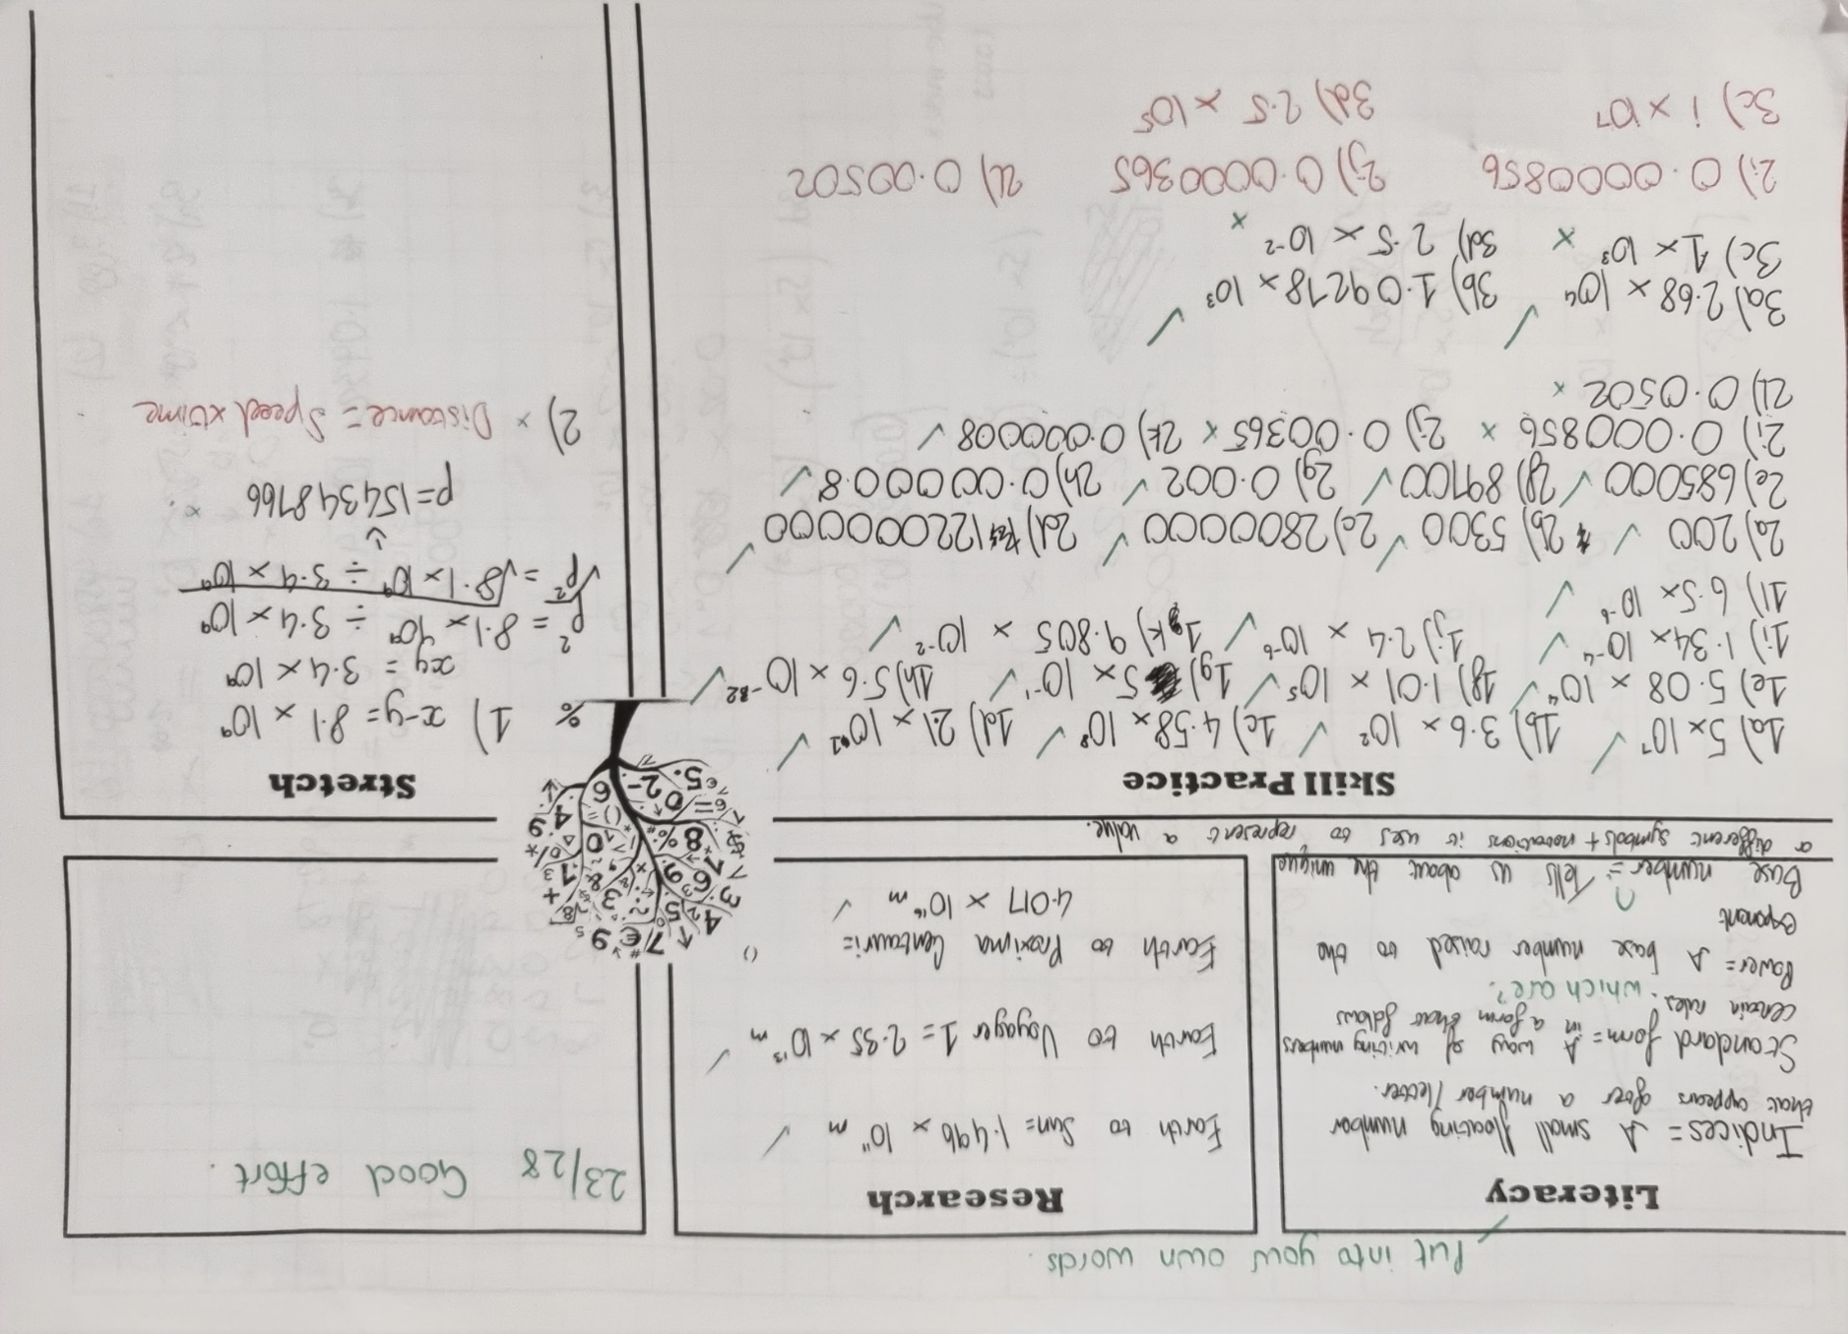
Homework – written
ALL sections attempted to a good standard, including the “stretch”
Answers written clearly in the appropriate answer space, with corrections made following feedback

Slide 6
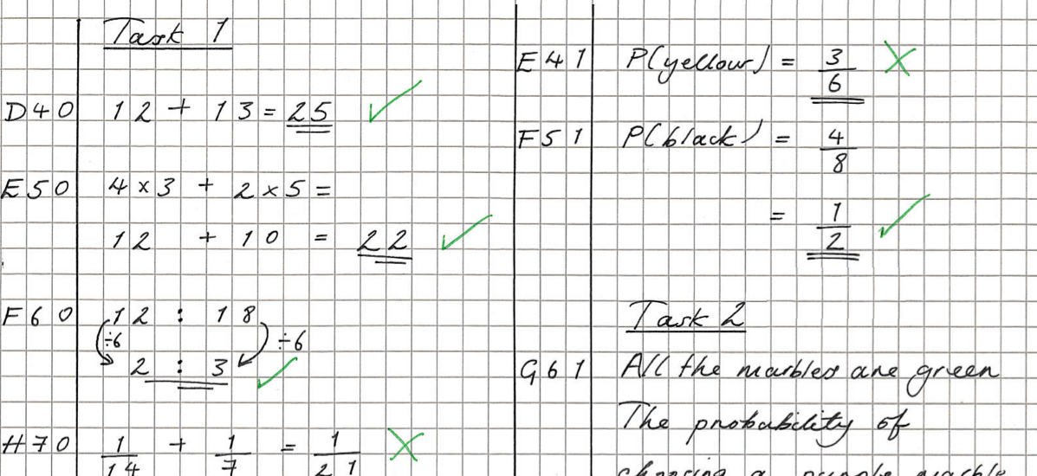
Homework – Sparx
All question answers written down, clearly labelled with question reference number (necessary for “bookwork checks”, helpful for seeking support from teachers) and marked
All working shown to support final answer – again, helpful if needing to seek support for a particular question

