Slide 1
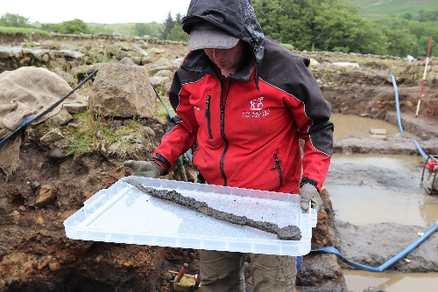
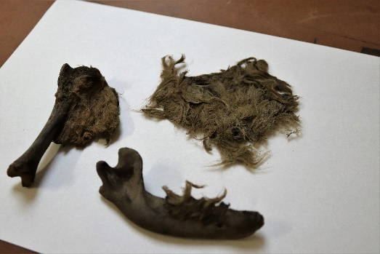
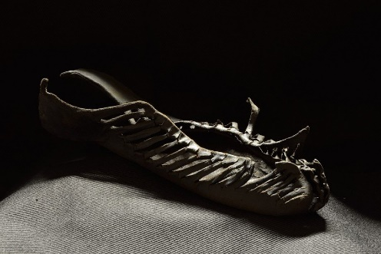
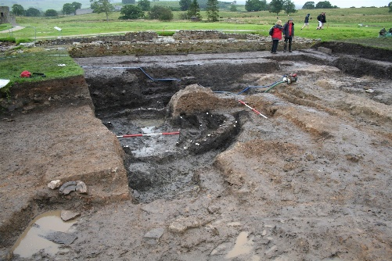
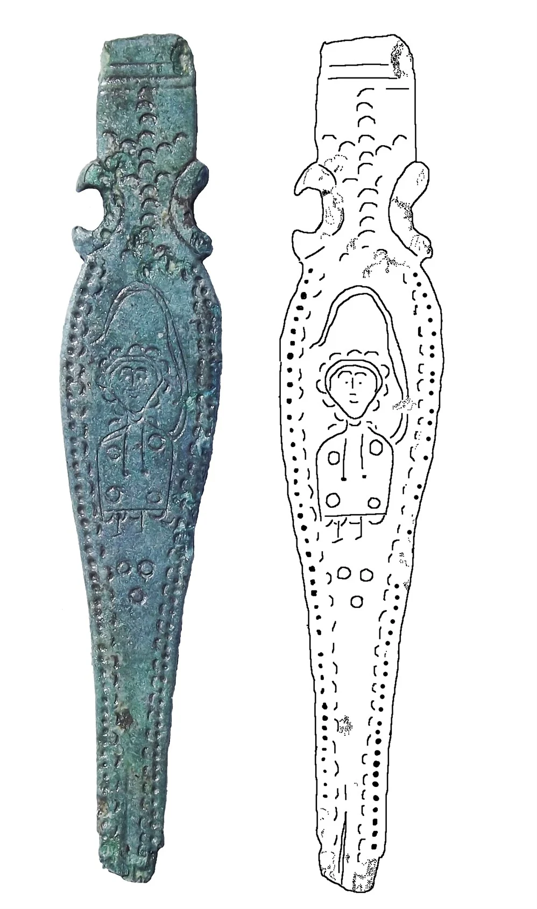
Roman artefacts
The Romans ruled Britain for 400 years, until 410AD when they left the country. This is over 1,500 years ago and can therefore pose a challenge to historians as there are fewer sources available to study than in other periods of history.
Vindolanda is an active excavation site (they dig things up!) in Northumberland, where archaeologists and historians work to uncover the legacy of the Roman occupation of Britain.
Many artefacts they have found are very useful for historians researching the Roman Empire.
Below there are Vindolanda’s ten greatest finds. In each box can you write:
What a historian can learn from this about the Romans
What extra research might they now want to do, since finding the artefact
1
A complete sword in its scabbard (found 2017)
Example answer: A historian could learn from this that the sword was a weapon used by the Romans. They can also learn that the Romans felt they needed to have weapons to defend themselves, which shows they perhaps did a lot of fighting. A historian might now want to research the Roman army in a bit more detail and learn how soldiers were trained to fight with swords and battles they were involved in.
The hairy dog (found 2018)
2
3
A child’s shoe (found in 2016 – one of over 400!)
4
Wooden circular huts (found in 2012 and 2013)
5
The end of a strap that was attached to a nail cleaner (found 2013 near a church)

Slide 2
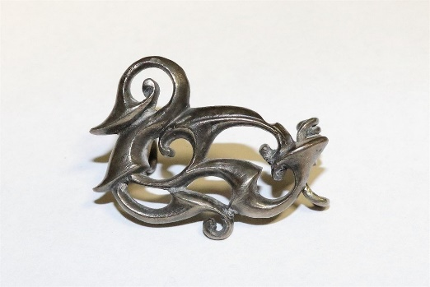
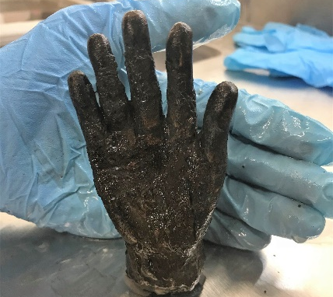
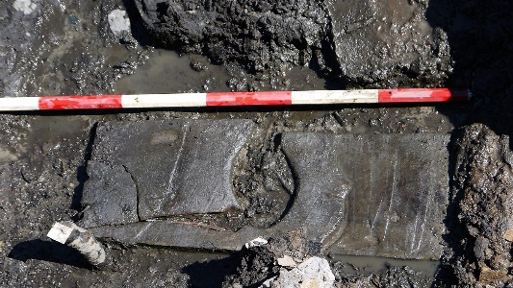
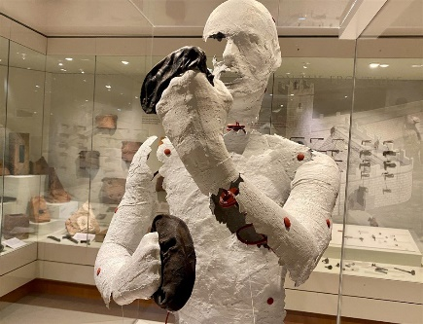
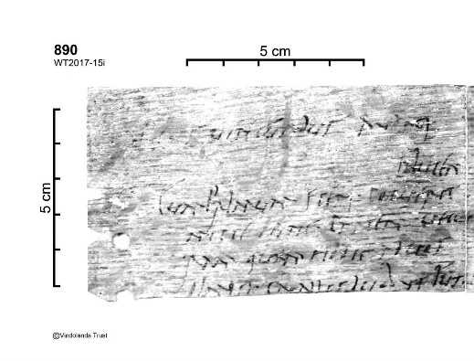



6
A Celtic style duck brooch (found 2018) – the Celts lived in Britain during the Roman occupation.
7
The ‘Hand of God’ – from the temple of Jupiter Dolichenus, who was a Roman God. (Found 2018)
8
A wooden toilet seat (found 2014)
9
Leather boxing gloves
10
The Verecundus archive – letters, written on writing tablets, from the founder of Vindolanda. Written nearly 2,000 years ago!
You must now choose one additional challenge activity to complete. You can do this in your book.
 | Which artefact do you think the archaeologists and historians at Vindolanda would have been most excited to discover? Why?
 | Which two artefacts do you think give historians the most information about the Romans? Why? Which two artefacts do you think give historians the least information? Why?
 | “The artefacts discovered at Vindolanda are vital to discovering the history of the Roman Empire. Without them, we would know so much less.” Do you agree with this historian? Explain your answer in a PEE paragraph, using examples of artefacts discovered.

