Slide 1
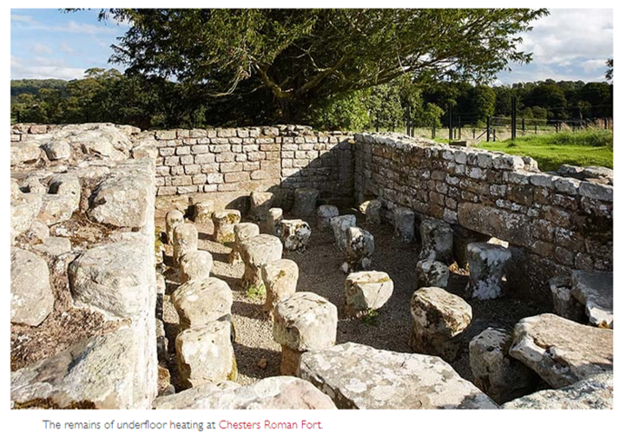
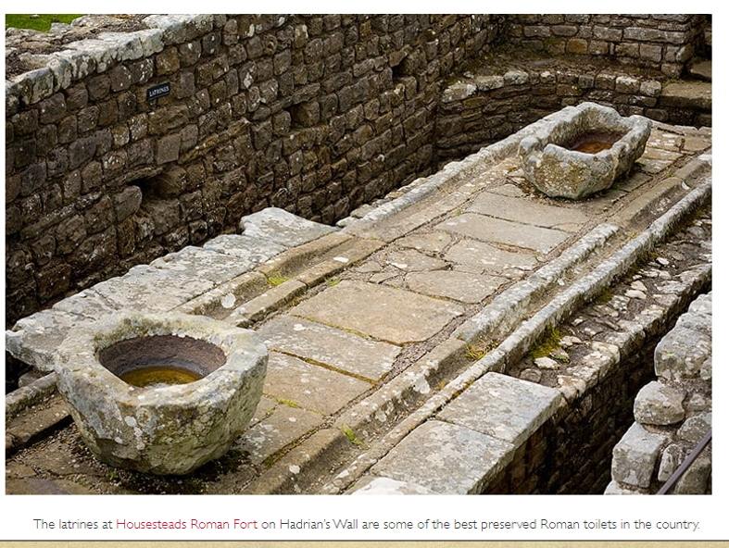
Source A – the remains of underfloor heating at Chester's roman fort
Source B – the latrines at Housesteads Roman Fort on Hadrian’s Wall
 | Source A | Source B
What does the source suggest? What does the source tell us?
Where is the source from? How might this effect the source?
Give one reason the source is useful to a historian

