Slide 1
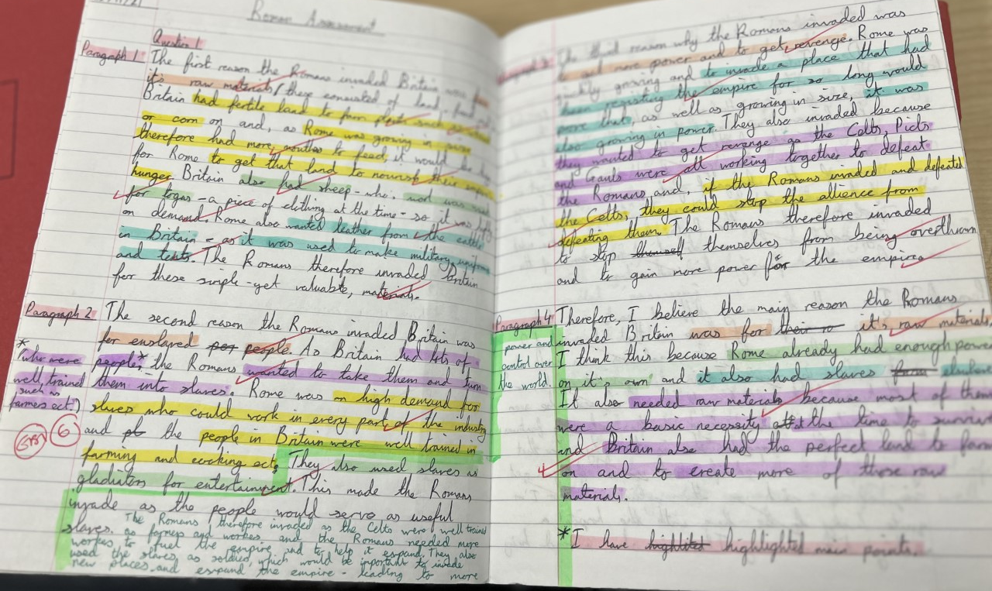
High quality assessment with student working hard to improve by responding to feedback and highlighting key elements of PEE paragraphs to ensure they have completed all key sections

Slide 2
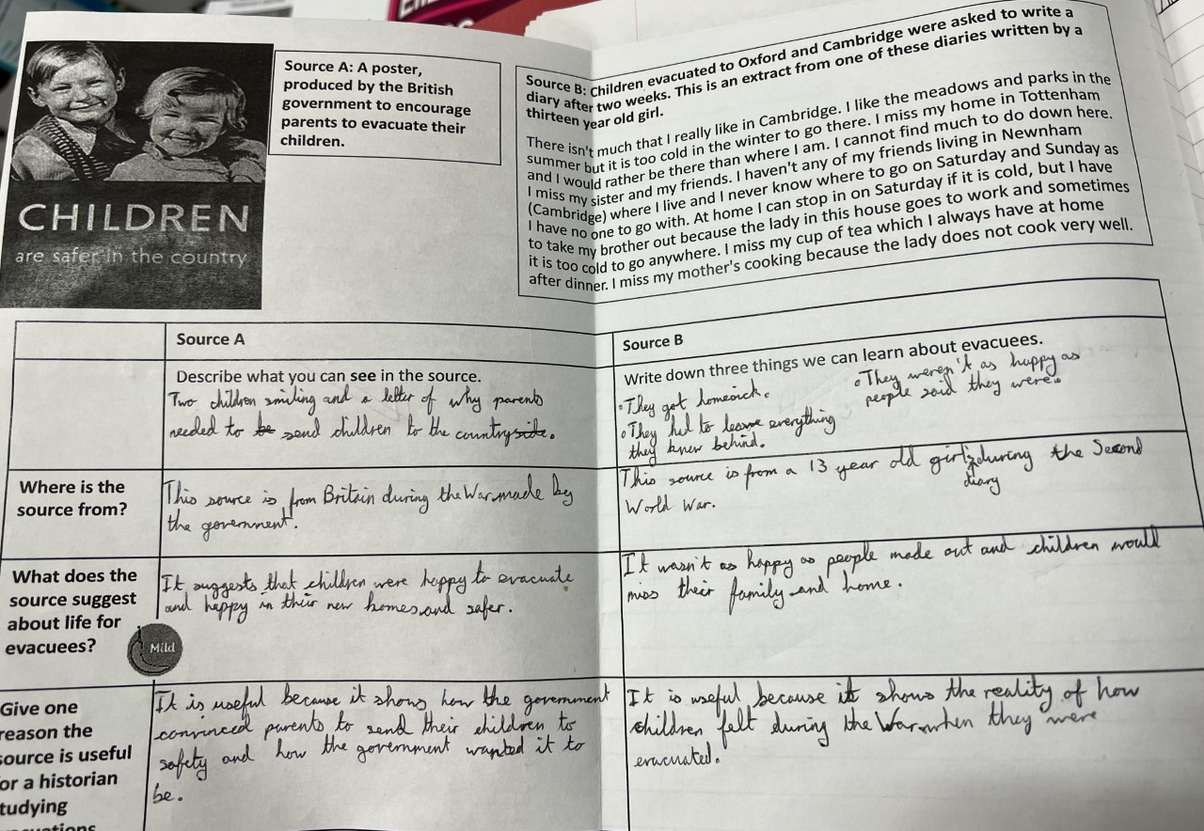
Clear planning and annotation of source work to develop source analysis work

Slide 3
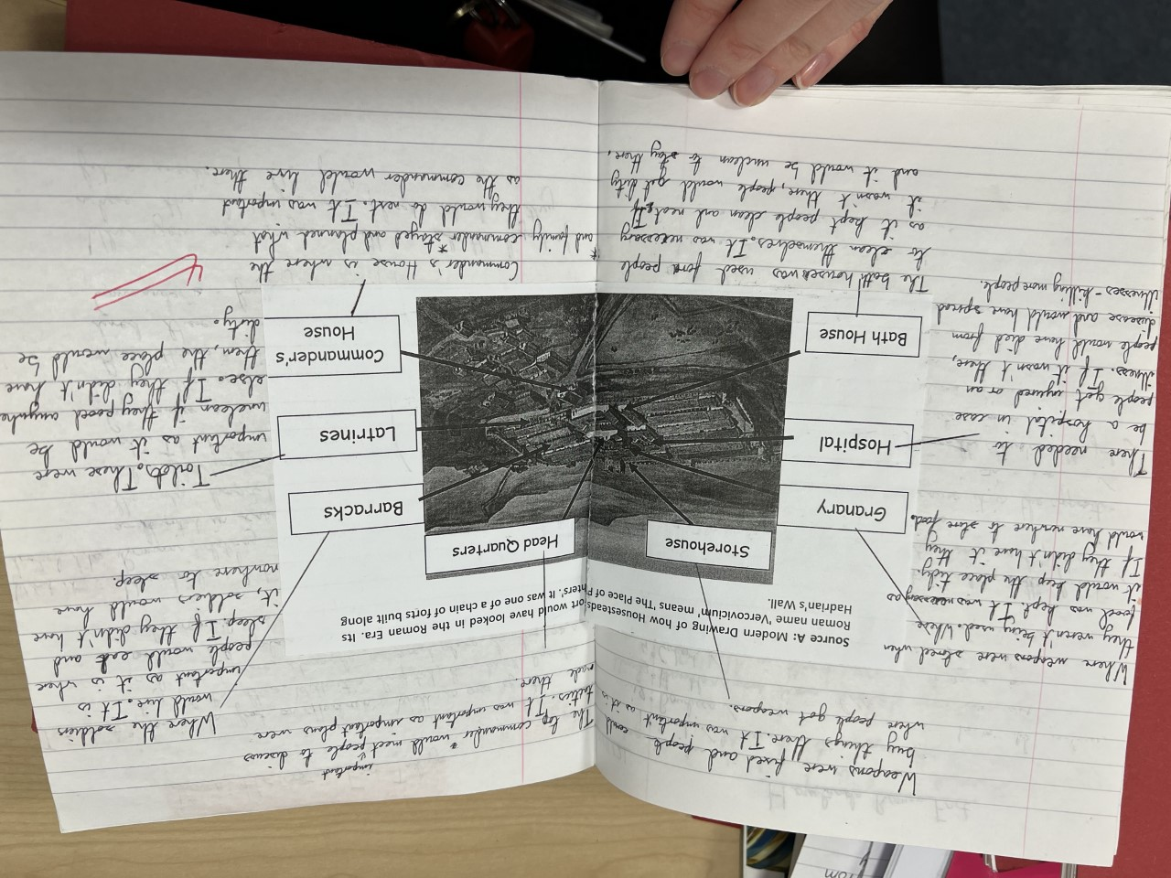
Detailed and specific knowledge demonstrated

