Slide 1

The Internal Structure of the Earth
The Crust is fractured into Tectonic Plates such as the Eurasian
The Crust – 2 types – Oceanic (denser, newer, thinner) and Continental (older, thicker & less dense)
Mid Atlantic Ridge
The Mantle, a zone of molten rock and other minerals. This is source of the Earth’s intense inner heat which sets up convection currents. 2,900km thick
Eurasian Plate
North American Plate
African Plate
Caribbean
plate
Cocos P.
Nazca Plate
Plate margin – the EDGES of plates where 2 plates are either moving apart, colliding together or sliding past one another
Outer Core – under slightly less pressure
Solid core of Iron and Nickel, which is solid despite temperatures of 3700°C because of the intense pressure there.
Convection currents – heat currents in the molten magma that move the crust above very slowly

Slide 2
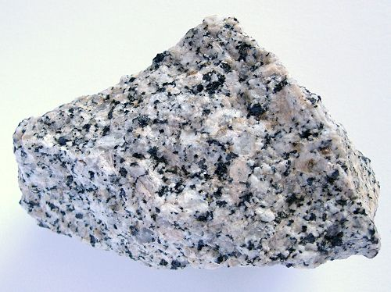
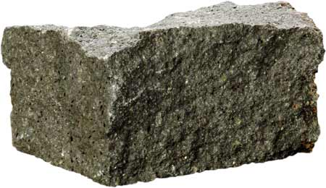
Continental and oceanic crust
The ocean floor is flat in places but also has deep trenches, underwater valleys, volcanoes and mountains
The continental crust is mainly granite. It is thicker and lighter than oceanic crust
Oceanic crust is found under oceans.
It is made from basalt.
It is dense and has a density of -2.7g/cm^{3.}
Continental crust is made from mainly granite and is less dense than oceanic crust with a density of 3.3g/cm^{3.}
Tectonic plates are moved by convection currents
COMPARING CRUST TYPES
The oceanic crust is made up of Basalt. It is heavier than Oceanic crust
Continental Shelf
Continental crust - 2.7 g/cm³
Up to 70km thick
Ocean water
7-10 km thick
Upper mantle
The crust and upper mantle are HARD, together they make up the LITHOSPHERE
Mantle rocks 3.3g/cm³
These heat carrying currents or convection currents are so powerful they are changing the face of the Earth.
The rock below the lithosphere is hot and moving. Currents rise very slowly, cool and sink again

Slide 3
Earth’s internal structure
Further help can be found
https://www.bbc.co.uk/bitesize/guides/z2vjxsg/revision/1
https://www.bbc.co.uk/bitesize/guides/zss8rwx/revision/1
Catchy song - https://www.youtube.com/watch?v=Q9j1xGaxYzY

