Slide 1
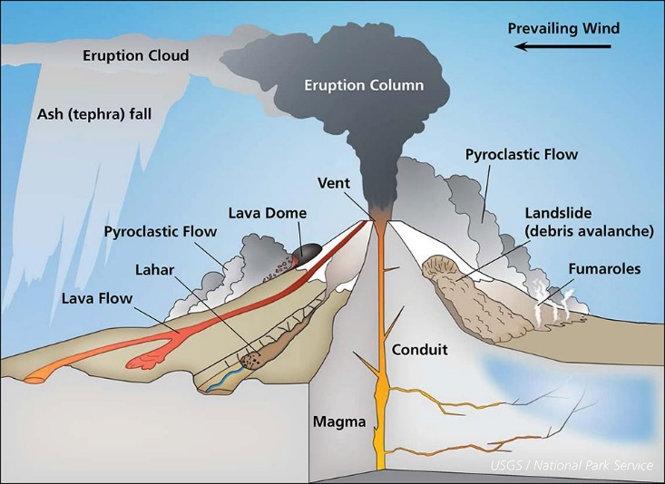
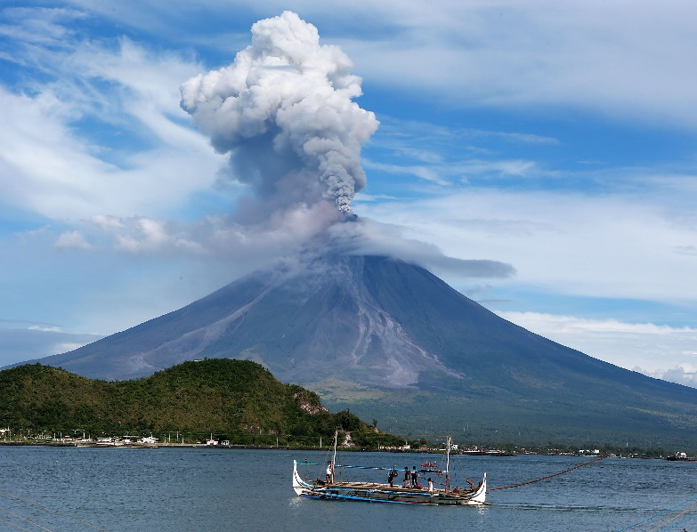
Impacts and management of volcanic eruptions
Look at the link below reading the information and try the quiz at the end to help improve this area of your knowledge.
Tectonic hazards – volcanoes.
There is some extra information on the following slides.

Slide 2
Volcanic eruptions
2.If the lava is thick and gassy it will explode from the crater
3.Forming a huge cloud of gas, dust, ash, bombs, cinders and rocks that are torn from the volcano
6.Red hot lava may flow down the side of a volcano like this
4. A heavy cloud will collapse and rush down the slope as a pyroclastic flow
5.If it gets mixed with water you get a river of mud called a Lahar
The lava can be viscous (thick like tar) or as runny as thin custard. It depends on the rock that melted. It gathers in magma chambers
Volcanic gas is mainly steam and carbon dioxide, plus some other gases. It can smell of rotten eggs
1. Magma gathers in a magma chamber and increases in pressure

Slide 3
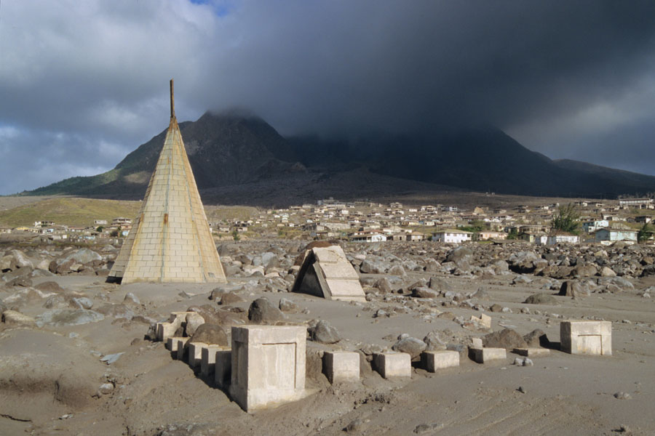
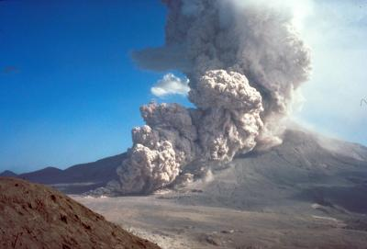
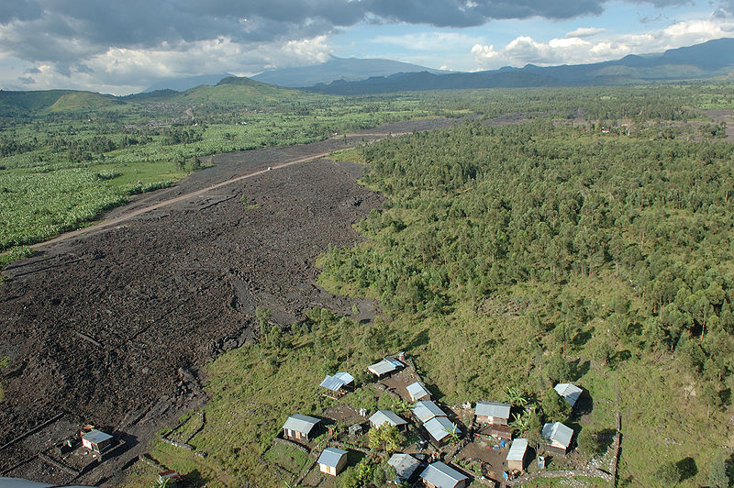
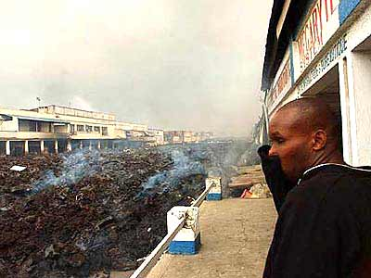
The impacts of volcanic eruptions
A pyroclastic flow travels at up to 200kph so you can’t escape. It smothers everything
Mudflows can travel at 100km per hour. They sweep everything along and can drown people and smother buildings
Dust and ash get everywhere – on your clothes, in your hair or in your lungs. It also causes global cooling
Plymouth, the former capital city and major port of Montserrat, years after the eruption 12 July 1997,
Pyroclastic flow during August 7, 1980 Mount St. Helens eruption
Lava flows destroy farms. They bury towns and villages but the people can walk away
Carbon dioxide from magma is heavy and sinks into hollows. It can suffer people and animals
Volcanic gas causes acid rain which pollutes water, kills vegetation and trees over a wide area
A thick blanket of ash will ruin crops so many people will starve
Lava fields surrounding Goma
Goma, a city in DRCongo, Africa, is invaded by a very fluid lava flow from Nyiragongo Volcano.

Slide 4
Management can reduce the effects of Tectonic Hazards
How Iceland predicts volcanic eruptions: https://www.youtube.com/watch?v=wnKvO4lzJzk
Monitoring
Earthquakes – seismometers and lasers monitor earth movements can be used in early warning systems to give very small warning. Not really enough warning time.
Volcanoes – monitor signs of an eruption such as tiny earthquakes with seismometers, escaping gas with gas detectors, and changes in the shape of the volcano with satellites or tilt meters.
Prediction
Earthquakes – cannot be reliably predicted but can forecast where they MAY occur by monitoring movement of plates
Volcanoes – can be predicted if monitored closely so we can evacuate
Can you see the warning sign in this clip? https://www.youtube.com/watch?v=h36j7aSsYWo

Slide 5
Planning – How else could we PLAN to reduce tectonic hazard risks?
Similar methods are used for earthquakes and volcanoes:
Plan where to allow or not allow building e.g. not building in high risk environments e.g. softer sediments.
Governments plan safe and quick evacuation routes
Emergency aid supplies (survival bag, clean water, food, blankets) prepared in advance.
Emergency services given specialist training e.g. rescue from collapsed buildings.
Education (people know what to do)
Emergency procedures (to know where to go for emergency services and the people)

Slide 6
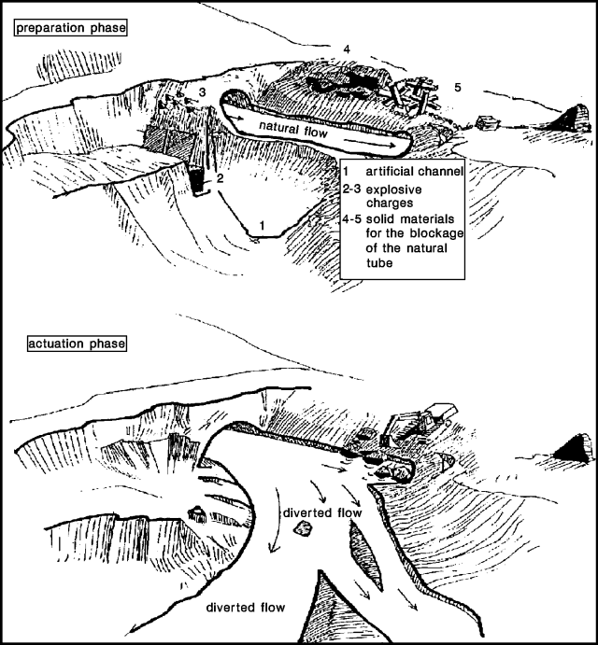
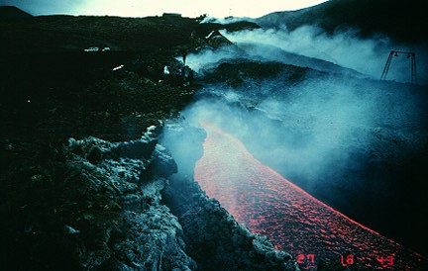
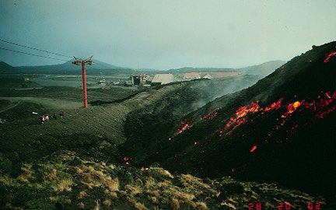
Protection – for volcanoes is extremely difficult, priority is to evacuate.
Some protections measures are:
Strengthening buildings so less likely to collapse under weight from ash.
Shutting windows and doors to block out ash
Creating lava diversion channels, not very successful.
People should avoid low-lying areas because of risk of lahars (mudflows)

Slide 7
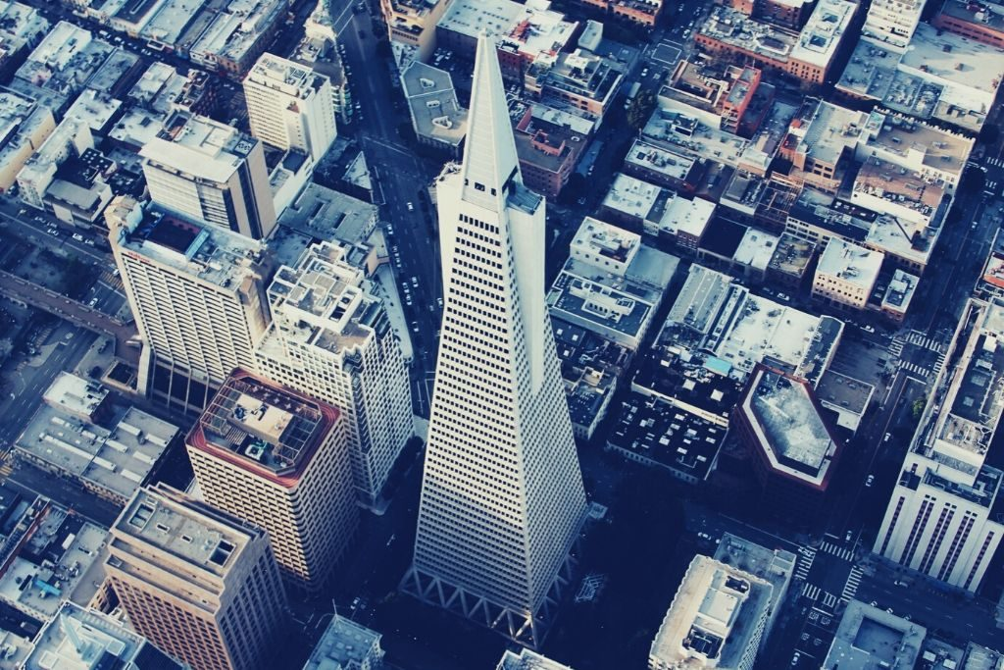
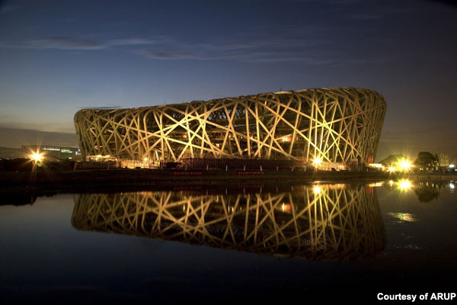
Protection: For Earthquakes it is slightly better with Earthquake proof buildings – you might have heard of these.
https://www.youtube.com/watch?v=tF204Pgf-eo
https://www.youtube.com/watch?v=iZoHoPFHAtw

